Slide 2
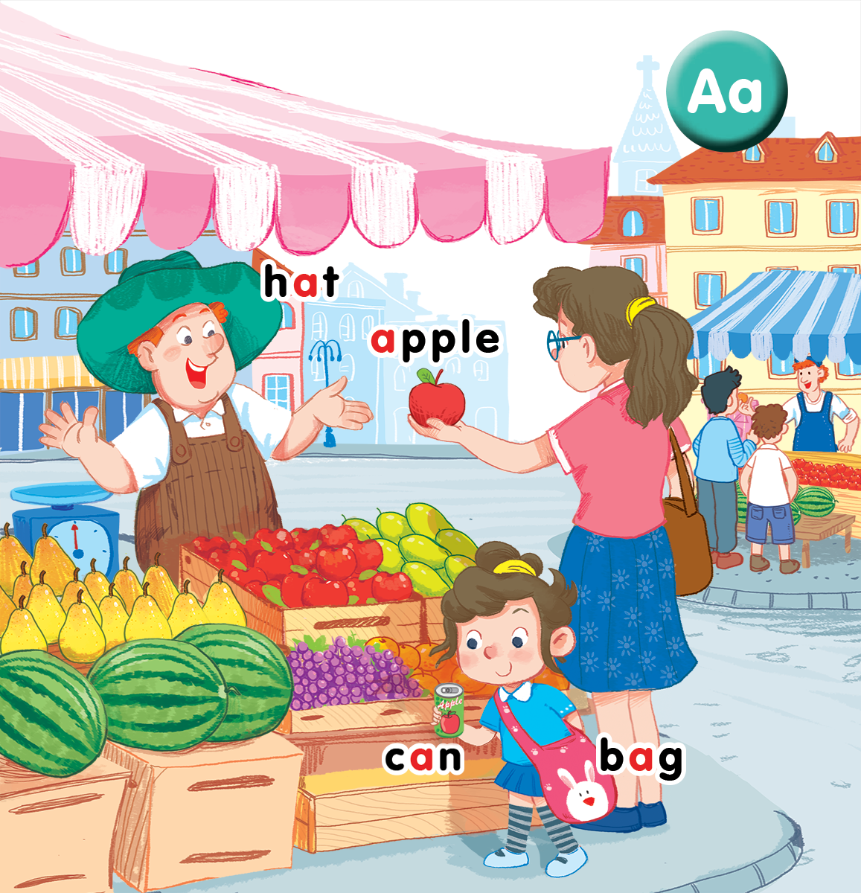
Unit 3
Lesson 1
At the street market
Notes:
By the end of the unit, pupils will be able to:
- pronounce the sound of the letter A/a in isolation and in the words apple, bag, can, hat correctly.
- say the sound of the letter A/a and the words apple, bag, hat, cat in a chant.
- recognize the words in different situations when listening.
- use This is my _____. to introduce things.
- trace the letter A/a.
- sing a song with the structures Hi, I’m _____. This is my _____.
Lesson 1
By the end of the lesson, pupils will be able to:
- pronounce the sound of the letter A/a in isolation and in the words hat, apple, can and bag correctly.
- point to the letter A/a and the things in the picture; say the sound of the letter A/a; understand and say the sound of the words hat, apple, can and bag.

Slide 3
Sit in groups and try to get as many stars as possible!
Group 1 | Group 2 | Group 3 | Group 4
O | O | O | O
O | O | O | O
O | O | O | O
O | O | O | O
O | O | O | O
O | O | O | O
O | O | O | O
O | O | O | O
Notes:
Classroom management
Pupils sit in groups.
Each group will have a star if they do the task well.
At the end of the lesson, the group with the most stars will be the winners.

Slide 4




Class rules
Sit nicely!
Listen!
Be happy!
Notes:
Set up the class rules.
Hold up or point to the picture and say Sit nicely! and do the TPR action. Have pupils do the TPR action.
Do the same with Listen! and Be happy!

Slide 5

Warm-up
Notes:
Goals:
Warm up the class and have pupils guess the key words.
Create the curiosity in learning.
Time: 5 minutes
Simon says
Simon says sit nicely!
Simon says listen!
Simon says be happy!
Simon says ball
Simon says bike
Simon says book
Simon says car
Simon says cat
Have pupils answer with TPR actions.
At the end of the game, teacher holds up a bag and says Simon says bag with a TPR action.
Do the same with apple, hat and can.

Slide 6

hat

Slide 7

apple

Slide 8

bag

Slide 9

can

Slide 10



Notes:
Listen and repeat is divided into 3 steps.
Step 1
Goals:
Set up the context.
Predict what pupils will learn.
Time: 3 minutes
Say Open your book! with a TPR action. Have pupils open the book, Unit 3, At the street market. Teacher opens the digital book.
Teacher points to apple, can, bag, hat and the people in the picture to introduce the topic.

Slide 12

bag
Notes:
Step 2
Goals:
- Pupils will be able to listen and repeat the unit key words bag and hat.
- Recognize and say the words with flashcards.
Time: 3-4 minutes
Introduce the unit keywords hat and bag with flashcards.
Teacher points to a hat and says hat. Put on a hat and say hat. Have pupils do the same TPR action and say hat.
Point to a bag and say bag. Put a bag on your shoulder and say bag. Have pupils do the same TPR action and say bag.
Have pupils guess the word and repeat by pointing to hat or bag.
Turn over the cards, have pupils guess the card and shout out the word.
Swap the cards and have pupils guess.

Slide 13

hat

Slide 14
bag
hat

Slide 15
bag
hat
or

Slide 16
bag
hat
or
Notes:
Tick on hat: the tick (V) appears
Tick on bag: the cross (X) appears

Slide 17
bag
hat
or
Notes:
Tick on hat: the cross (X) appears.
Tick on bag: the tick (V) appears.

Slide 18
Step
apple
Notes:
Step 3
Listen and repeat
Goals:
- Pupils will be able to listen and repeat the unit keywords apple and can; listen and repeat the sound a
- Recognize and say the words with flashcards.
Time: 3-4 minutes.
Introduce the unit keywords apple and can with flashcards.
Hold up the flashcard for apple and have pupils say out loud the word. Stick the flashcard on the board.
Continue with the flashcard for can.
On the board, there are two flashcards for apple and can. The flashcard for apple is above the flashcard for can.
Teacher points to the apple, say the word and have pupils repeat the word. Do the TPR action which saying the word.
Do the same with can.
Have pupils guess the word and repeat by pointing to apple or can. Hold your hand up or down to the position of the flashcard.
Turn over the cards, have pupils guess the card and say out loud the word.
Swap the cards and have pupils guess.
Play the game with all four 4 flashcards for bag, hat, can, apple.
Ask pupils what is similar at the beginning of each word.
Introduce the sound a, point to the letter a in each word and say. Have pupils listen and repeat.

Slide 19

can

Slide 20
apple
can
or

Slide 21

apple
can
or
Notes:
Tick on can: the tick (V) appears
Tick on apple: The cross (X) appears

Slide 22
apple
can
or
Notes:
Tick on apple: the cross (V) appears.
Tick on can: the tick (X) appears.

Slide 23

bag
hat
or
Notes:
Tick on hat: the tick (V) appears
Tick on bag: the cross (X) appears

Slide 24

bag
hat
or
Notes:
Tick on bag: the tick (V) appears
Tick on hat: the cross (X) appears

Slide 25



Notes:
Point and say is divided into 3 main steps.
Step 1
Goal: Pupils will be able to listen and repeat the words.
Time: 3 minutes
Choose a picture on the digital book. Ask What can you see? and prompt pupils to answer. (Say Mum and Ann are at the street market).
Point to things in the picture, have pupils listen and repeat with TPR actions.
Step 2.
Goal: Pupils will be able to point and say to the words in group.
Time: 4 minutes
Hold up your index finger, demonstrate the action for Point.
Say Point and say with the TRP actions.
Point to the flashcards of apple, can, bag, hat in turn then have students say with the whole class first then individuals.
Step 3
Goal: Pupils will be able to point and say the pictures in pairs.
Time: 3 minutes
Have pupils work in pairs and do the activity.
Stick 4 flashcards on the 4 class corners. One pupil says the word and the other points to the flashcards.

Slide 27

Game
Notes:
Who’s faster?
Goal: Pupils will be able to recognize the unit words through pictures, sounds, meaning.
Time: 5 minutes
Invite 2 pupils to play the game.
They stand back to back.
Count 1, the pupils go one step apart.
Count 2, the pupils go one more step.
Count 3, the pupils go one more step and turn around.
Teacher shows a flashcard. Who says the word faster get the point.
Can include the keywords in units 1 and 2 in this game.

Slide 28

It’s time to say goodbye
Notes:
Goodbye
Time: 2 minutes
Teacher and pupils say goodbye to the words.

Slide 29
Goodbye
hat

Slide 30
Goodbye
apple

Slide 31
Goodbye
bag

Slide 32
Goodbye
can

Slide 33
Website: hoclieu.vn
Fanpage: facebook.com/www.tienganhglobalsuccess.vn

