Slide 1







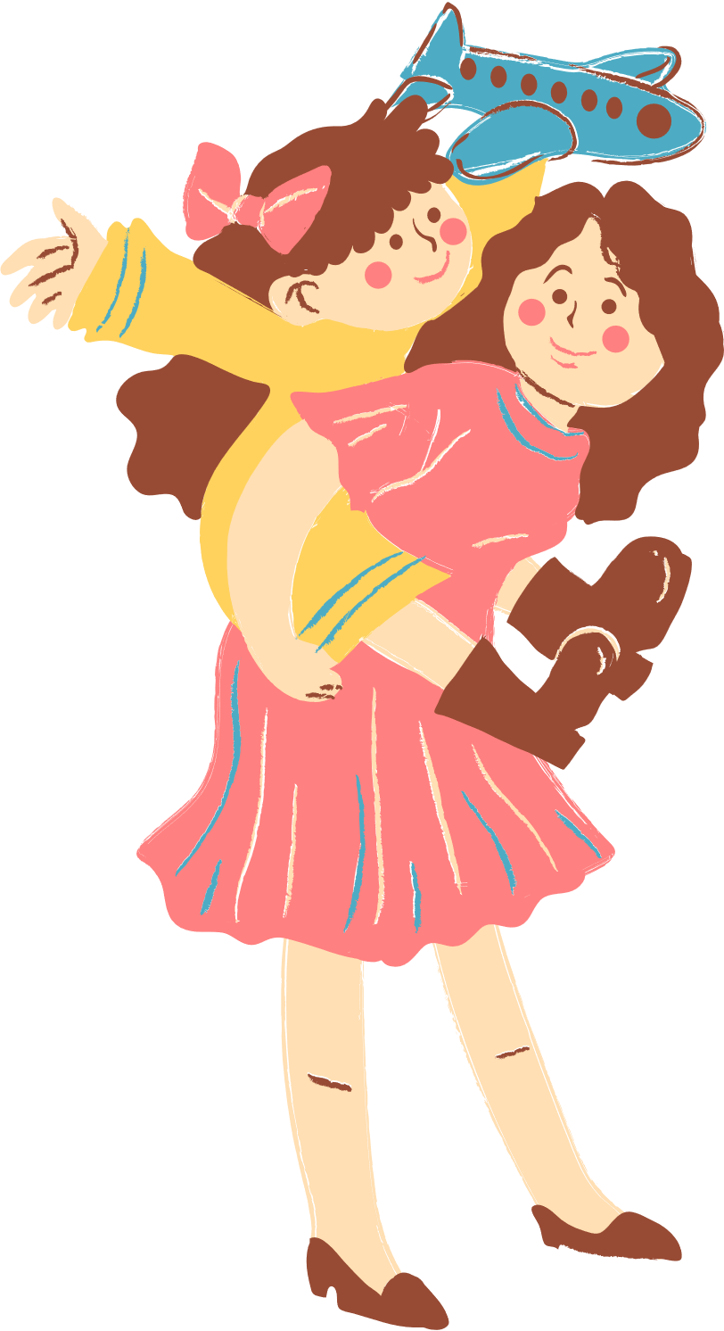
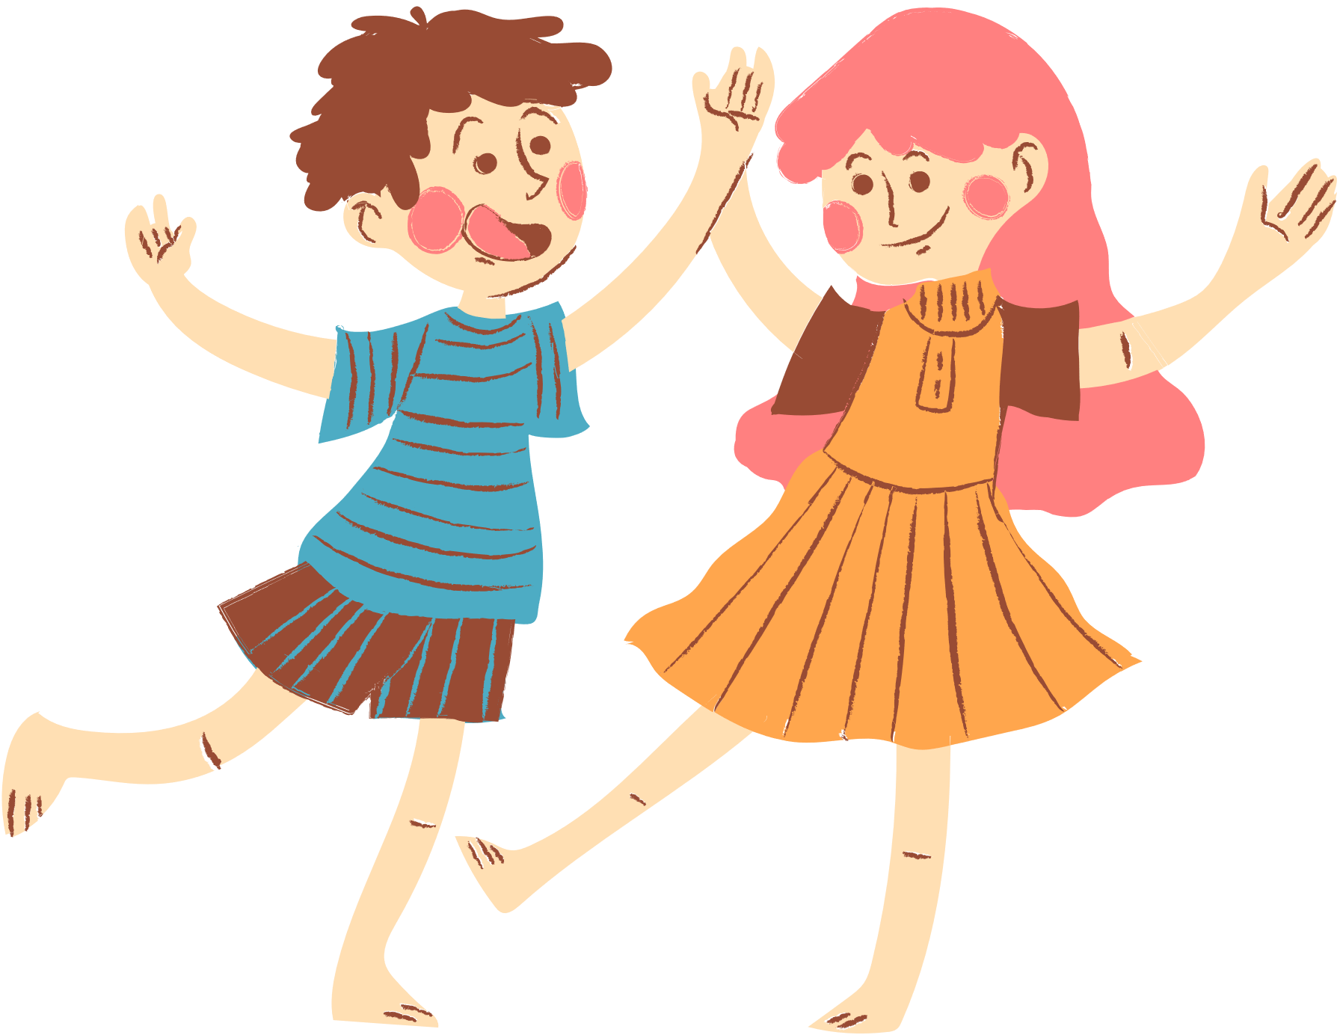
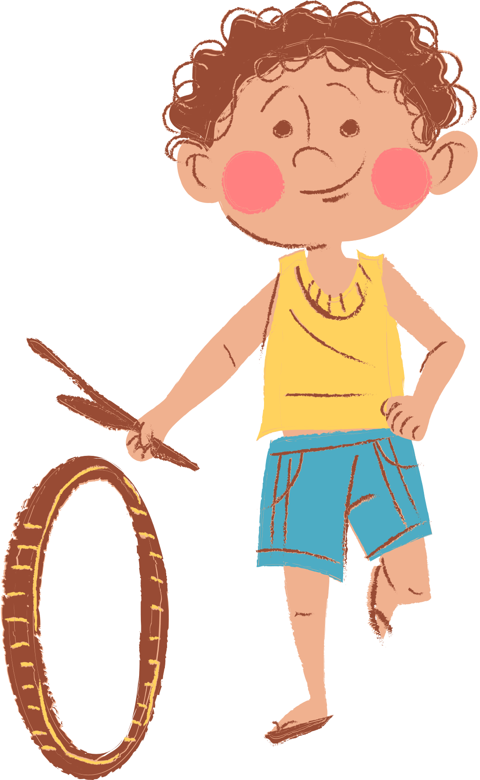
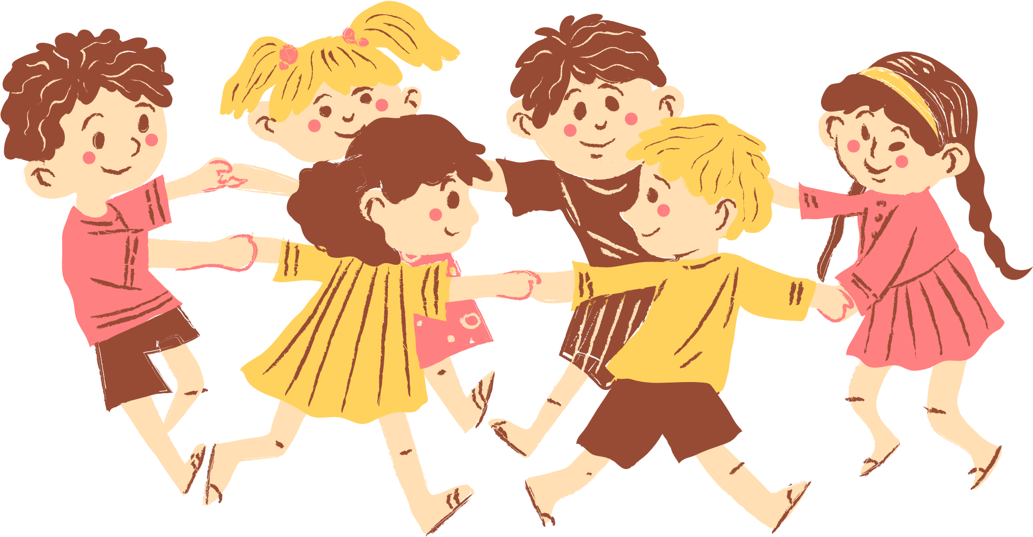
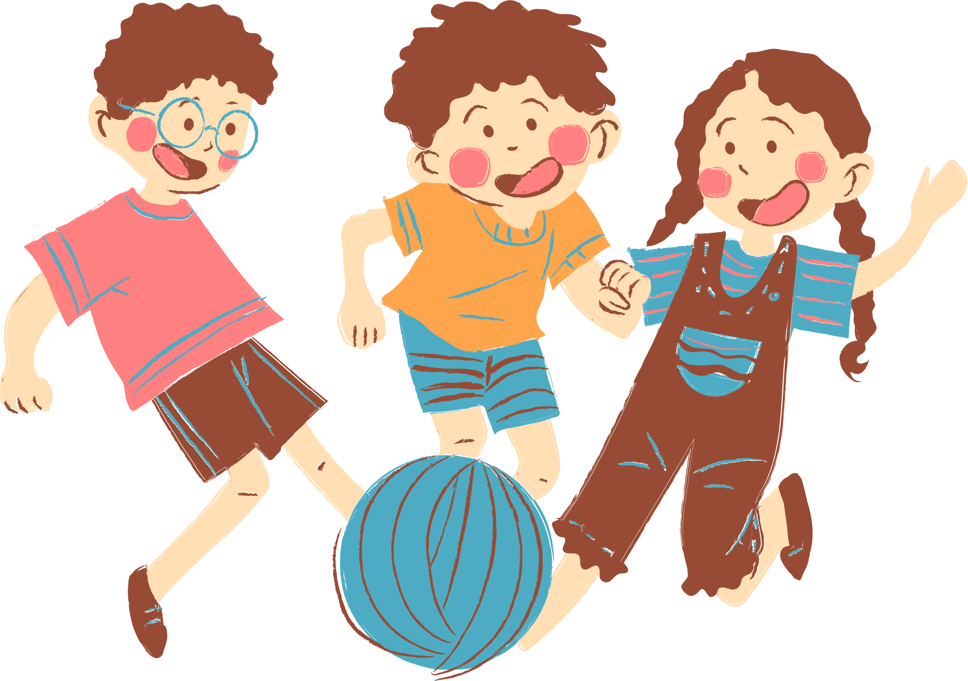
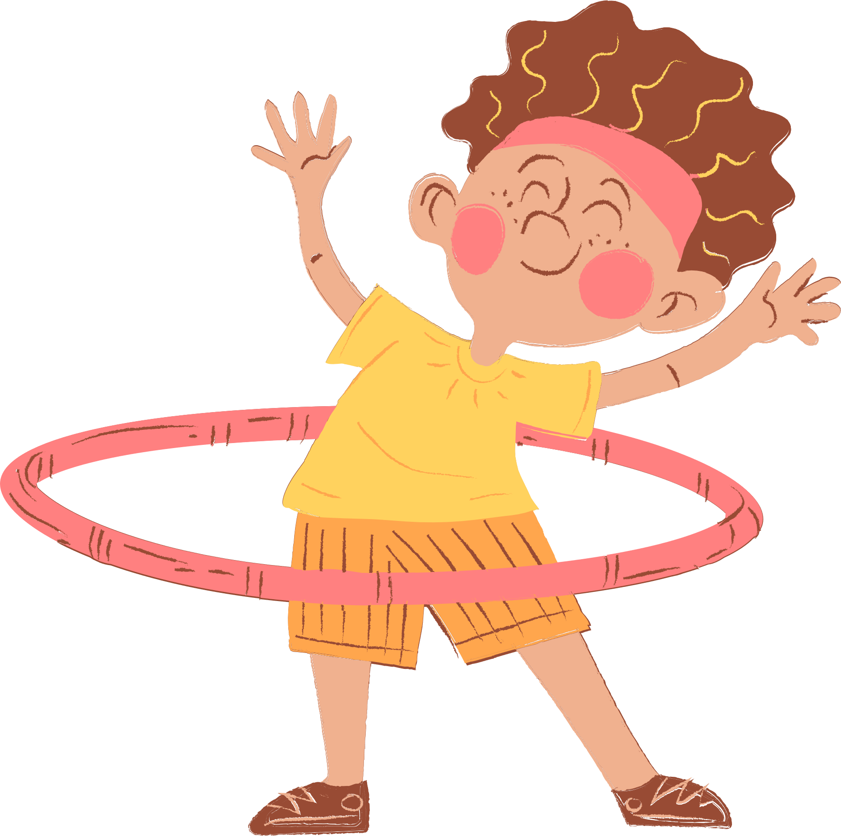
Unit 4
Our Free-time Activities
Lesson 3: 1, 2, 3

Slide 2





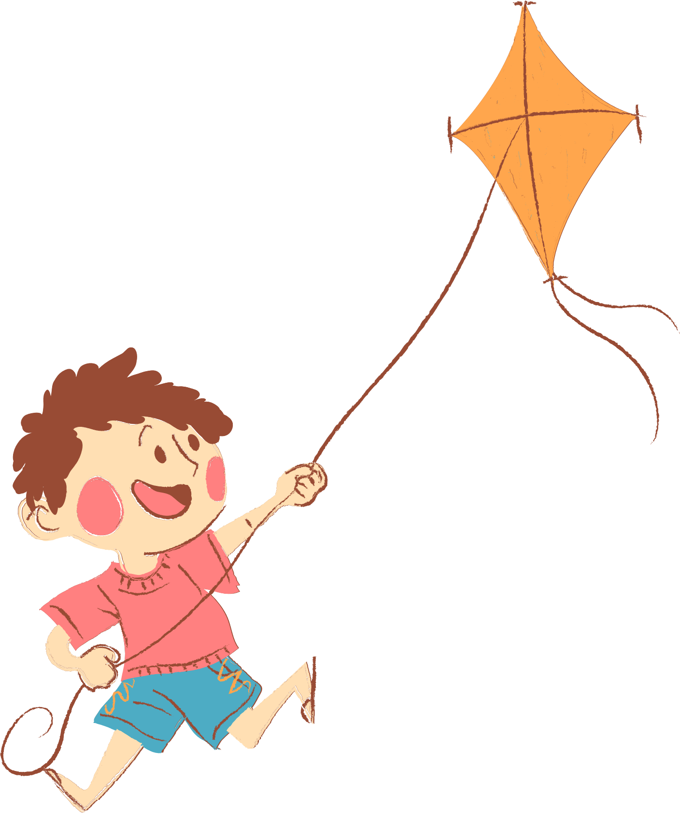
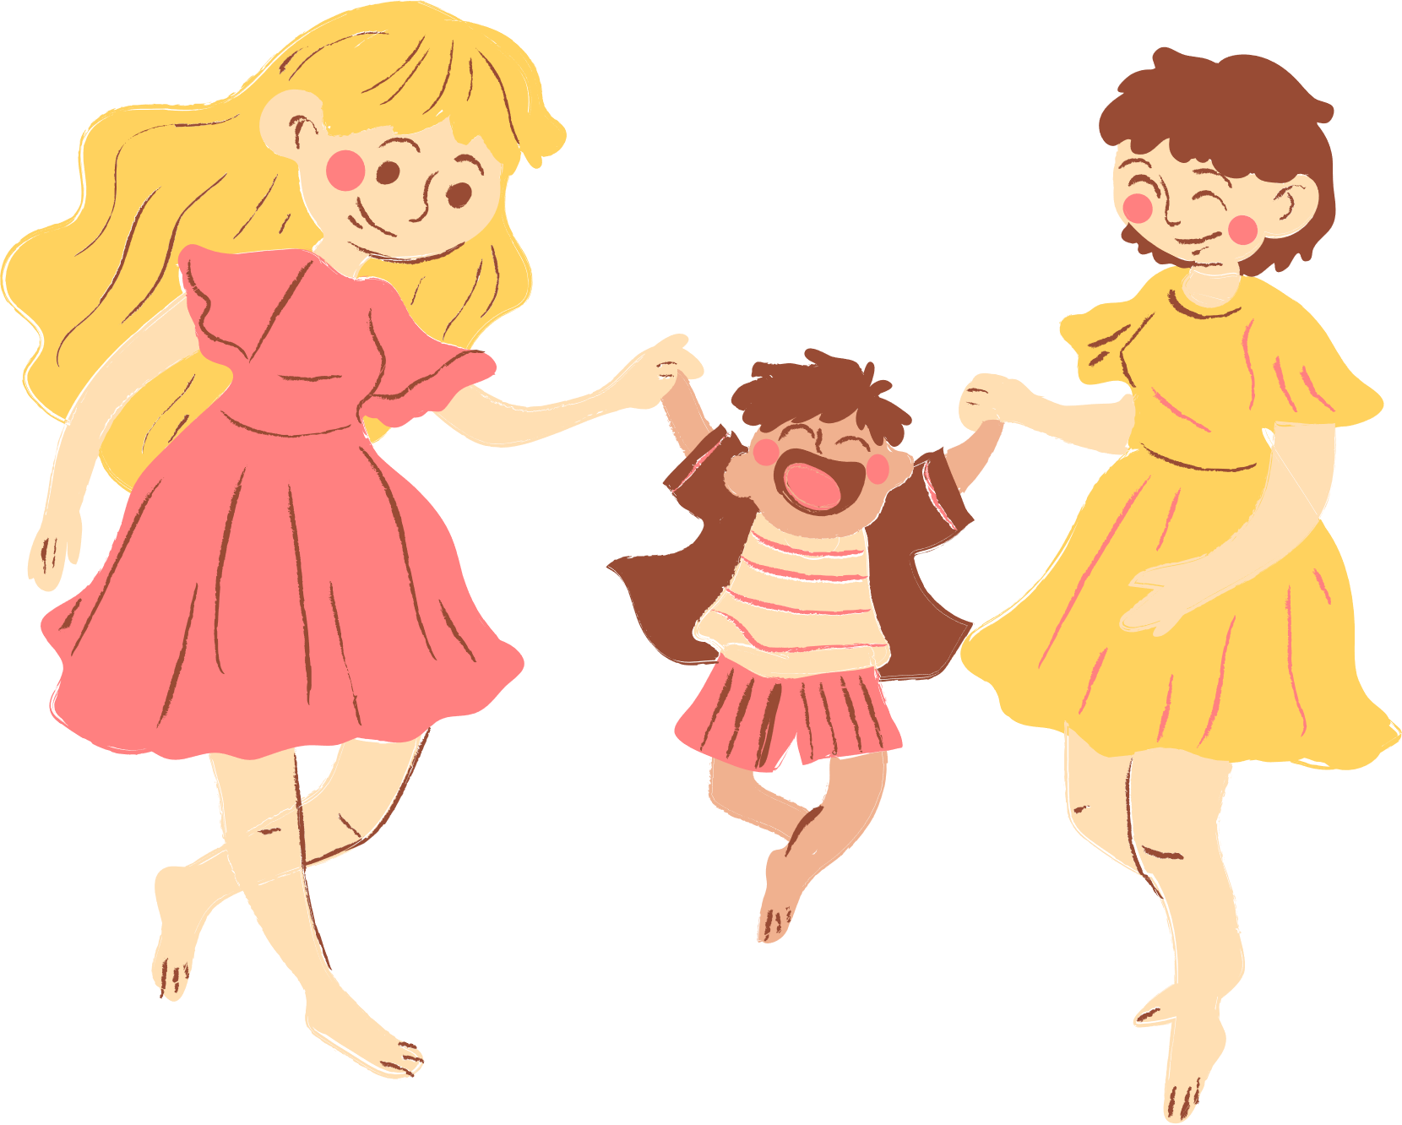
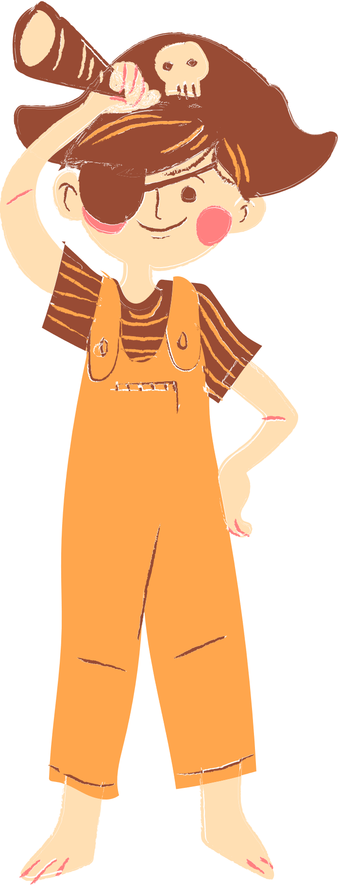
Warm Up
Notes:
Thanh Yen Tran 0967 255 149 /081 811 4340 zalo / FB https://www.facebook.com/thanhyentrangiaoandientu

Slide 3
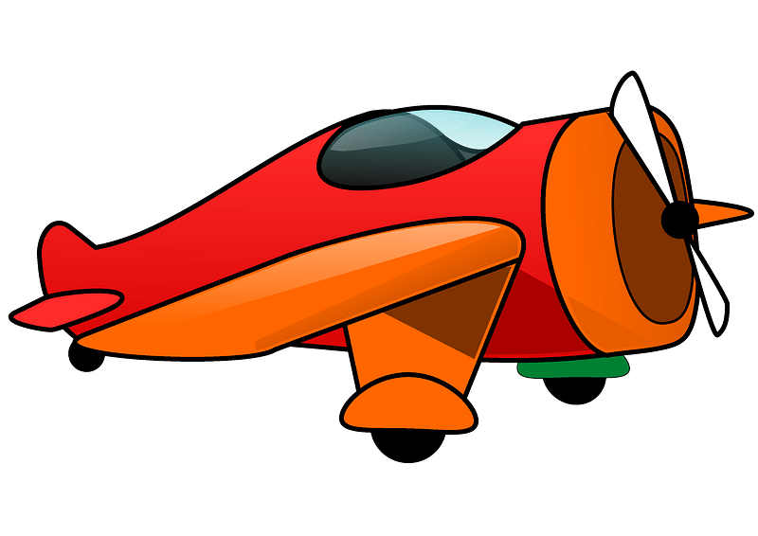
Grammar plane
Start

Slide 4
Find the mistake and correct
She oftens watches TV.
She oftens watches TV.
Plane
oftens → often
Check
Notes:
Thanh Yen Tran 0967 255 149 /081 811 4340 zalo / FB https://www.facebook.com/thanhyentrangiaoandientu

Slide 5
Find the mistake and correct
I like play the violin in my free time.
I like play the violin in my free time.
Plane
play → playing
Check
Notes:
Thanh Yen Tran 0967 255 149 /081 811 4340 zalo / FB https://www.facebook.com/thanhyentrangiaoandientu

Slide 6
Find the mistake and correct
I alway listen to music at the weekend.
I alway listen to music at the weekend.
PLANE
alway → always
CHECK

Slide 7
Find the mistake and correct
How do you do at the weekend?
How do you do at the weekend?
Plane
How → What
Check

Slide 8
Find the mistake and correct
We sometime read stories.
We sometime read stories.
Plane
sometime → sometimes
Check

Slide 9

Good job!
Notes:
Thanh Yen Tran 0967 255 149 /081 811 4340 zalo / FB https://www.facebook.com/thanhyentrangiaoandientu

Slide 10
01. Listen and
repeat.

Slide 11

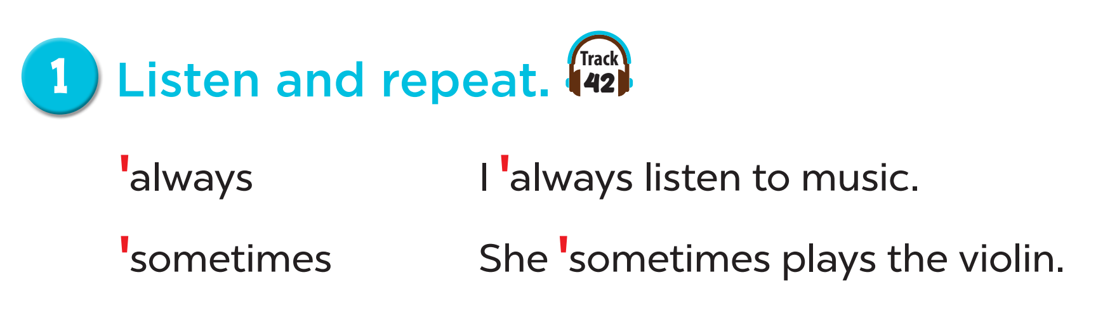



Slide 12
02. Circle, listen and check.

Slide 13


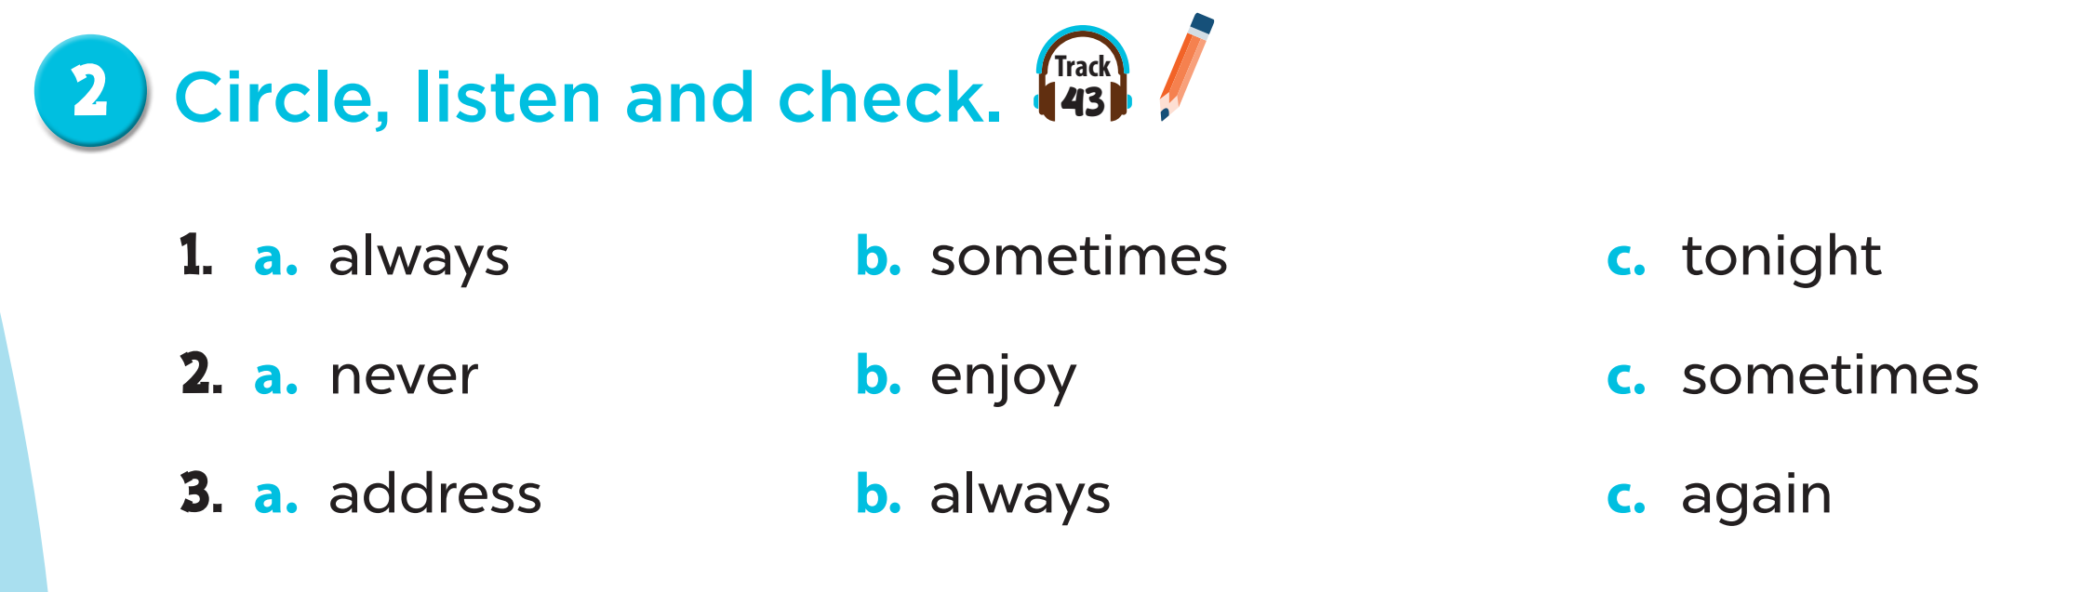
‘
‘
‘
‘
‘
‘
‘
‘
‘

Slide 14
03. Let’s chant.

Slide 15
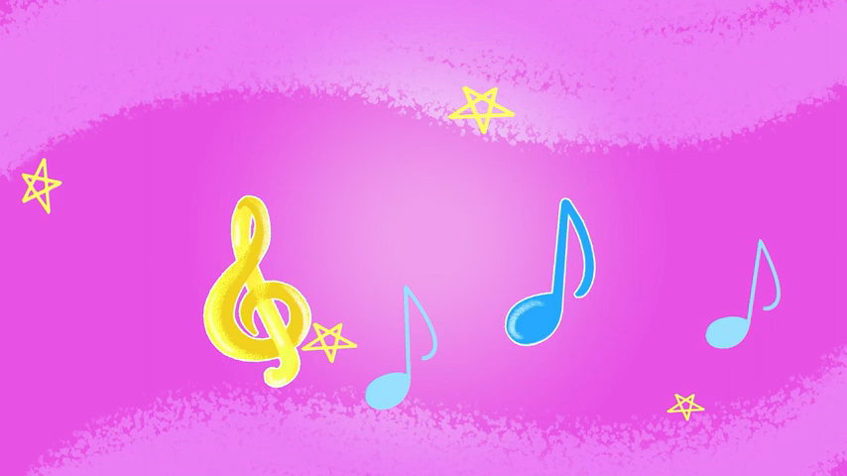

Slide 16
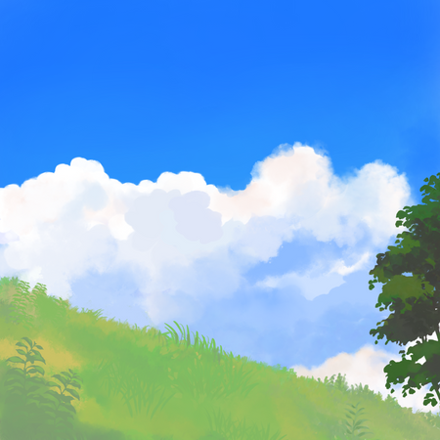
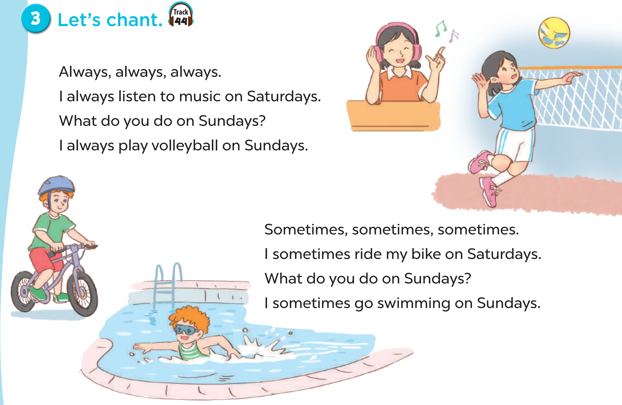


Slide 17
Always, always, always.
I always listen to music on Saturdays.
What do you do on Sundays?
I always play volleyball on Sundays.
Sometimes, sometimes, sometimes.
I sometimes ride my bike on Saturdays.
What do you do on Sundays?
I sometimes go swimming on Sundays.
Notes:
Thanh Yen Tran 0967 255 149 /081 811 4340 zalo / FB https://www.facebook.com/thanhyentrangiaoandientu

Slide 18
Goodbye
Notes:
Thanh Yen Tran 0967 255 149 /081 811 4340 zalo / FB https://www.facebook.com/thanhyentrangiaoandientu

