Slide 2

Unit 9
Our outdoor activities
Lesson 1 - Period 1

Slide 3

Table of contents
01
Warm-up and Review
02
Activity 1. Look, listen and repeat.
03
Activity 2. Listen, point and say.
04
Activity 3. Let’s talk.
05
Fun corner and Wrap-up

Slide 4


01
Warm-up and Review

Slide 5


MATCHING
GAME

Slide 6
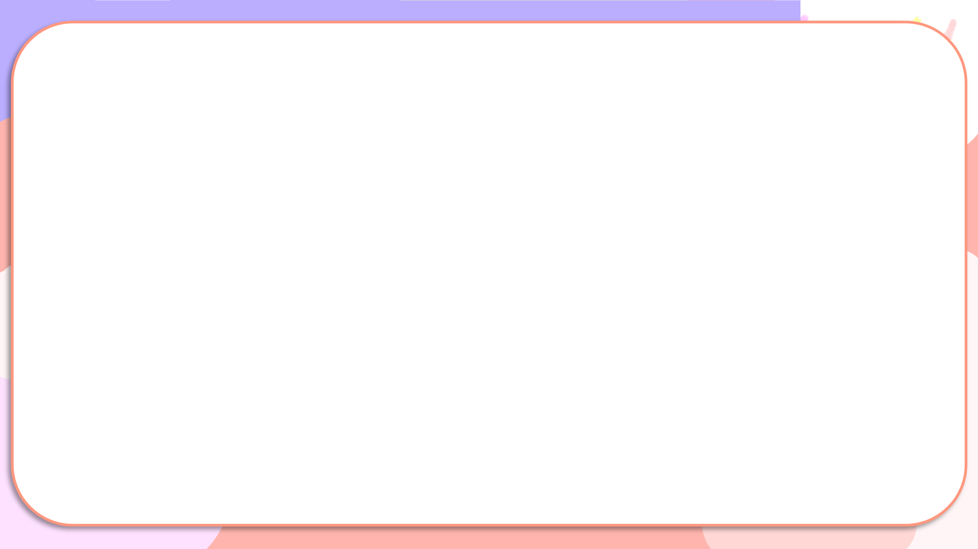


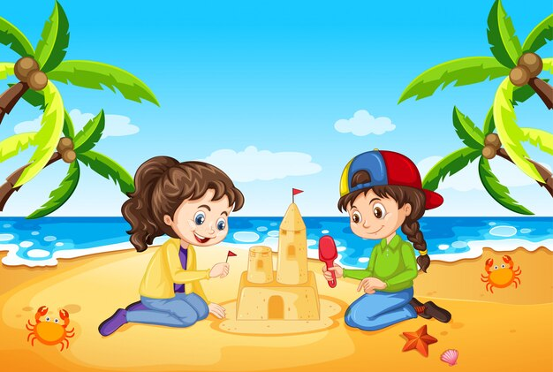
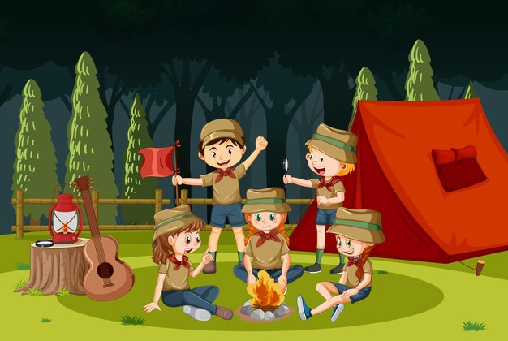

Matching
1
2
3
4
5
at school
at the funfair
at the campsite
at home
on the beach

Slide 7
02
Activity 1.
Look, listen and repeat.

Slide 8

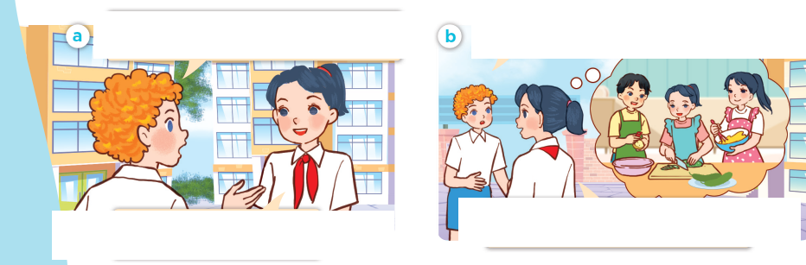
Look, listen and repeat.

Slide 9

Look, listen and repeat.
Hi, Mai. I didn’t see you at the campsite yesterday. Where were you?
I was at home. My cousins
came to visit.
Notes:
Nháy vào hội thoại để nghe lại âm thanh từng câu.

Slide 10
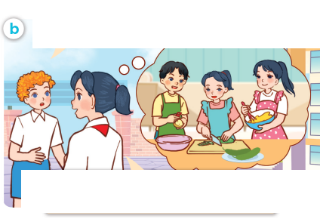
Look, listen and repeat.
Were all your family at home?
Yes, we were. We listened to music and cooked lunch together.
Notes:
Nháy vào hội thoại để nghe lại âm thanh từng câu.

Slide 11

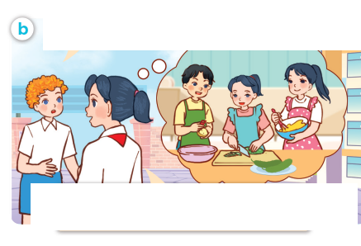
Look, listen and repeat.
Hi, Mai. I didn’t see you at the campsite yesterday. Where were you?
Were all your family at home?
Yes, we were. We listened to music and cooked lunch together.
I was at home. My cousins came to visit.

Slide 12
03
Activity 2.
Listen, point and say.

Slide 13
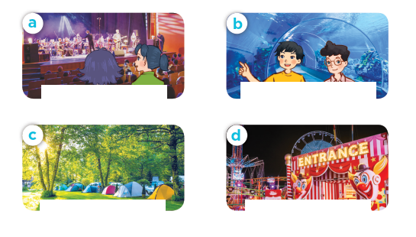
Listen, point and say.

Slide 14

Listen, point and say.
theatre / yes

Slide 15

Listen, point and say.
aquarium / yes

Slide 16

Listen, point and say.
campsite / no

Slide 17

Listen, point and say.
funfair / no

Slide 18


Were you at the ____ yesterday?
Yes, we were.
No, we weren’t.

Slide 19

Listen, point and say.
Were you at the theatre yesterday?
theatre / yes
Yes, we were.

Slide 20

Listen, point and say.
Were you at the aquarium yesterday?
aquarium / yes
Yes, we were.

Slide 21

Listen, point and say.
Were you at the campsite yesterday?
campsite / no
No, we weren’t.

Slide 22

Listen, point and say.
Were you at the funfair yesterday?
No, we weren’t.
funfair / no

Slide 23
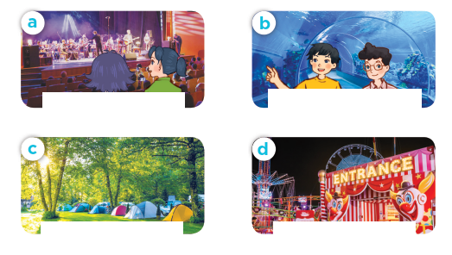
Were you at the ____ yesterday?
Yes, we were.
No, we weren’t.

Slide 24
04
Activity 3. Let’s talk.

Slide 25
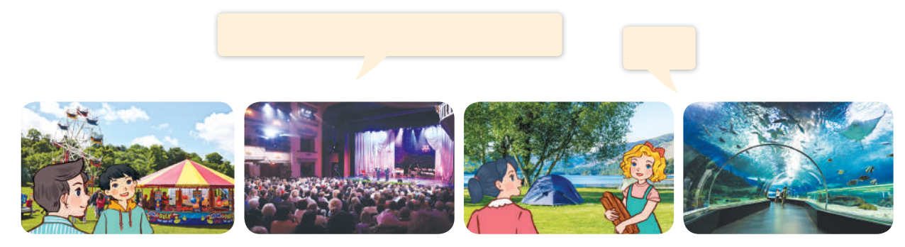
Let’s talk.
Were you at the ________ yesterday?
____.

Slide 26
Were you at the ____ yesterday?
Yes, we were.
No, we weren’t.

Slide 27
05
Fun corner and Wrap-up

Slide 28

Missing flash card
Game

Slide 29

Missing flash card
Game
Team 1
Team 2

Slide 30

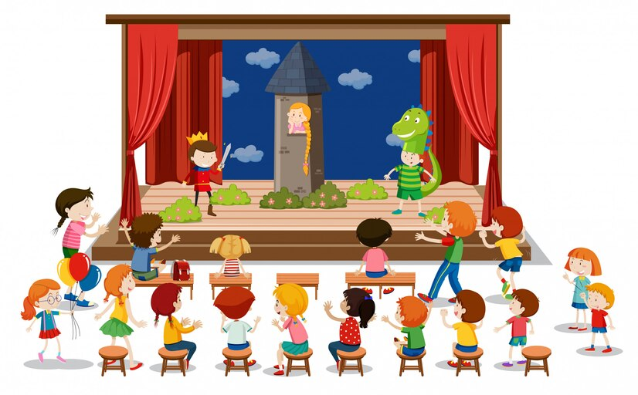

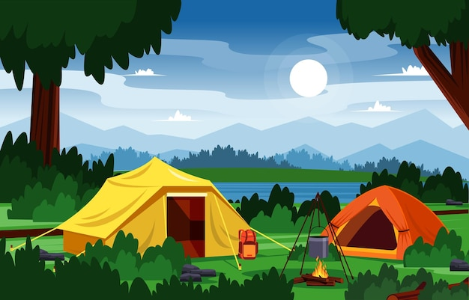

Team 1
Team 2
Notes:
Nháy chuột và hình ảnh để biến mất hình ảnh đó.
GV ghi điểm cho HS bằng cách nháy vào tên team. Mỗi lần nháy 1 ngôi sao xuất hiện.

Slide 31
Website: hoclieu.vn
Fanpage: https://www.facebook.com/tienganhglobalsuccess.vn/

