Slide 1


Slide 2


Our sports day
9
Lesson 1 - Period 2

Slide 3
Table of contents
Warm-up
01
02
03
04
Let’s sing.
Listen and match.
Game
05
Look, complete and read.

Slide 4
01
Warm-up

Slide 5
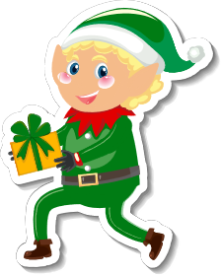
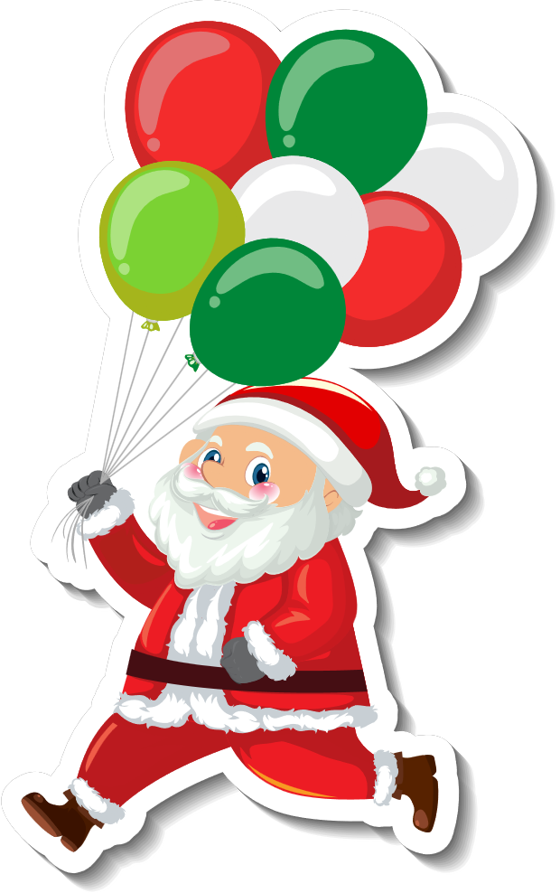




In which month can you see these?

Slide 6
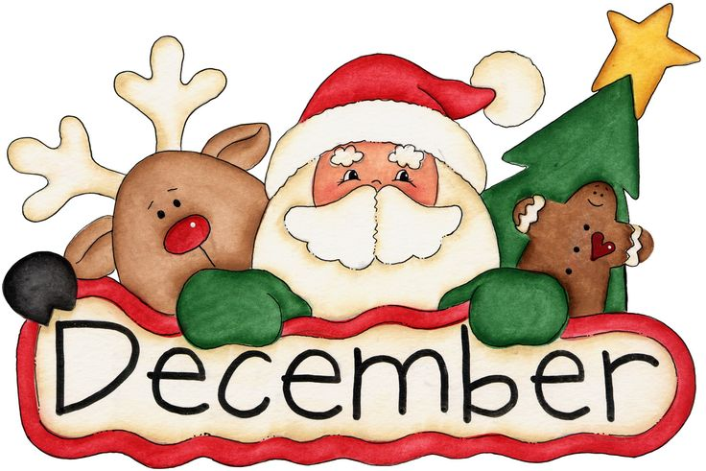
The 12th month of the year

Slide 7
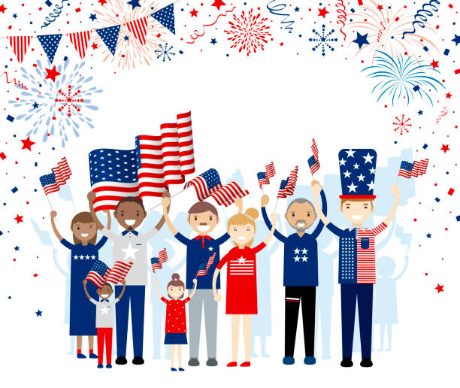

American Independence Day
Summer Holiday

Slide 8

The 7th month of the year

Slide 9

Summer holiday
starts

Slide 10
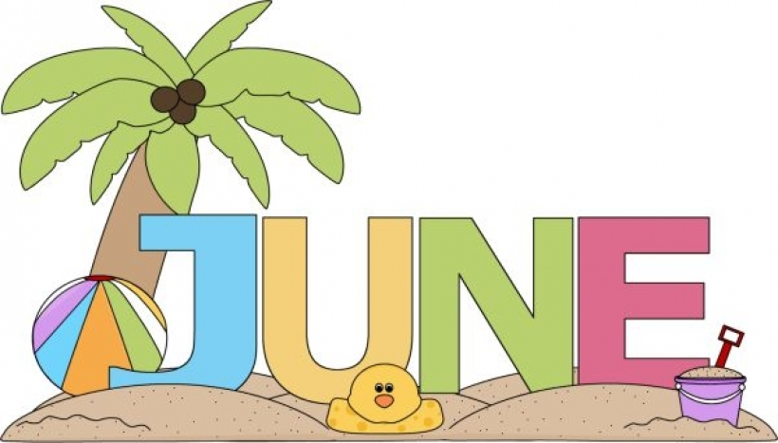
The 6th month of the year

Slide 11


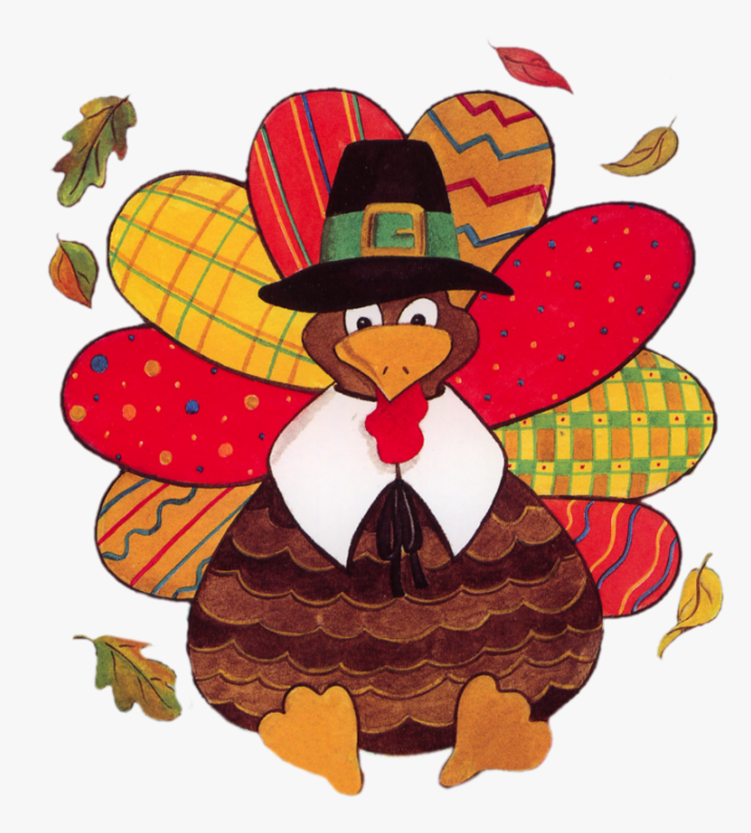

Slide 12

The 11th month of the year

Slide 13



Slide 14
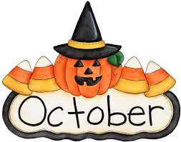
The 10th month of the year

Slide 15


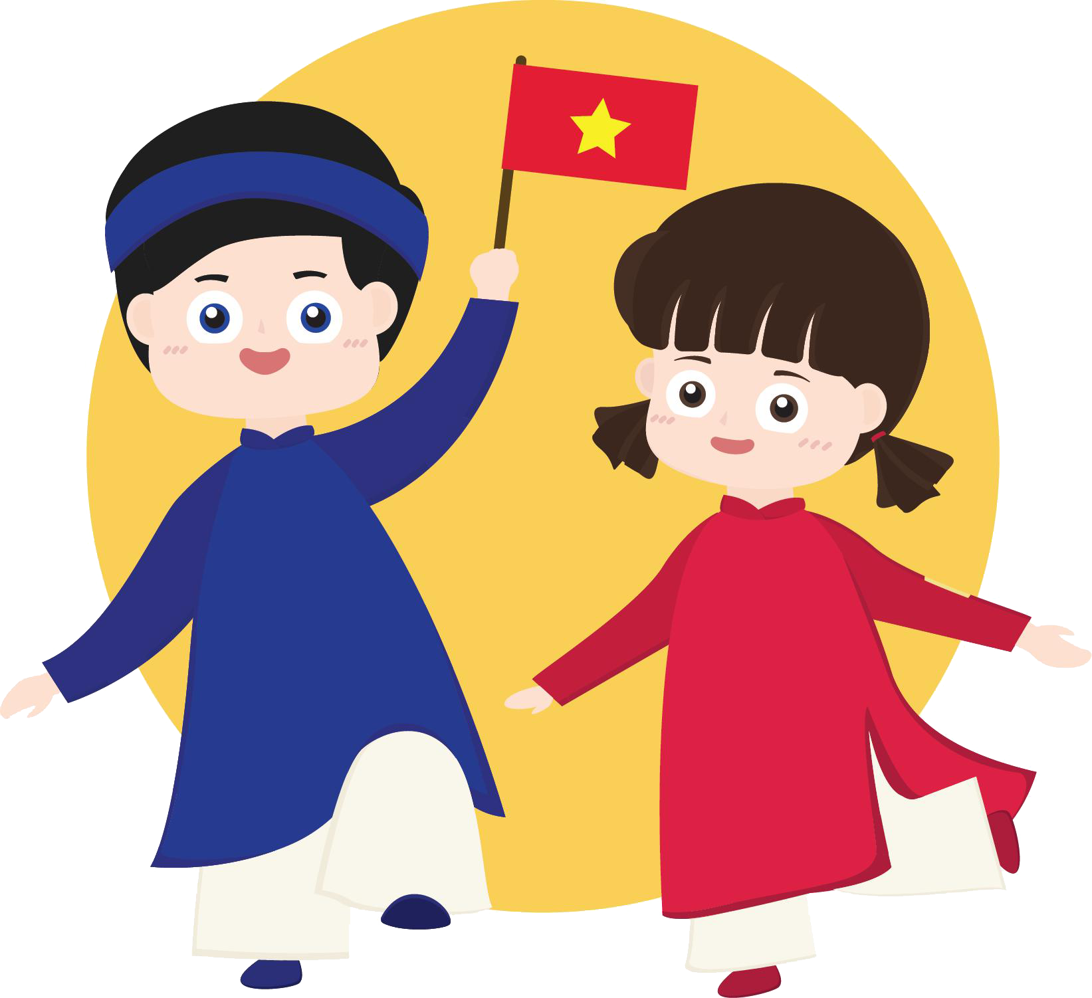

Slide 16

The 9th month of the year

Slide 17
02
Listen and match.

Slide 18
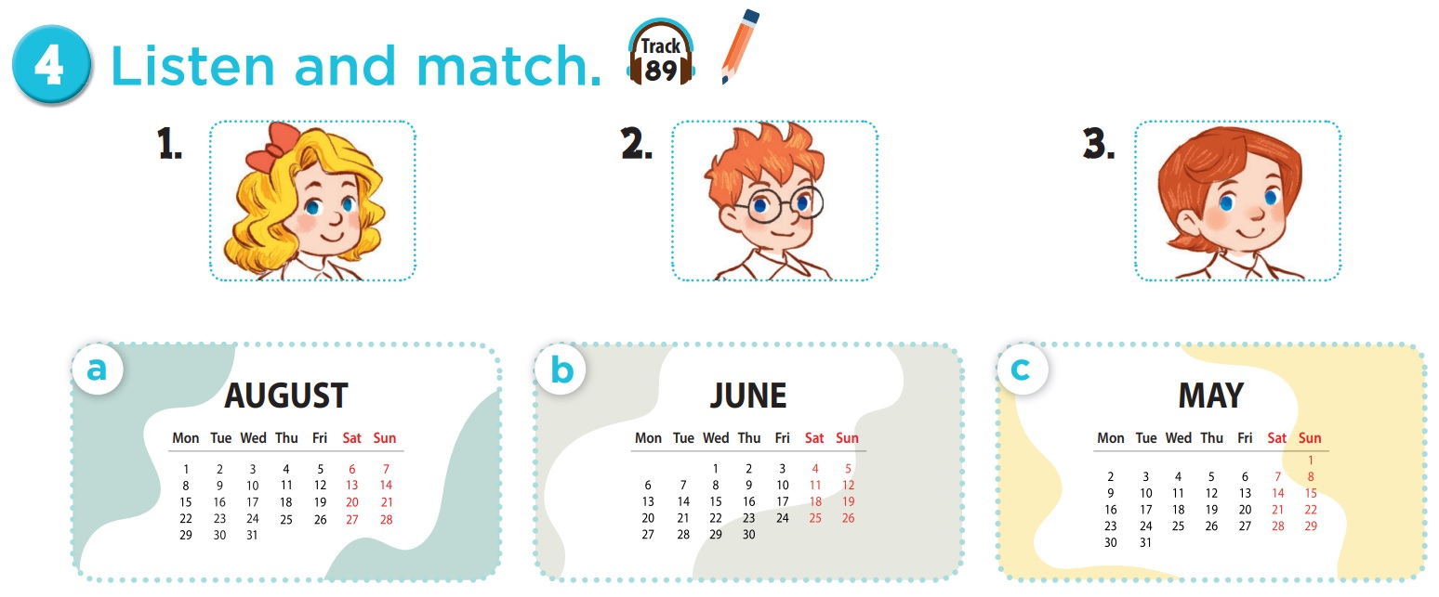

Who is she? Who is he?

Slide 19
Which month do you see?

Slide 20


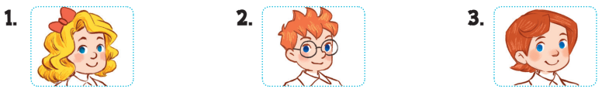
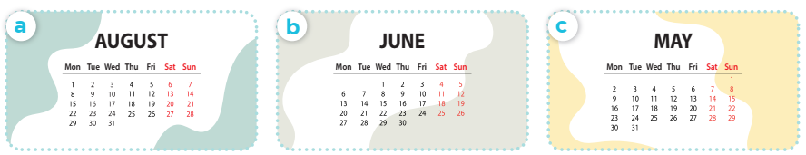

Slide 21
03
Look, complete and read.

Slide 22

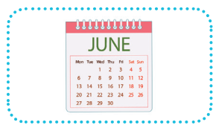

1.
A: Is your sports day in June?
B: Yes, ______.
2.
A: Is your sports day in ________?
B: Yes, it is.
it is
August

Slide 23
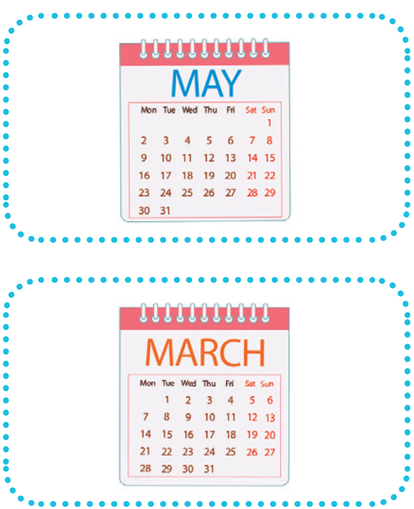
3.
A: _____ your sports day in February?
B: No, it isn’t. It’s in _____. 4.
A: Is your sports day ____ July?
B: _________. It’s in March.
Is
May
in
No, it isn’t

Slide 24
04
Let's sing.

Slide 25



Our sports day
Sports day, sports day.
Is your sports day in May?
Yes, it is. Yes, it is.
It’s in May.
Sports day, sports day.
Is your sports day in June?
No, it isn’t. No, it isn’t.
It’s in July.

Slide 26
05
Game

Slide 27



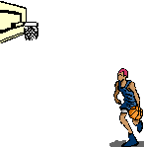

All-Star

Slide 28

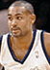
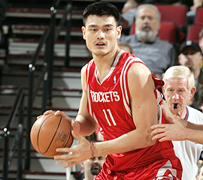

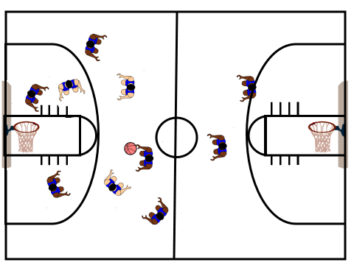
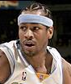
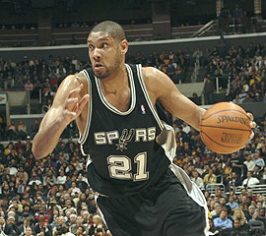


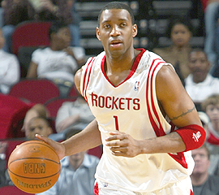

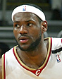

Scoreboard
Grant Hill
Yao Ming
Pippin
Tim Duncan
Allen
Michael Jordan
Grady
Nick
James

Slide 29
Is your sports day _____ June?
in
B
A. on
B. in
C. at
D. for

Slide 30


Slam Dunk
Slam Dunk

Slide 31
___ your sports day in May?
A
A. Is
B. It

Slide 32
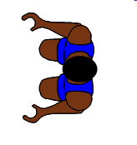
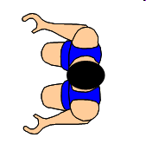

No point!

Slide 33

Is your sports day
in April?
B
A. Yes, it is.
B. No, it isn't.
Notes:
Encourage students to say "It's in March."

Slide 34

Slam Dunk
Slam Dunk

Slide 35

Is your sports day in July?
C
A. Yes, it isn't.
B. No, it isn't.
C. Yes, it is.
D. No, it is.

Slide 36

Slam Dunk
Slam Dunk

Slide 37

A: Is your sports day
in ___?
B: Yes, it is.
A
A. March
B. May

Slide 38
Slam Dunk
Slam Dunk

Slide 39
A: Is your sports day
in ___?
B: No, it isn't.
B
A. March
B. May

Slide 40
No point!

Slide 41
A: Is your sports day
in February?
B: Yes, _____.
A
A. it is
B. it isn't

Slide 42

Slam Dunk
Slam Dunk

Slide 43
A: Is your sports day in September? B: No, _____.
B
A. it is
B. it isn't

Slide 44

Slam Dunk
Slam Dunk

Slide 45
A: Is your sports day
in January?
B: _____. It's in March.
C
A. Yes, it isn't.
B. Yes, it is.
C.No, it isn't.
D. No, it is.

Slide 46
Slam Dunk
Slam Dunk

Slide 47

Website: hoclieu.vn
Fanpage: facebook.com/www.tienganhglobalsuccess.vn
Website: sachmem.vn; hoclieu.vn
Fanpage: www.facebook.com/sachmem.vn

