Slide 1

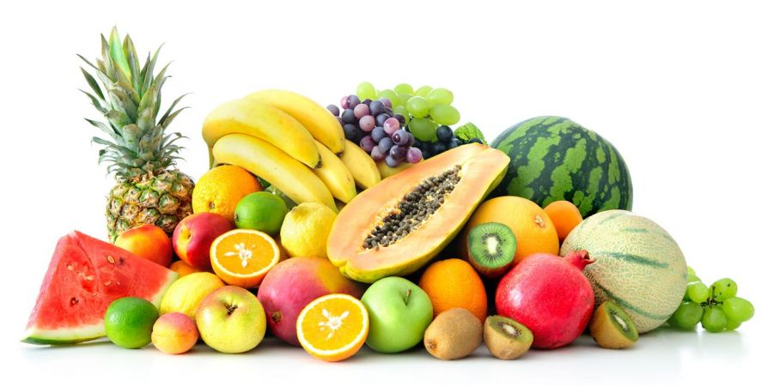
Fruit

Slide 2

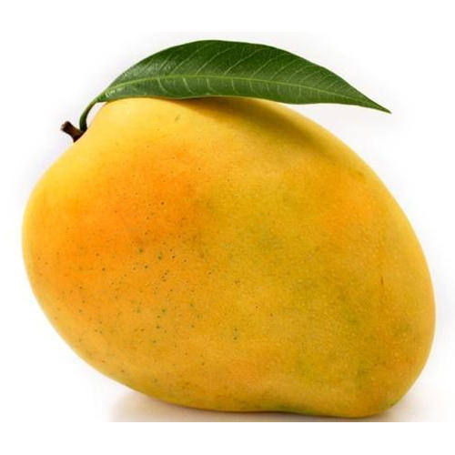
Mango

Slide 3
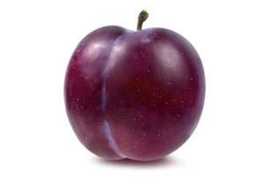
Plum

Slide 4
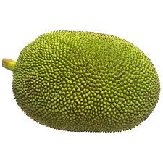
Jackfruit

Slide 5
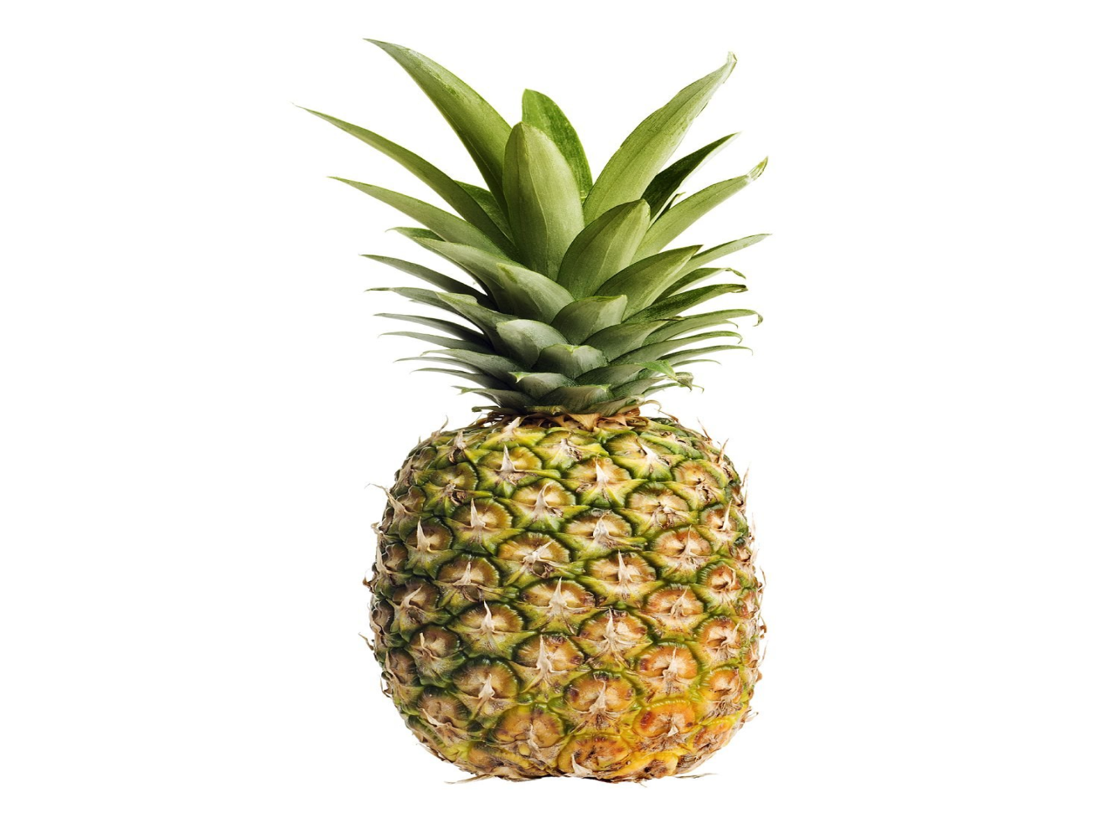
Pineapple

Slide 6
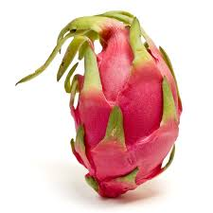
Dragon fruit

Slide 7
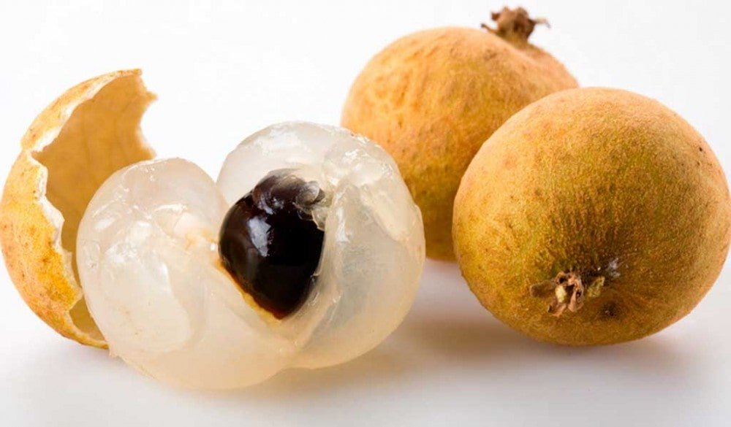
Longan

Slide 8
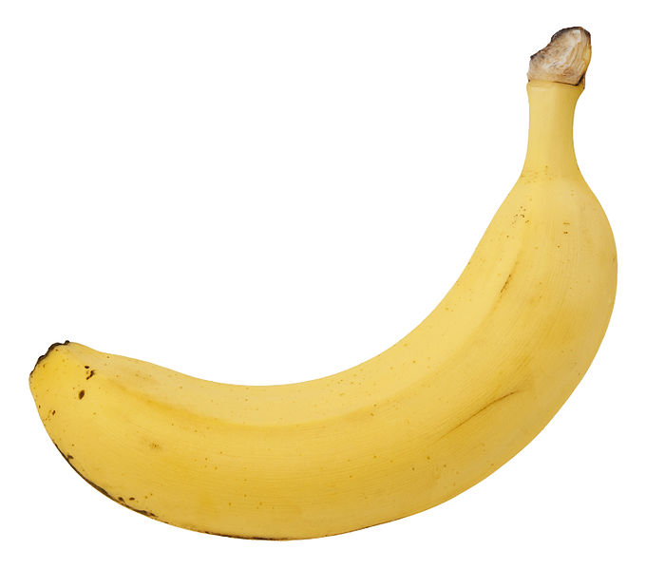
Banana

Slide 9
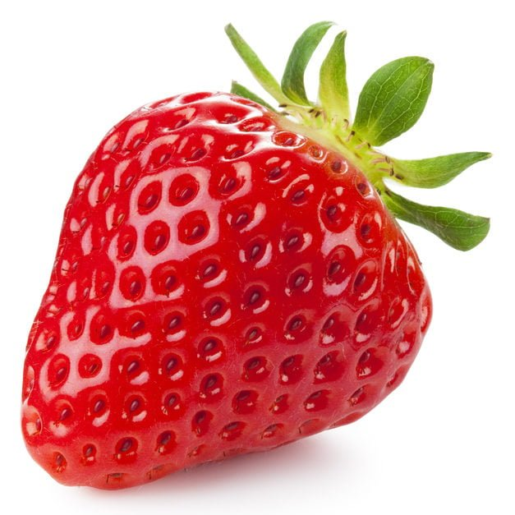
Strawberry

Slide 10
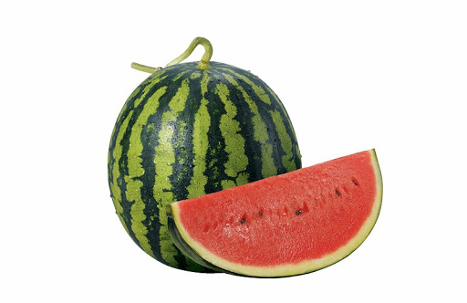
Watermelon

Slide 11

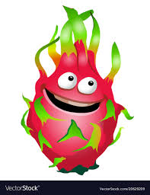

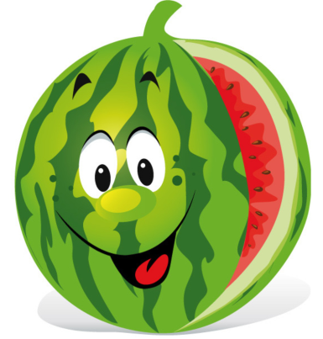

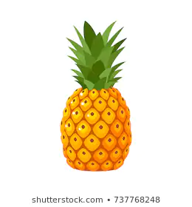
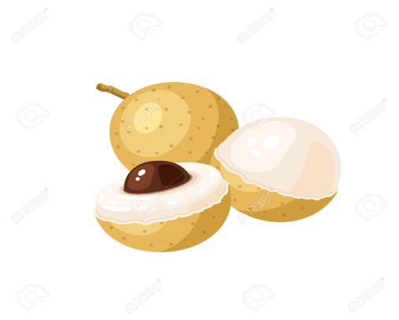
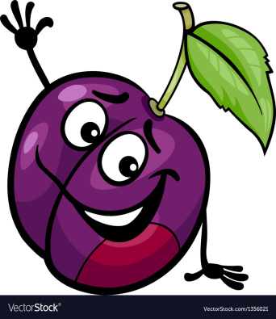

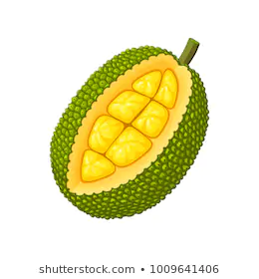

Lucky fruit

Slide 12

Count from 1 to 12

Slide 13
Count from 5 to 15

Slide 14
What fruits do you like?

Slide 15
What fruits do you like?

Slide 16
Count from 3 to 13

Slide 17
Count from 10 to 15

Slide 18
What fruits do you like?

Slide 19
What fruits do you like?

Slide 20
Lucky fruit

Slide 21
Lucky fruit

