Slide 1


Slide 2




Pen
BÚT CHÌ
BẢN ĐỒ
Ruler
SÁCH
Book
BÚT
Map
Pencil
THƯỚC

Slide 3

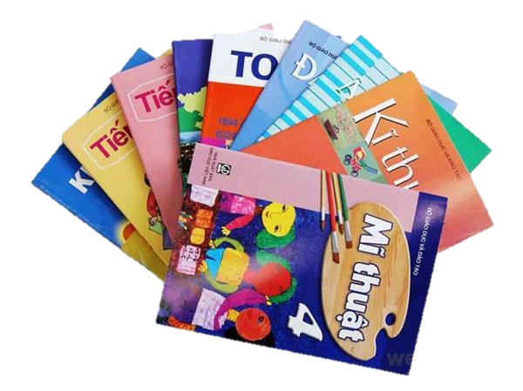
subject
môn học

Slide 4
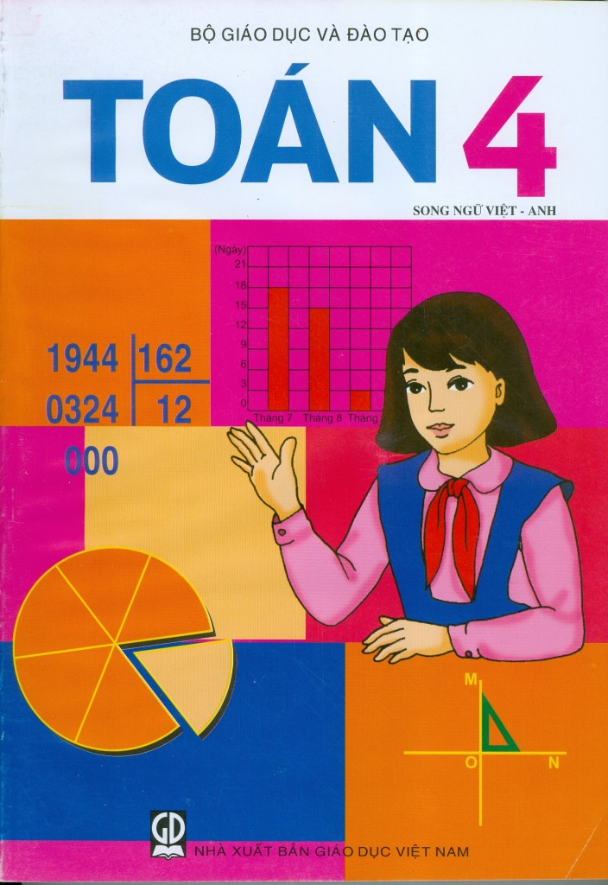
Maths

Slide 5

Vietnamese

Slide 6


English

Slide 7

Science

Slide 8

Art

Slide 9

Music

Slide 10

Informatics
= IT

Slide 11

PE
= Physical Education

Slide 12
Model sentences:
What subjects do you have today?
I have _______________ .
Example:
What subjects do you have today?
I have Maths, Vietnamese and IT.

Slide 13
Do you have _________ today?
Yes, I do.
No, I don’t.
Example:
Do you have Art today?
Yes, I do.

