Slide 1



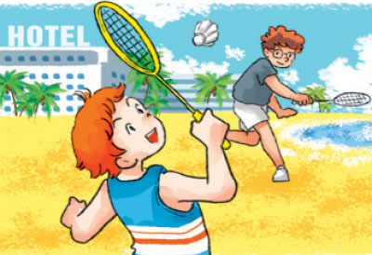
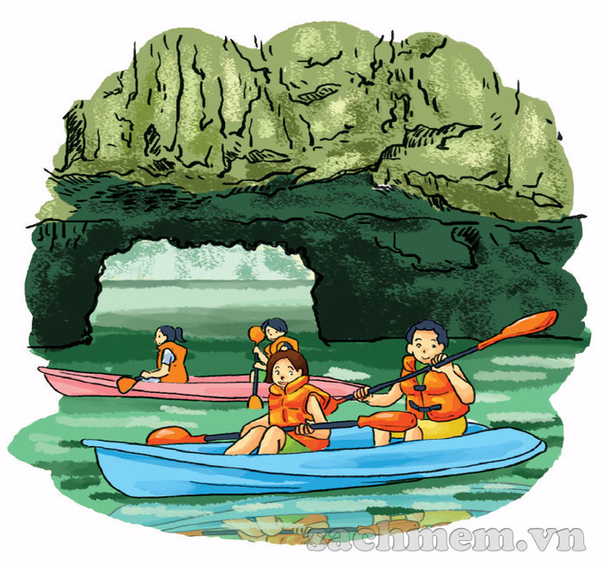
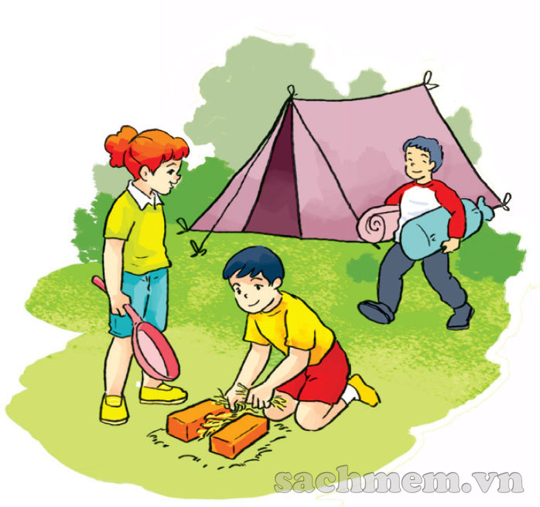
Warmly welcome all teachers attending our lesson today!
Teacher : Dang Thi Thanh Thu
School: Nguyen Doc Tin Primary school
Class : 5C
Lesson: Unit 5- Lesson 3 - period 15
( Part 1,2,3)

Slide 2
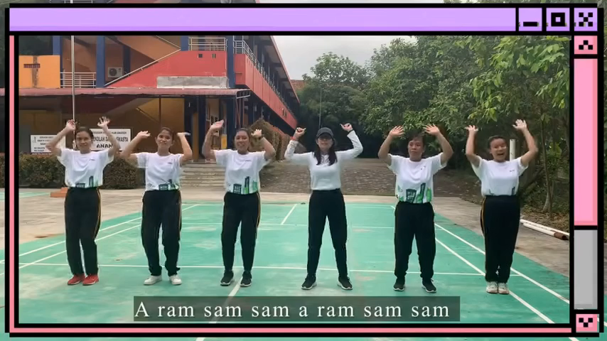

Slide 3



Slide 4






Question 1
10
9
8
7
6
5
4
3
2
1
0
Where will you be next Sunday?
A. By the sea
B. At school
C. In the countryside

Slide 5
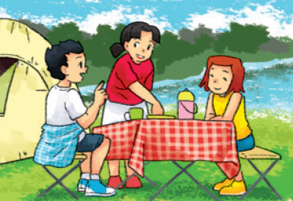
Question 2
10
9
8
7
6
5
4
3
2
1
0
I think I’ll be in the island.
A. True (Yes)
B. False (No)

Slide 6
Question 3
10
9
8
7
6
5
4
3
2
1
0
What will you do at
Ha Long Bay?
- I think we’ll…….
A: on the beach
B. at the seaside
C: swim in the sea

Slide 7

Question 4
10
9
8
7
6
5
4
3
2
1
0
What will they do this weekend?
A: play football
B: go on a picnic
C: swim in the sea

Slide 8


Where will you be this weekend?
Where will you be this weekend, Peter?
I think I'll be in the countryside.
What will you do this weekend, Peter?
(I think I will have a picnic^{)2.}
Where will you be next Sunday, Tony?
I think we'll be at the seaside.
What will you do next Sunday, Tony?
(I think we will visit the islands^{)2.}

Slide 9

Where will you be this weekend?
Where will you be this weekend, Peter?
I think I'll be in the countryside.
What will you do this weekend, Peter?
(I think I will have a picnic^{)2.}
Where will you be next Sunday, Tony?
I think we'll be at the seaside.
What will you do next Sunday, Tony?
(I think we will visit the islands^{)2.}

Slide 10
Part 1
Where will you be this weekend, Peter?
I think I'll be in the countryside.
What will you do this weekend, Peter?
(I think I will have a picnic^{)2.}

Slide 11
Where will you be this weekend?
Where will you be this weekend, Peter?
I think I'll be in the countryside.
What will you do this weekend, Peter?
(I think I will have a picnic^{)2.}
Where will you be next Sunday, Tony?
I think we'll be at the seaside.
What will you do next Sunday, Tony?
(I think we will visit the islands^{)2.}

Slide 12
Thank for your attending !
Goodbye! See you later!

Slide 13
