Slide 1
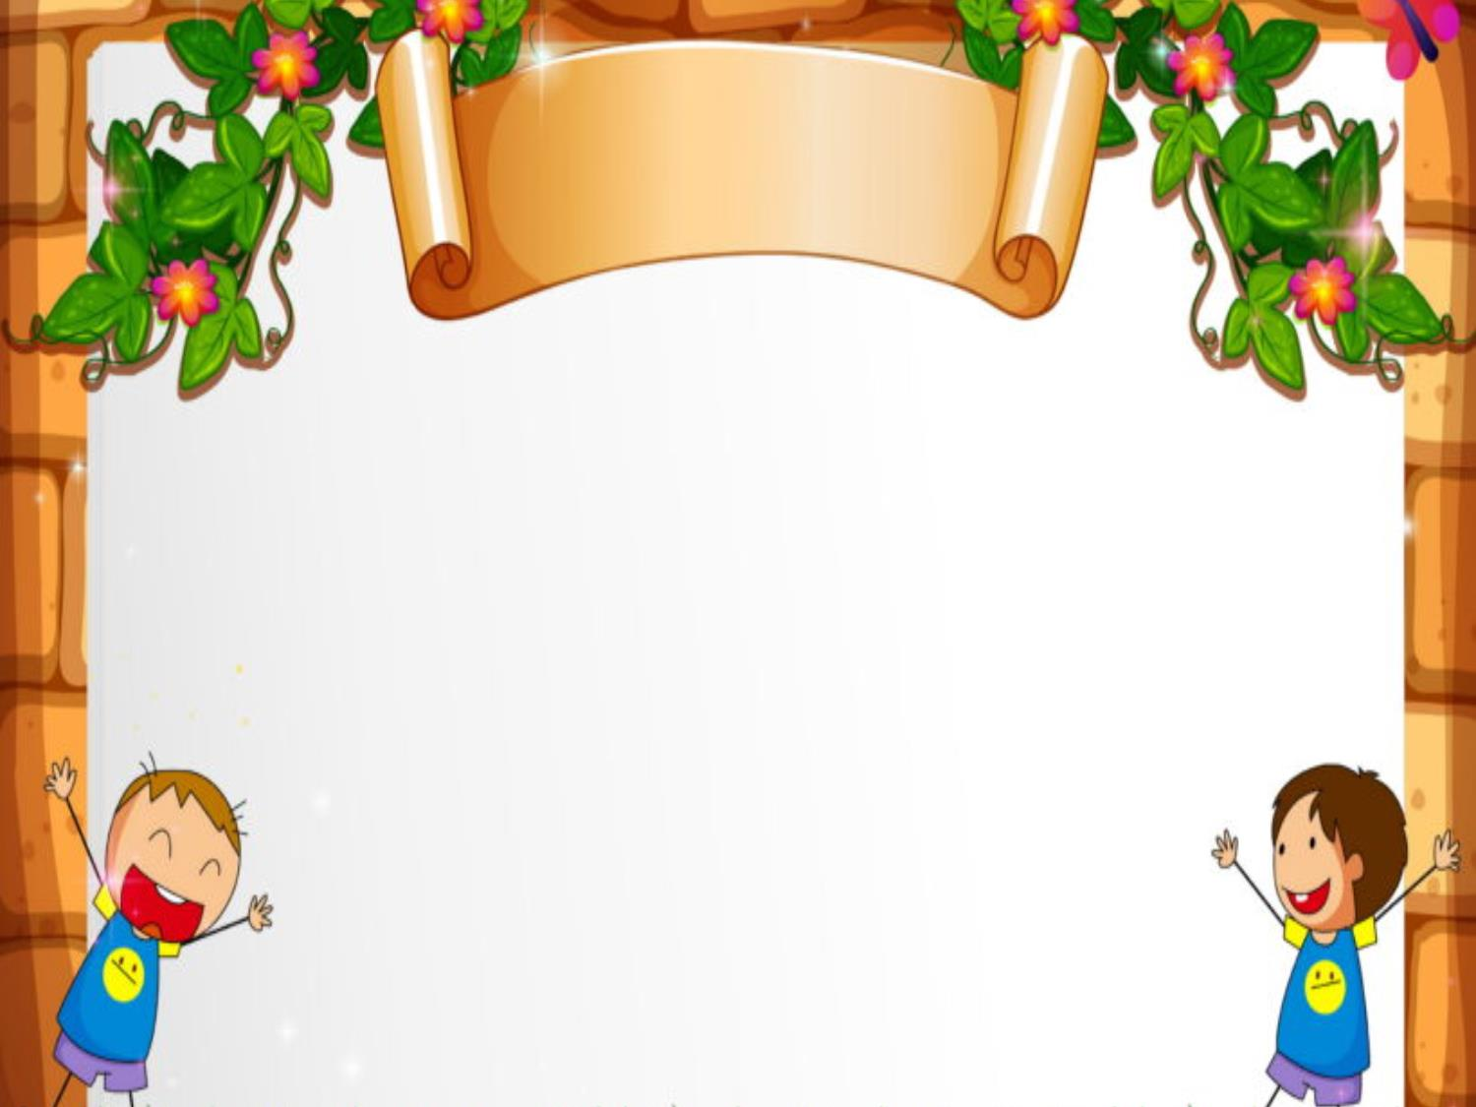
Welcome to our class!
Teacher: Tạ Thị Minh Hồng
Class : 4A1

Slide 2

Warm-up

Slide 3


Slide 4
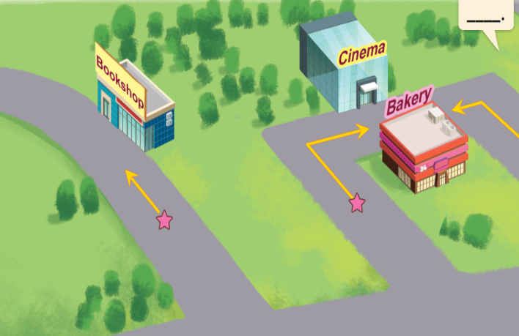
Wednesday, March 27th 2024
Unit 17
In the city
Lesson 2 : Activity 1,2,3

Slide 5
TABLE OF CONTENTS
Wednesday, March 27th 2024
Unit 17: In the city
Lesson 2: Activity 1,2,3 / P.48
01
02
03
Look, listen and repeat.
Listen, point and say.
Let’s talk.

Slide 6

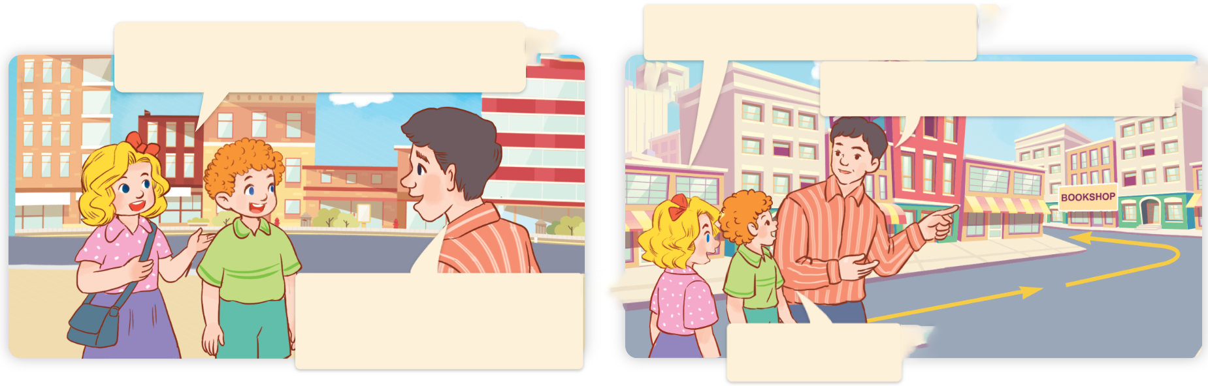
1. Look, listen and repeat.
How can we get there?
We want to buy some books.
a
b
Go straight and turn left.
There’s a bookshop in Hoa Binh Street.
Thank you.
What are they talking about?
Where are they?
Who are they?

Slide 7

WORK IN PAIRS
a
b
How can we get there?
We want to buy some books.
Go straight and turn left.
There’s a bookshop in Hoa Binh Street.
Thank you.

Slide 8
2. Listen, point and say
Vocabulary

Slide 9

go straight
/ɡəʊ streɪt/
đi thẳng

Slide 10

turn right
/tɜːnˈraɪt/
rẽ phải

Slide 11

turn left
/tɜːnˈleft/
rẽ trái

Slide 12
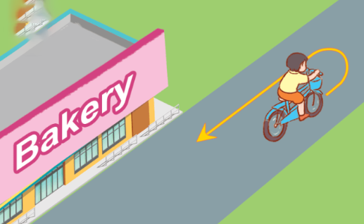
Vocabulary
turn round
/tɜːnˈraʊnd/
quay lại, đổi hướng ngược lại

Slide 13

Checking vocabulary

Slide 14
I say

Slide 15
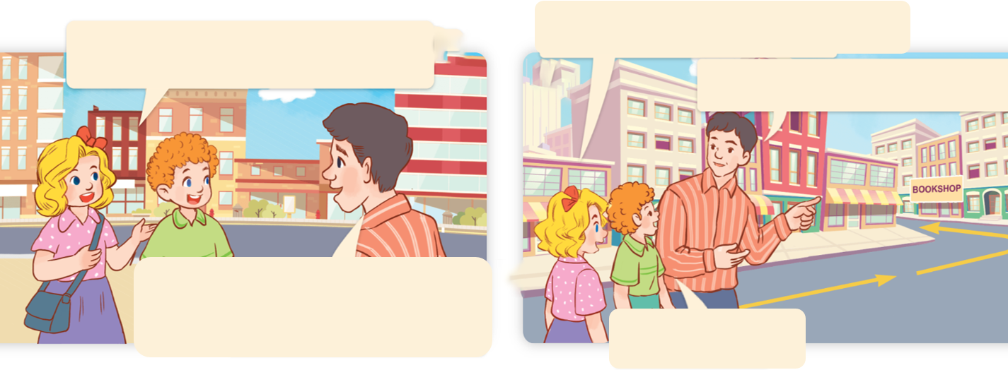
How can I get to the bookshop?
How can we get there?
Go straight and turn left
Go straight and turn left.
Thank you.

Slide 16


*SENTENCE PATTERNS
Cách hỏi làm cách nào để đi tới một nơi:
How can I get to the ________?
( Mình có thể đi đến ______ bằng cách nào?)
___________.

Slide 17
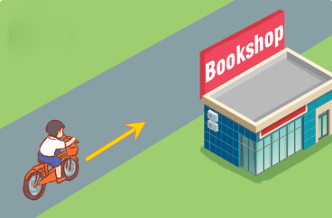
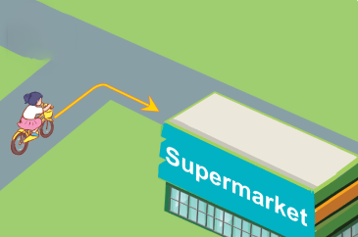
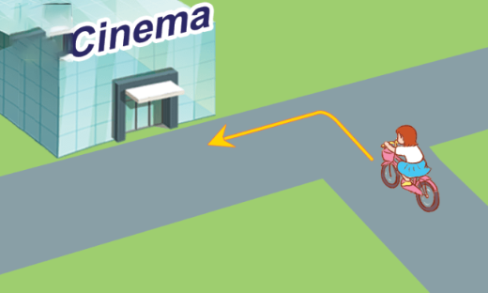
2. Listen, point and say.
a
b
How can I get to the _______?
________.
go straight
turn right
c
d
turn left
turn round

Slide 18


2. Listen, point and say.
a
How can I get to the _____?
________.
go straight
How can I get to the bookshop?
Go straight.
Click on the sentences to listen.

Slide 19


2. Listen, point and say.
How can I get to the supermarket?
b
turn right
Turn right.

Slide 20

1
5
2
6
3
4
LUCKY STARS

Slide 21

How can I get to the bakery?
2 points
d
Turn round.

Slide 22


LUCKY STAR
3 points

Slide 23
How can I get to the supermarket?
1 points
b
Turn right.

Slide 24
How can I get to the bookshop?
a
2 points
Go straight.
Click on the sentences to listen.

Slide 25
LUCKY STAR
3 points

Slide 26
How can I get to the cinema?
c
1 points
Turn left.

Slide 27

Facebook : Bùi Liễu
0968142780
Good job!

Slide 28

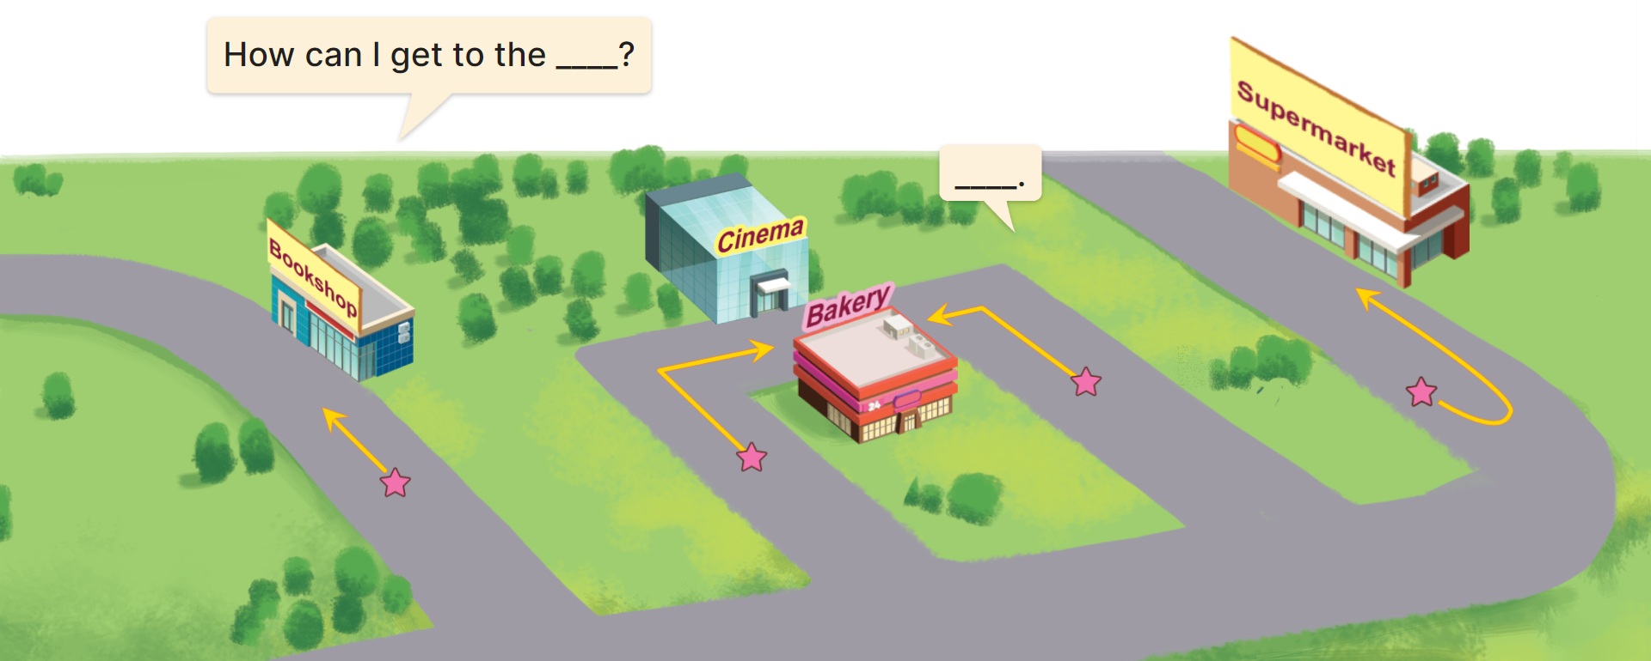
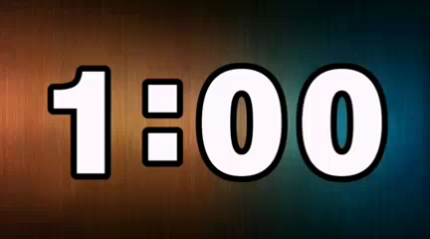
3. Let’s talk.

Slide 29
Wrap up

Slide 30


Review
How can I get to the _______?
__________.
go straight
turn round
turn right
turn left

Slide 31

Thank you!

