Slide 1

Welcome to our class!
NGUYEN KHUYEN PRIMARY SCHOOL
Teacher: Ta Thi Minh Hong

Slide 2

Warm-up

Slide 3
SHOW ME PLEASE
Game

Slide 4
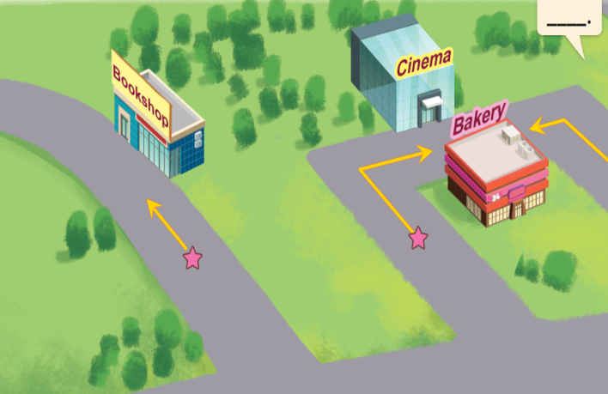
Thursday, April 4th 2024
Unit 17
What would you like to eat
Lesson 2: Task 1, 2, 3/P.48

Slide 5
Contents
Look, listen and repeat.
1
Point and say.
2
Let’s talk.
3

Slide 6

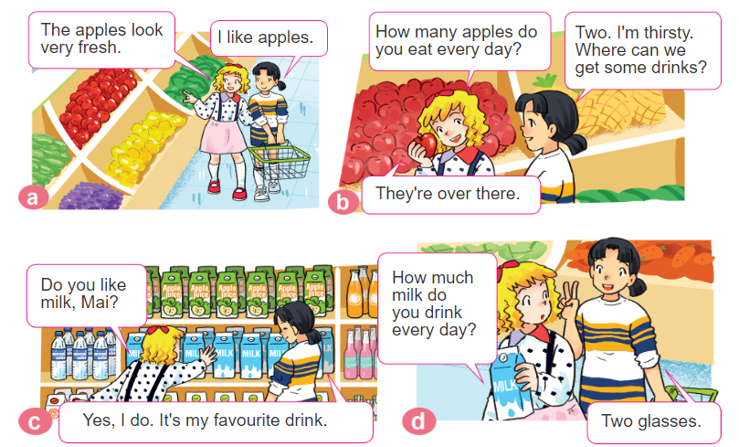
1. Look, listen and repeat.

Slide 7
1. Look, listen and repeat.

Slide 8

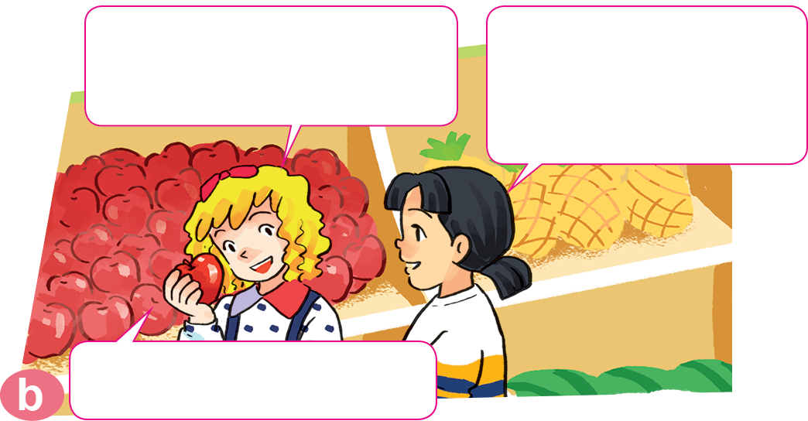
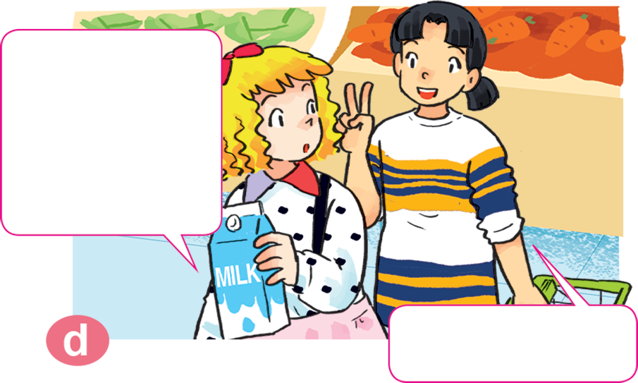
1. Look, listen and repeat.
Two
Two. I'm thirsty. Where can we
get some drinks?
How many apples do you eat every day?
How many apples do you eat every day?
How much milk do you drink every day?
How much milk do you drink every day?
Two glasses.
Two glasses.

Slide 9


Sentence patterns
Countable nouns (danh từ đếm được)
How many apples do you eat every day?
Bạn ăn bao nhiêu quả táo mỗi ngày?
I eat two.
Mình ăn hai quả
Quantity (số lượng)

Slide 10
Sentence patterns
Uncountable nouns (danh từ đếm được)
How much milk do you drink every day?
Bạn uống bao nhiêu sữa mỗi ngày?
I drink two glasses.
Tôi uống hai cốc
Quantity (số lượng)

Slide 11
Note (Ghi nhớ)
How many
1
Bao nhiêu
How much
2
How many
+
Countable nouns(danh từ đếm được)
3
How much
+
unountable nouns(danh từ khôngđếm được)
4
After “How many” always being a plural noun (danh từ số nhiều)
(Theo sau “How many” luôn là một danh từ số nhiều)

Slide 12
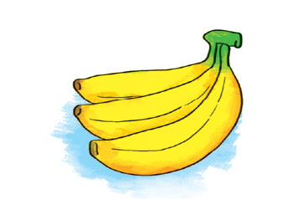
2. Point and say
Vocabulary
bananas
three bananas

Slide 13
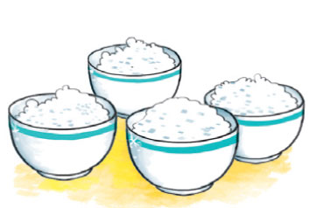
2. Point and say
Vocabulary
rice
four bowls

Slide 14
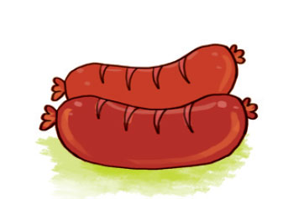
2. Point and say
Vocabulary
sausages
two sausages

Slide 15
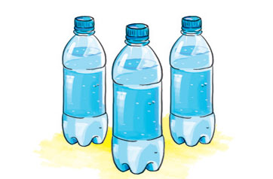
2. Point and say
Vocabulary
water
Three bottles

Slide 16
2. Point and say
bananas/ three bananas
rice/ four bowls
sausages/ two sausages
water/ three bottles

Slide 17

Let’s play!
Ring the golden bell

Slide 18


A: How many bottles are there?
B: _______________
Câu 1
Three bottles
A
Two bottles
B
Four bottles
c
Hết giờ
0
5
1
3
4
2

Slide 19
A: How many sausages are there?
B: _______________
Câu 2
Two sausages
A
Four sausages
B
Four sausage
c
Hết giờ
0
5
1
3
4
2

Slide 20
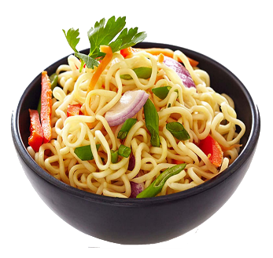
A: How many bowls of noodles are there?
B: _______________
Câu 3
Five bowl
A
Five bowls
B
Fine bowls
c
Hết giờ
0
5
1
3
4
2

Slide 21


A: How many glasses of water are there?
B:______________________
Câu 3
Glasses
A
Three glasses
B
Three water
c
Hết giờ
0
5
1
3
4
2

Slide 22
Choose the odd one out
Câu 5
rice
A
sausages
B
chocolate
c
Hết giờ
0
5
1
3
4
2

Slide 23
Choose the odd one out
Câu 6
A
orange
banana
B
c
water
Hết giờ
0
5
1
3
4
2

Slide 24

Binh ...Boong...
Great job!
Binh ...Boong...

Slide 25
2. Point and say.
How _________ do you every day?
bananas
drink
many
eat
much
water
I __________________.
eat
three bananas
drink
three bottles

Slide 26
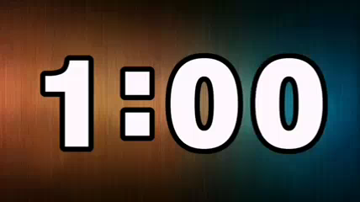
Work in pairs

Slide 27
2. Point and say.
How much _______ do you drink every day?
water
I eat _____________________.
three bottles
water/ three bottles

Slide 28
2. Point and say.
How many _________ do you eat every day?
sausages
I eat _____________________.
two sausages
sausages/ two sausages

Slide 29
2. Point and say.
How many _________ do you eat every day?
bananas
I eat _____________________.
three bananas
bananas/ three bananas

Slide 30
2. Point and say.
How much _________ do you eat every day?
rice
I eat _____________________.
four bowls
rice/ four bowls

Slide 31
Let’s play!
Look and say

Slide 32




Question
A: How _______ rice do you eat every day?
B: I eat three bowls.
Time’s up
much
1
2
3
4
5
Answer
Back
Notes:
Ms Huyền Phạm - 0936.082.789 – YOUTUBE: MsPham. Facebook: Dạy và học cùng công nghệ.

Slide 33
Question
Time’s up
1
2
3
4
5
many
A: How ______ bananas do you eat every day?
B: I drink two bottles.
Answer
Back
Notes:
Ms Huyền Phạm - 0936.082.789 – YOUTUBE: MsPham. Facebook: Dạy và học cùng công nghệ.

Slide 34
Question
Time’s up
1
2
3
4
5
much
A: How ______ water do you drink every day?
B: I eat two glasses.
Answer
Back
Notes:
Ms Huyền Phạm - 0936.082.789 – YOUTUBE: MsPham. Facebook: Dạy và học cùng công nghệ.

Slide 35
Question
Time’s up
1
2
3
4
5
much
A: How ______ chocolate do you eat a week?
B: I eat two bars.
Answer
Back
Notes:
Ms Huyền Phạm - 0936.082.789 – YOUTUBE: MsPham. Facebook: Dạy và học cùng công nghệ.

Slide 36
Question
Time’s up
1
2
3
4
5
much
A: How ______ milk do you drink every day?
B: I drink four cartons.
Answer
Back
Notes:
Ms Huyền Phạm - 0936.082.789 – YOUTUBE: MsPham. Facebook: Dạy và học cùng công nghệ.

Slide 37
Question
Time’s up
1
2
3
4
5
much
A: How ______ meat do you eat a week?
B: eat a kilo.
Answer
Back
Notes:
Ms Huyền Phạm - 0936.082.789 – YOUTUBE: MsPham. Facebook: Dạy và học cùng công nghệ.

Slide 38


3. Let’s talk
How many/much ______ do you
eat/drink every day?
I eat/drink _______.
Use these sentence patterns to ask and answer questions about the quantity of your daily food and drink.

Slide 39

Work in groups of 4
Ask and answer questions about the quantity of food and drink you eat and drink every day

Slide 40
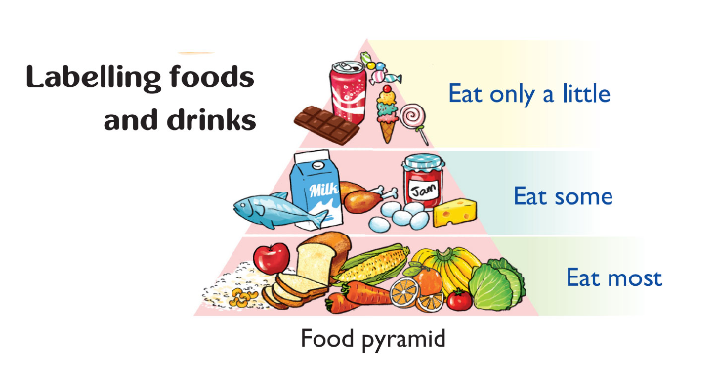
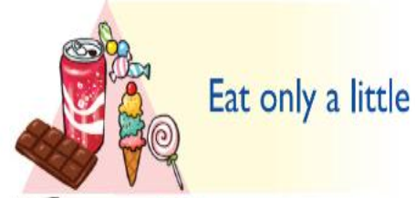

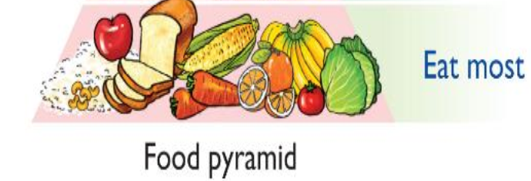

Slide 41

Thank you!

Slide 42
How _______ do you every day?
I ______________________.
many
rice
eat
much
bananas
drink
water
sausages
eat
two sausages
drink
three bottles
three bananas
four bowls
water
sausages
bananas
rice
three bottles
three bananas
two sausages
four bowls
Ms.Phạm English

Slide 43


