Slide 1
Unit 3
Where did you go
on holiday?
Lesson 2

Slide 2
Objectives
By the end of this lesson, students will be able to…
-Pronounce three- syllable words with the stress on the first syllable :
‘motobike. ‘underground. ‘holiday. ‘family.

Slide 3
Warm-up

Slide 4
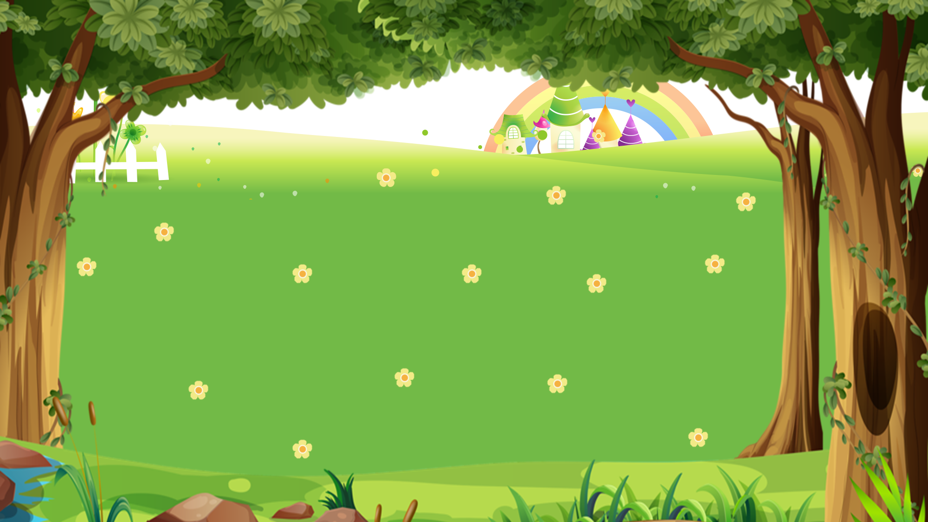

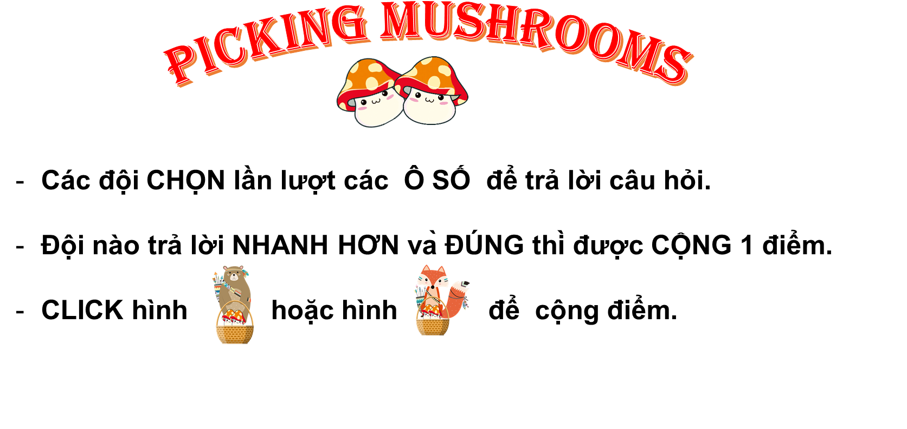







PICKING MUSHROOMS
1
2
3
Các đội CHỌN lần lượt các Ô SỐ để trả lời câu hỏi.
Đội nào trả lời NHANH HƠN và ĐÚNG thì được CỘNG 1 điểm.
CLICK hình hoặc hình để cộng điểm.
4
5
6
7
8
9
10

Slide 5







Time’s up
1
2
3
4
5
6
7
8
9
10
How did you get there?
Back
A. I went by motorbike.
B. I went to Ha Long Bay.
C. I went swimming.
A.

Slide 6
Time’s up
1
2
3
4
5
6
7
8
9
10
I went by bus.
Back
A. Where did you go on holiday?
B. How did you get there?
C. Where did you do?
A.

Slide 7
Time’s up
1
2
3
4
5
6
7
8
9
10
How did you get there?
_____ coach.
Back
A. I went
B. I went to
C. I went by
A.

Slide 8
Time’s up
1
2
3
4
5
6
7
8
9
10
____ was the trip ___?
It was great.
Back
A. How / like
B. Where / like
C. What / like
A.

Slide 9
Time’s up
1
2
3
4
5
6
7
8
9
10
Where did you go on holiday?
Back
A. I went by bus.
B. I went to Hue Imperial City.
C. I go to Hue Imperial City.
A.

Slide 10
Time’s up
1
2
3
4
5
6
7
8
9
10
Where ____ you go on holiday?
Back
A. do
B. did
C. are
A.

Slide 11
Time’s up
1
2
3
4
5
6
7
8
9
10
How did you get there?
Back
A. I went bike train
B. I went to train
C. I went by train.
A.

Slide 12
Time’s up
1
2
3
4
5
6
7
8
9
10
How did you get there?
Back
A. To taxi
B. By taxi
C. Go taxi
A.

Slide 13
Time’s up
1
2
3
4
5
6
7
8
9
10
______ did you do on holiday?
I went to Ho Chi Minh City.
Back
A. What
B. Where
C. How
A.

Slide 14
Time’s up
1
2
3
4
5
6
7
8
9
10
It was really wonderful.
Back
A. Where di you go?
B. How did you get there?
C. What was the trip like?
A.

Slide 15
PRONUNCIATION

Slide 16

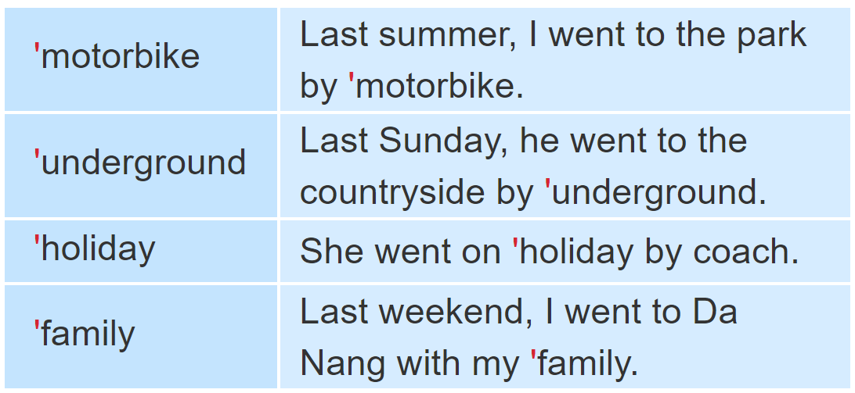
1. Listen and repeat

Slide 17
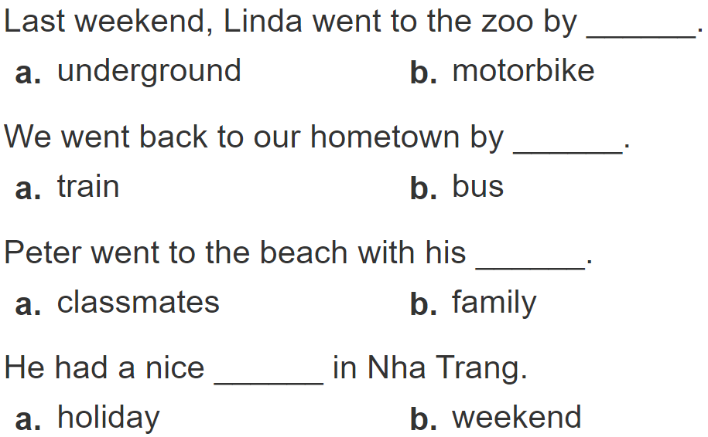
2.
Listen and circle a or b. Then say the sentences aloud.
1
2
3
4

Slide 18
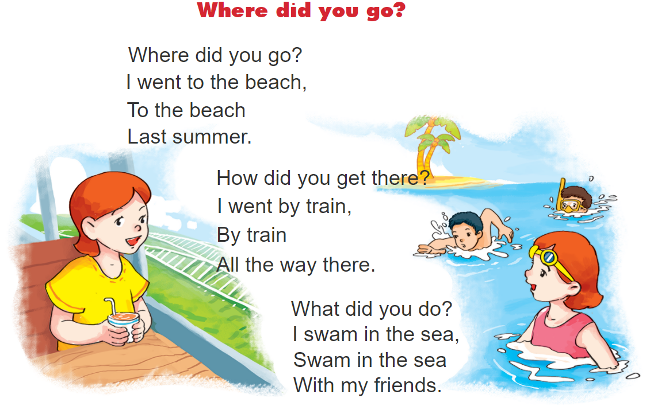



3. Let’s chant.

