Slide 1
Unit 4
Did you go to the party?
Lesson 1

Slide 2
Objectives
By the end of this lesson, students will be able to…
Use the words and phrases related to the topic Past activities
- Ask and answer questins about where someone did something.
Vocabulary: go on a picnic, enjoy the party, join the funfair, watch TV
Structure: Did you………………………..?
yes, I did
No, I did’nt

Slide 3
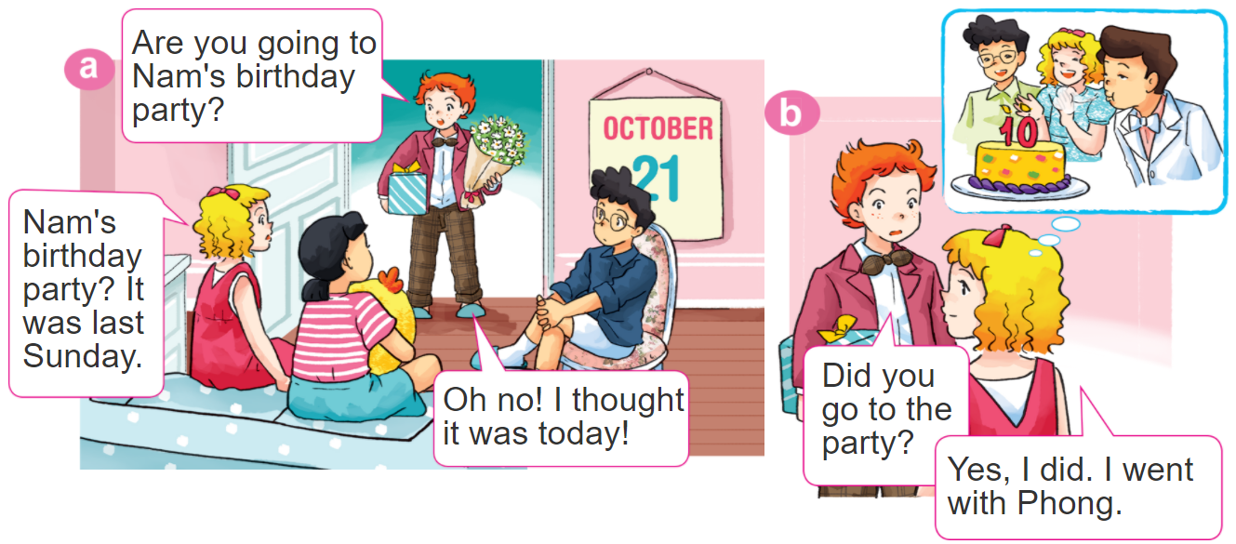

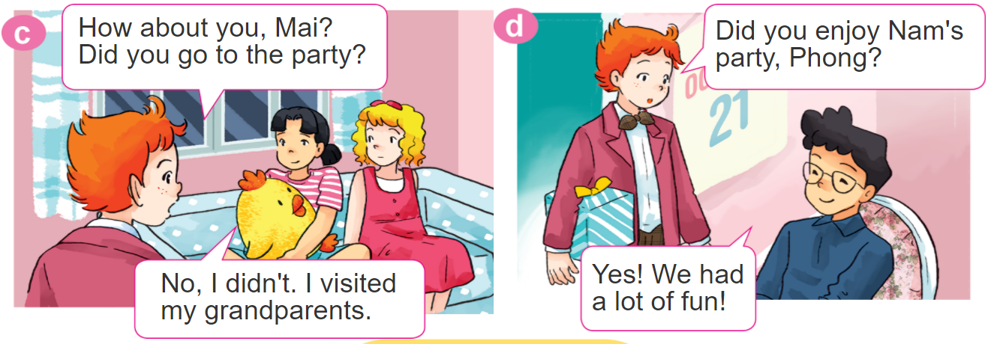
1. Look, listen and repeat.

Slide 4
VOCABULARY

Slide 5
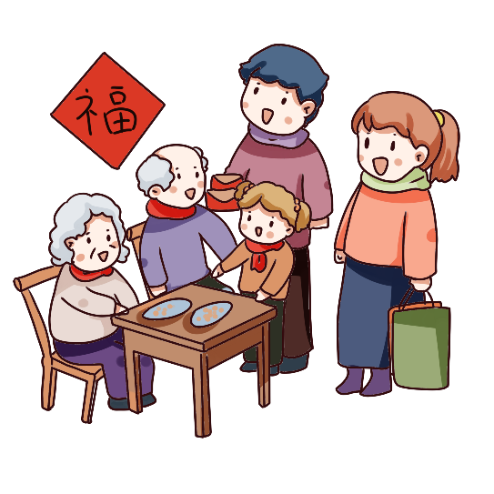
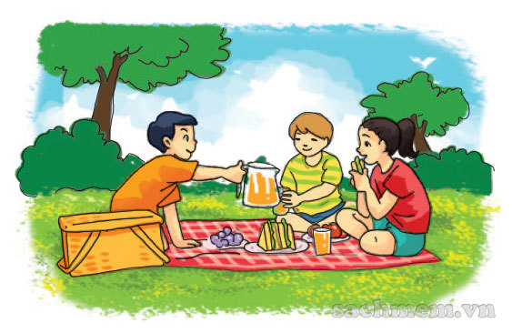
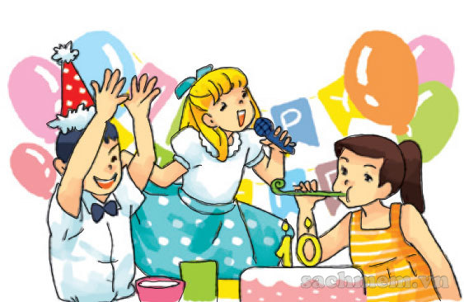
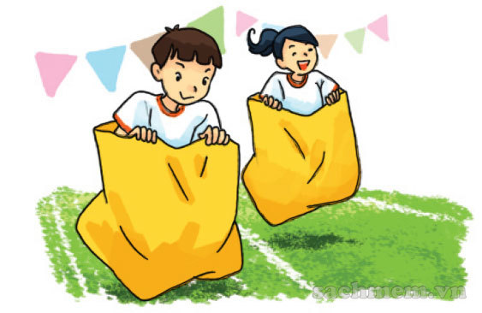
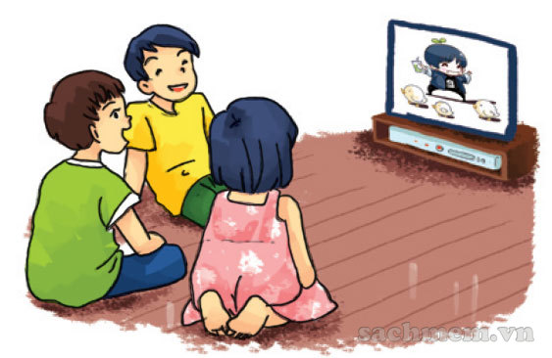
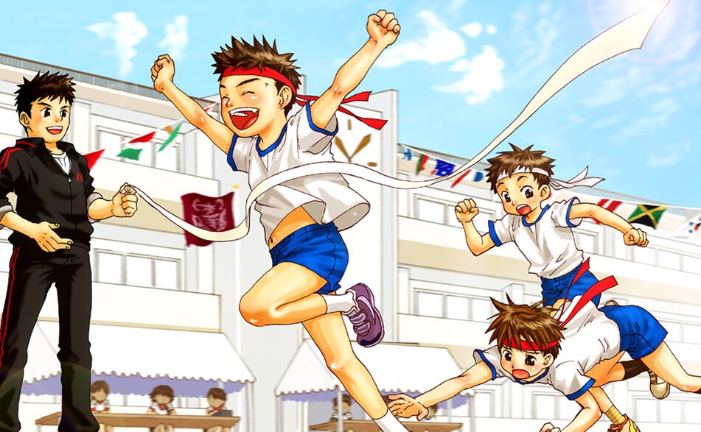
A. Vocabulary
visit my
grandparents
go on a picnic
enjoy a party
Đi dã ngoại
Thích bữa tiệc
Đi thăm ông bà
join the funfair
watch cartoon
sport festival
Tham gia hội trại
Xem hoạt hình
Lễ hội thể thao

Slide 6
Fill the blanket
visit my
grandparents
sport festival
_____
_____
watch cartoon
_____
Lễ hội thể thao
Xem hoạt hình
Đi thăm ông bà
go on a picnic
enjoy a party
___
_____
join the funfair
_____
Đi dã ngoại
Thích bữa tiệc
Tham gia hội trại

Slide 7
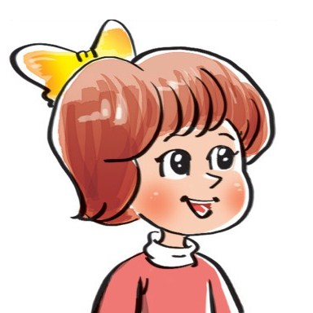

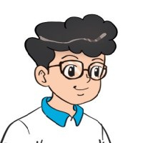

2. Point and say
Yes. I did.
Did you _________?
No, I didn't.
go on a picnic
watch TV
enjoy a party
join the funfair

Slide 8

3. Let’s talk
Did you go on a picnic?
Yes. I did.
Did you enjoy the weekend?
No, I didn't.
Did you watch TV?

Slide 9
B. Grammar
Hỏi và đáp bạn đã làm gì đó phải không:
Did you ___________?
+ activity
Yes. I did.
No, I didn't.

Slide 10




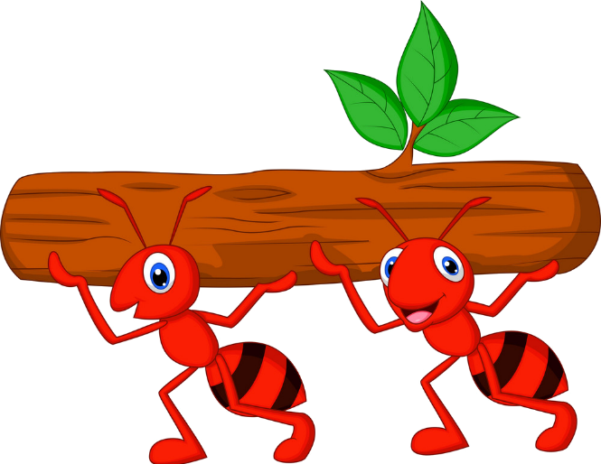



Kiến chăm chỉ
PLAY

Slide 11

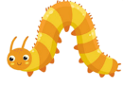





Did you join the festival?
Yes, I did.
Next
Notes:
Ms Huyền Phạm - 0936.082.789 – YOUTUBE: MsPham. Facebook: Dạy và học cùng công nghệ.

Slide 12
Did you visit your grandparents?
Yes, I did.
Next
Notes:
Ms Huyền Phạm - 0936.082.789 – YOUTUBE: MsPham. Facebook: Dạy và học cùng công nghệ.

Slide 13
Did you watch cartoon
No, I didn’t.
Next
Notes:
Ms Huyền Phạm - 0936.082.789 – YOUTUBE: MsPham. Facebook: Dạy và học cùng công nghệ.

Slide 14
Did you join the funfair?
No, I didn’t.
Next
Notes:
Ms Huyền Phạm - 0936.082.789 – YOUTUBE: MsPham. Facebook: Dạy và học cùng công nghệ.

Slide 15
Did you enjoy a party?
Yes, I did.
Next
Notes:
Ms Huyền Phạm - 0936.082.789 – YOUTUBE: MsPham. Facebook: Dạy và học cùng công nghệ.

Slide 16
Did you go on the picnic?
Yes, I did.
Next
Notes:
Ms Huyền Phạm - 0936.082.789 – YOUTUBE: MsPham. Facebook: Dạy và học cùng công nghệ.

Slide 17
Did you go to school
yesterday?
No, I didn’t.
Next
Notes:
Ms Huyền Phạm - 0936.082.789 – YOUTUBE: MsPham. Facebook: Dạy và học cùng công nghệ.

Slide 18
Did you get up early
this morning?
Yes, I did.
Next
Notes:
Ms Huyền Phạm - 0936.082.789 – YOUTUBE: MsPham. Facebook: Dạy và học cùng công nghệ.

Slide 19
WELL DONE!
EXIT
Notes:
Ms Huyền Phạm - 0936.082.789 – YOUTUBE: MsPham. Facebook: Dạy và học cùng công nghệ.

