Slide 1

Warm-up

Slide 2


Slide 3


Slide 4

UNIT 9: TOYS
Lesson 3
Task D, E/P.61

Slide 5

Part D

Slide 6

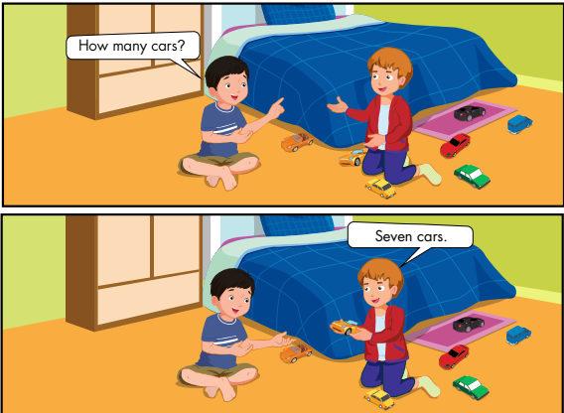
D.1: Listen to the story

Slide 7
How many cars?
How many balls?
Seven cars
Nine balls
How many teddy bears?
One teddy bear

Slide 8
1. How many cars?
2. Seven cars
3. How many balls?
4. Nine balls
5. How many teddy bears?
6. One teddy bear

Slide 9
D.1: Listen to the story
How many cars?
Seven cars

Slide 10




D.2: Listen and repeat
A: How many _________________?
name’s object
B: ________ _______________
Number
name’s object
→ Hỏi và trả lời về số lượng đồ vật

Slide 11
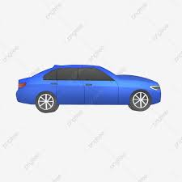
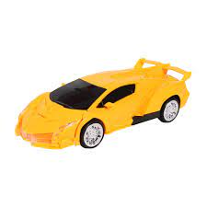


D.2: Listen and repeat
How many _______?
cars
_______ ______
Seven
cars
→ Hỏi và trả lời về số lượng đồ vật

Slide 12
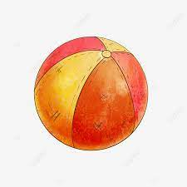
How many ______?
balls
_____ ______
Nine
balls

Slide 13

How many ____________?
teddy bears
_____ __________
One
teddy bear

Slide 14

Work in pairs

Slide 15

1. How many cars?
2. Seven cars
3. How many balls?
4. Nine balls
5. How many teddy bears?
6. One teddy bear

Slide 16
Part E:
Play “count the objects”

Slide 17

Part D.1: Listen to the story
Part D.2: Listen and repeat.
Part E. Play “count the objects”

Slide 18
Work in groups of 4

Slide 19



How many balls?
Four balls

Slide 20

How many cars?
Five cars

Slide 21

How many pencils?
Ten pencils

Slide 22

How many books?
Eight books

Slide 23

How many bags?
One bag

Slide 24
Check your memory

Slide 25








Ms Huyền Phạm
0936.082.789
Notes:
Ms Huyền Phạm - 0936.082.789 – YOUTUBE: MsPham. Facebook: Dạy và học cùng công nghệ.

Slide 26

How many balls?
Four balls
Three balls
Ms Huyền Phạm
0936.082.789
Notes:
Ms Huyền Phạm - 0936.082.789 – YOUTUBE: MsPham. Facebook: Dạy và học cùng công nghệ.

Slide 27
Ten pencils.
How many pencils?
Nine pencils.
Ms Huyền Phạm
0936.082.789
Notes:
Ms Huyền Phạm - 0936.082.789 – YOUTUBE: MsPham. Facebook: Dạy và học cùng công nghệ.

Slide 28
How many books?
Seven books
Eight books
Ms Huyền Phạm
0936.082.789
Notes:
Ms Huyền Phạm - 0936.082.789 – YOUTUBE: MsPham. Facebook: Dạy và học cùng công nghệ.

Slide 29
How many cars?
Two cars.
Five cars.
Ms Huyền Phạm
0936.082.789
Notes:
Ms Huyền Phạm - 0936.082.789 – YOUTUBE: MsPham. Facebook: Dạy và học cùng công nghệ.

Slide 30
________ _____ my pants.
This is
These are
Ms Huyền Phạm
0936.082.789
Notes:
Ms Huyền Phạm - 0936.082.789 – YOUTUBE: MsPham. Facebook: Dạy và học cùng công nghệ.

Slide 31
How many bags?
One bags
One bag
Ms Huyền Phạm
0936.082.789
Notes:
Ms Huyền Phạm - 0936.082.789 – YOUTUBE: MsPham. Facebook: Dạy và học cùng công nghệ.

Slide 32

Good job!
Ms Huyền Phạm
0936.082.789
Notes:
Ms Huyền Phạm - 0936.082.789 – YOUTUBE: MsPham. Facebook: Dạy và học cùng công nghệ.

Slide 33
Play
Secret box

Slide 34
Thank you

Slide 36



