Slide 1


Slide 2

Warm-up

Slide 3
Unit 18
What will the weather
be like tomorrow?
Lesson 3

Slide 4
* What will the weather be like tomorrow?
It will be hot and sunny.
* What’s spring like in your country?
It’s usually cold and windy.

Slide 5
1. Listen and repeat:

Slide 6

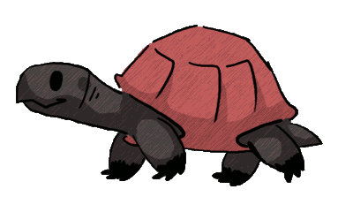
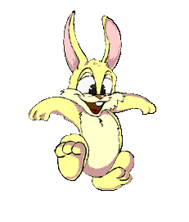




Lucky Wheel
30
20
1
2
3
40
10
50
80
4
5
6
60
70
Spin

Slide 7
1. What is the weather like today?
A. UP
B. DOWN

Slide 8
2. There are a lot of flowers in winter.
A. UP
B. DOWN

Slide 9
3. It’s usually cool and windy .
A. UP DOWN
B. DOWN UP

Slide 10
4. What are the sentence stress?
Underline the sentence stress below.
What’s autumn like in your country?
A. What, autumn, country
B. What, like, autumn, country

Slide 11


Slide 12
2.Listen and circle a or b. Then say the sentences aloud:

Slide 13
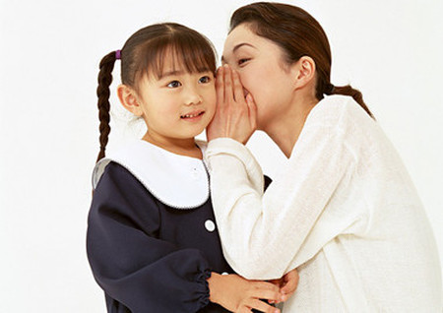
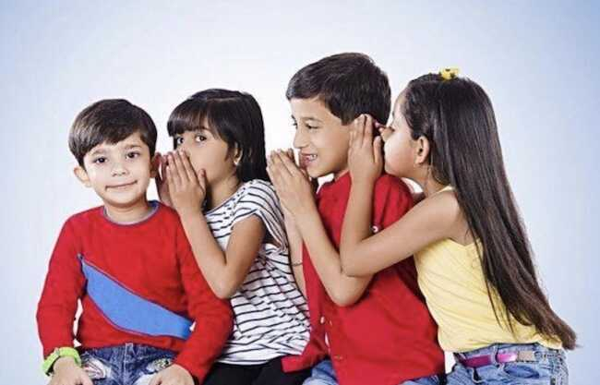
GAME
Whispering

Slide 14
What will the weather be like tomorrow?

Slide 15
2. It will be cool and windy.

Slide 16
3. What’s the summer like in your country?

Slide 17
4. It’s sunny and hot.

Slide 18
3, Let’s chant

