Slide 1
Saturday, 23 March 2024
UNIT 1: A LONG AND HEALTHY LIFE
LESSON 7 - COMMUNICATION AND CULTURE/CLIL
CLIL: Bacteria and viruses

Slide 2
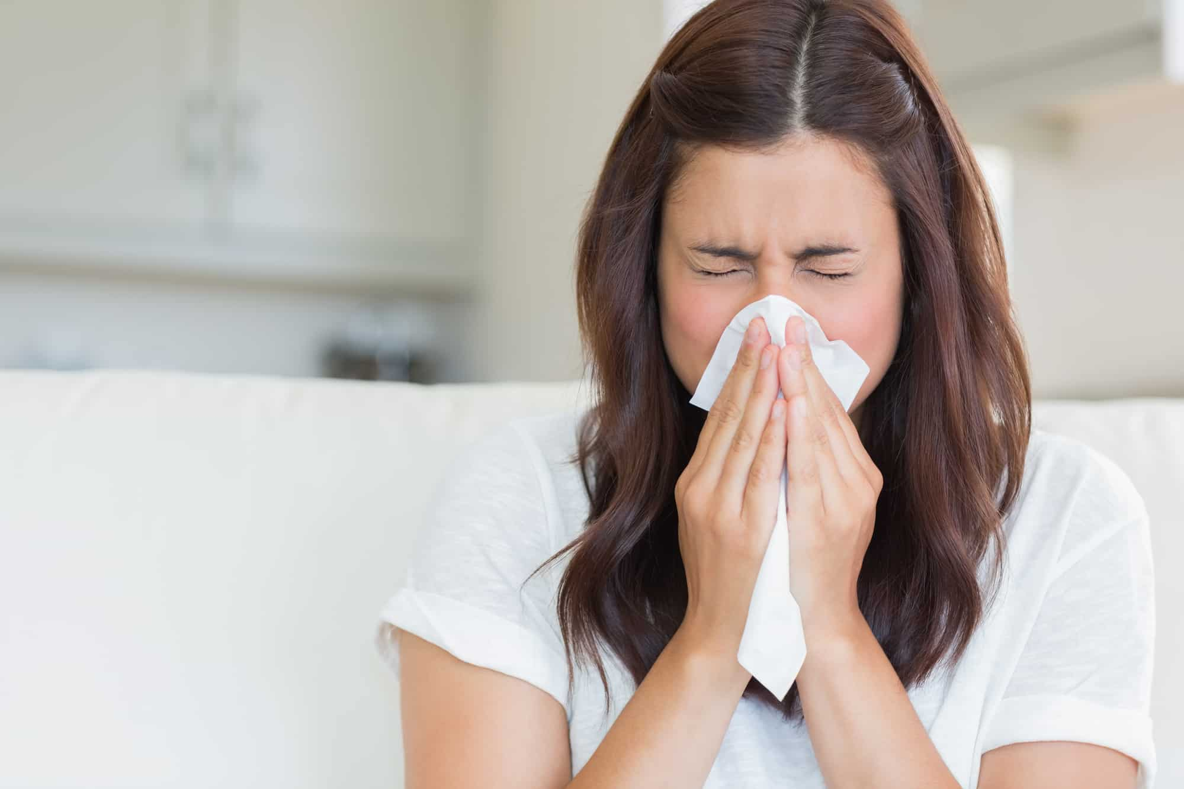
common cold

Slide 3
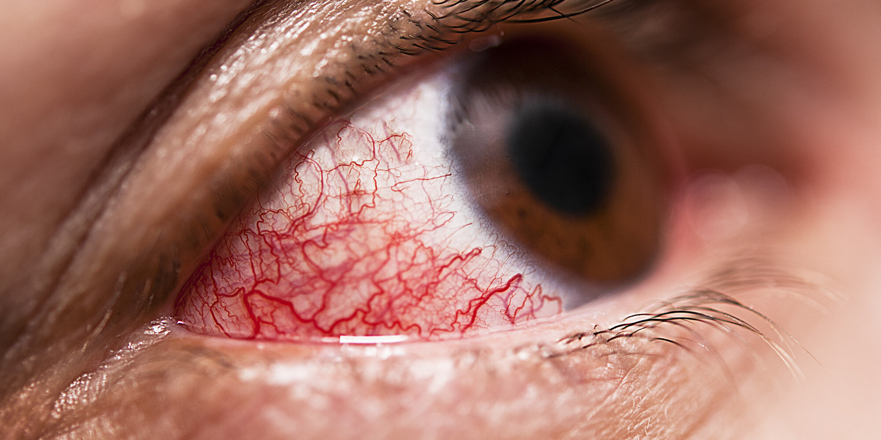
sore eyes

Slide 4
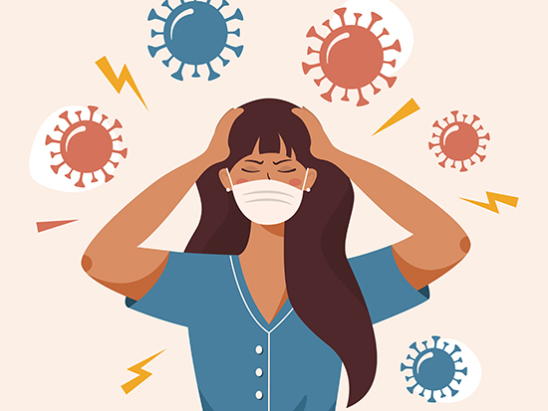
flu

Slide 5
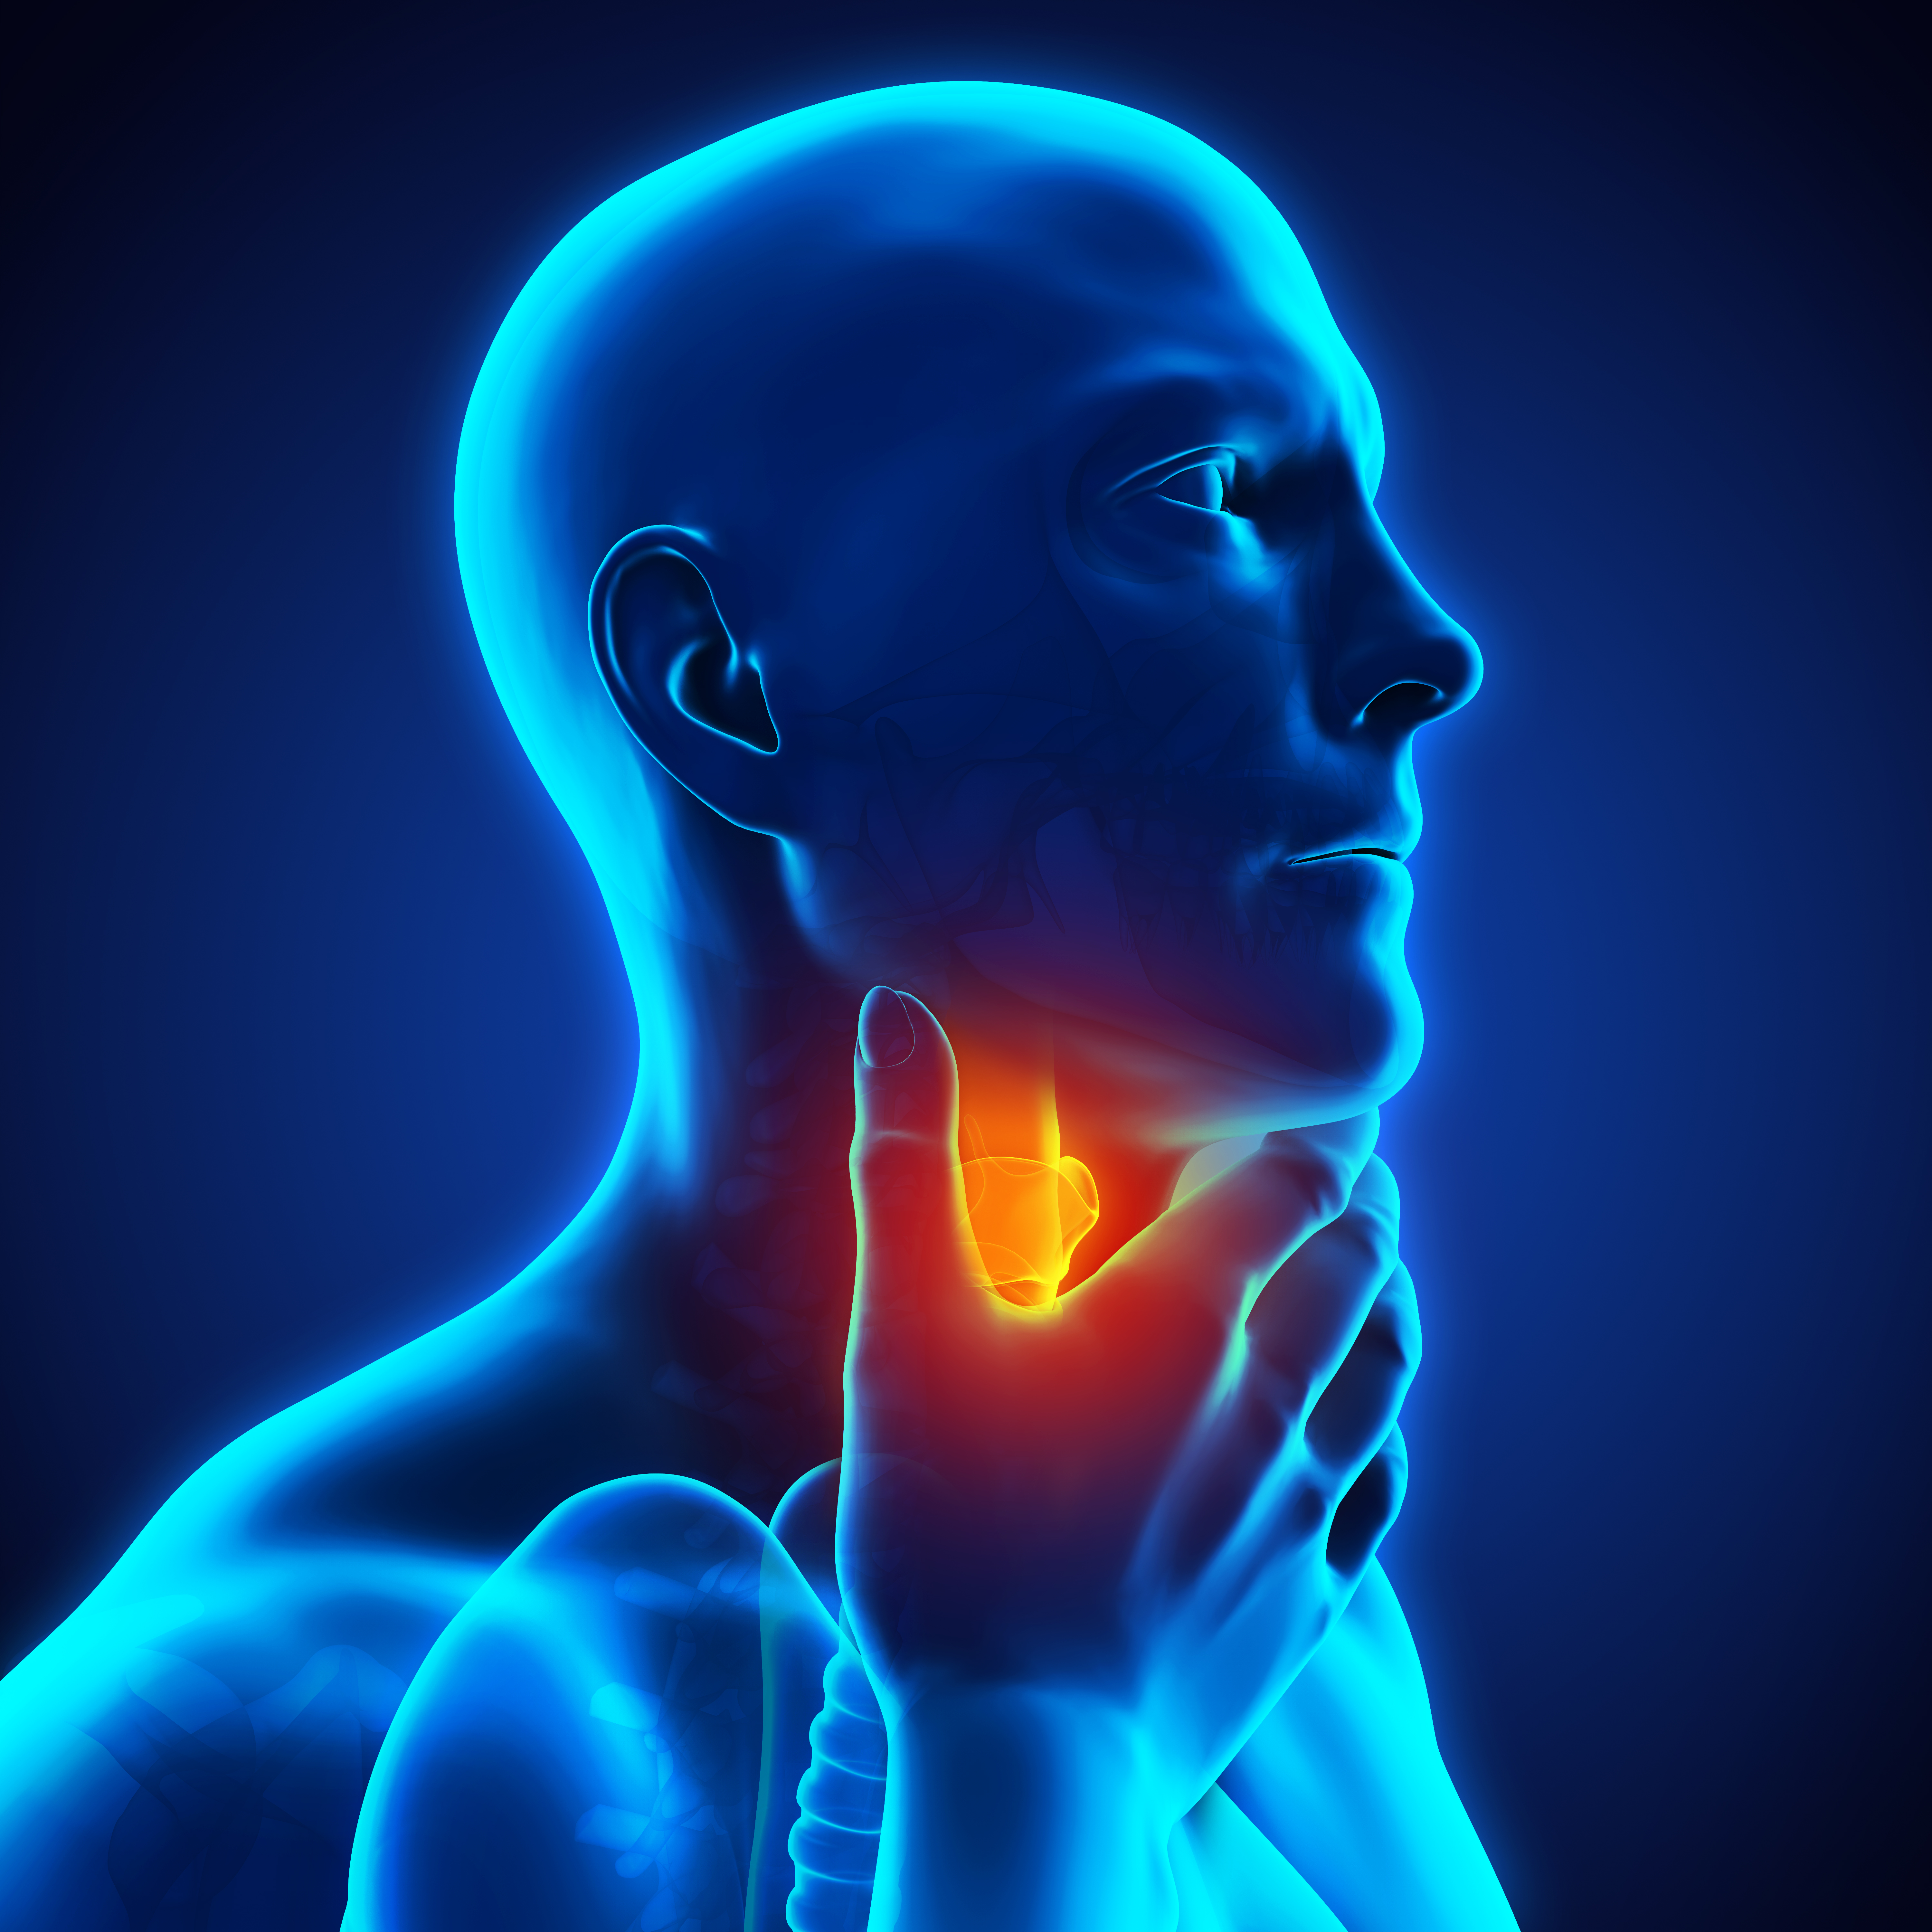
sore throat

Slide 6
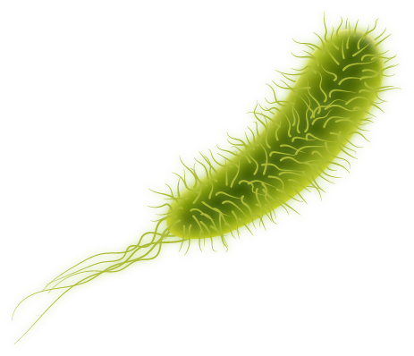
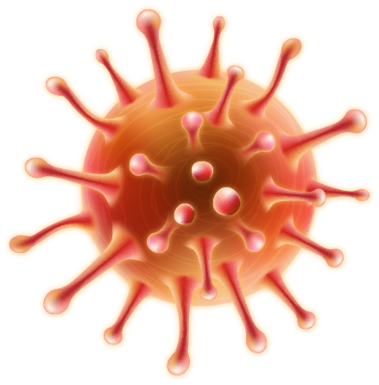
BACTERIA and VIRUSES
common cold
flu
sore eyes
sore throat
UNIT 1: A LONG AND HEALTHY LIFE
LESSON 7 - COMMUNICATION AND CULTURE/CLIL
CLIL: Bacteria and viruses

Slide 7

UNIT 1: LESSON 7 - CLIL (p. 16)
Bacteria are living organisms. They can live in many places, such as soil, water, and the human body. The smallest bacteria are about 0.4 microns* in diameter. Some bacteria in our bodies are helpful, but some can cause infectious diseases such as tuberculosis** or food poisoning. Antibiotics are often used to treat infections caused by bacteria.
*1 metre = 1 million microns
**a serious lung disease
Viruses are tiny germs that cause diseases in people, animals, and plants. They can cause a range of illnesses, from the common cold or the flu to more serious diseases such as AIDS and Covid-19. As they are very small (0.02 to 0.25 micron), viruses can get into our bodies easily. They are not living things, so they need to enter our bodies to become active. Then, they start to grow and cause the infected cell to make millions of copies of the virus. Vaccines are often used to prevent the spread of diseases caused by viruses.

Slide 8
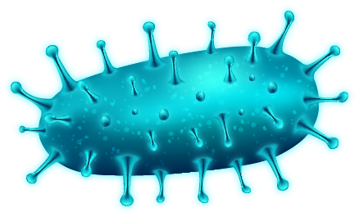
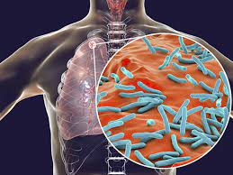

tuberculosis (n) /tʃuːˌbɜː.kjəˈləʊ.sɪs/ lao phổi

Slide 9
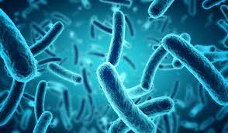
organism (n) /ˈɔː.ɡən.ɪ.zəm/ sinh vật

Slide 10
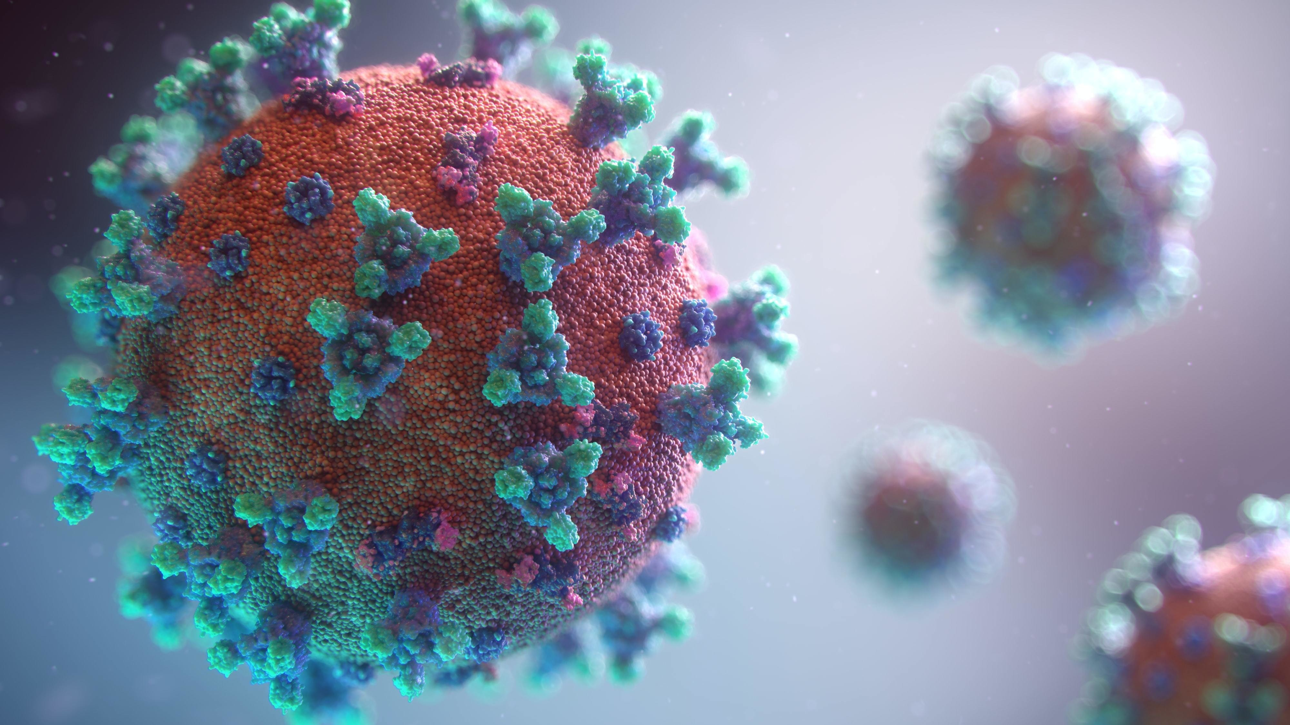
infection (n) /ɪnˈfek.ʃən/ sự lây nhiễm

Slide 11
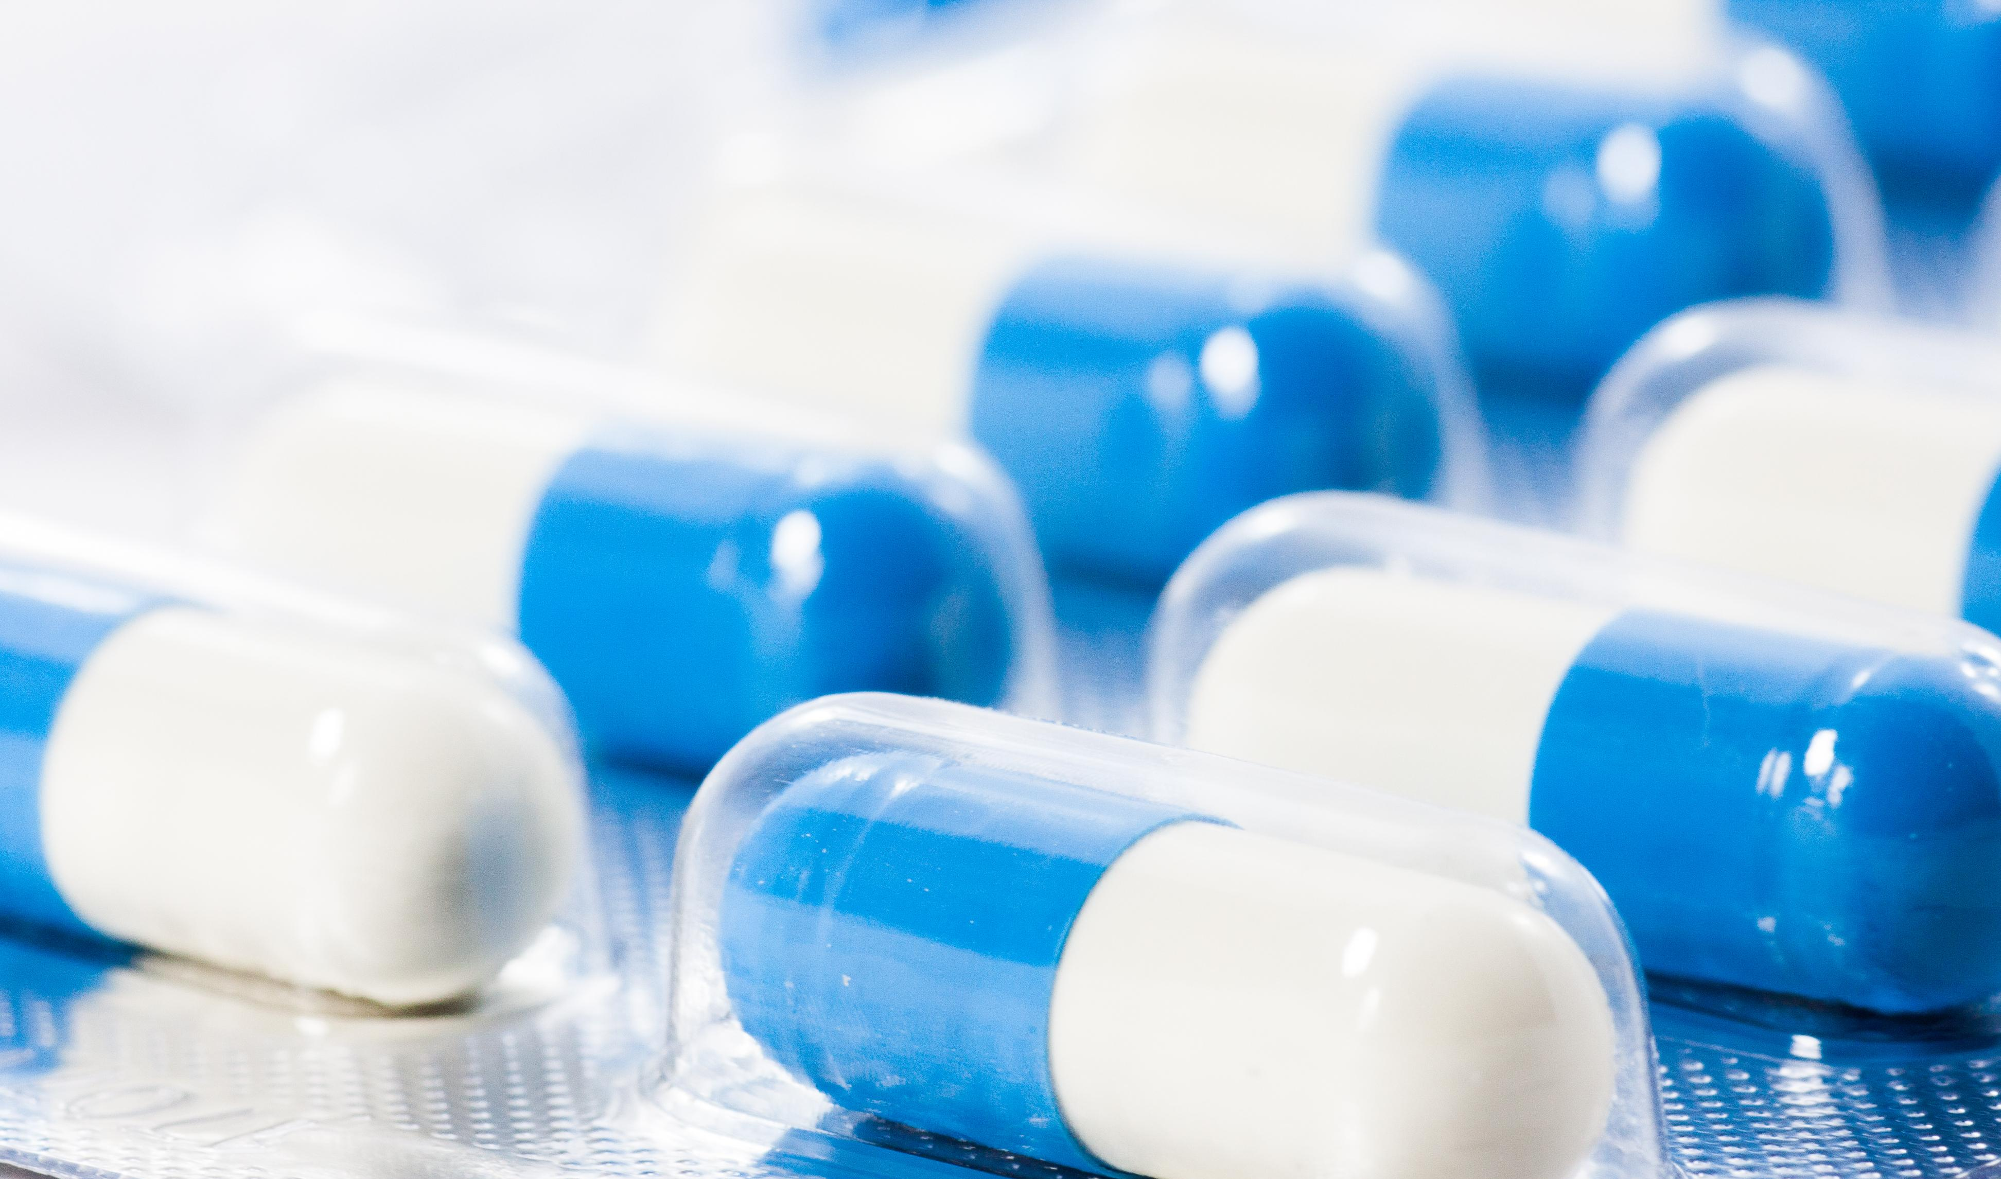
antibiotic (n) /ˌæn.ti.baɪˈɒt.ɪk/ thuốc kháng sinh

Slide 12
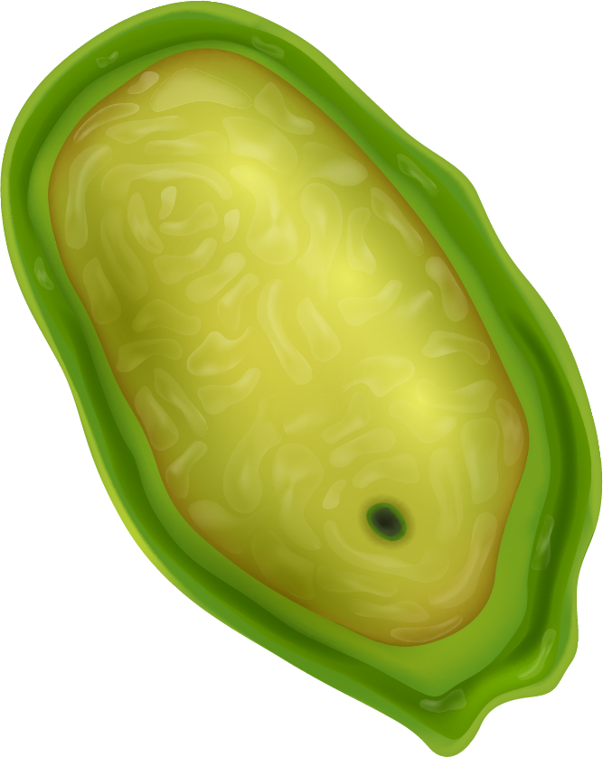
Task 1: Read the text and complete the mind map

Slide 13
UNIT 1: LESSON 7 - CLIL (p. 16)
Bacteria are living organisms. They can live in many places, such as soil, water, and the human body. The smallest bacteria are about 0.4 microns* in diameter. Some bacteria in our bodies are helpful, but some can cause infectious diseases such as tuberculosis** or food poisoning. Antibiotics are often used to treat infections caused by bacteria.
*1 metre = 1 million microns
**a serious lung disease
Viruses are tiny germs that cause diseases in people, animals, and plants. They can cause a range of illnesses, from the common cold or the flu to more serious diseases such as AIDS and Covid-19. As they are very small (0.02 to 0.25 micron), viruses can get into our bodies easily. They are not living things, so they need to enter our bodies to become active. Then, they start to grow and cause the infected cell to make millions of copies of the virus. Vaccines are often used to prevent the spread of diseases caused by viruses.

Slide 14
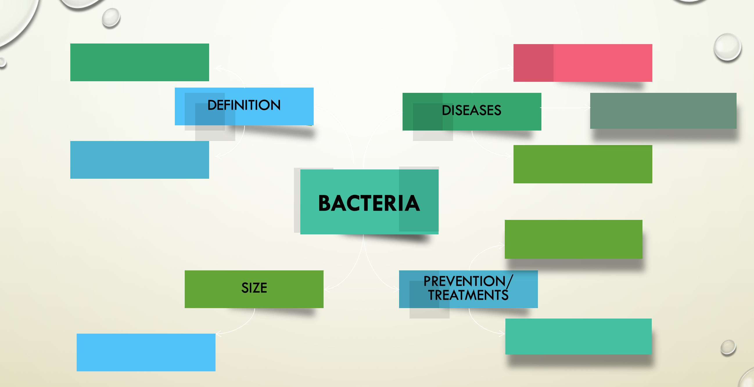
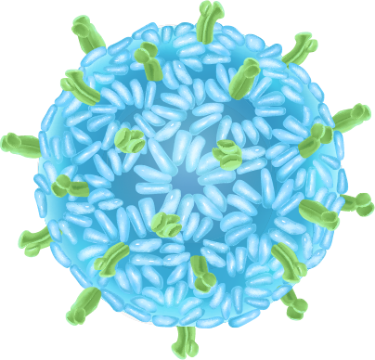
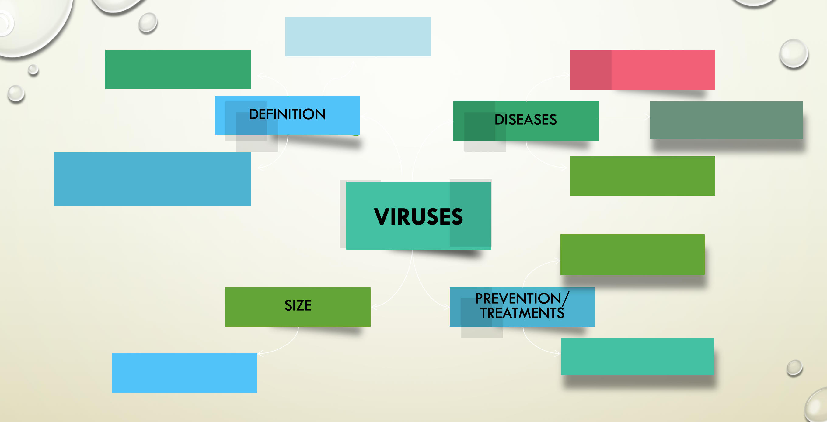

Slide 15

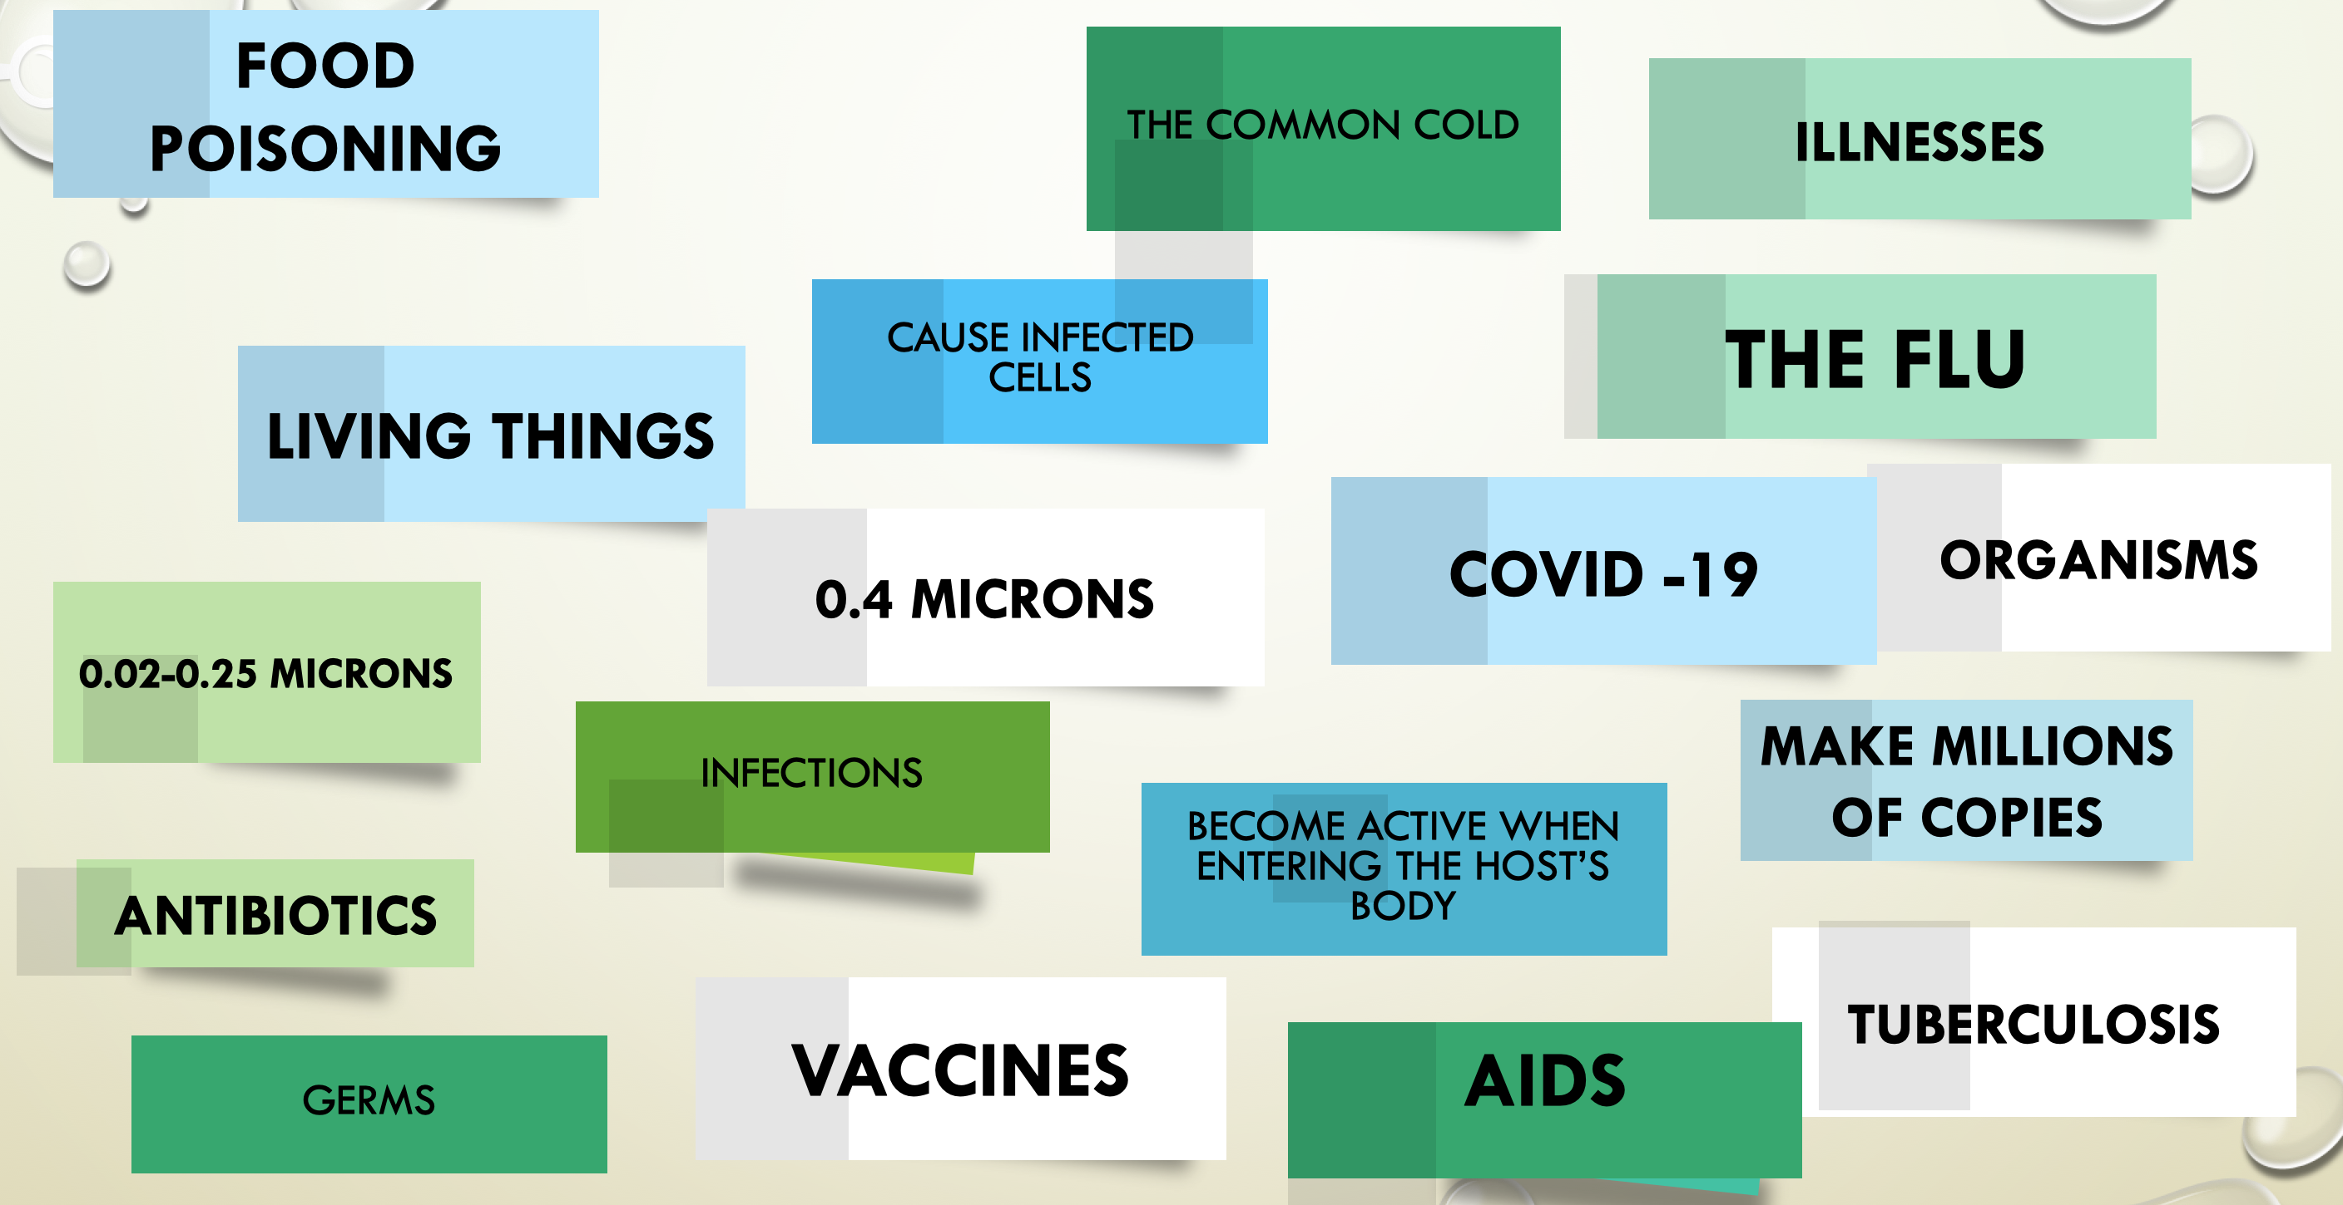

Slide 16
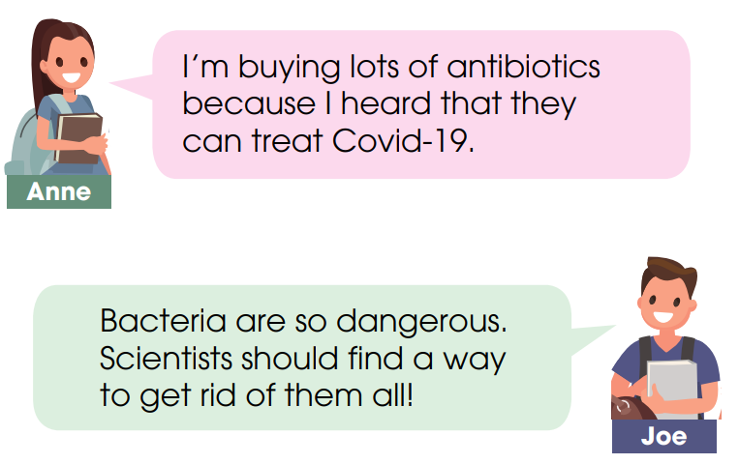

Task 2: Discuss in groups.
What would you say to these people?
“I’m buying a lot of antibiotics because I heard that they can treat Influenza A”
“Bacteria are so dangerous. Scientists should find a way to get rid of them all.”

Slide 17
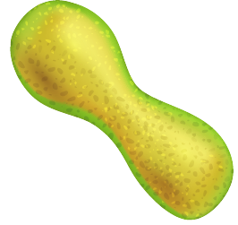
Some pandemics or diseases caused by viruses and/or bacteria
Diseases caused by viruses:
Ebola sốt xuất huyết
Measles bệnh sởi
Chickenpox thuỷ đậu
Shingles Zona thần kinh
Diseases caused by bacteria
Pneumonia viêm phổi
Cholera bệnh tả

Slide 18

What should we do to protect ourselves from bacteria and viruses?
SCAN ME

Slide 19
 | Bacteria | Viruses
Living or not when entering human body? | Living | Not living
Which is smaller? | bigger | smaller
Examples of diseases they can cause | Tuberculosis, food poisoning, pneumonia, cholera | Common cold, flu, AIDS, and Covid – 19, Ebola, influenza, measles, chickenpox and shingles
How to treat/prevent diseases caused by them? | Antibiotics | Vaccines

Slide 20
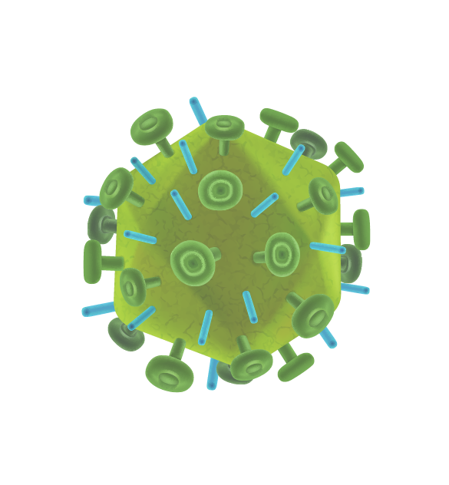
QUIZ
QUESTION 1
What is TRUE about VIRUSES?
A
They can be killed by antibiotics.
B
They are bigger than bacteria.
C
They can be prevented by vaccines.
D
They are living organisms.

Slide 21
QUIZ
QUESTION 2
What is NOT TRUE about BACTERIA?
A
They can be killed by antibiotics.
B
Their sizes range from 0.02 to 0.25 micron.
C
They can cause infections.
D
They are living organisms.

Slide 22
QUIZ
QUESTION 3
TUBERCULOSIS IS CAUSED BY…?
A
Viruses
B
Bacteria

Slide 23
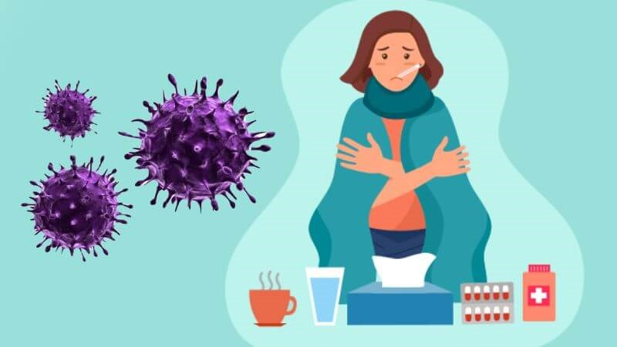
HOMEWORK
Write a paragraph about
what a patient infected with INFLUENZA A should do.

Slide 24
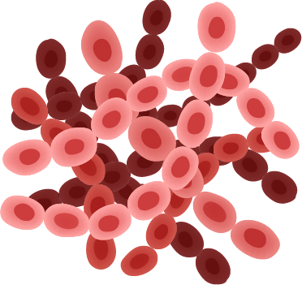
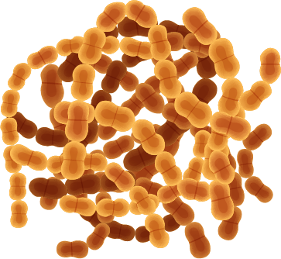
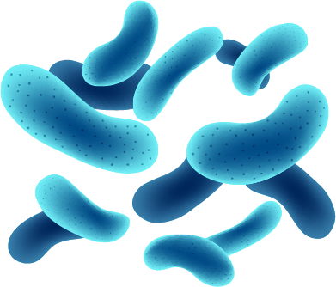
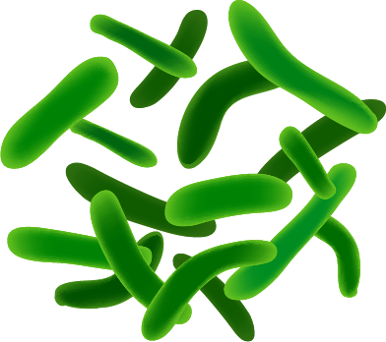
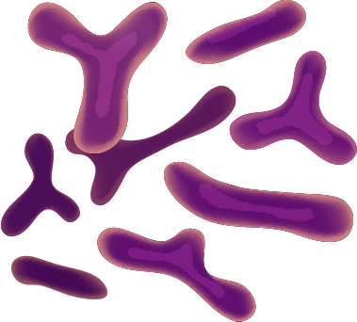
THANK YOU

