Slide 1


Unit 9: social issues
Lesson 7: communication & culture/ clil
Saturday 23rd March 2024

Slide 2
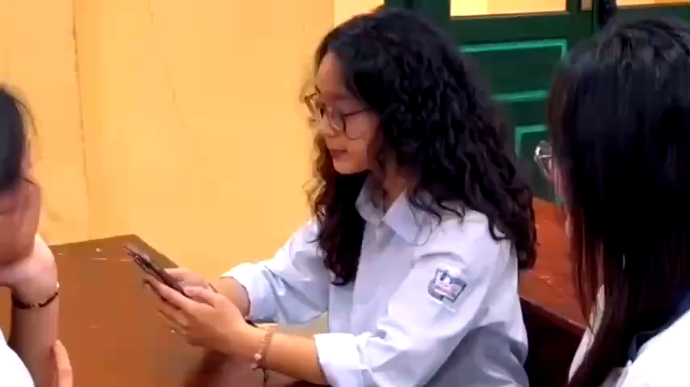

Slide 3





Question 1
Question 2
What problems is this student facing?
Are there any other social problems that teenagers or even you are facing?

Slide 4
Question 1
Question 2
Depression
Cyberbullying
Peer pressure
Pressure from parents’ expectation
Academic pressure
Financial problems
Drinking and smoking/ drug abuse
Self-esteem & body image
Social media or cyber addiction

Slide 5

UNIT 9: SOCIAL ISSUES
Lesson 7: Communication & Culture/CLIL

Slide 6
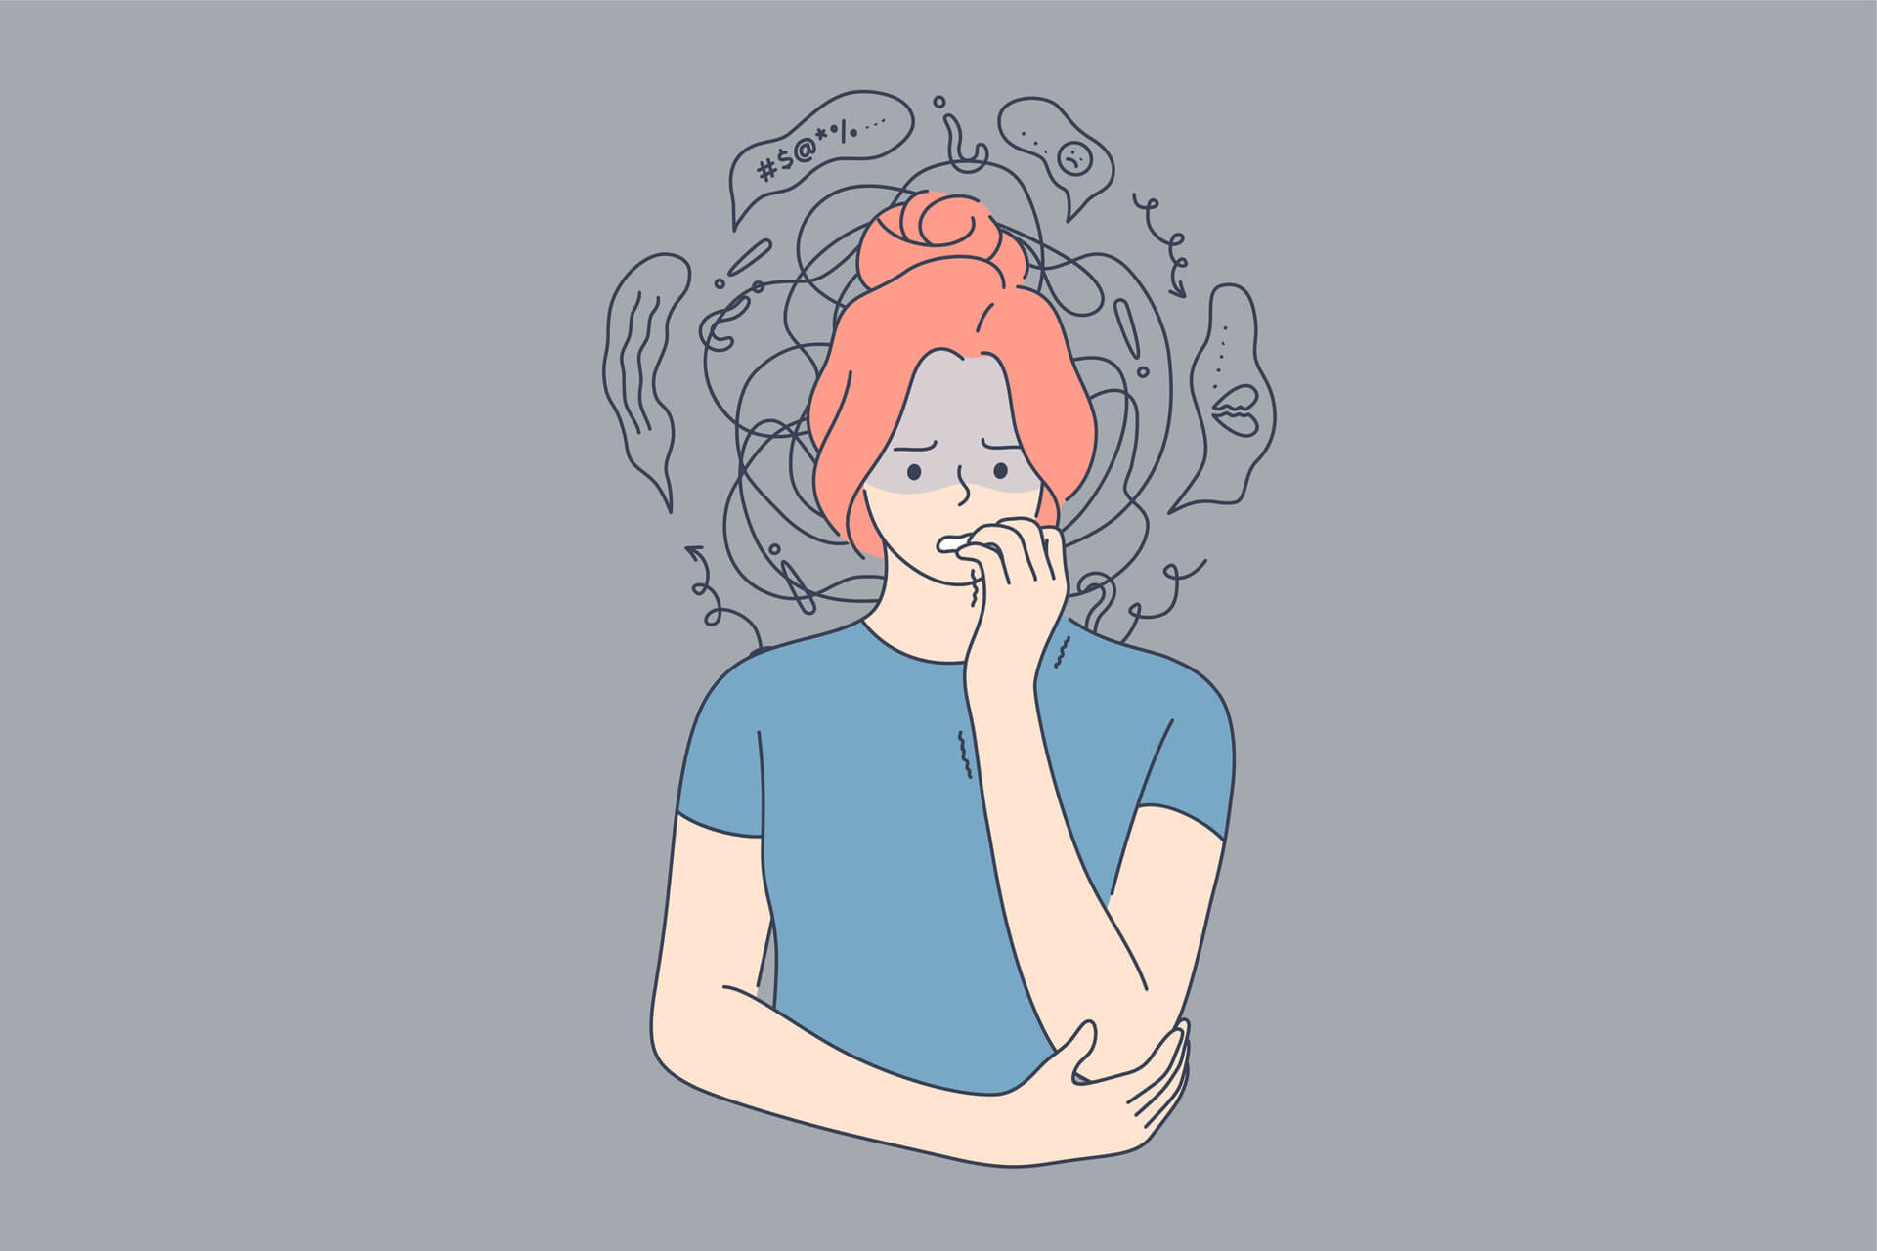
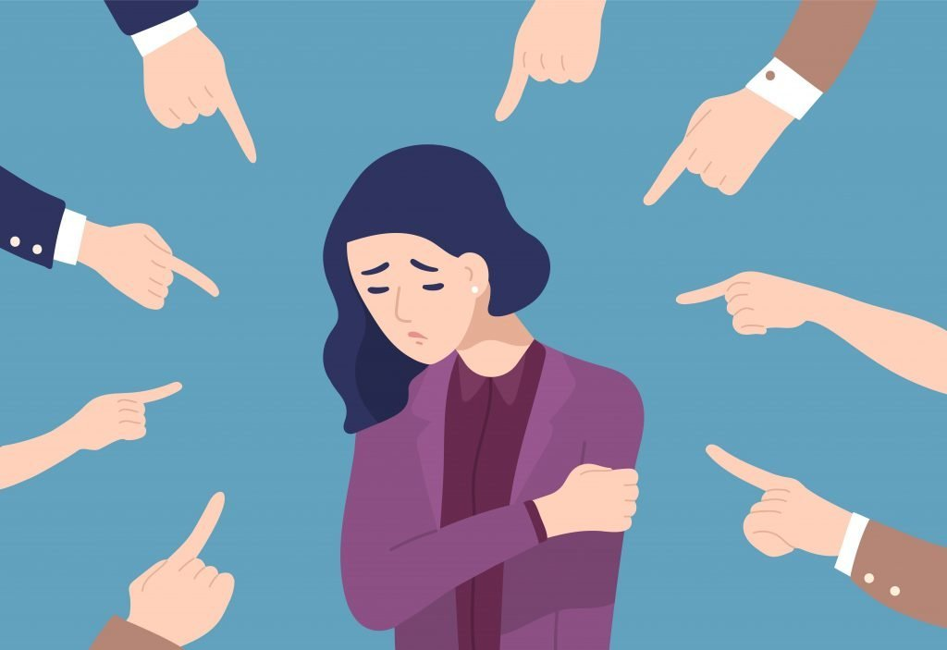
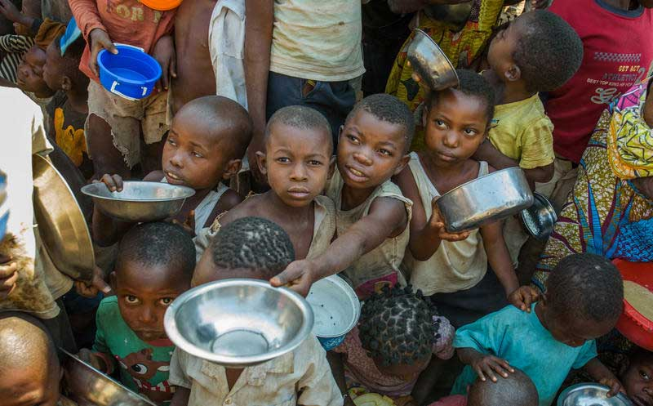

anxiety
victim
sympathy
below the poverty line

Slide 7
anxiety
victim
below the poverty line
sympathy

Slide 8
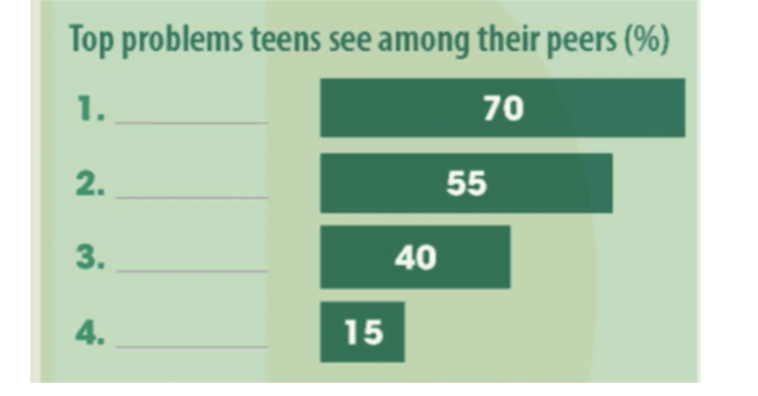
Read the text and match each percentage in the chart with ONE social problem mentioned in the text
In many countries around the world, it is not easy growing up because teens are dealing with many social issues. A study carried out by a famous research centre in the US found out that the following were among the most serious ones.
Anxiety and depression: Seven in ten teenagers considered them a serious problem among their peers. The main source of teenagers’ anxiety and depression was social pressure, such as the pressure to look good, to fit in social groups, and to be good at sport.
Bullying: 55% said that bullying was a major problem for teenagers, and around 15% admitted that they had experienced some form of cyberbullying. Girls or younger students were more likely to be victims of bullying.
Poverty: Four out of 10 teens said that poverty was also a major problem for them. In fact, about 20% of the teens in the survey struggled to live below the poverty line every day.
The survey results suggest that more support should be provided to help teenagers avoid serious social issues and enjoy a happier life.

Slide 9
SCREEN

Slide 11
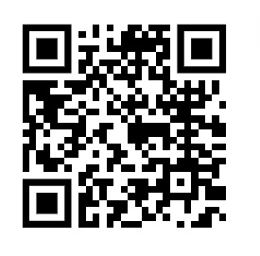
ONLINE SURVEY: SOCIAL PROBLEMS FACING TEENS IN VIETNAM TODAY

Slide 12
SURVEY

Slide 13
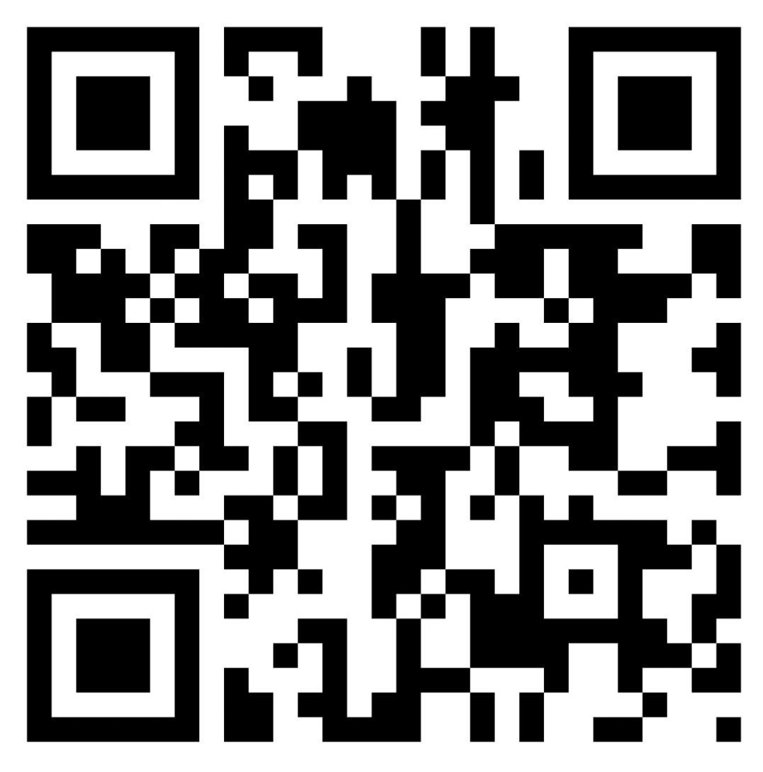
POST AND SHARE YOUR DISCUSSION ON PADLET.COM

Slide 14
Viet Nam
Parents’ expectations
America
Racial discrimination
Study pressure
Lack of psychological consultation
Freedom
Social development

Slide 15




ROLE-PLAY
Teachers
Parents
Friends
Psychologists

Slide 16
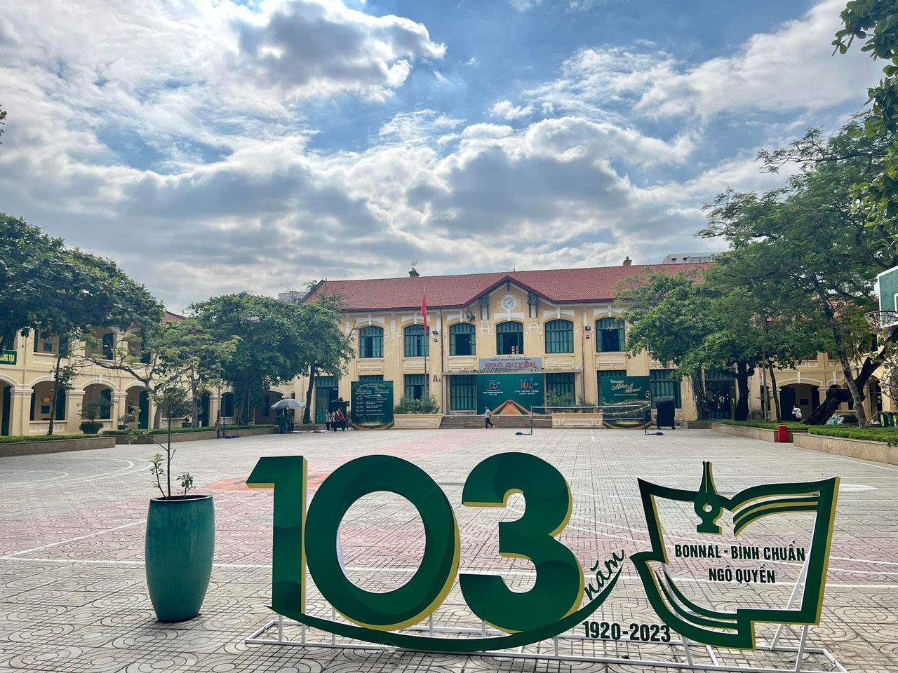

Slide 17

PSYCHOLOGY CLINIC

Slide 18




Facts
Causes
Solutions
Social problems facing teens in the US and Viet Nam today
The reasons why there exist the differences or similarities in the rates of teens facing social problems in the US and Viet Nam
Solutions to social problems facing teens in Viet Nam from different perspectives

Slide 19





HOMEWORK
  Write a short paragraph to describe the chart in details.
  Students write a short paragraph to reflect on themselves: What solution(s) do you find useful for yourself when coping with social problems?
.

Slide 20
THANK YOU FOR YOUR PARTICIPATION !

