Slide 1
Unit 2: Humans And
The Environment
Lesson 4: Speaking
Living green

Slide 2

Unit
1
1
Unit
OBJECTIVES
By the end of this lesson, students will be able to:
1. Knowledge
- talk about ways to live green.
2. Core competence
- be collaborative and supportive in pair work and team work;
- develop presentation skills;
- actively join in class activities;
- be critical thinking.
3. Personal qualities
- recognise what activities teenagers should do to live green;
- be aware of the importance of a green lifestyle.

Slide 3
TABLE OF CONTENTS
01
02
03
04
Warm-up
Pre-speaking
While-speaking
Consolidation

Slide 4
01
Warm-up
Game: Board Race

Slide 5
WARM-UP
Board race
There are 4 teams;
Find the words which are related to the topic Green living;
Each word has a letter in the topic word.
+ If the word begins with a letter in the topic word, the team gets 1 point.
+ If the letter of the topic word appears in the middle position, the team gets 2 points.
+ if the letter of the topic word is at the end of the word, the team gets 3 points.

Slide 6
WARM-UP
Board race
For example, if the topic word is FILMS and with the words found in the table below, a team gets 9 points in total.
 |  |  |  |  |  | F | A | M | O | U | S | (1 point)
 |  |  | M | O | V | I | E |  |  |  |  | (2 points)
 |  |  |  |  |  | L | O | V | E |  |  | (1 point)
 |  | C | I | N | E | M | A |  |  |  |  | (2 points)
A | C | T | R | E | S | S |  |  |  |  |  | (3 points)
Total |  |  |  |  |  |  |  |  |  |  |  | 9 points

Slide 7
02
Pre-speaking

Slide 8
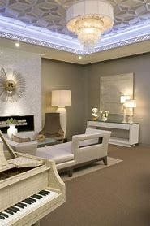

PRE-SPEAKING
leave something on (idiom)
/liːv ˈsʌmθɪŋ ɒn/
choose to keep something operational or switched to an "on" position.
không tắt

Slide 9

PRE-SPEAKING
chemical (n)
/ˈkemɪkl/
a substance obtained by or used in a chemical process
hóa chất

Slide 10
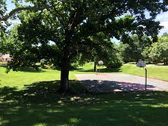
PRE-SPEAKING
shade (n)
/ʃeɪd/
slight darkness caused by something blocking the direct light from
bóng mát, bóng râm

Slide 11
PRE-SPEAKING
Form | Pronunciation | Meaning
leave something on (idiom) | /liːv ˈsʌmθɪŋ ɒn/ | make or allow something to remain in working condition
chemical (n) | /ˈkemɪkl/ | a substance obtained by or used in a chemical process
shade (n) | /ʃeɪd/ | slight darkness caused by something blocking the direct light from the sun

Slide 12


Slide 13


Slide 14

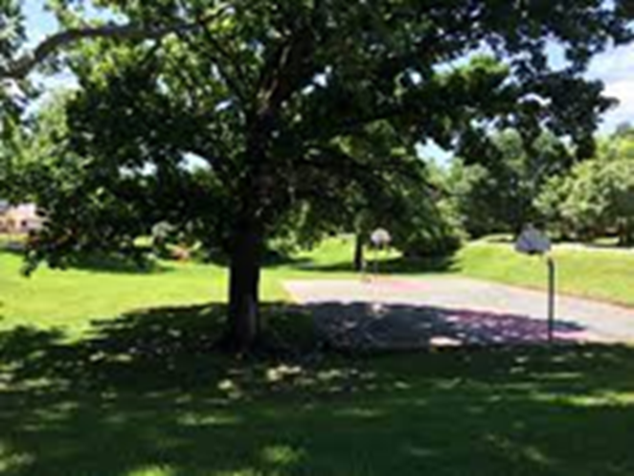
chemical
Click on the right picture
NEXT

Slide 15
leave something on
Click on the right picture
NEXT

Slide 16
shade
Click on the right picture

Slide 17
PRE-SPEAKING
1
Which of the following activities do you think teenagers should or shouldn’t do to live green? Put a tick in the appropriate column.
Activities | Should | Shouldn’t
1. Leaving your appliances on when not in use
2. Recycling your used items
3. Using plastic bags when shopping
4. Buying organic food
5. Dropping litter in the street
6. Planting trees
✔
✔
✔
✔
✔
✔

Slide 18
PRE-SPEAKING
2
The table below presents the reasons why teenagers should or shouldn’t do the activities in 1. Work in pairs and match them with the activities.
Reasons | Activities
a. This makes the street dirty and polluted.
b. This wastes electricity and creates dangerous situations.
c. It takes years for the material to break down into small pieces.
d. This reduces the use of harmful chemicals in food.
e. This protects natural resources.
f. They provide shade and fresh air.
5. Dropping litter in the street
1. Leaving your appliances on when not in use
3. Using plastic bag when shopping
4. Buying organic food
2. Recycling your used items
6. Planting trees

Slide 19
03
While-speaking

Slide 20
WHILE-READING
PRACTICE
3
Work in groups. Discuss and present your ideas about what you should or shouldn't do to live green.
Game: Passing the ball
Rules:
A song is played while students are passing a ball one by one.
When the music stops, the student who keeps the ball will make a presentation.
Example: There are many things that we should or shouldn’t do to live green. We should recycle our used items so that we can protect natural resources. We shouldn’t drop litter in the street because this will make the street dirty and pollute the environment.

Slide 21
04
Consolidation

Slide 22
CONSOLIDATION
1
Wrap-up
WHAT HAVE WE LEARNT TODAY?
Activities and the reasons why we should or shouldn’t do to live green.
2
Homework
Do exercises in the workbook
Prepare for the listening lesson

Slide 23
SEE YOU NEXT TIME !!

