Slide 1
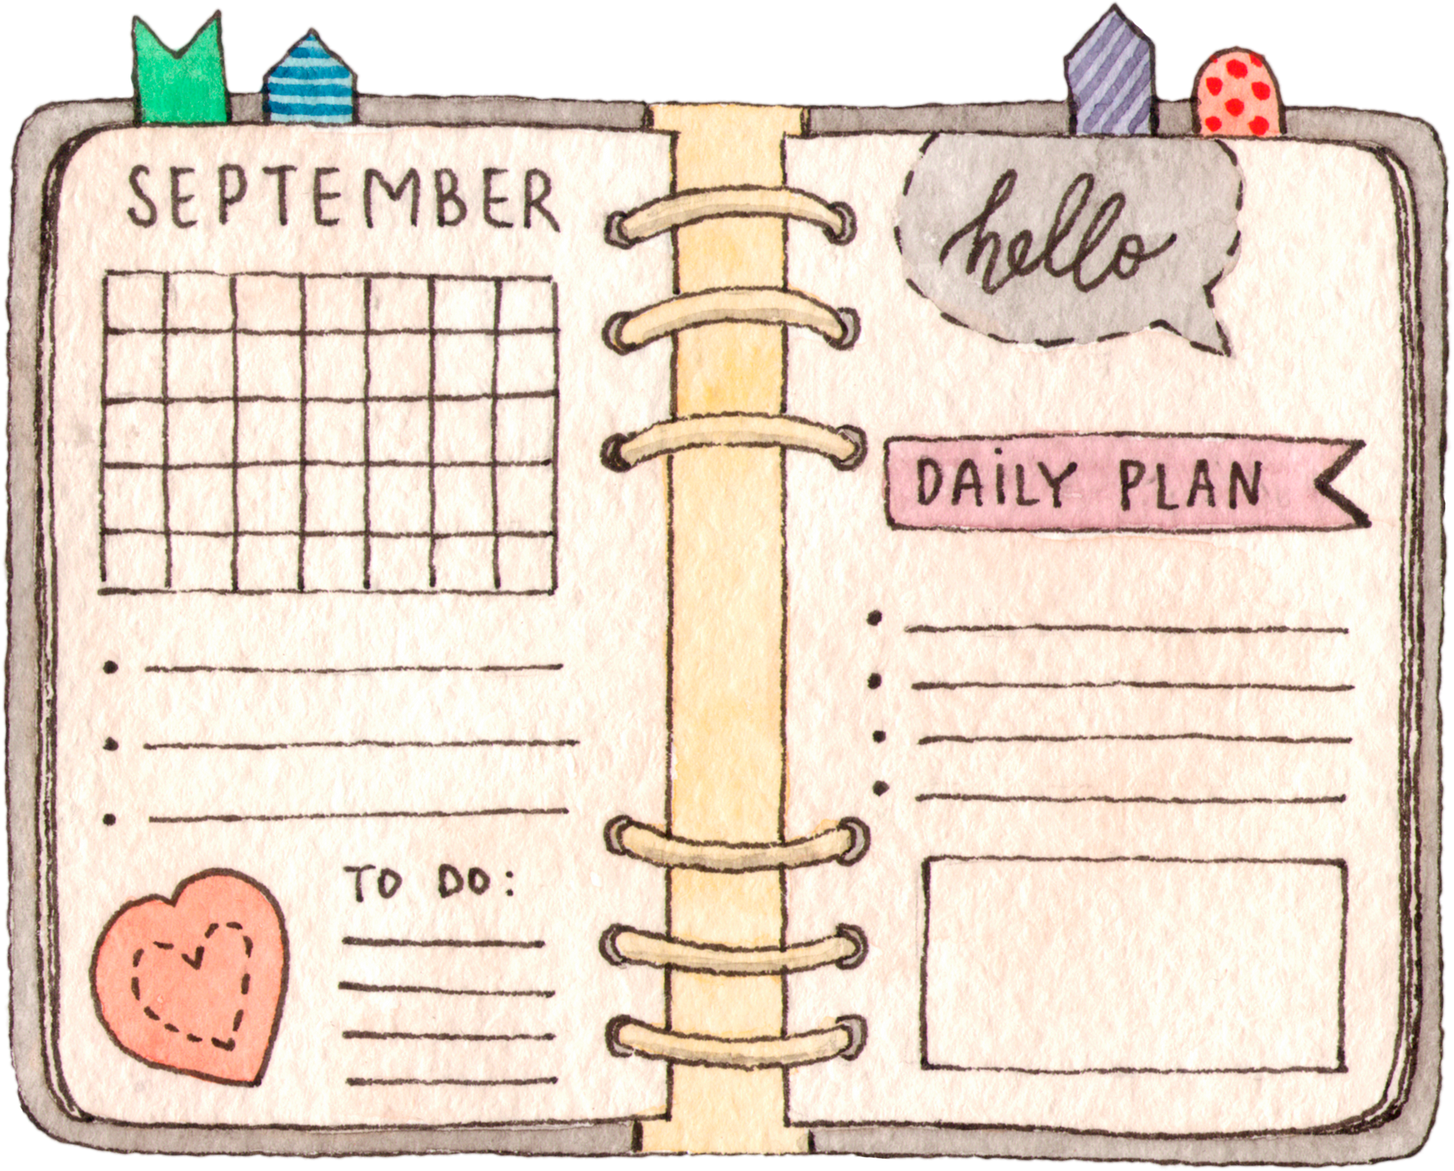


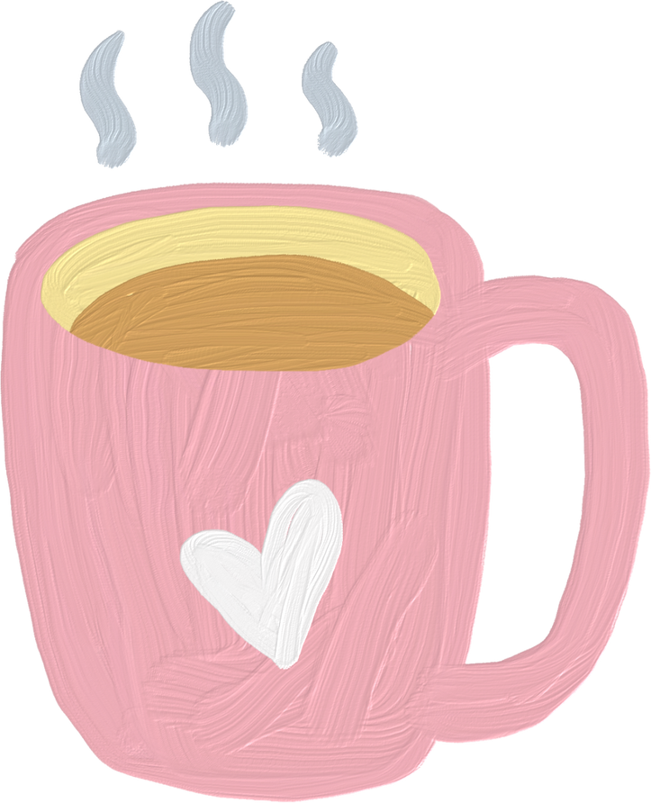

UNIT1
Family Life
LESSON 2
LANGUAGE
Name :
CÔNG THÀNH+TRỌNG QUYỀN

Slide 2

WARM-UP

Slide 3

WARM-UP
GUESS THE WORD!
There are 8 pictures related to the topic “Family life”.
You have 5 seconds to think, then guess the word corresponding to the picture.
Correct answer → +1
Wrong answer → -1

Slide 4


Split (v)
VOCABULARY

Slide 5
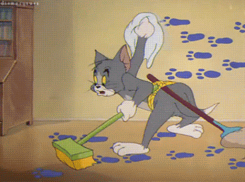
Chore (n)
VOCABULARY

Slide 6
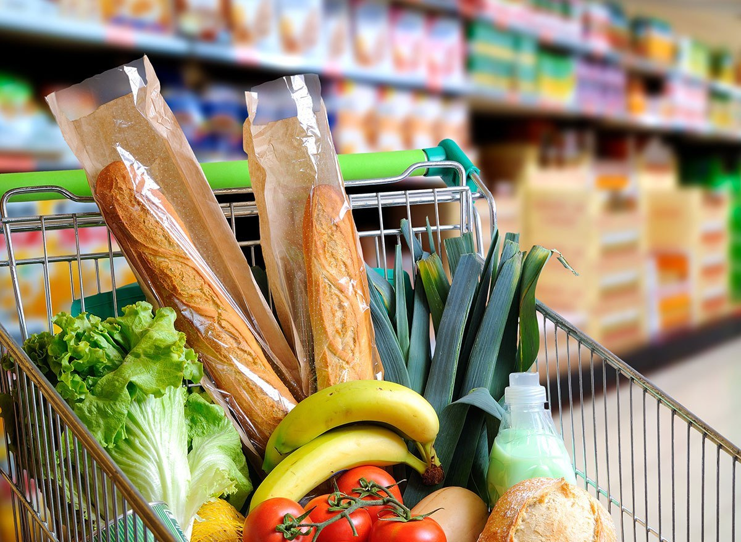
Groceries (n)
VOCABULARY

Slide 7
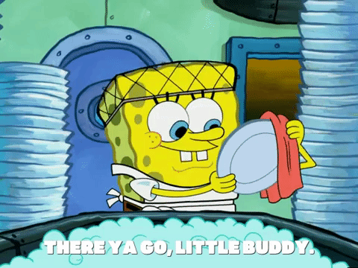
Washing-up (n)
VOCABULARY

Slide 8


Breadwinner (n)
VOCABULARY

Slide 9
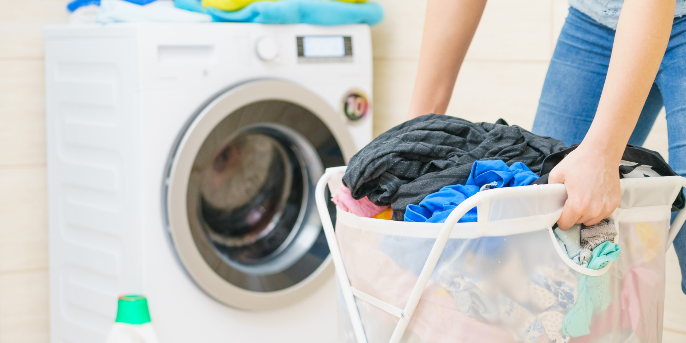
Laundry (n)
VOCABULARY

Slide 10
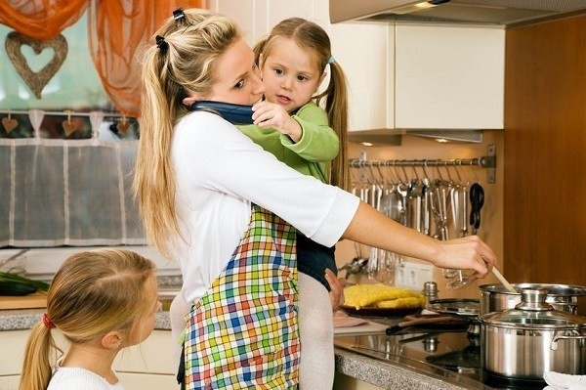
Homemaker (n)
VOCABULARY

Slide 11
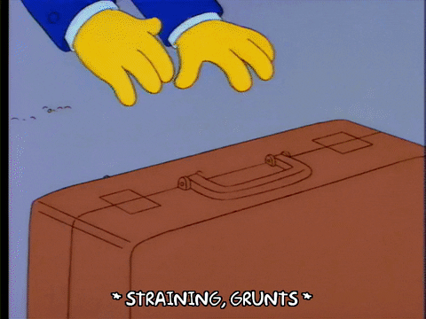
Heavy lifting (n)
VOCABULARY

Slide 12

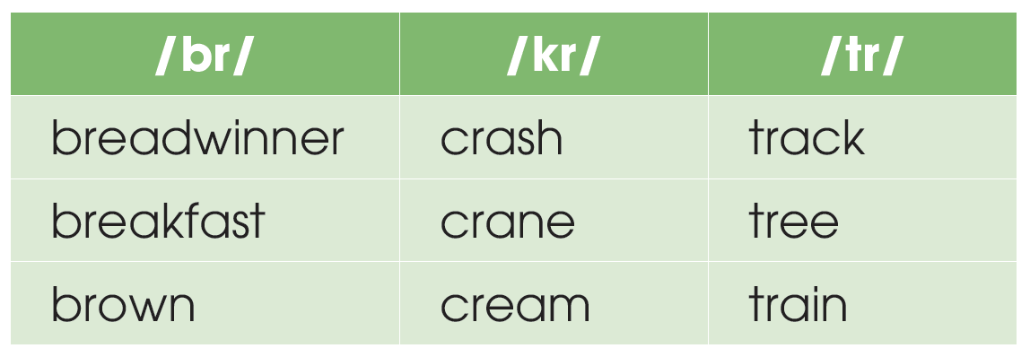
PRONUNCIATION
1
Listen and repeat. Pay attention to the consonant blends /br/, /kr/, and /tr/.

Slide 13
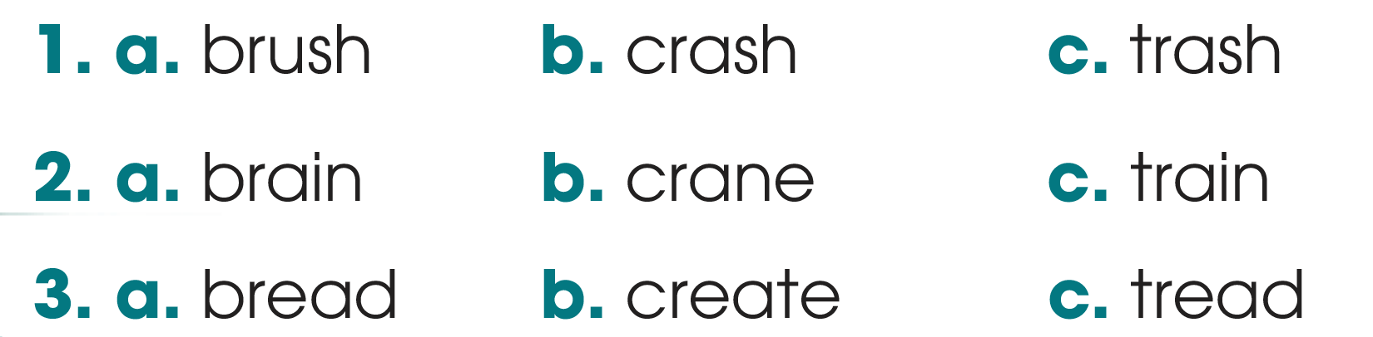
PRONUNCIATION
2
Listen to the sentences and circle the words you hear.

Slide 14

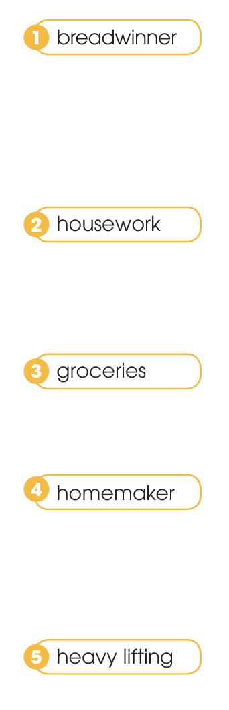
VOCABULARY
1
Match the words with their meanings.
a. a person who manages a home and often raises children instead of earning money
b. someone who earns money to support their family
c. picking up and carrying heavy objects
d. work around the house such as cooking, cleaning or washing clothes
e. food and other goods sold at a shop or a supermarket

Slide 15
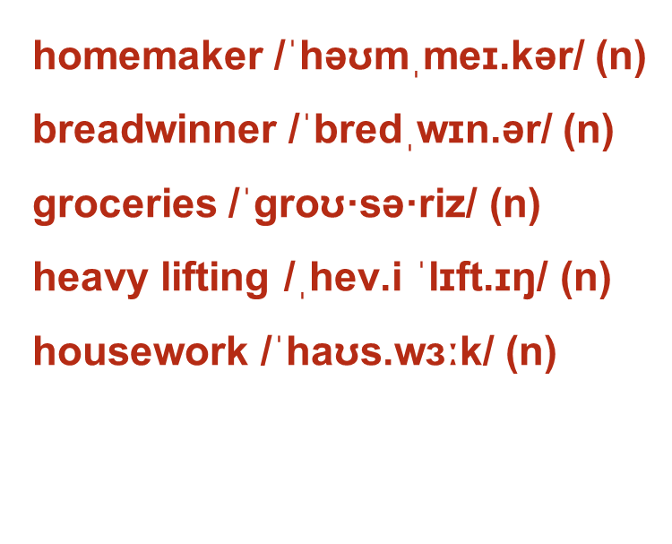
VOCABULARY
người nội trợ
trụ cột gia đình
thực phẩm và tạp hóa
mang vác nặng
việc nhà

Slide 16

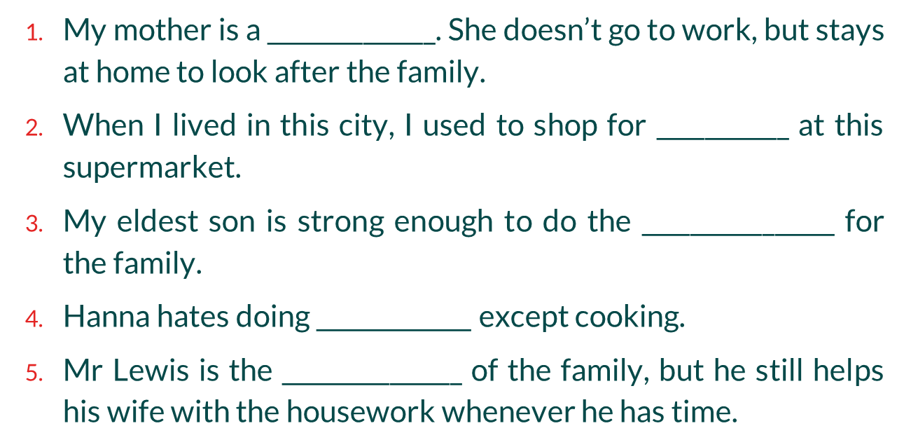




VOCABULARY
2
Complete the sentences with the words in Task 1.

Slide 17
GRAMMAR
Present continuous
to talk about things which are happening at the moment of speaking.
Example: My mother isn’t cooking now. She’s working in her office.
Present simple
to talk about habits or things we do regularly.
Example: My mother cooks every day.

Slide 18
Present simple vs. Present continuous
GRAMMAR
 | Present simple | Present continuous
Signal words | usually, always, every day, often, never, seldom… → adverbs of frequency | now, at the moment, at present, presently,…
Example | I listen to music every day. He never eats cheese. She is always cheerful. | I am listening to music now. He isn’t eating cheese at the moment.

Slide 19
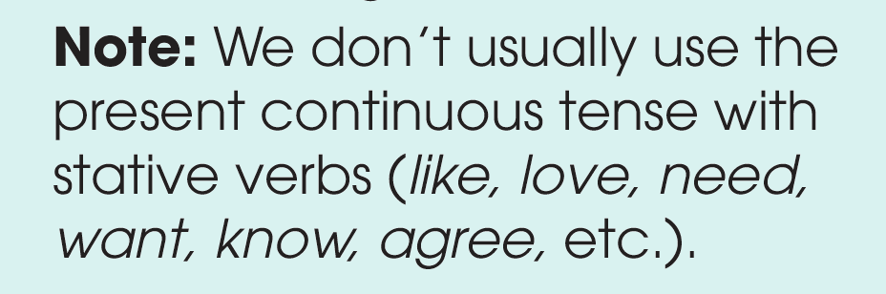
Remember!
GRAMMAR

Slide 20
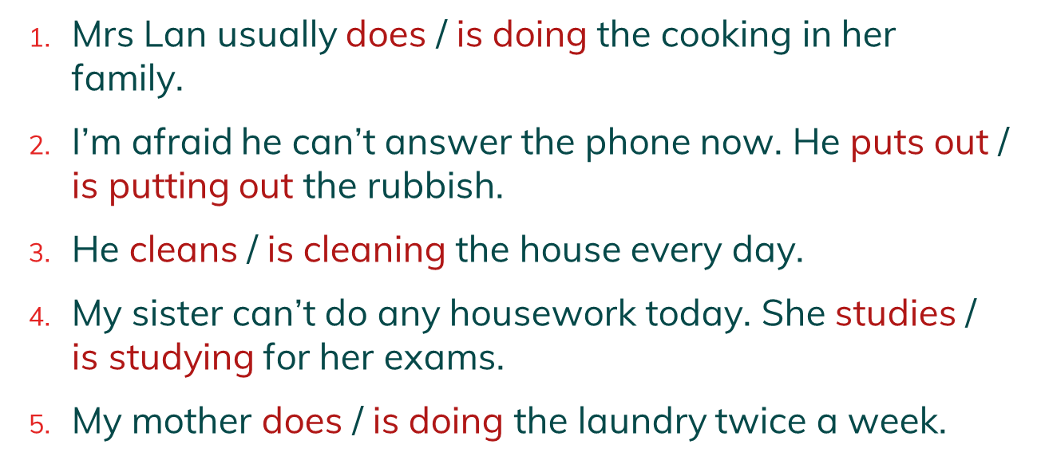
GRAMMAR
1
Choose the correct form of the verb in each sentence.

Slide 21
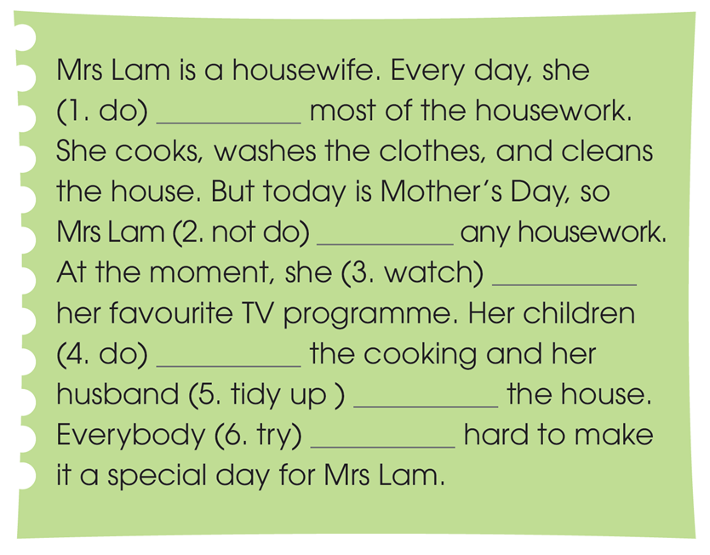
GRAMMAR
2
Read the text and put the verbs in brackets in the present simple or present continuous.
does
isn‘t doing
is watching
are doing
is tidying up
is trying

Slide 22
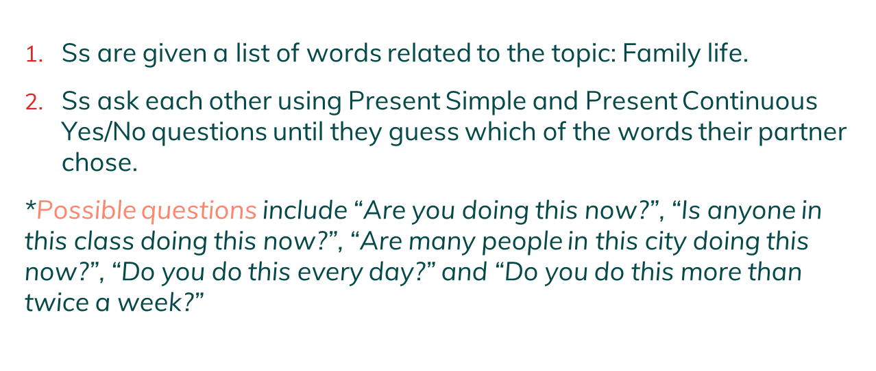
GAME
EXTRA ACTIVITY

Slide 23





FISHING GAME
GO

Slide 24


Question 1: He ( go ) to school everyday
C.right
A.Gone
D.Is going
C.goes
B.Are go

Slide 25
Question 2: I ( not read ) a book at the moment
D.right
A.reads
B.don’t read
C.Is reading
D. Am not reading

Slide 26
Question 3: look! The train ( come )
A.right
A.Is coming
D.Came
C. Do ... Come ?
B.comes

Slide 27
Question 4: you (be ) a student ?
D.right
A.Are
B.was
C. Am
D were .

Slide 28
CONSOLIDATION
What have you learnt today?
- consonant blends /br/, /kr/, and /tr/
- some lexical items about household chores;
- present simple vs. present continuous

Slide 29
Homework
- Do exercises in the workbook.
- Prepare for Lesson 3 - Unit 1.

Slide 30
SEE YOU NEXT TIME !!

