Slide 1
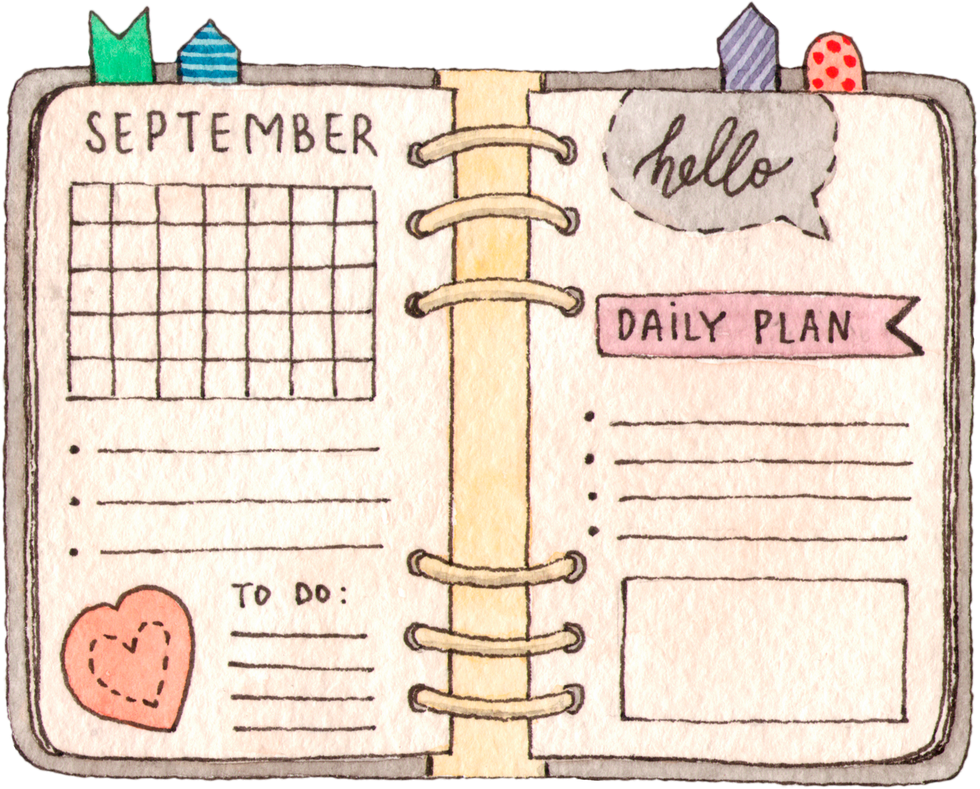


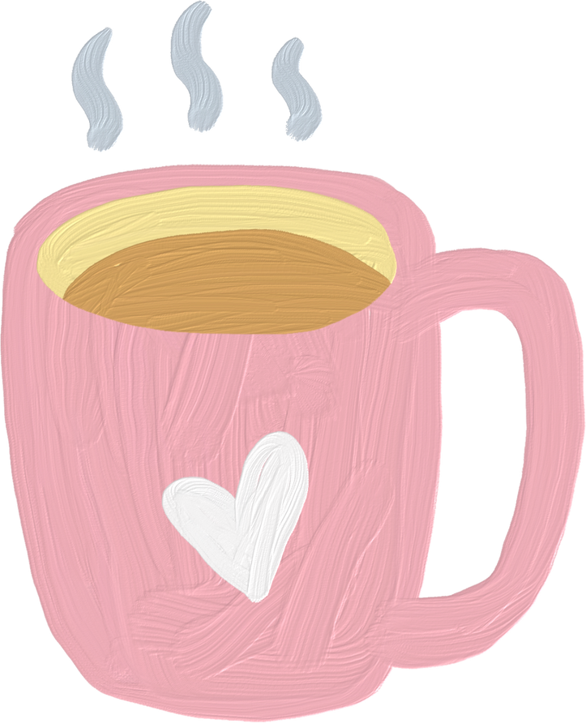

UNIT1
Family Life
LESSON 3
READING
Benefits of doing housework
Name :
CÔNG THÀNH+TRỌNG QUYỀN

Slide 2
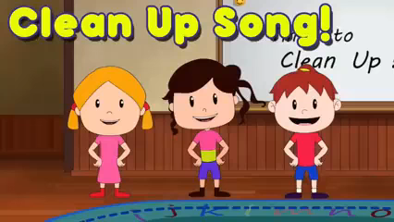
WARM-UP

Slide 3
WARM-UP
How to play?
- Work in 4 groups.
- In 3 minutes, list down (as much as possible) housework that you think mom, dad and kids usually do.
- After you finish, 1 representative from each group comes and writes on the board.
- The 1st group to finish says ‘STOP THE BUS’ and the others stop writing.

Slide 4
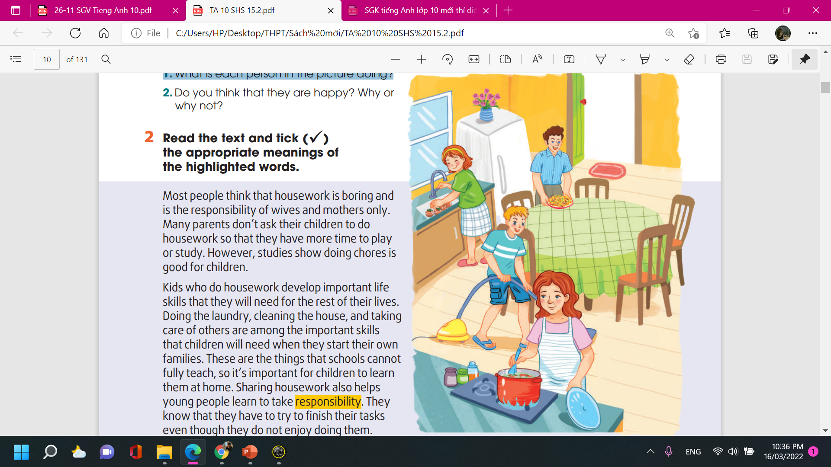
PRE-READING
1
Work in pairs. Look at the picture and answer the questions.
1. What is each person in the picture doing?
→ The mother is cooking; the father is laying the table; the son is cleaning (vacuuming) the floor; the daughter is washing vegetables.
2. Do you think that they are happy? Why or why not?
→ The people are happy because they are doing housework together and all the family members are sharing the household chores.

Slide 5
WHILE-READING
2
Read the text and tick the appropriate meanings of the
highlighted words.
responsibility a. duty b. hobby | 4. bonds a. close connections b. common interests
2. gratitude a. the feeling of being great b. the feeling of being grateful | 5. character a. qualities that make a person the same as others b. qualities that make a person different from others
3. strengthen a. make something stronger b. make something more difficult
✓
✓
✓
✓
✓

Slide 6
Vocabulary
WHILE-READING
responsible /rɪˈspɒnsəbəl/ (adj)
gratitude /ˈɡrætɪtʃuːd/ (n)
strengthen /ˈstreŋθən/ (v)
bond /bɒnd/ (n)
character /ˈkærəktər/ (n)
có trách nhiệm
lòng biết ơn
củng cố, làm mạnh
mối liên kết
tính cách

Slide 7
WHILE-READING
3
Read the text again and answer the questions.
What do most people think about housework?
Why don’t many parents make their children do housework?
What are some important life skills children can learn when doing housework?
What do children learn as they finish household tasks that they don't enjoy?
Why does sharing housework strengthen family bonds?

Slide 8
WHILE-READING
3
Read the text again and answer the questions.
1. What do most people think about housework?
→ Most people think that housework is boring and is the responsibility of wives and mothers only.
2. Why don’t many parents make their children do housework?
→ They want to give their children more time to play or study.
3. What are some important life skills children can learn when doing housework?
→ These are doing the laundry, cleaning the house, and taking care of others.

Slide 9
WHILE-READING
3
Read the text again and answer the questions.
4. What do children learn as they finish household tasks that they don't enjoy?
→ They learn that they have to try to finish their tasks even though they do not enjoy doing them
5. Why does sharing housework strengthen family bonds?
→ Because children learn to appreciate all the hard work their parents do around the house for them.
They also start treating doing household chores as special moments shared with their parents.

Slide 10
POST-READING
4
Work in pairs. Discuss the question.
What benefits do you think you can get from sharing housework?

Slide 11
CONSOLIDATION
What have we learnt today?
- Read for specific information in a text about the benefits of doing housework for children
- Understand the topic-related words introduced in previous lessons
- Use the topic-related words in meaningful contexts

Slide 12
Homework
Do exercises in the workbook
Prepare for the next lesson: Speaking

Slide 13
SEE YOU NEXT TIME !!

