Slide 1

Welcome to class

Slide 2

WARM-UP
Guess the name of the songs
Whose song is “Baby one more time”?
What kind of music is it?
It is a song of Britney Spears
SONG 1
Còn duyên
Folk music
Is she a talented singer?
SONG 2
Happy new year
Pop music
Yes, she is considered the Princess of Pop.
SONG 3
Ra khơi
Rock’n roll music
SONG 4
Baby one more time
Teen pop music
SONG 5
Tiến quân ca
National anthem

Slide 3
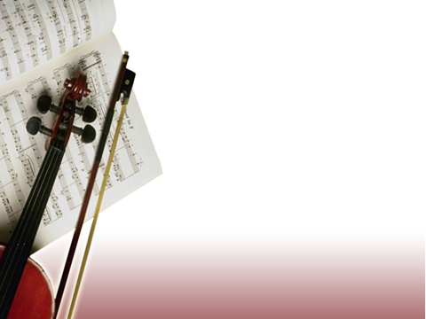
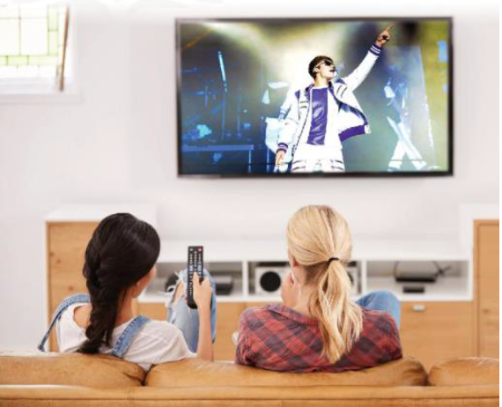
UNIT 3
MUSIC
Lesson 1 : Getting started
A talented artist

Slide 4
I. Vocabulary
1. Famous /ˈfeɪməs/ (adj): nổi tiếng
2. traditional music /trəˈdɪʃənl ˈ/ (n.phr):âm nhạc truyền thống
3. talented /ˈtæləntɪd/ (adj): tài năng
4. pop singer /pɒp ˈsɪŋə/ (n.phr): ca sĩ nhạc pop
5. fan /fæn/ (n): fan hâm mộ
6. award /əˈwɔːrd/ (n): giải thưởng
7. trumpet /ˈtrʌmpɪt/ (n): kèn
8. teenager /ˈtiːneɪdʒə(r)/ (n): thiếu niên
9. upload /ˌʌpˈləʊd/ (v): đăng tải
10. reach /riːtʃ/ (v): đạt mốc
11. be good at something /biːgʊd ætˈsʌmθɪŋ/:giỏi về việc gì đó
12. musical instrument / ˈmjuː.zɪ.kəl ˈɪn.strə.mənt/ : nhạc cụ
13. perform /pəˈfɔːm/ (v): biểu diễn

Slide 5
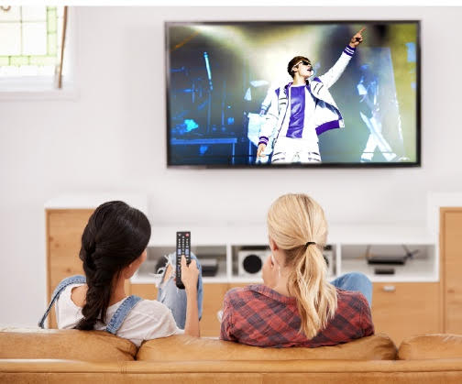
II. PRACTICE
A talented artist
Act 1. Listen and read.
Mai: That pop singer looks great, Ann!
Ann: Yeah. He’s a popular teen idol around the world now.
Mai: Really? You must be a fan of his!
Ann: Yep, I really love his music. He’s a talented artist who can write music and play many musical instruments. He has received several awards such as Grammy, Billboard Music and Teen Choice Awards.
Mai: Wow! Did he go to a music school?
Ann: No, he didn’t, but he learnt to play the piano, drums, guitar, and trumpet by himself. When he was a teenager, he performed at the local theatre in his home town during the tourist season.
Mai: How did he become famous?
Ann: Well, when he was 12, his mother started to upload his cover song videos on social media, and the videos made him an online star within a couple of months.
Mai: Sounds amazing!
Ann: And his videos have reached more than two billion total views. Many fans say that his beautiful songs have helped bring more love into their lives.

Slide 6
II. PRACTICE
PRACTICE
2. Read the conversation again and answer the following questions.
1. Who are Ann and Mai talking about?
2. What is he good at?
3. What made him popular?
(Line:1, 4- Mai 1: That pop singer looks great, Ann (4) He’s a talented artist ……….)
They are talking about a young pop singer, a talented artist.
(Line: 4, 5- He’s a talented artist who can write music and play many musical instruments.)
He is good at writing music and playing many musical instruments.
(Line: 14 when he was 12, his mother started to upload his cover song videos on social media, and the videos made him an online star within a couple of months.)
His cover song videos made him popular

Slide 7
II. PRACTICE
3. Find words or phrases in the conversation which refer to:
1. a type of music
2. music awards
3. musical instruments
4. ways of sharing information and videos
pop
Grammy, Billboard Music and Teen Choice Awards
piano, drums, guitar, and trumpet
social media

Slide 8
II. PRACTICE
4. Match the two parts to make complete sentences.
1. This artist didn’t go to a music school,
a. and he has received several awards.
b. to upload his cover song videos on social media.
2. His beautiful songs have helped
3. His mother started
c. bring more love to people’s lives.
d. but he learnt to play musical instruments by himself.
4. He is a talented artist,

Slide 9
III. Consolidation
Choose A, B, C or D to complete the sentences
1. Can you play any ____? - Yes. I can play the piano and the guitar.
A. musical tools B. pieces of music
C. musical instruments D. musical devices
2. He has received several _______ such as Grammy, Billboard Music and Teen Choice Awards
A. awards B. presents C. postcard D. medals
3. when he was 12, his mother started to _______ his cover song videos on social media
A. send B. post C. upload D. boast
4. Many fans say that his ______songs have helped bring more love into their lives.
A. beauty B. beautiful C. beautifully D. beautily

Slide 10
Homework
2
Do exercises in the workbook
Memorize vocabulary to talk about music idols and musical instruments
Prepare for language

Slide 11


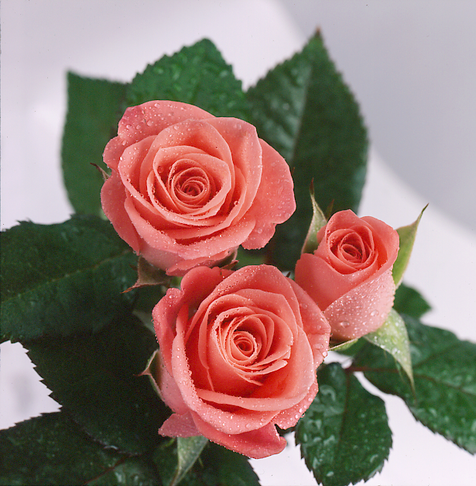
Thank you for your attendance

