Slide 1

Unit
3
1
FAMILY LFE
Unit
MUSIC
LESSON 2
LANGUAGE

Slide 2
Table of contents
01
02
03
Warm-up
Vocabulary
Pronunciation
04
05
Grammar
Consolidation

Slide 3

Unit
1
1
FAMILY LIFE
Family Life
Unit
OBJECTIVES
Pronounce two-syllable words with correct stress;
Understand and use words and phrases related to music;
Use conjunctions to make compound sentences;
Use to-infinitives and bare infinitives after some verbs.

Slide 4
01
Warm-up
Game: Board race

Slide 5
WARM-UP
Game: Board race
RULES:
4 teams
Find the words related to the topic Music;
Each word has a letter in the topic word.
+ If the word begins with a letter in the topic word: 1 point
+ If the letter of the topic word appears in the middle position: 2 points
+ If the letter of the topic word is at the end of the word: 3 points

Slide 6
WARM-UP
Game: Board race
E.g. If the topic word is FILMS and with the words found in the table below, a team gets 9 points in total.
 |  |  |  |  | F | A | M | O | U | S | (1 point)
 |  | M | O | V | I | E |  |  |  |  | (2 points)
 |  |  |  |  | L | O | V | E |  |  | (1 point)
 |  | C | I | N | E | M | A |  |  |  | (2 points)
A | C | T | R | E | S | S |  |  |  |  | (3 points)
 |  |  |  |  |  |  |  |  |  |  | 9 points

Slide 7
02
Pronunciation

Slide 8

PRONUNCIATION
1
Listen and repeat. Pay attention to the stressed syllable in each word.
Stress on the first syllable | Stress on the second syllable
singer programme common careful | relax perform attract decide

Slide 9
PRONUNCIATION
RULES
Stress in two-syllable words
1. Most two-syllable nouns and adjectives have stress on the first syllable except for the ones ending with oo, oon.
E.g. + table /ˈteɪbl/, climate /ˈklaɪmət/, happy /ˈhæpi/, clever /ˈklevə(r)/
+ bamboo /ˌbæmˈbuː/, balloon/bəˈluːn/
2. Most two-syllable verbs have stress on the second syllable except for the ones ending with ow, en, er, le, el, ish, y.
E.g. + appear /əˈpɪə(r)/, explain /ɪkˈspleɪn/
+ finish /ˈfɪnɪʃ/, harden /ˈhɑːdn/, suffer /ˈsʌfə(r)/, follow /ˈfɒləʊ/, carry /ˈkæri/, struggle /ˈstrʌɡl/, travel /ˈtrævl/

Slide 10
PRONUNCIATION
2
Listen and mark the stressed syllables in the words in bold.
1. She is a famous artist.
2. I enjoy his songs about friendship.
3. Their latest show received a lot of good comments.

Slide 11
PRONUNCIATION
3
Write down words with the same stress pattern.
social | upload

Slide 12
03
Vocabulary

Slide 13

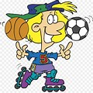
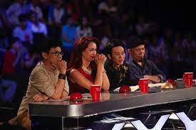


VOCABULARY
1
Match the words with their meaning.
a. having the ability to do something well
b. a music recording that has one song
1. perform (v)
c. to dance, sing or play music in order to interest or please people
4. talented (adj)
d. a person who decides on the results of a competition
2. judge (n)
e. the people who watch, read or listen to the same thing
5. single (n)
3. audience (n)
4. litter 5. eco-friendly

Slide 14


Slide 15







having the ability to do something well

Slide 16
the people who watch, read or listen to the same thing

Slide 17
to dance, sing or play music in order to interest or please people

Slide 18
a person who decides on the results of a competition

Slide 19
a music recording that has one song

Slide 20
04
Grammar

Slide 21
GRAMMAR: COMPOUND SENTENCES
Simple Sentence | Compound Sentence
E.g. - The cat chased the mouse. - The mouse ran into a hole. | E.g. - The cat chased the mouse, and the mouse ran into the hole. - The mouse ran into the hole, so the cat couldn’t catch the mouse.
A compound sentence contains two or more independent clauses.
Conjunctions (for, and, nor, but, or, and yet, so) join these independent clauses. (Hint: The conjunctions spell FANBOYS.)
The conjunction used can impact the meaning of the sentence.

Slide 22
GRAMMAR: COMPOUND SENTENCES
Make compound sentences using the correct conjunctions in brackets.
I am a jazz fan. My favourite style is from the late 1960s. (and/ but)
2. Jackson wants to go to the music festival on Saturday. He has a maths exam on that day. (but/ so)
3. You can book the tickets online. You can buy them at the stadium ticket office. (but/ or)
4. The concert didn’t happen. We stayed at home. (or/ so)
➔ I am a jazz fan, and my favourite style is from the late 1960s.
➔ Jackson wants to go to the music festival on Saturday, but he has a maths exam on that day.
➔ You can book the tickets online, or you can buy them at the stadium ticket office.
➔ The concert didn’t happen, so we stayed at home.

Slide 23
GRAMMAR: TO-INFINITIVE AND BARE INFINITIVE
Verbs followed by to-infinitive (to + V) |  | Verbs followed by bare infinitive (V)
agree afford arrange decide demand expect fail happen hesitate hope intend | 12. learn 13. manage 14. offer 15. plan 16. pretend 17. promise 18. refuse 19. seem 20. tend 21. threaten 22. want | 1. Modal verbs: can, may, must, would, should, could, may, might … E.g. I can dance gracefully. He should stop smoking 2. would rather/ would sooner, had better E.g. I would rather stay at home than go out on such a rainy night. You had better tell him the truth. 3. make, let, see, hear, feel, watch, notice + Object E.g. I saw her get off the bus. The police made the thief raise his hands. In the passive voice, these verbs are followed by a to-infinitive except “let”. E.g. The thief was made to raise his hands. 4. have sb E.g. I am going to have someone repaint my house.

Slide 24
PRACTICE
GRAMMAR: TO-INFINITIVE AND BARE INFINITIVE
Complete the following sentences, using the to-infinitive or bare infinitive of the verbs in brackets.
Her fans planned (send) __________ her a surprise present on her birthday.
Their performance was so boring that it made us (fall) __________ asleep.
Due to the bad weather, the band decided (delay) ___________ their live concert.
Her parents won’t let her (watch) ___________ such TV shows.
to send
fall
to delay
watch

Slide 26
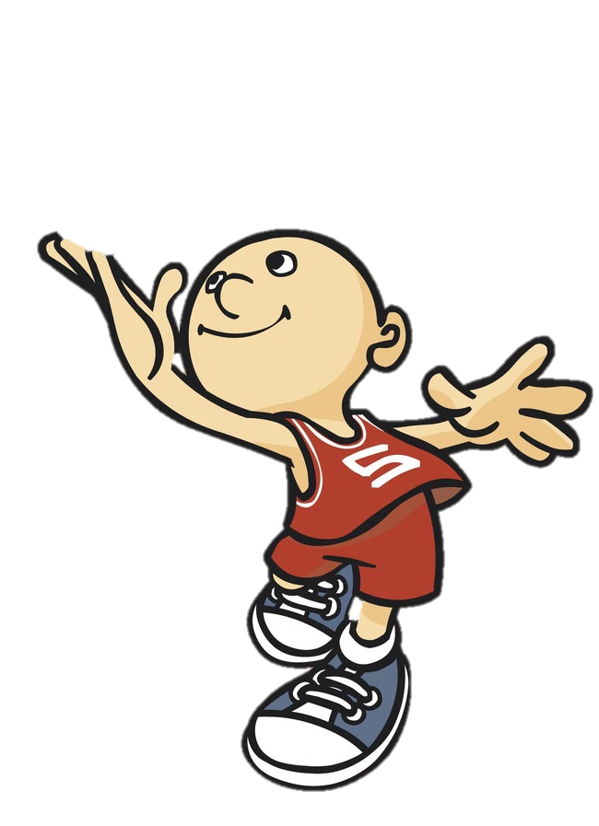

Play
To V
V
Infinitive
Bare infinitive

Slide 27



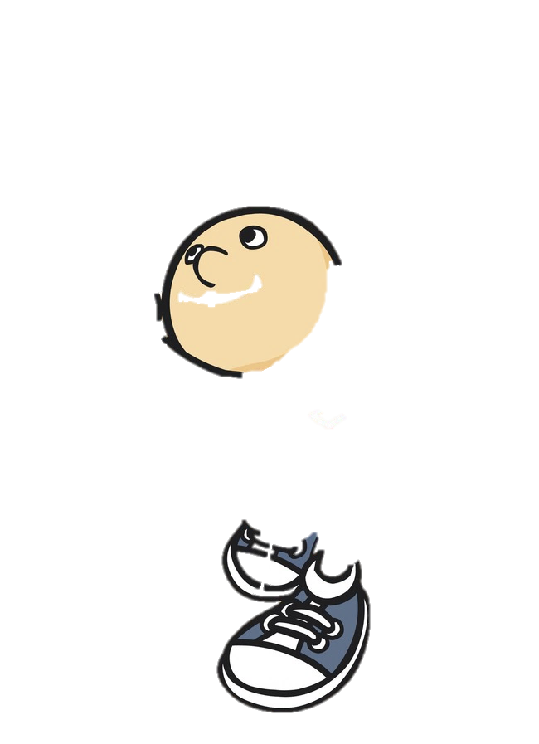

To V
V
She intends ………….. (leave) the company.
to leave

Slide 28
To V
V
to be
We expect ……….. (be) landing at London soon.

Slide 29
To V
V
Let it ……… (rain).
rain

Slide 30
To V
V
On cold mornings, the car may refuse ……………. (start).
to start

Slide 31
To V
V
Would you rather ….. (eat) now or later?
eat

Slide 32
PRODUCTION
PRACTICE
Make compound sentences in which there is a to-infinitive or bare infinitive.
RULES:
+ One correct compound sentence: 1 points
+ Using to-infinitive or bare infinitive in your compound sentence: 2 points
+ Using both to-infinitive or bare infinitive and a word related to the topic Music in your compound sentence: 3 points
For example:
The cat chases, and the mouse runs. (1 point)
The singer started to sing, but many audiences were still talking. (3 points)

Slide 33
05
Consolidation

Slide 34
CONSOLIDATION
1
Wrap-up
Learn how to pronounce two-syllable words with correct stress;
Understand and use words and phrases related to music;
Use conjunctions to make compound sentences;
Use to-infinitives and bare infinitives after some verbs.

Slide 35
CONSOLIDATION
2
Homework
Do exercises in the workbook.

Slide 36
THANK YOU

