Slide 1

Unit
3
1
FAMILY LFE
Unit
MUSIC
LESSON 3
READING

Slide 2

Unit
1
1
FAMILY LIFE
Family Life
Unit
OBJECTIVES
Read for specific information in a text about a famous TV music show;
Guess the meaning of words/phrases in context;
Talk about reasons why they want or don’t want to participate in a music competition.

Slide 3
Table of contents
01
02
03
Warm-up
Pre-reading
While-reading
04
05
Post-reading
Consolidation

Slide 4
01
Warm-up
Watch a video

Slide 5
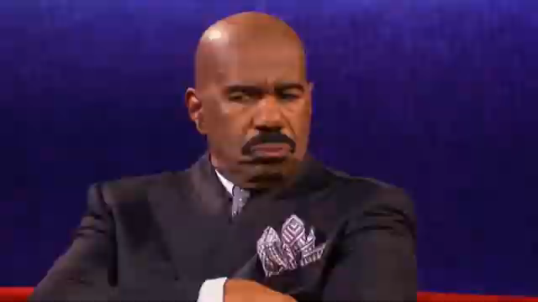

Slide 6

Have you ever watched a famous TV show?
What are they?
Do you like them? Why?

Slide 7
02
Pre-reading

Slide 8
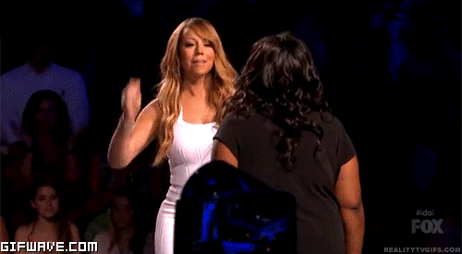

VOCABULARY
reality (n)
/riˈæləti/
using real people (not actors) in real situations, presented as entertainment
thực tế

Slide 9
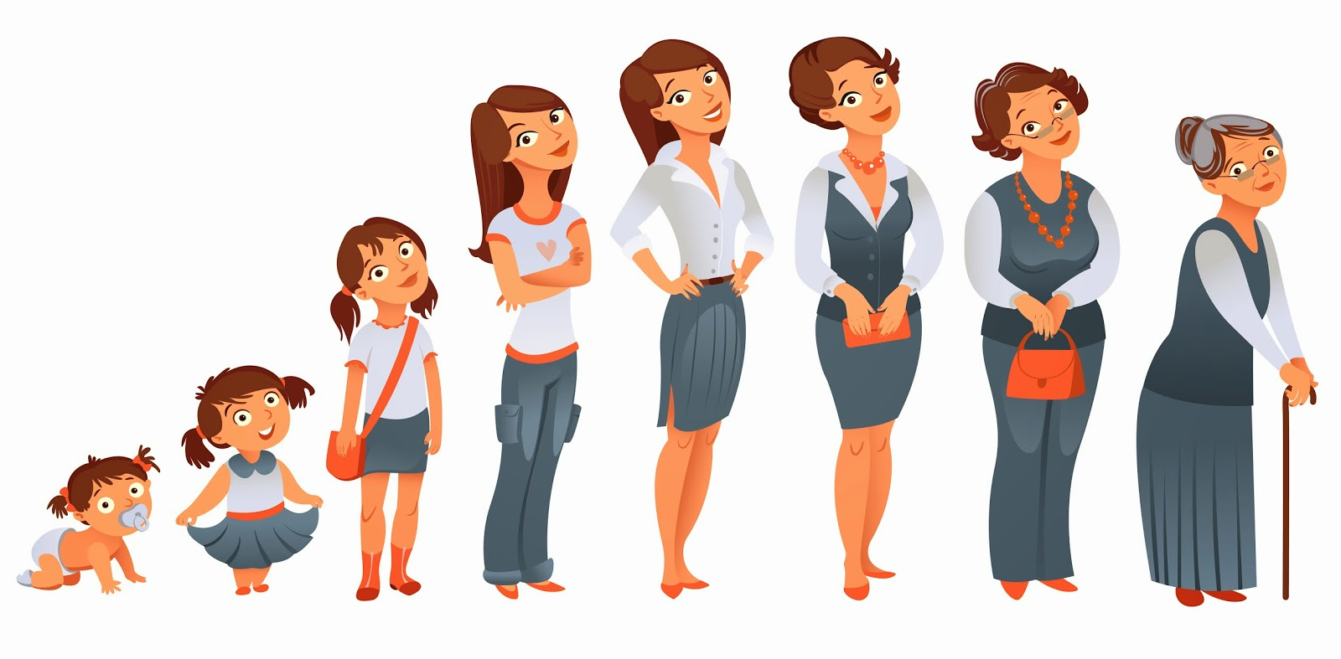
VOCABULARY
stage (n)
/steɪdʒ/
a period or state that something/ somebody passes through while developing or making progress
giai đoạn, thời kì

Slide 10

VOCABULARY
semi-final (n)
/ˌsemi ˈfaɪnl/
one of the two games or parts of a sports competition that are held to decide who will compete in the last part
bán kết

Slide 11

VOCABULARY
play a role in (idiom)
/pleɪ ə rəʊl ɪn /
be involved in or have an effect on
đóng vai trò
Ex: Deciding to travel instead of going straight to college after high school played a major role in my life.

Slide 12
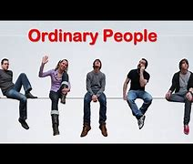
VOCABULARY
ordinary (adj)
/ˈɔːdnri/
not unusual or different in any way
thông thường, bình thường
E.g. Readers of the magazine said they wanted more stories about ordinary people and fewer stories about the rich and famous.

Slide 13
VOCABULARY
New words | Pronunciation | Meaning
reality (n) | /riˈæləti/ | using real people (not actors) in real situations, presented as entertainment
stage (n) | /steɪdʒ/ | a period or state that something/somebody passes through while developing or making progress
semi-final (n) | /ˌsemi ˈfaɪnl/ | one of the two games or parts of a sports competition that are held to decide who will compete in the last part (the final)
play a role in (idiom) | /pleɪ ə rəʊl ɪn / | be involved in or have an effect on
ordinary (adj) | /ˈɔːdnri/ | not unusual or different in any way

Slide 14


Slide 15



VOCABULARY REVIEW

Slide 16

What is this?
semi-final

Slide 17
What is this?
ordinary

Slide 18
What is this?
reality

Slide 19
What is this?
play a role in

Slide 20
What is this?
stage

Slide 21
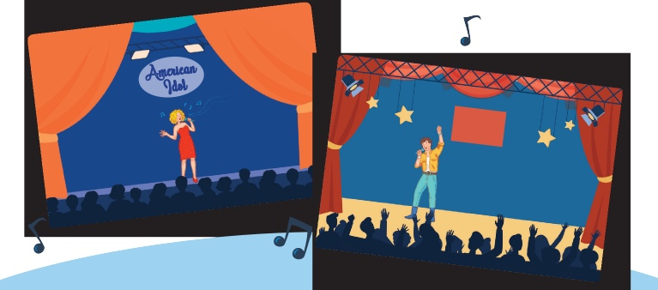
PRE-READING
1
Work in pairs. Look at the pictures and discuss the following questions.
What are these shows?
What do you know about them?

Slide 22
PRE-READING
1
Work in pairs. Look at the pictures and discuss the following questions.
What are these shows? What do you know about them?
American Idol: a famous TV music show...
The X Factor: a television singing competition originated in the United Kingdom. Competitors go through weeks of auditions before judges until the winner is decided by a public vote. The prize is usually a recording contract. In addition to giving comments on the contestants’ performance, the judges help them choose the songs and style of their songs. The format of the X Factor has been adopted in many countries around the world.

Slide 23
03
While-reading

Slide 24
WHILE-READING
2
Read a text about a famous music show. Match the highlighted words and phrases in the text to the meanings.
feel that they are similar to and can understand them
a set of TV or radio programmes on the same subject
removed from the competition
looking for
identify with
series
eliminated
in search of

Slide 26
WHILE-READING
3
Read the text again and choose the best answers.
1. What is American Idol?
A. A game show on TV
B. A TV singing contest
B. A TV singing contest
GIVE OR TAKE
-5
C. A live dancing competition

Slide 27
WHILE-READING
3
Read the text again and choose the best answers.
2. Which of the following statements is correct?
A. From the semi-final, singers who can go to the next stage are decided by the audience vote.
A. From the semi-final, singers who can go to the next stage are decided by the audience vote.
GIVE OR TAKE
+8
B. The judges choose as many singers as they can.
C. People around the world can vote for the songs they like.

Slide 28
WHILE-READING
3
Read the text again and choose the best answers.
3. Who wins American Idol?
A. The singer with the highest number of the votes on the final night.
A. The singer with the highest number of the votes on the final night.
GIVE OR TAKE
+2
B. The singer with the highest number of votes and highest scores from the judges.
C. The singer with the highest scores from the judges.

Slide 29
WHILE-READING
3
Read the text again and choose the best answers.
4. Which of the following statements about the judges is NOT mentioned?
A. They give comments after each live performance.
GIVE OR TAKE
+6
B. They have different views about the singers’ performances.
C. They are not in favour of choosing ordinary people.
C. They are not in favour of choosing ordinary people.

Slide 30
WHILE-READING
3
Read the text again and choose the best answers.
5. What can be inferred about the competition in Viet Nam?
A. The audience decides who makes it to the final stage.
GIVE OR TAKE
-2
B. All the singers will be famous.
C. It can help develop participants’ singing careers.
C. It can help develop participants’ singing careers.

Slide 31
WHILE-READING
3
Read the text again and choose the best answers.
6. When was American Idol shown for the first time on television?
A. Twenty-four years ago
GIVE OR TAKE
-6
B. In 2002
B. In 2002
C. In 2007

Slide 32
WHILE-READING
3
Read the text again and choose the best answers.
7. Who can vote for their preferred singers in American Idol?
A. People who are over thirteen
GIVE OR TAKE
+3
B. People who live in the US, Puerto Rico or the Virgin Islands
C. People living in the US, Puerto Rico or the Virgin Islands and over thirteen
C. People living in the US, Puerto Rico or the Virgin Islands and over thirteen

Slide 33
WHILE-READING
3
Extension: Make questions
Rules:
2 teams;
Prepare 6 - 8 quiz questions based on the reading text and write them on a piece of paper;
Take turns to ask the other team;
2 points for each correct question or answer;
The winner is the team with most points.

Slide 34
04
Post-reading

Slide 35

POST-READING
PRACTICE
4
Work in pairs. Discuss whether you want to participate in Vietnam Idol. Give your reasons.

Slide 36
05
Consolidation

Slide 37
CONSOLIDATION
1
Wrap-up
A text about a famous music show: American Idol.

Slide 38
CONSOLIDATION
2
Homework
Search for more music shows on the Internet, take note the regulations and the prizes and post them on the Facebook/ Zalo group of your class.
Prepare for the Speaking lesson.

Slide 39
THANK YOU

