Slide 1
Unit 4
For A Better Community
Lesson 4: SPEAKING
Benefits of volunteering activities

Slide 2

Unit
1
1
FAMILY LIFE
Family Life
Unit
OBJECTIVES
Talk about the benefits of volunteering activities

Slide 3
Table of contents
01
02
03
Warm-up
Pre-speaking
Practice
04
Consolidation

Slide 4
01
Warm-up
Jumbled words

Slide 5


Slide 6
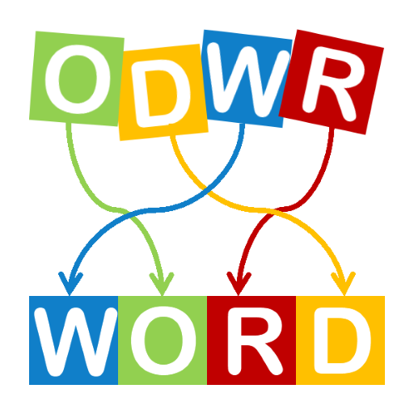
JUMBLED WORDS
anitondo
donation
revloetun
volunteer
dnuf
fund
temero
remote
tbosot
boost

Slide 7
02
Pre-speaking

Slide 8
PRE-SPEAKING
1
Choose the THREE most important benefits of volunteering activities.
Coming into contact with other teenagers with similar interests
Improving essential life skills, such as skills that will get you a job, or time management skills
Appreciating the good things in life and being positive
Helping teenagers find a sense of purpose in life
Gaining life experiences

Slide 9
PRE-SPEAKING
2
Complete the diagram with examples and details that explain the benefits of volunteering activities.
coming into contact with other teenagers with similar interests
sharing common interests and values
helping you become more confident
…
learning good things from each other

Slide 10
PRE-SPEAKING
2
Complete the diagram with examples and details that explain the benefits of volunteering activities.
improving essential life skills
time management skills
communication skills
…
group working skills

Slide 11
PRE-SPEAKING
2
Complete the diagram with examples and details that explain the benefits of volunteering activities.
…
…
…
…
helping different people
gaining life experiences
going to different places
dealing with different situations

Slide 12
03
While-speaking

Slide 14


1. First/Second,
A. Order points and expressions
B. Giving examples

Slide 15
2. For instance, …
A. Order points and expressions
B. Giving examples

Slide 16
3. Third, …
A. Order points and expressions
B. Giving examples

Slide 17
4. Second, …
A. Order points and expressions
B. Giving examples

Slide 18
5. For example, …
A. Order points and expressions
B. Giving examples

Slide 19
6. Finally, …
A. Order points and expressions
B. Giving examples

Slide 20
7. … such as …
A. Order points and expressions
B. Giving examples

Slide 21
WHILE-SPEAKING
3
Work in groups. Give a presentation about the benefits of volunteering activities.
Functions | Useful expressions
Order points and expressions | First of all, … Second, … Third, … Finally, …
Giving examples | For example, … For instance, … … such as …

Slide 22

WHILE-SPEAKING
3
Work in groups. Give a presentation about the benefits of volunteering activities.
Present about the benefits of volunteering activities

Slide 23
04
Consolidation

Slide 24
CONSOLIDATION
1
Wrap-up
Talk about the benefits of volunteering activities

Slide 25
CONSOLIDATION
2
Homework
Prepare for the next lesson: Unit 4: Listening
2. Do exercises in the workbook

Slide 26
SEE YOU NEXT TIME !!

