Slide 1
Unit 4 For A Better Community
Lesson 6: WRITING
Writing an application letter for volunteer work

Slide 2

Unit
1
1
FAMILY LIFE
Family Life
Unit
OBJECTIVES
Write an application letter for a volunteer work

Slide 3
Table of contents
01
02
03
Warm-up
Pre-writing
While-writing
04
Post-writing
05
Consolidation

Slide 4
01
Warm-up
Game: Hangman

Slide 5
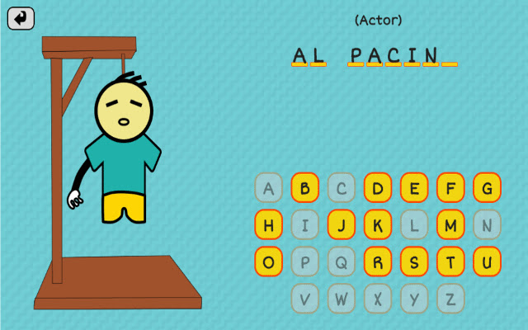
WARM-UP
HANGMAN
This is a kind of letter you need to write when you apply for a job.
APPLICATION LETTER

Slide 6
02
Pre-writing

Slide 7


Slide 8
PRE-WRITING
1
Read the application letter for a volunteer position. Match the paragraphs with their aims.
A. Saying why you want to do the job
B. Saying when you are available for an interview and can start work
C. Mentioning the job you are applying for and where you got the information from

Slide 9




Match the paragraphs with their aims.
Match the paragraphs with their aims.
A. Saying why you want to do the job
B. Saying when you are available for an interview and can start work
C. Mentioning the job you are applying for and where you got the information from

Slide 10
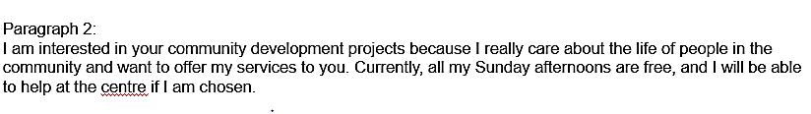
Match the paragraphs with their aims.
A. Saying why you want to do the job
B. Saying when you are available for an interview and can start work
C. Mentioning the job you are applying for and where you got the information from

Slide 11

Match the paragraphs with their aims.
A. Saying why you want to do the job
B. Saying when you are available for an interview and can start work
C. Mentioning the job you are applying for and where you got the information from

Slide 12

PRE-WRITING
2
Read the job advert and answer the questions.
1. What qualities are needed for the job?
2. What are the job duties?
Reliable and hardworking.
Welcoming guests and visitors, and receiving and sorting donations.

Slide 13
03
While-writing

Slide 14
WHILE-WRITING
3
Complete the application letter for the job.
……………. Street
……………, ……………
1 January 20___
Heart to Heart
Charitable Organisation
100 Ha Thanh Street, Ha Noi
Dear Sir or Madam,
I am writing to apply for a volunteer
position …………………........….…....…
……………………………........….…....…
I am interested in ………….……......…
……………………………........…....……
I am available for an interview
…………………….........………… If my
application is successful, I can start
……………………………........….…....…
I look forward to hearing from you.
Yours faithfully,
…...…….....……

Slide 15
WHILE-WRITING
SAMPLE
877 Kim Ma Street
Ba Dinh, Ha Noi
12 March 2022
Heart to Heart
Charitable Organisation
100 Ha Thanh Street, Ha Noi
Dear Sir or Madam,
I am writing to apply for a volunteer position at the head office of Heart to Heart Charitable Organisation. I saw the job advert on our school notice board.
I am interested in volunteer work and projects to help people in our community. I am polite, reliable and hardworking. I also have great people skills, which I believe are important for this position.
I am available for an interview on any weekday after 4.30 p.m. or at weekends. If my application is successful, I can start next month.
I look forward to hearing from you.
Yours faithfully,
Nguyen Ha Anh

Slide 16
04
Post-writing

Slide 17

POST-WRITING
Cross-check and final check

Slide 18
05
Consolidation

Slide 19
CONSOLIDATION
1
Wrap-up
Write an application letter for a volunteer work

Slide 20
CONSOLIDATION
2
Homework
Prepare for the next lesson: Communication and Culture/ CLIL
2. Do exercises in the workbook
3. Rewrite the paragraph in the notebooks.

Slide 21
SEE YOU NEXT TIME !!

