Slide 1
Unit 4
For A Better Community
Lesson 7: COMMUNICATION AND CULTURE/ CLIL

Slide 2

Unit
1
1
FAMILY LIFE
Family Life
Unit
OBJECTIVES
By the end of the lesson, students will be able to:
Revise how to describe feelings;
Know more information about Save the Children and what it has contributed to the development of Viet Nam.

Slide 3
Table of contents
01
02
03
Warm-up
Everyday English
Culture
04
Consolidation

Slide 4
01
Warm-up
Game: Who remembers more?

Slide 5

WARM-UP
Watch the video and write down information about:
Three principles of volunteering
Places of volunteering

Slide 6
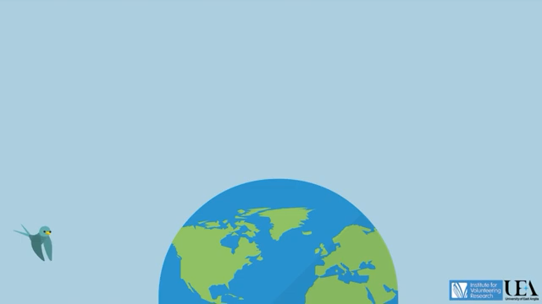
Unit
Watch the video and write down information
Notes:
Link: https://www.youtube.com/watch?v=tYmvsrkN8po

Slide 7
02
Everyday English

Slide 8


Slide 9





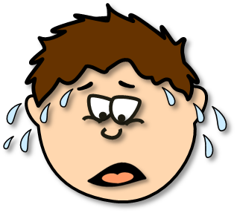





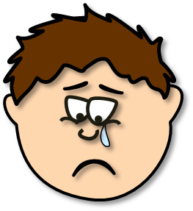


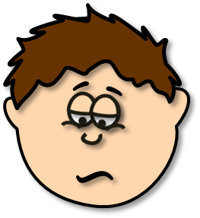
Click to
start

Slide 10


He’s thirsty.
He’s hungry.
He’s cold.
great
next

Slide 11

He’s sleepy.
He’s happy.
He’s angry.
great
next

Slide 12

He’s hot.
He’s shy.
He’s angry.
great
next

Slide 13

He’s surprised.
He’s tired.
He’s bored.
great
next

Slide 14

He’s scared.
He’s disgusted.
He’s shy.
great
next

Slide 15

He’s in love.
He’s frustrated.
He’s bored.
great
next

Slide 16

He’s angry.
He’s scared.
He’s sad.
great
next

Slide 17

He’s furious.
He’s cold.
He’s hot.
great
next

Slide 18

He’s hot.
He’s happy.
He’s bored.
great
next

Slide 19

EVERYDAY ENGLISH
1
Listen and complete the conversation.
A. excited B. worried C. cheerful D. confused
Nam: Hi Lan! You look very (1) __________today! I heard you went on a volunteer trip to the mountains. How was it?
Lan: Great! I’m so happy and relaxed now though at first I was (2) __________. I didn’t understand the purpose of the trip. I knew nothing about the place, so I also felt a little bit (3) __________.
Nam: Oh, did you go there with other members of the volunteer club? Was everything OK?
Lan: Yes, we went as a team. The local people were so friendly and helpful. Now we are preparing for our next volunteer trip in the summer. I’m so (4) __________ about it.
C. cheerful
D. confused
B. worried
A. excited

Slide 20
EVERYDAY ENGLISH
2
Role-play
Useful expressions
I feel / felt / am / was excited / confused /confident/ pleased …
To be honest, I'm / I was a little bit stressed / disappointed / upset ...
Volunteering / Helping people made me feel happy / grateful / appreciated ...

Slide 21
03
Culture

Slide 22
CULTURE
1
Read and complete the diagram about Save the Children.
started in the UK in 1919
International
non-governmental
organisation
now working in (1) ________ countries
120
Save the Children
particularly focuses on education
helps teachers (2) _________________________________ _________________in their classrooms
improve (their) teaching skills and use
digital technology
In Viet Nam
creates opportunities for children in remote areas
(3) __________________
to go to school
life-saving skills
offers training on (4) __________________ for both teachers and students

Slide 23

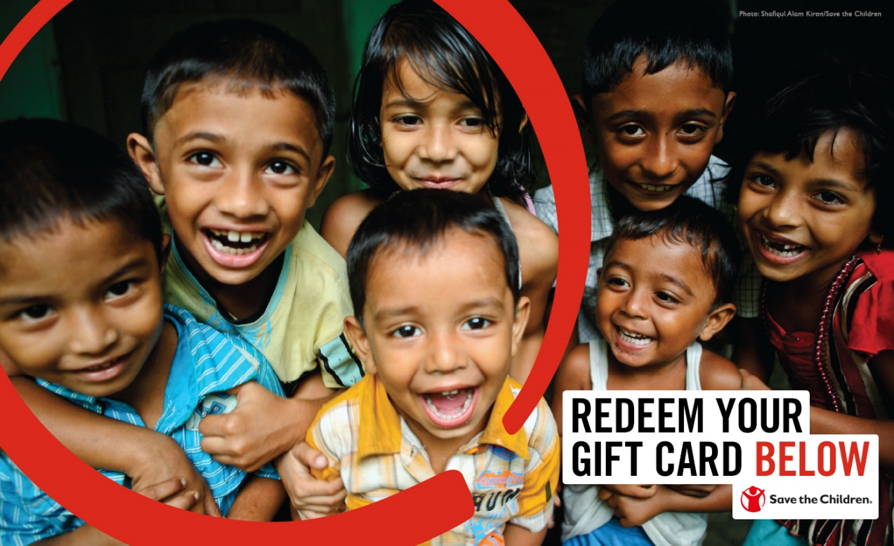
CULTURE
2
Talk about Save the Children.

Slide 24
04
Consolidation

Slide 25
CONSOLIDATION
1
Wrap-up
Revise how to describe feelings;
Know more information about Save the Children and what it has contributed to the development of Viet Nam.

Slide 26
CONSOLIDATION
2
Homework
1. Prepare for the next lesson: Looking back and project
2. Do exercises in the workbook

Slide 27
SEE YOU NEXT TIME !!

