Slide 1

Welcome to our class

Slide 2
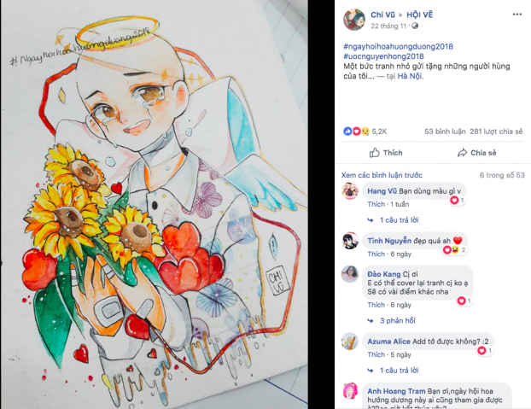
Watch a video clip and answer the questions

Slide 3


Slide 4

1. How do you feel when watching the video?
2. Have you ever heard about the girl in the video?
3. Do you admire her?

Slide 5
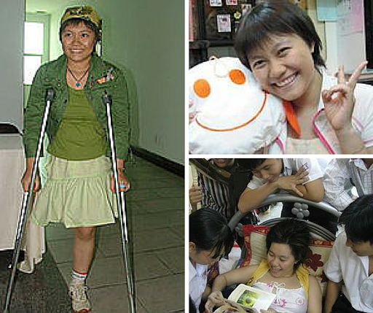
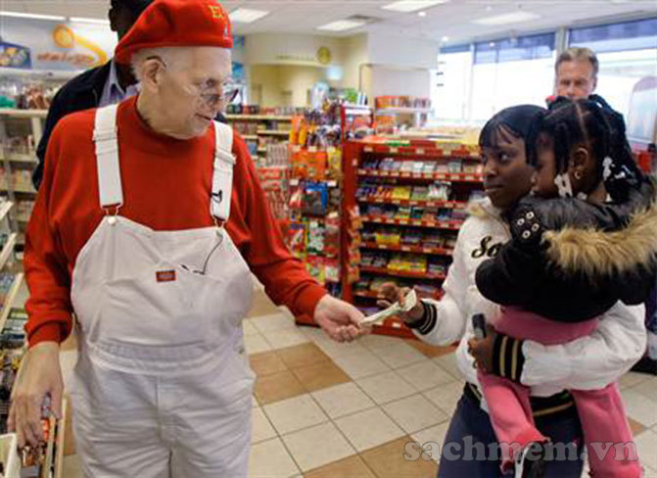
Unit 1: Life stories
Lesson 3: Reading
Giving back to the community

Slide 6
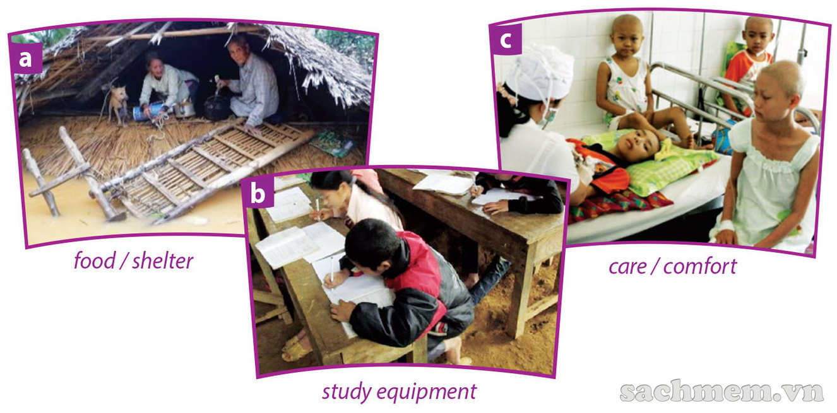
Task 1. Discuss with a partner. What do the people in the pictures need? What can you do to help them? Use the words under the pictures to answer the questions.
These flood victims need
food and shelter.
These young cancer patients need care and comfort.
These students are studying in a shabby classroom. They need study equipment and a decent place to study.

Slide 7

Vocabulary

Slide 8
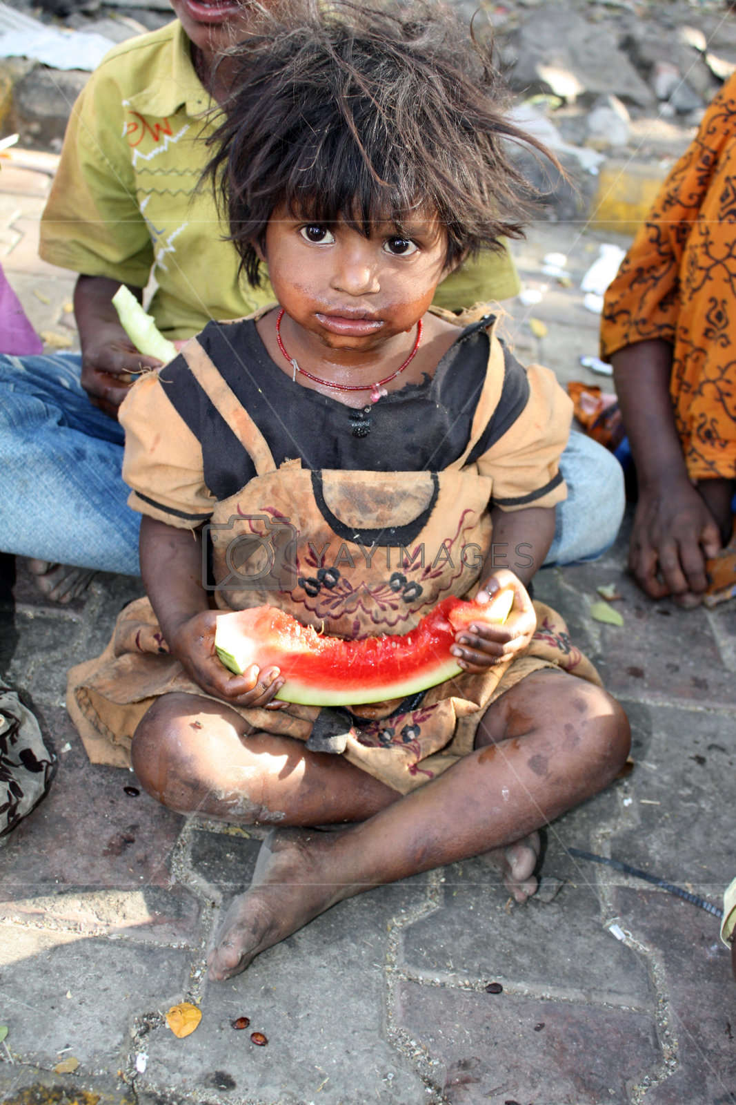
Humble (adj)
/ˈhʌmbl/

Slide 9
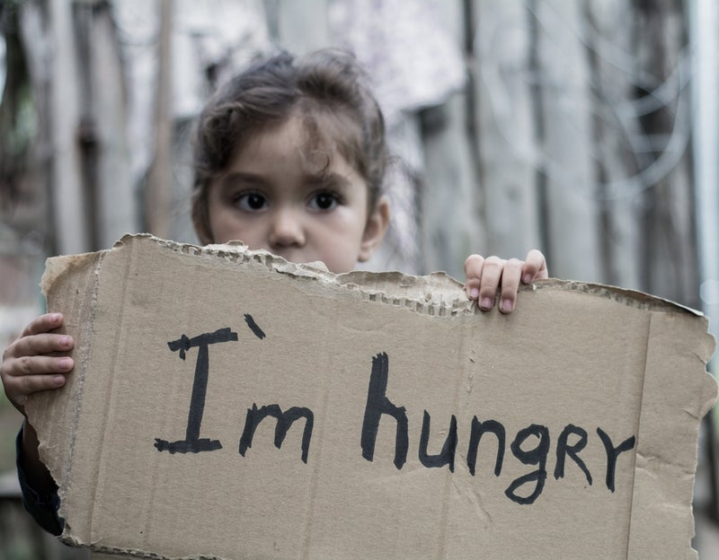
Starve (v)
/'stɑ:v/

Slide 10

Vow (v)
/vaʊ/

Slide 11

Diagnose (v)
/daiəg'nouz/

Slide 12
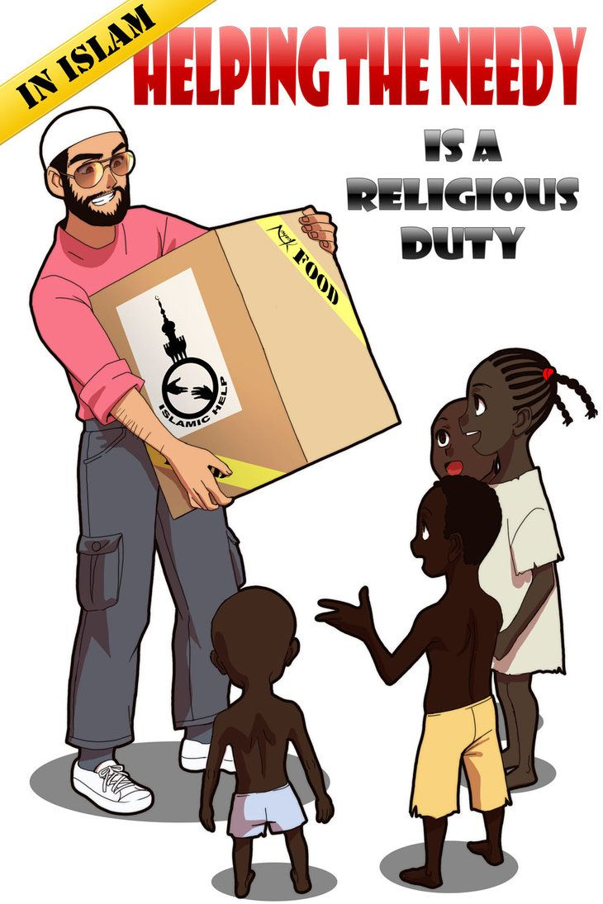
The needy
/'ni:di/

Slide 13
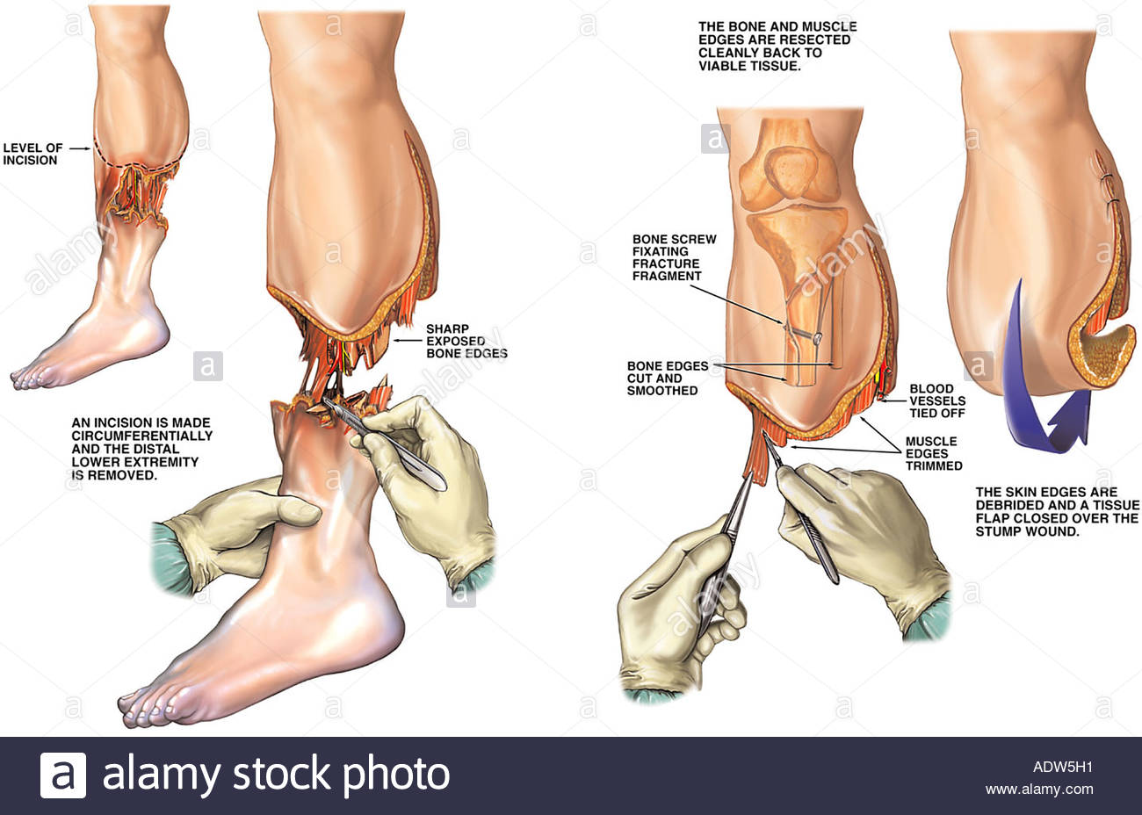
Amputate (v)
/'æmpjuteit/

Slide 14

Anonymous (adj)
/ə'nɒniməs/

Slide 15
Vocabulary
- Humble (adj)
/'hʌmbl/ : Thấp kém, tầm thường
- Starve (v)
/'stɑ:v/ : Bị đói
- Vow (v)
/vaʊ/: Thề
- Diagnose (v)
/daiəg'nouz/: Chẩn đoán
- Anonymous (adj)
/ə'nɒniməs/ : Ẩn danh
- Amputate (v)
/'æmpjuteit/ : Cắt cụt
- The needy
/'ni:di/: Những người khó khăn

Slide 16
Task 2. Read two people's life stories and complete the table with facts about them.
Name | Larry Stewart | Le Thanh Thuy
Born
Died
Nationality
Health problem
Dedicated life to
1948
1988
2007
2007
American
Vietnamese
Cancer
Bone cancer
The needy
Young cancer patients

Slide 17
Task 3. Read the stories again and answer the questions.
1. What did Larry Stewart do to help those in need ?
2. Why was he called ‘ Secret Santa’ ?
3. How has his act of kindness influenced other people since his death ?
4. What di Thanh Thuy do to help other people ?
5. What title was Thuy awarded?
6. How does The Tuoi Tre manage Thuy’s Dream Programme?

Slide 18


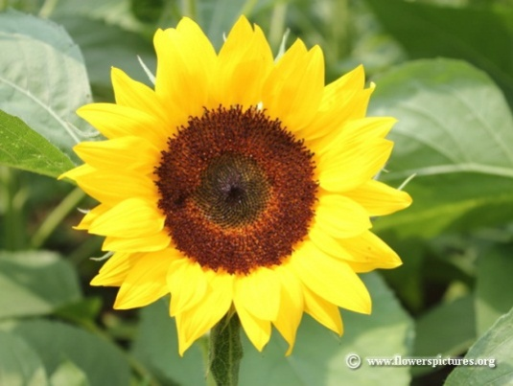
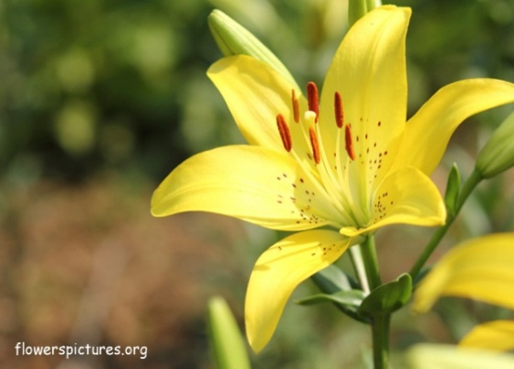

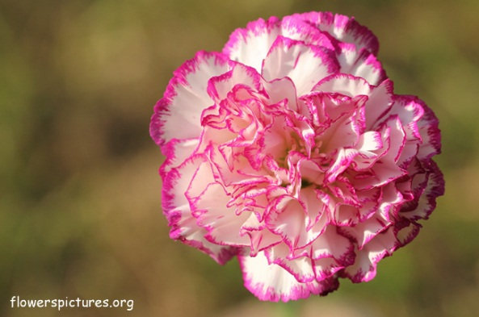
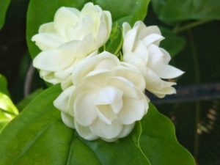
Game: Lucky flower

Slide 19
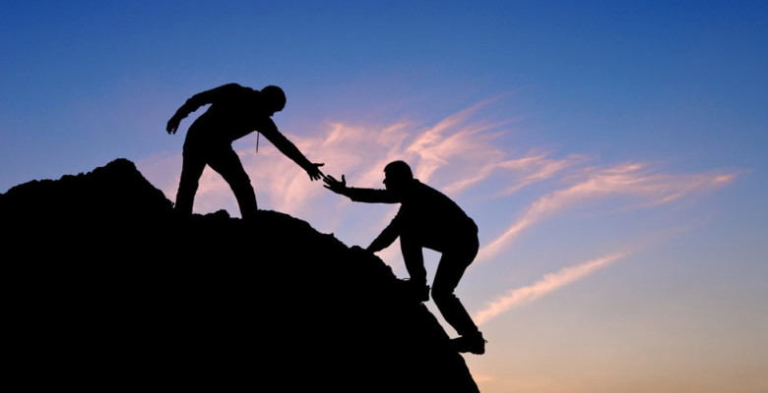
Task 5. Watch a video clip and answer the questions.

Slide 20
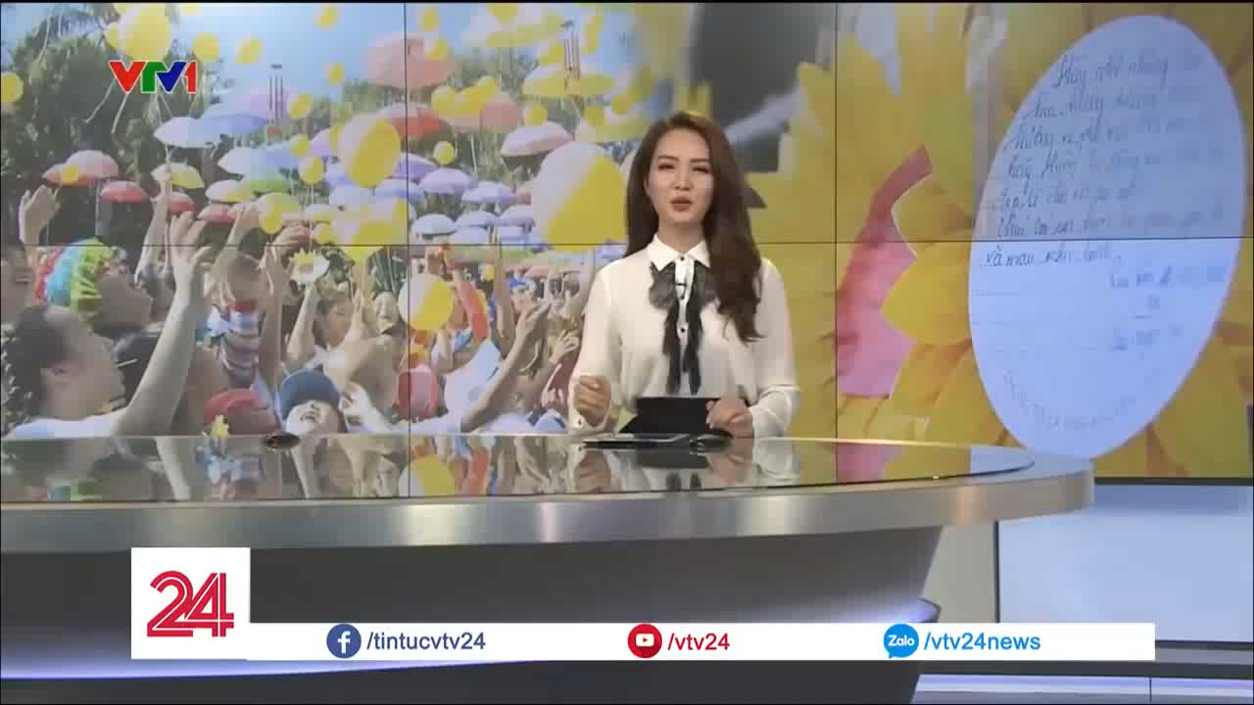

Slide 21
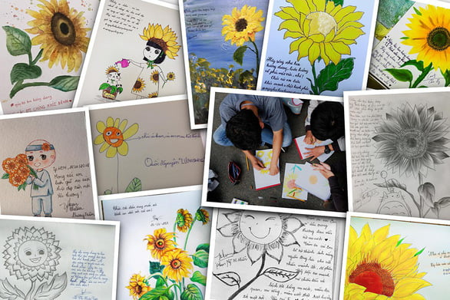
Task 5. Work in pairs. Ask and answer the questions
1. Have you ever taken part in the Sunflower Festival to support Thuy’s Dream Programme?
2. If yes, what did you do during the festival?
3. If no, would you like to do it in the future and how would you help? Give your reason.

Slide 22
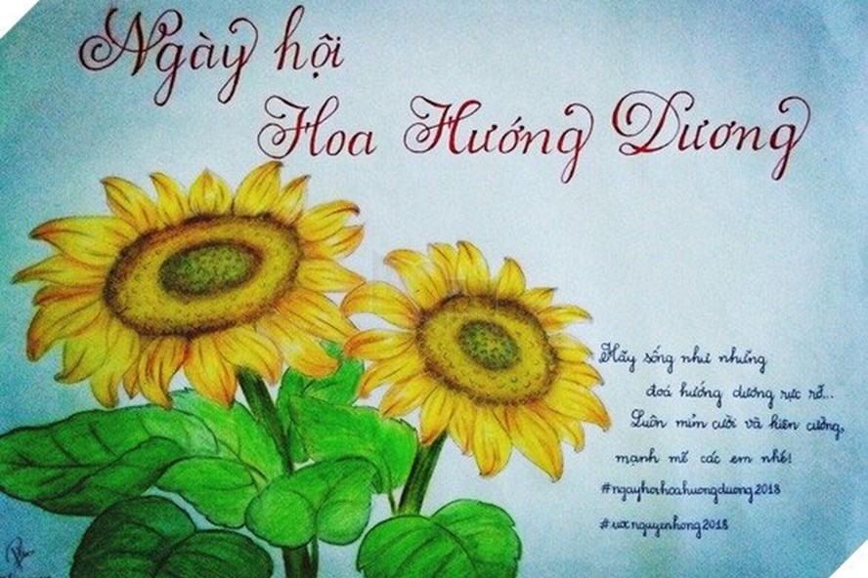
Homework
- Write a short paragraph about what you will you do to help needy people around you ?
- Prepare the lesson speaking

Slide 23
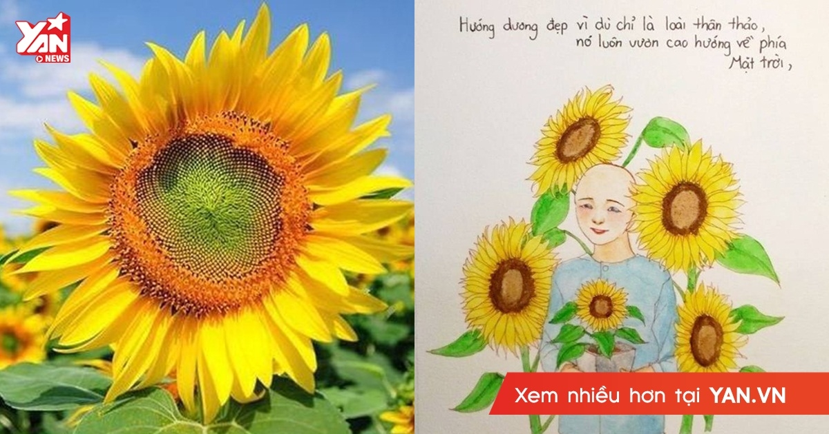
Thank you
Và em cũng vậy
Sunflower Festival

Slide 24
1. What did Larry Stewart do to help those in need?
Every Christmas, Larry Stewart handed out thousands of dollars to needy people in public places.

Slide 25
2. Why was Larry called ‘ Secret Santa’?
Because he gave money to people during the festive season of December while his identity was hidden.

Slide 26
3. How has Larry’s act of kindness influenced other people since his death ?
People have been inspired to continue his mission of kindness and charitable work.

Slide 27
4. What did Thanh Thuy do to help other people ?
Thuy organised charity activities to relieve young cancer patients’ pain.

Slide 28
5. What title was Thuy awarded ?
She was awarded the title ‘ Ho Chi Minh City Outstanding Young Citizen.

Slide 29
6. How does The Tuoi Tre manage Thuy’s Dream Programme ?
The newspaper holds annual events to support her programme. One of them is the Sunflower Festival, where children and their families get together and have fun. Gifts are given to the young patients, and the memory of Thuy is kept alive by her story about love and sharing

Slide 30


