Slide 1


Slide 2

Unit
4
1
Unit
FAMILY LIFE
FOR A BETTER COMMUNITY
LESSON 1
GETTING STARTED
Volunteering in the community

Slide 3

Unit
1
1
FAMILY LIFE
Family Life
Unit
OBJECTIVES
By the end of this lesson, students will be able to gain:
an overview about the topic For a better community
vocabulary to talk about voluntary work

Slide 4
LESSON 1
GETTING STARTED
Unit
GETTING STARTED
WARM-UP
Clip watching
PRESENTATION
Vocabulary
Task 1: Listen and read.
Task 2: Read the conversation and answer the questions.
Task 3: Find the adjectives.
Task 4: Complete the sentences.
PRACTICE
PRODUCTION
Self-reflection
PRACTICE
Wrap-up
Homework

Slide 5
LESSON 1
GETTING STARTED
Unit
GETTING STARTED
WARM-UP
Clip watching

Slide 6

WARM-UP
Clip watching

Slide 7
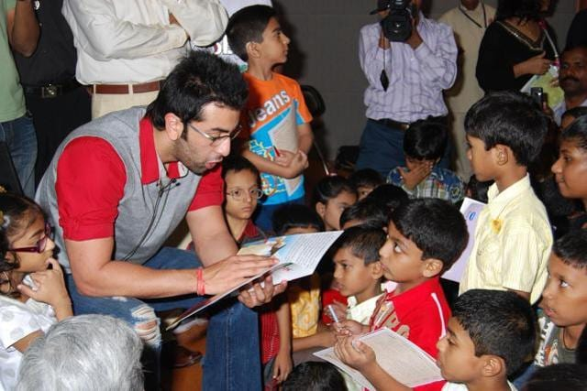
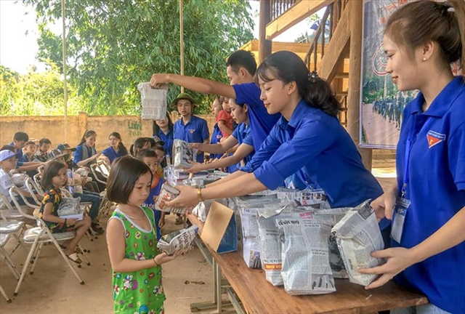
WARM-UP
Clip watching
+ Read books for children in orphanages
+ Visit and play games with them or listen to their problems
+ Work in home of sick and old people
+ Volunteer to work in remote or mountainous areas

Slide 8
LESSON 1
GETTING STARTED
Unit
GETTING STARTED
WARM-UP
Clip watching
PRESENTATION
Vocabulary

Slide 9


PRESENTATION
volunteer (n)
/ˌvɒlənˈtɪə(r)/
a person who does a job without being paid for it

Slide 10

PRESENTATION
advertisement (n)
/ədˈvɜːtɪsmənt/
a notice, picture or film telling people about a product, job or service

Slide 11

PRESENTATION
community (n)
/kəˈmjuːnəti/
all the people who live in a particular area, country, etc. when talked about as a group

Slide 12

PRESENTATION
boost (v)
/buːst/
to make something increase, or become better or more successful

Slide 13
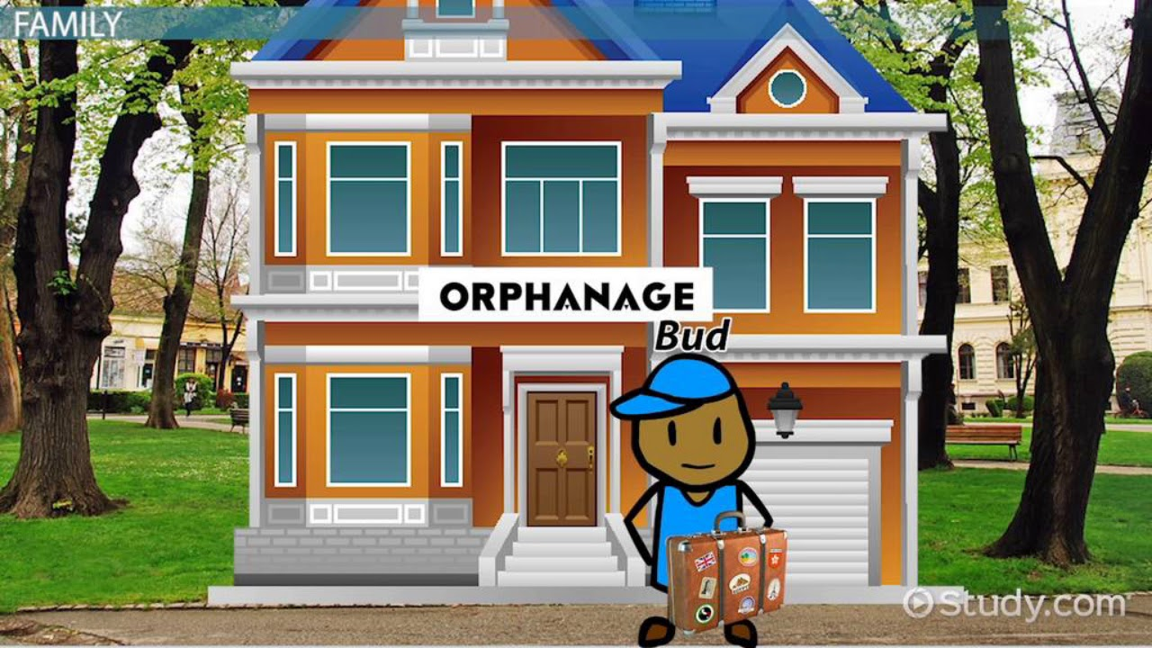
PRESENTATION
orphanage (n)
/ˈɔːfənɪdʒ/
a home for children whose parents are dead

Slide 14
PRESENTATION
New words | Pronunciation | Meaning
volunteer (n) | /ˌvɒlənˈtɪə(r)/ | a person who does a job without being paid for it
advertisement (n) | /ədˈvɜːtɪsmənt/ | a notice, picture or film telling people about a product, job or service
community (n) | /kəˈmjuːnəti/ | all the people who live in a particular area, country, etc. when talked about as a group
boost (v) | /buːst/ | to make something increase, or become better or more successful
orphanage (n) | /ˈɔːfənɪdʒ/ | a home for children whose parents are dead

Slide 15
LESSON 1
GETTING STARTED
Unit
GETTING STARTED
WARM-UP
Clip watching
PRESENTATION
Vocabulary
Task 1: Listen and read.
Task 2: Read the conversation and answer the questions.
Task 3: Find the adjectives.
Task 4: Complete the sentences.
PRACTICE

Slide 16
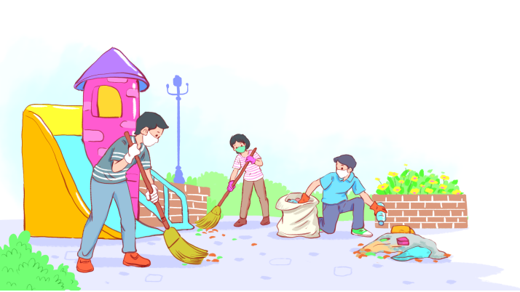
PRACTICE
1
Listen and read.
Volunteering in the community

Slide 17

PRACTICE
1
Listen and read.
Volunteering in the community
Kim: Hi, Tam. I went to your house at 9 a.m., but you weren’t there.
Tam: Oh, when you came, I was working as a volunteer at our local centre for community development.
Kim: Ah, I see. How did you become a volunteer there?
Tam: Just by chance. Last summer, while I was visiting the centre, I saw an advertisement for volunteers. I applied and my application was successful.
Kim: I also want to be a volunteer. I find community work very interesting.
Tam: I agree. Community service not only benefits the local area, but can also boost our confidence and help us learn many useful skills.

Slide 18
PRACTICE
PRACTICE
1
Listen and read.
Volunteering in the community
Kim: What are the regular activities organised by the centre?
Tam: Oh, there are endless opportunities for getting involved. For example, you can join a local environmental group to clean up the park once a week or volunteer at an orphanage.
Kim: Sounds good. How can I apply?
Tam: I’ll email you the form. You just fill it in and send it in.
Kim: Thanks so much. I’m so excited about volunteering at the centre.
Tam: No problem. Good luck. Hope your application is successful and you enjoy the work.

Slide 19
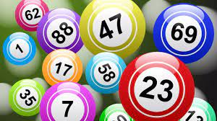
PRACTICE
PRACTICE
2
Read the conversation again and answer the questions.
Game: Lucky number

Slide 20
PRACTICE
3
Find the adjectives with the following suffixes in the conversation and write them below.
suffixes | adjectives
-ed
-ing
-ful
-less
excited
interesting
useful, successful
endless

Slide 21
PRACTICE
4
Find a verb phrase in the conversation to complete each sentence.
1. Oh, when you came, I____________ as a volunteer at our local centre for community development.
2. Last summer, while I was visiting the centre, I_____ an advertisement for volunteers.
was working
saw

Slide 22
LESSON 1
GETTING STARTED
Unit
GETTING STARTED
WARM-UP
Clip watching
PRESENTATION
Vocabulary
Task 1: Listen and read.
Task 2: Read the conversation and answer the questions.
Task 3: Find the adjectives.
Task 4: Complete the sentences.
PRACTICE
PRODUCTION
Self-reflection

Slide 23
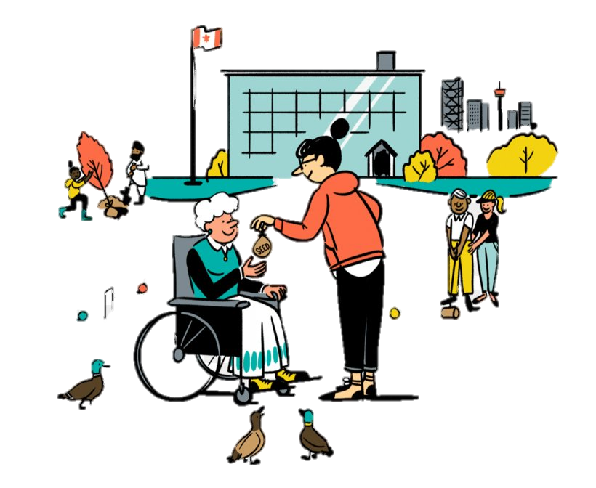
PRODUCTION
SELF-REFLECTION
- Talk about activities you are going to do to make your community a better one for a minute
- Your talk should include:
+ How many activities are you going to talk about?
+ Where do you do those activities?
+ Who do you do with?
+ How often do you do those activities?

Slide 24
LESSON 1
GETTING STARTED
Unit
GETTING STARTED
WARM-UP
Clip watching
PRESENTATION
Vocabulary
Task 1: Listen and read.
Task 2: Read the conversation and answer the questions.
Task 3: Find the adjectives.
Task 4: Complete the sentences.
PRACTICE
PRODUCTION
Self-reflection
PRACTICE
Wrap-up
Homework

Slide 25
CONSOLIDATION
1
Wrap-up
Gain an overview about the topic For a better community
Gain vocabulary to talk about voluntary work

Slide 26
CONSOLIDATION
2
Homework
1. Do exercises in the workbook
2. Prepare for the next lesson
3. Prepare for the Project

Slide 27

Website: sachmem.vn
Fanpage: facebook.com/sachmem.vn/

