Slide 1


Slide 2

Unit
5
1
Unit
FAMILY LIFE
INVENTIONS
LESSON 4
SPEAKING
Inventions and how they are used

Slide 3

Unit
1
1
FAMILY LIFE
Family Life
Unit
OBJECTIVES
Talk about inventions and how they are used.

Slide 4
LESSON 4
SPEAKING
WARM-UP
Guessing game
Task 1: Talk about the uses of these inventions.
CONTROLLED PRACTICE
LESS CONTROLLED PRACTICE
Task 2: Talk more about one of the inventions in task 1.
Task 3: Present your ideas to the whole class.
CONSOLIDATION
Wrap-up
Homework

Slide 5
LESSON 4
SPEAKING
WARM-UP
Guessing game

Slide 6

GUESSING GAME
Click in the box, It opens partially of picture
Guessing What’s inventions in the box?

Slide 7



GUESSING GAME

Slide 8


The internet
Click here to guess what’s in the box

Slide 9

E-readers
Click here to guess what’s in the box

Slide 10
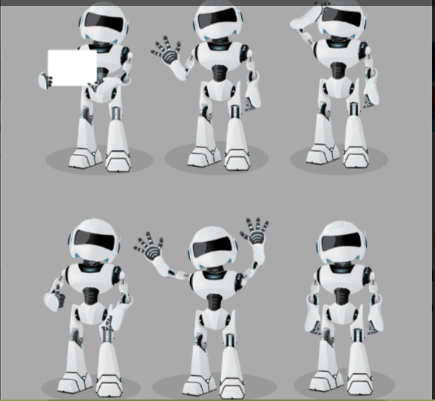
robots
Click here to guess what’s in the box

Slide 11
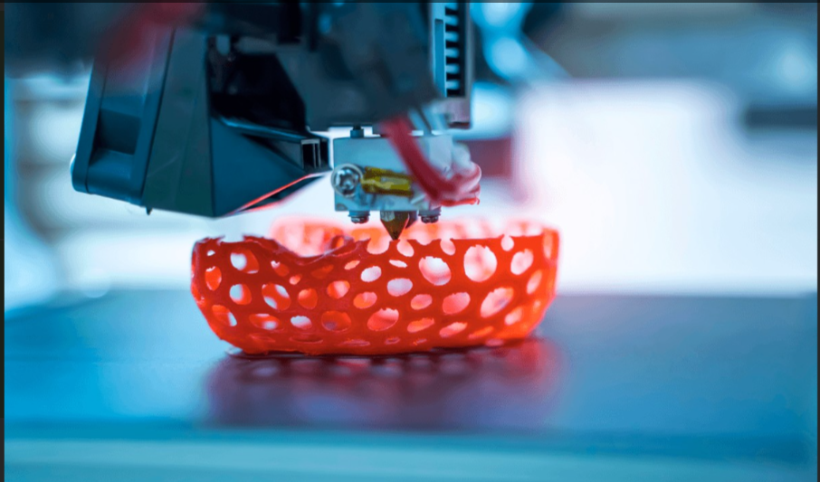
3D printing
Click here to guess what’s in the box

Slide 12
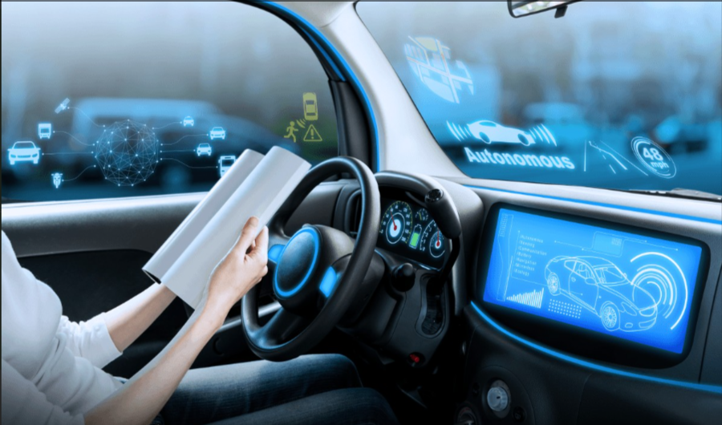
Driverless cars
Click here to guess what’s in the box

Slide 13
LESSON 4
SPEAKING
WARM-UP
Guessing game
Task 1: Talk about the uses of these inventions.
CONTROLLED PRACTICE

Slide 14
CONTROLLED PRACTICE
Functions | Useful expressions
Uses of inventions | - … help(s)/ allow(s) us to do st Example: The Internet helps us to communicate over long distances. - We/ People (can) use st to do/ for st Example: People can use the Internet to communicate over long distances. - … is/ are used for st/ doing st Example: The Internet is used for communication/ communicating over long distances.

Slide 15
New words
E-readers /iː-ˈriːdəz/ (n.phr): | thiết bị đọc sách điện tử
3D printing /θriːdiː ˈprɪntɪŋ/ (n.phr): | In 3D
driverless car /ˈdraɪvləs kɑː/ (n.phr): | xe không người lái
distance /ˈdɪstəns/ (n): | khoảng cách
be used for /biː juːzd fɔː/ (v.phr): | được sử dụng
development /dɪˈveləpmənt/ (n): | sự phát triển
important /ɪmˈpɔːtnt/ (adj): | quan trọng

Slide 16
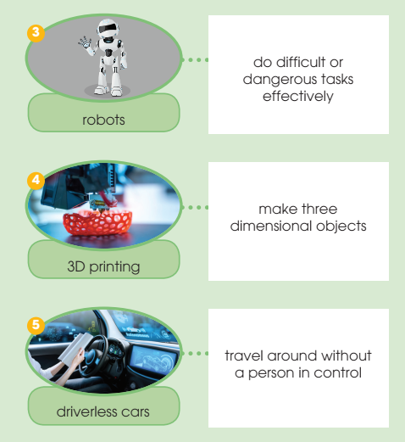
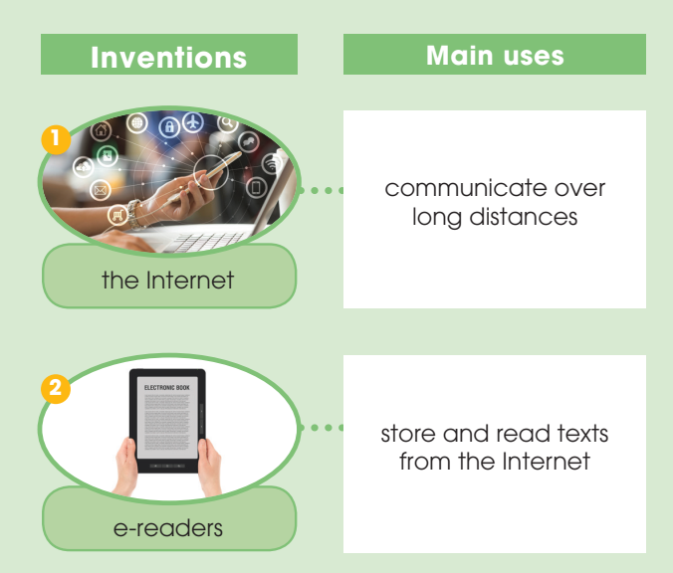
CONTROLLED PRACTICE
1
Work in pairs. Talk about the uses of these inventions. Use the expressions below to help you.

Slide 17
LESSON 4
SPEAKING
WARM-UP
Guessing game
Task 1: Talk about the uses of these inventions.
CONTROLLED PRACTICE
LESS CONTROLLED PRACTICE
Task 2: Talk more about one of the inventions in task 1.
Task 3: Present your ideas to the whole class.

Slide 18
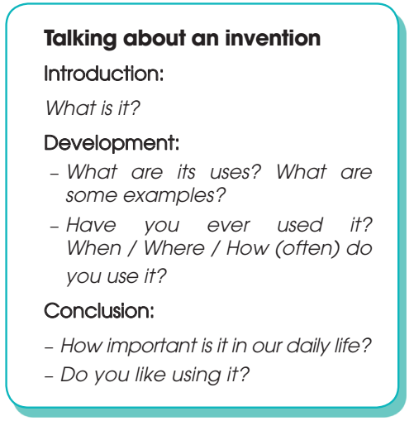
LESS CONTROLLED PRACTICE
2
Work in groups. Talk more about one of the inventions in activity 1. Use the outline below to help you prepare a group presentation.

Slide 19

LESS CONTROLLED PRACTICE
3
Present your ideas to the whole class. Then vote for the most interesting group presentation.
Present group’s ideas.
Give comments for friends’ groups and vote for the most interesting group presentation.

Slide 20
LESSON 4
SPEAKING
WARM-UP
Guessing game
Task 1: Talk about the uses of these inventions.
CONTROLLED PRACTICE
LESS CONTROLLED PRACTICE
Task 2: Talk more about one of the inventions in task 1.
Task 3: Present your ideas to the whole class.
CONSOLIDATION
Wrap-up
Homework

Slide 21
CONSOLIDATION
1
Wrap-up
Speaking about inventions and how they are used.

Slide 22
CONSOLIDATION
2
Homework
Prepare for the next lesson: Unit 5 – Listening
2. Do exercises in the workbook

Slide 23

Website: sachmem.vn
Fanpage: facebook.com/sachmem.vn/

