Slide 1
UNIT 4:
My birthday party
QUANG TRUNG PRIMARY SCHOOL
Lesson 1 – Period 1
Teacher: Bui Thi Minh Ngoc

Slide 2


Table of contents
01
Warm-up
02
Activity 1
Activity 2
03
Guessing game
Look, listen and repeat.
Listen, point and say.
04
Activity 3
05
Let’s talk.
Game

Slide 3
01
Warm-up
Guessing game

Slide 4
Guess the words.
Days of the week

Slide 5

a y M n o d
Monday

Slide 6
a i r y d F
Friday

Slide 7
W y d a n e s e d
Wednesday

Slide 8
S t r u a a d y
Saturday

Slide 9
u T s e d y a
Tuesday

Slide 10
s a y u T h r d
Thursday

Slide 11
S n a y d u
Sunday

Slide 12
02
Activity 1
Look, listen and repeat.

Slide 13
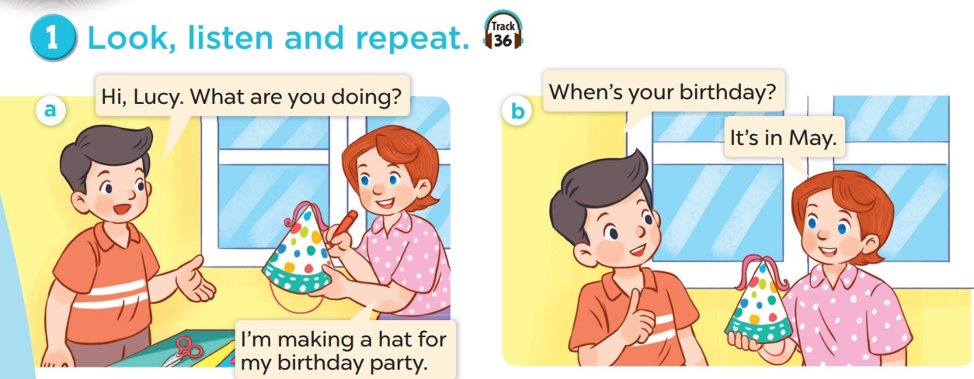

Look and listen.

Slide 14
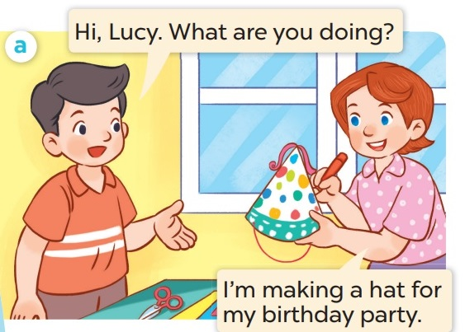
Listen and repeat.

Slide 15
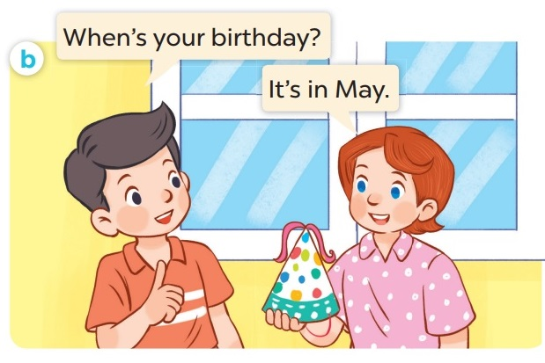
Listen and repeat.

Slide 16
03
Activity 2
Listen, point and say.

Slide 17
New words

Slide 18


There are 12.
Let’s watch a video about 12 months in a year!
How about months in
a year? How many?
Do you know how many days there are in a week?
I don’t know.
How many?
Seven.

Slide 19


Slide 20

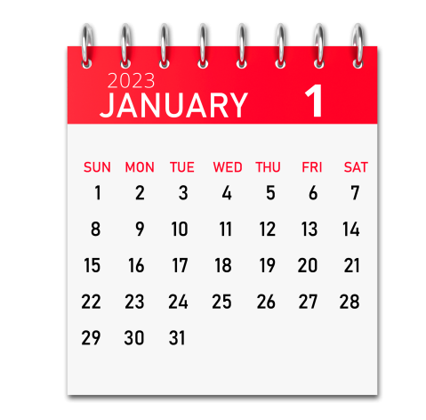
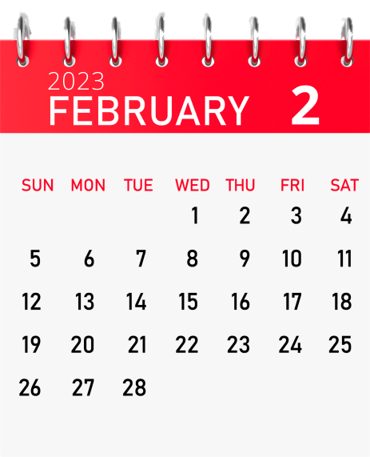
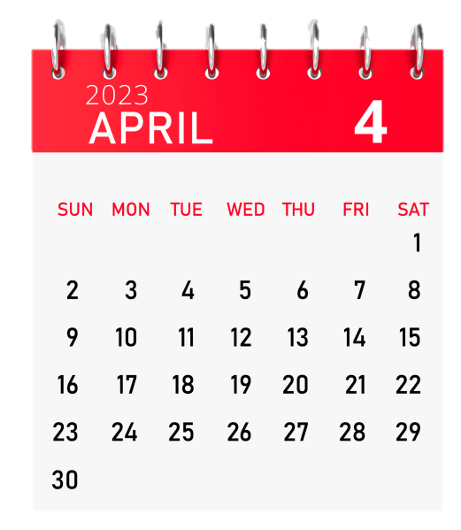
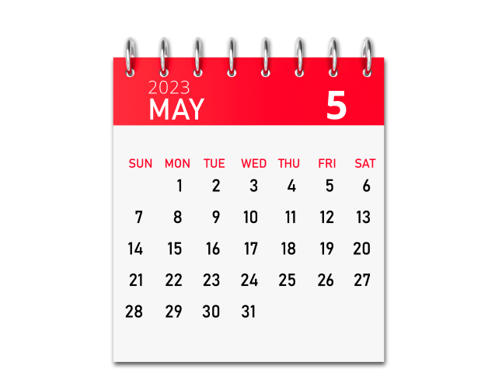
January
February
March
April
May

Slide 21

BOARD RACING
Notes:
Teacher says the months, students write the number.

Slide 22
May
5

Slide 23
March
3

Slide 24
January
1

Slide 25
April
4

Slide 26
February
2

Slide 27
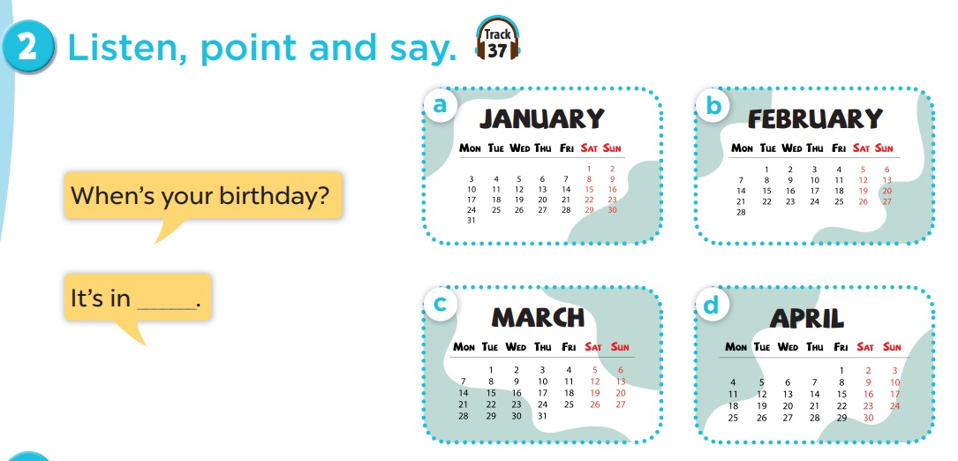
Work in pairs. Play roles.
Listen and repeat.

Slide 28
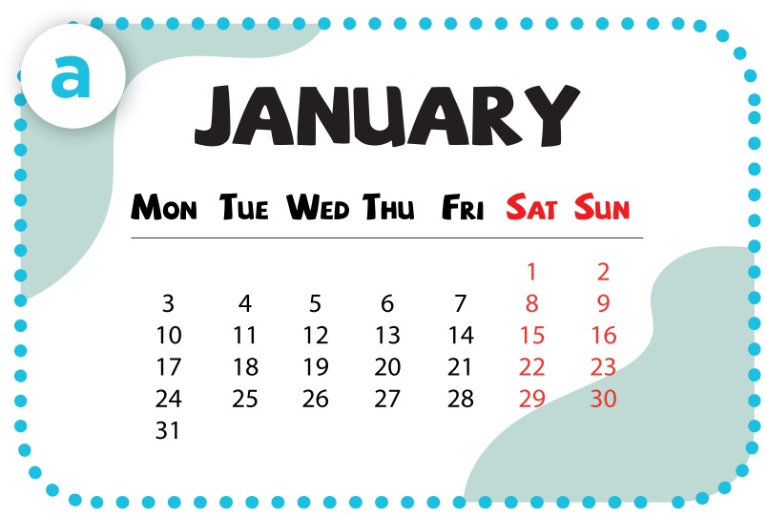
- When’s your birthday?
- It’s in January.

Slide 29
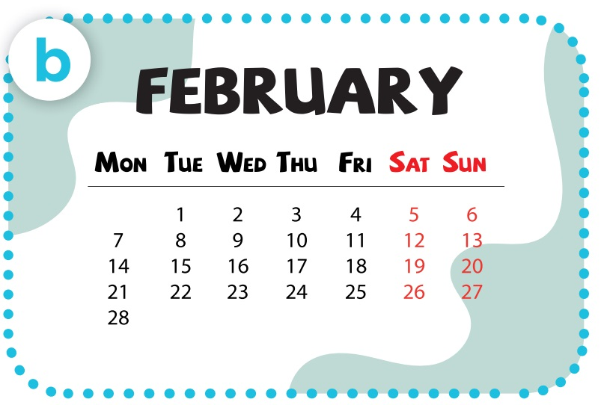
- When’s your birthday?
- It’s in February.

Slide 30
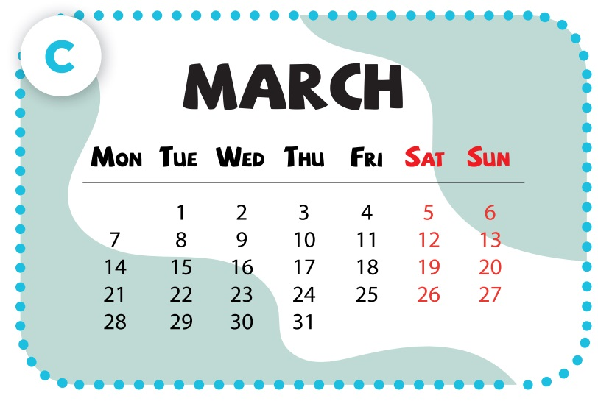
- When’s your birthday?
- It’s in March.

Slide 31
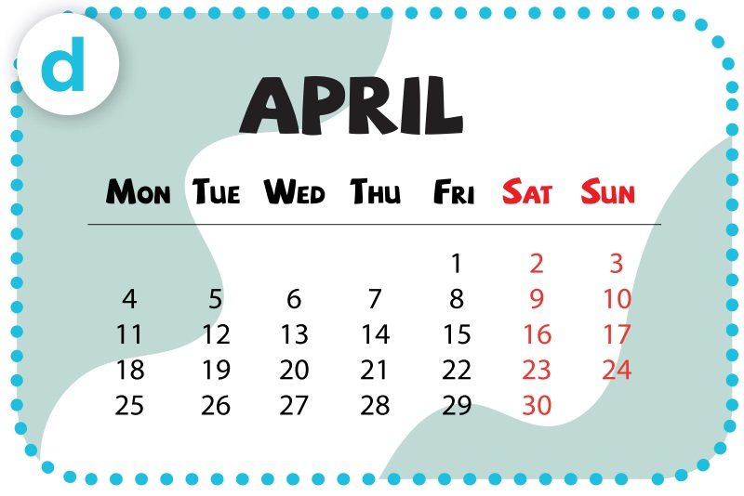
- When’s your birthday?
- It’s in April.

Slide 32
04
Activity 3
Let’s talk.

Slide 33
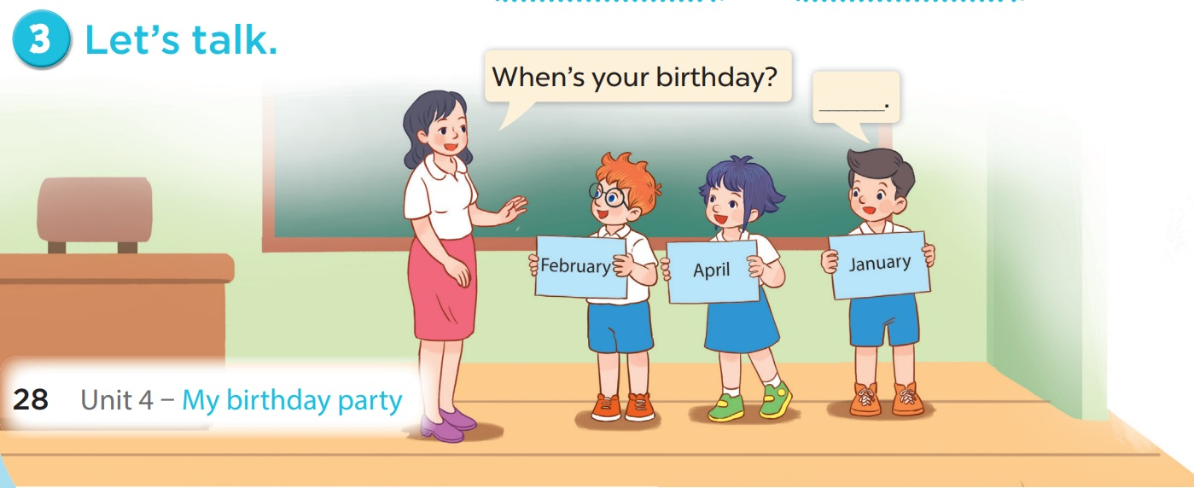

Slide 34
05
Game

Slide 35


Slide 36
Instructions for teachers
Before doing anything, you need to install the font.
Once the font is installed, re-open the file. Now you can easily edit the slides.
(font - Curse Casual JVE)
Questions will automatically appear after a letter has been chosen. Click again for the answer to appear. On the “Change” slide, click SpongeBob’s skeleton to return. On the “Steal” slide, click Patrick. On the “Lose all” slide, click anywhere in the background.
http://waygook.org/index.php/topic,22140.0.html
for more game templates and instructions.
-Sprite06
(www.waygook.org)

Slide 37








Slide 38



Slide 39



Slide 40



Slide 41



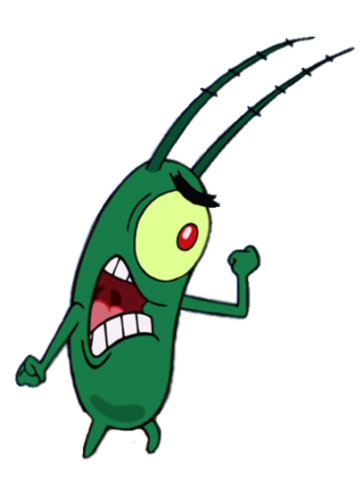


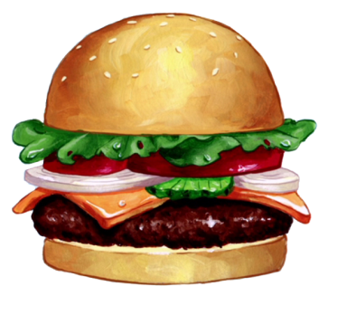
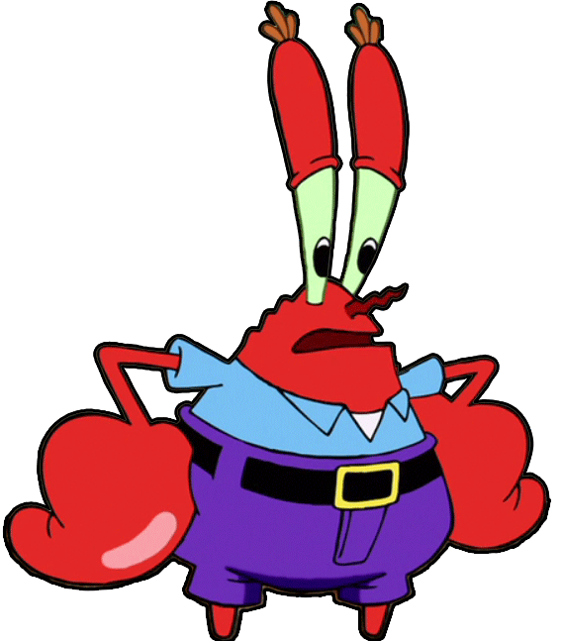
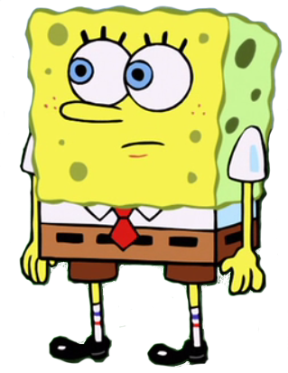
SpongeBob? SpongeBob!
Where are you?
And PROTECT the
Secret Formula!!!!
OK, Mr. Krabs.
Have a nice vacation!
Don’t let Patrick steal
any Krabby Patties.
I need you to cook Krabby
Patties while I’m gone.
SpongeBob, I’m going on
vacation.
Yes, Mr. Krabs?
= Points!

Slide 42


A
B
C
D
E
F
H
I
J
K
L
G

Slide 43


When’s your birthday?
It’s in January.

Slide 44
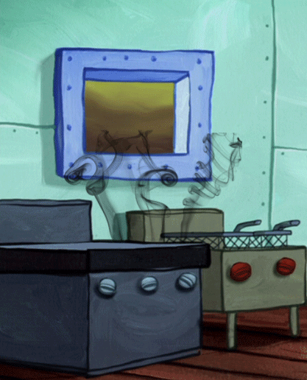


Two points!

Slide 45
When’s your birthday?
It’s in February.

Slide 46
Four points!

Slide 47
When’s your birthday?
It’s in March.

Slide 48
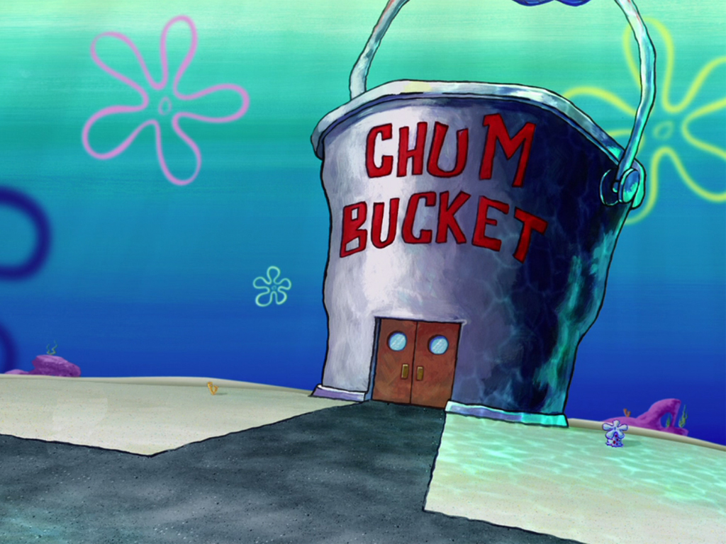
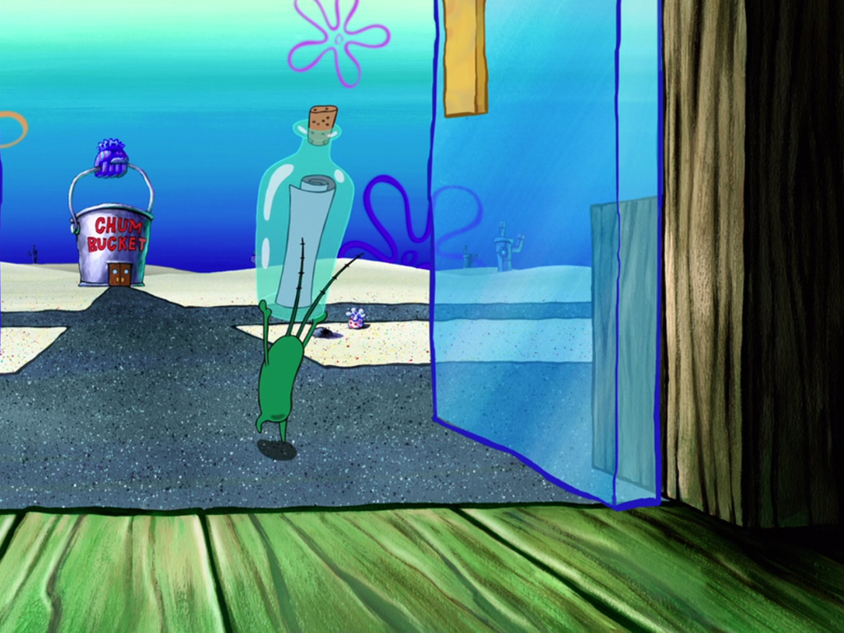
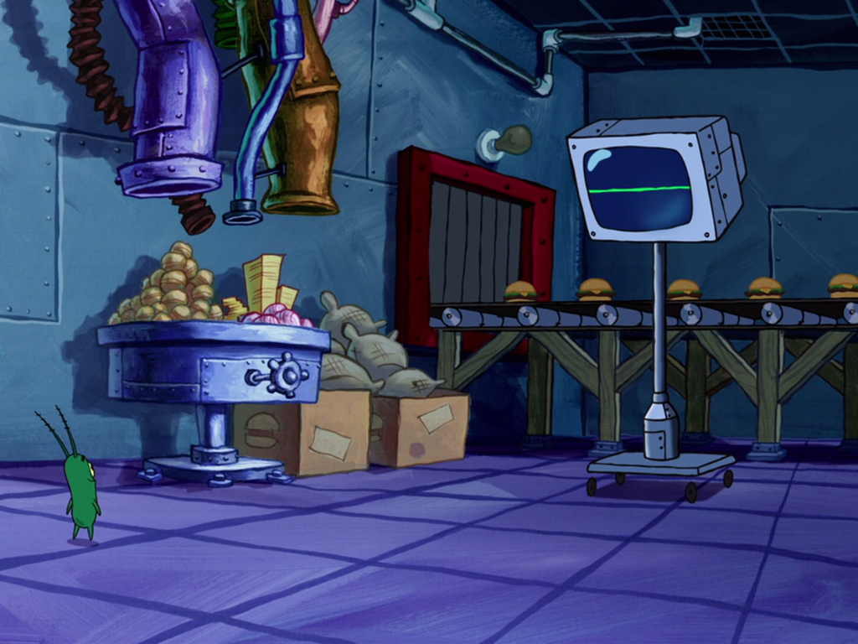
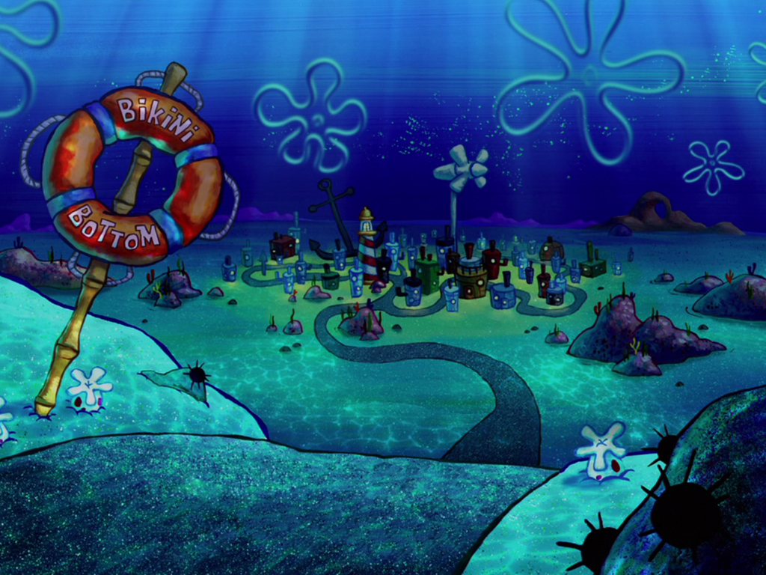



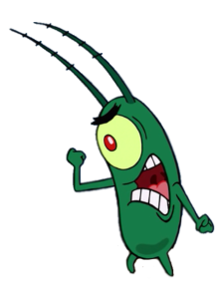




Plankton stole your secret formula!
All teams lose points.

Slide 49
When’s your birthday?
It’s in April.

Slide 50
One point!

Slide 51
When’s your birthday?
It’s in May.

Slide 52
Five points!

Slide 53
- ____ ’s your birthday?
- It’s in April.
When

Slide 54
Three points!

Slide 55
- When’s your birthday?
- It’s ___ March.
in

Slide 56
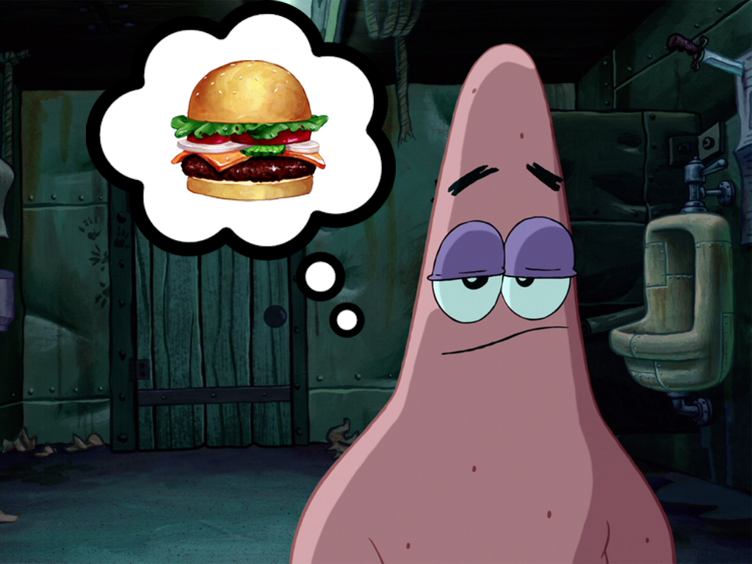




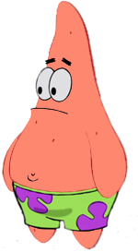
Pick a barrel !
2
4
3
1

Slide 57
Steal 3 points!

Slide 58

Steal 2 points!

Slide 59
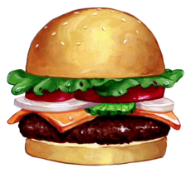
Steal 4 points!

Slide 60

Steal 1 point!

Slide 61
- When’s your _____?
- It’s in May.
birthday

Slide 62
Three points!

Slide 63
- When’s your birthday?
- _____ in January.
It’s

Slide 64
Five points!

Slide 65
__ebruary
F

Slide 66
Four points!

Slide 67
Ap_il
r

Slide 68
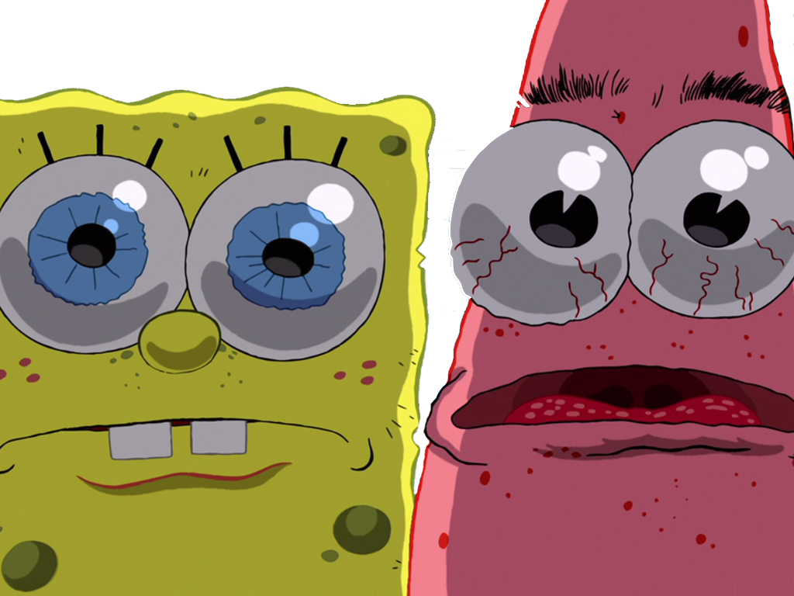


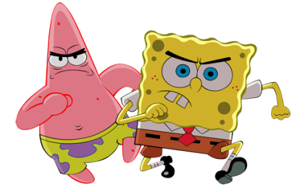





Stung by a jellyfish!
Minus – 3 points!

Slide 69
M_rch
a

Slide 70
One point!

