Slide 1



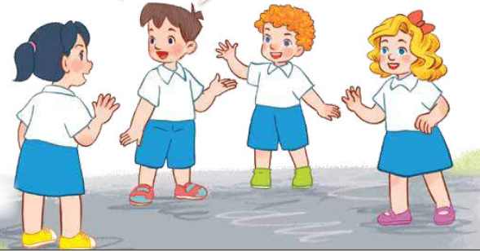
Our friends
3
LESSON 2 – PERIOD 3
Teacher: Duong Thi Bich Ngoc
Quang Trung Primary School

Slide 2


CONTENTS
1
Warm up & Review
2
Look, listen ad repeat.
3
Listen, point and say.
4
Let’s talk.
Fun corner & Wrap-up
5
Next
Notes:
G

Slide 3




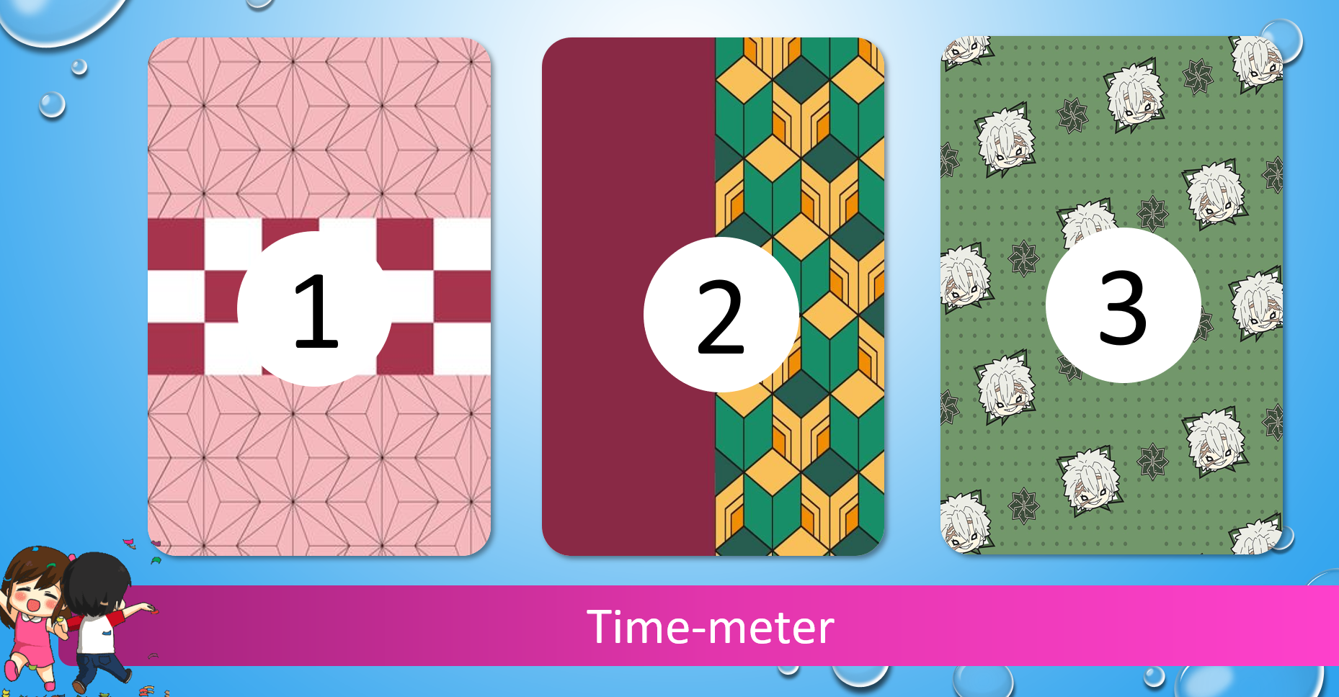




1
Warm-up & Review
A
0
1
2
3
4
5
6
7
8
9
0
1
2
3
4
5
6
7
8
9
0
1
2
3
4
5
6
7
8
9
B
0
1
2
3
4
5
6
7
8
9
0
1
2
3
4
5
6
7
8
0
9
1
2
3
4
5
6
7
8
9
1
2
Notes:
- Divide the class into 2 teams standing in lines.
- Have a pupil in the front row choose a number. The pupil MUST give the answer before the time’s up. If they answer correctly, they will get stars. If their answer is wrong or given after the time meter goes off, they will have to go to the back of the line.
- How to use time-meter: After clicking a number, simply click on the time meter to start it.
- Click the STAR at the corner to turn back to the Select Menu.
- Give points to the pupils (corresponding to the stars on the pictures).

Slide 4












What’s your name?
How are you?
Good morning.
1
2
3
Time-meter

Slide 5






….. is Mary
….. is Lucy
….. is Ms Hoa
1
2
3
Time-meter

Slide 6






This …. Mr Long.
That…. Mai.
This is …. Linh
1
2
3
Time-meter

Slide 7







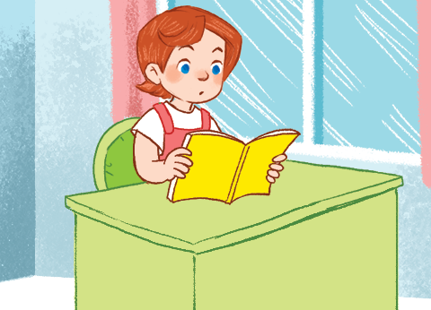


Look and say.
1
2
3
Time-meter

Slide 8
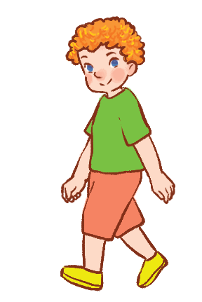
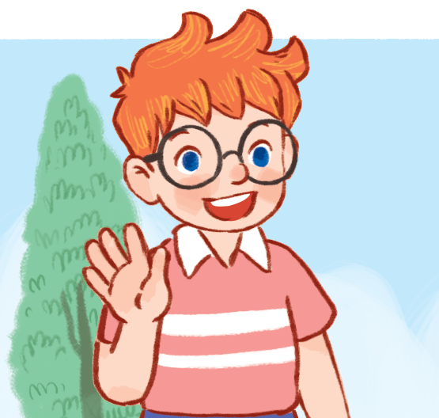
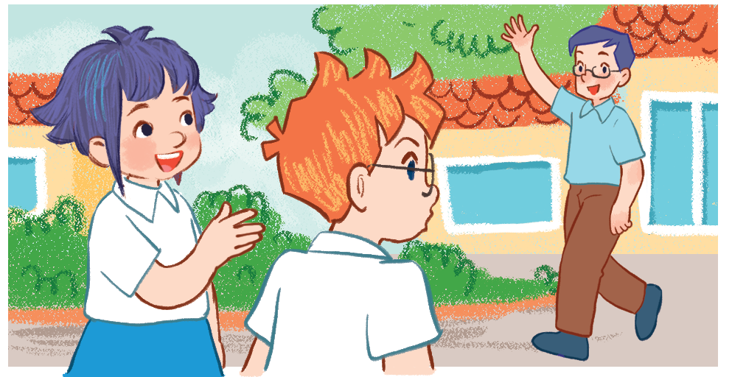
Look and say.
1
2
3
Time-meter

Slide 9






….. is Mr Long.
….. is Minh
….. is Ben.
1
2
3
Time-meter

Slide 10

….. is Bill
….. is Mary.
….. is Mai..
1
2
3
Time-meter

Slide 11



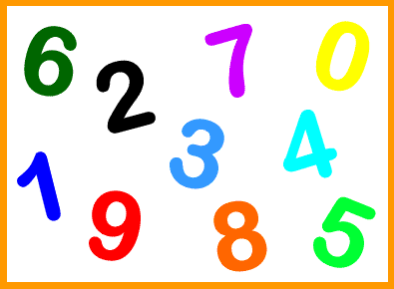

How do you spell your name?
How old are you?
Good afternoon.
1
2
3
Time-meter

Slide 12
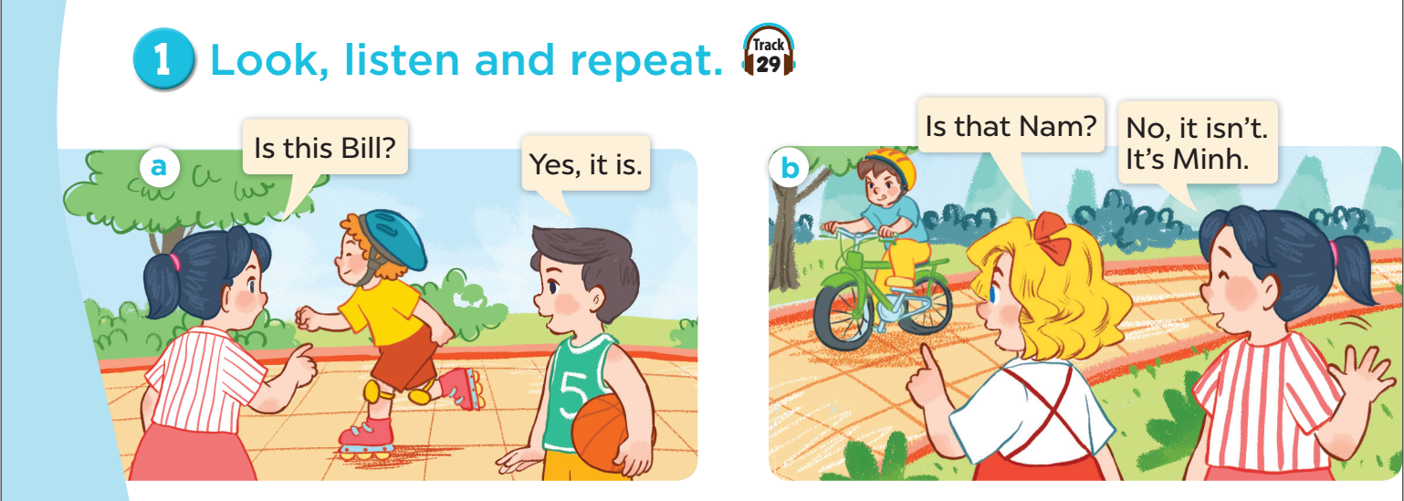


Notes:
G

Slide 13
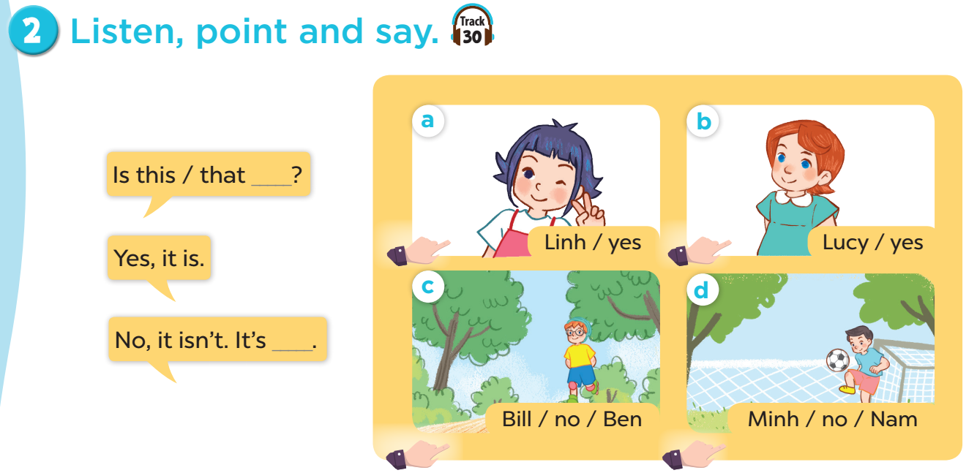
Notes:
G

Slide 14
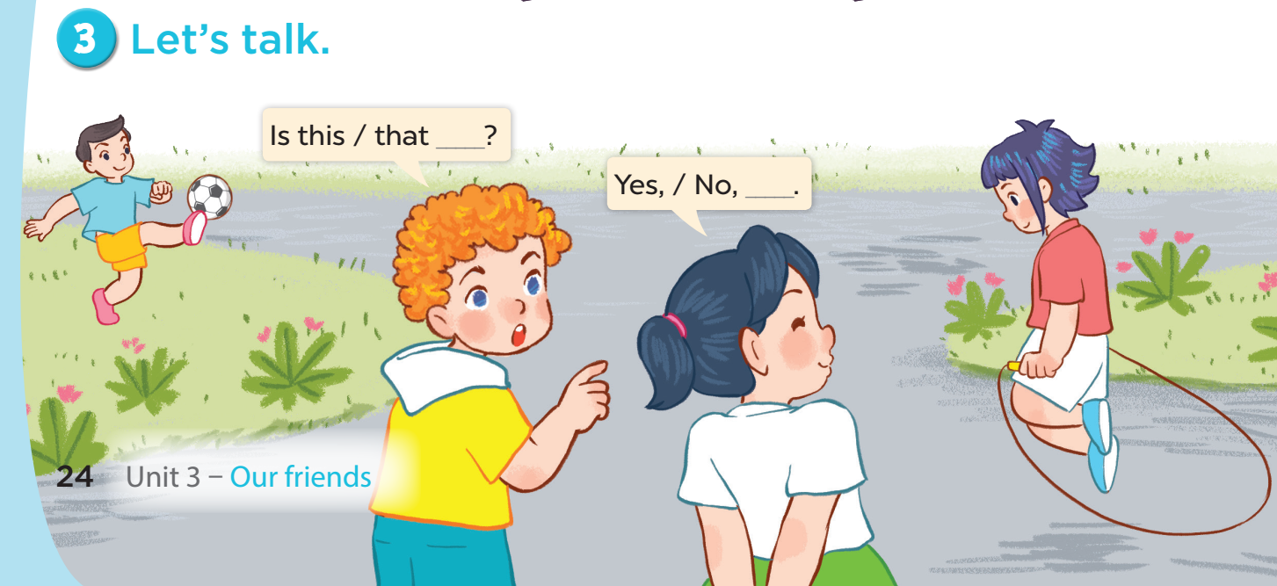
Notes:
G

Slide 15









A
B
Fun corner & Wrap-up
5
1
3
2
4
5
8
6
7
Notes:
Divide the class into 2 teams. Have the teams take turns to choose numbers. Teachers clicks the chosen numbers to go to the questions. For each correct answer, pupils choose a number to get their points. The team with more points will be the winner.

Slide 16
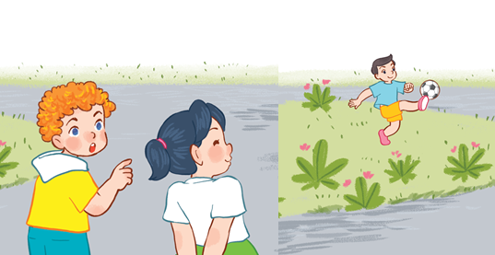

Is that Minh?
A
Yes, it is.
No, it isn’t.
B

Slide 17


Is this Linh?
A
Yes, it is.
No, it isn’t.
B

Slide 18
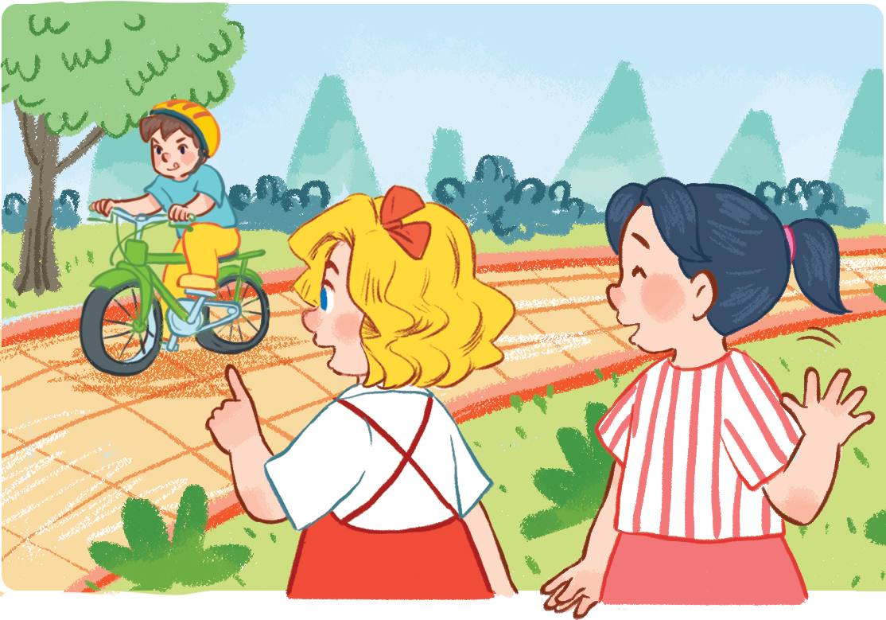
Is that Nam?
Yes, it is.
A
B
No, it isn’t.

Slide 19
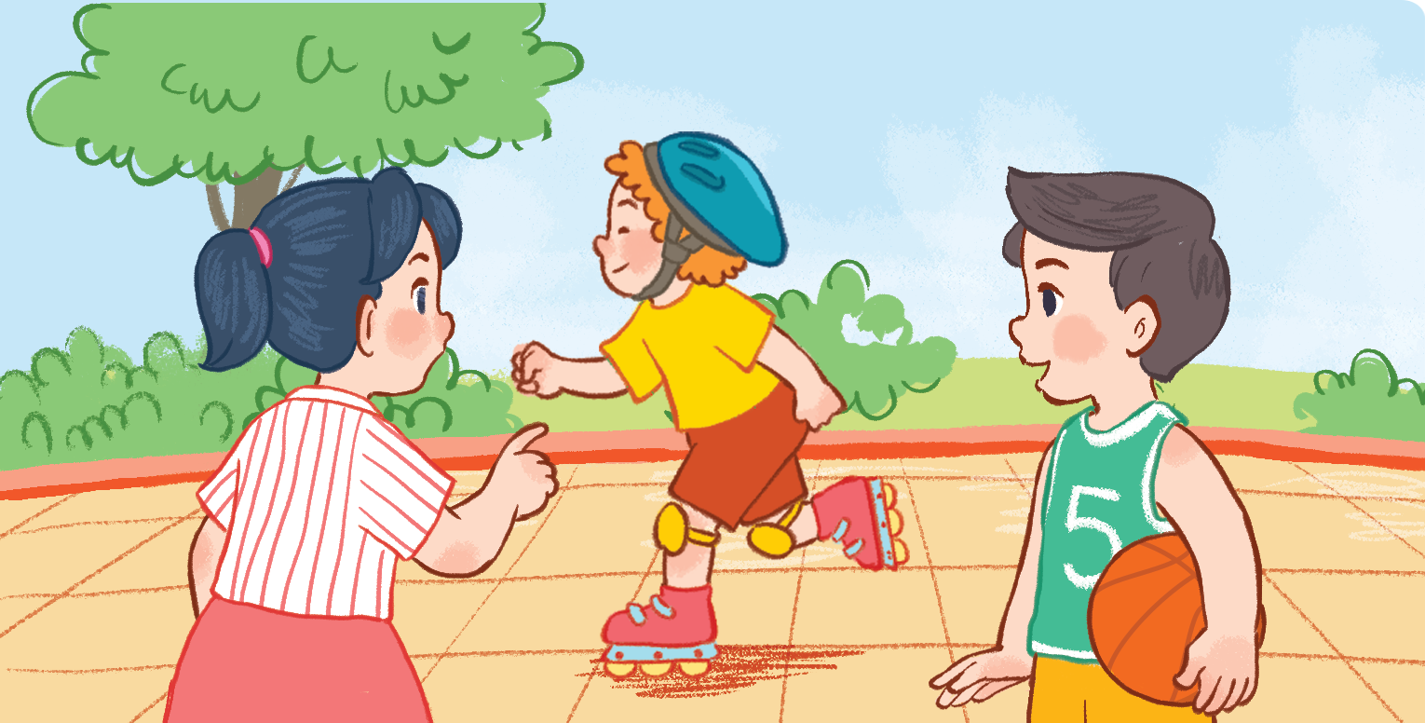
Is this Bill?
A
Yes, it is.
No, it isn’t.
B

Slide 20
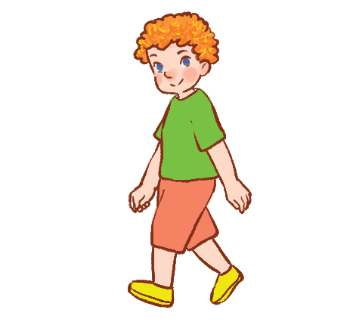

Is that Ben?
A
Yes, it is.
No, it isn’t.
B

Slide 21

Is this Lucy?
A
Yes, it is.
No, it isn’t.
B

Slide 22
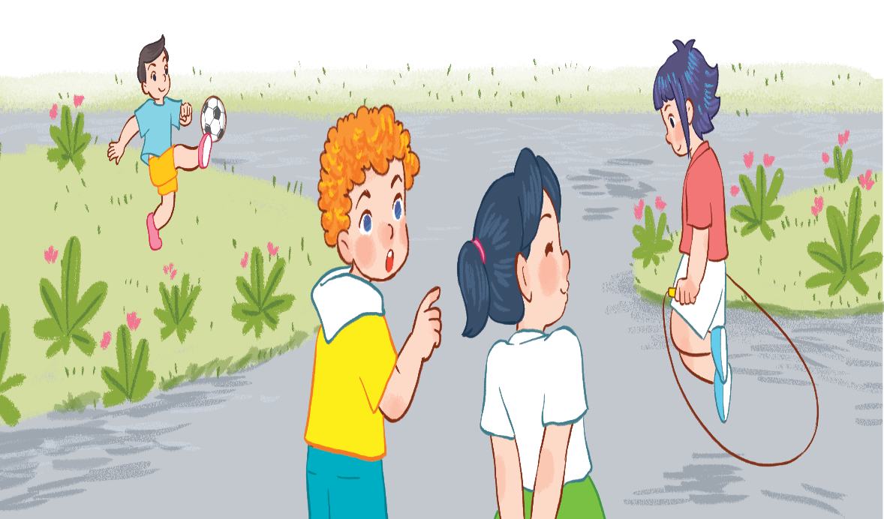
Is that Mai?
Yes, it is.
A
B
No, it isn’t.

Slide 23
Is this Mai?
A
Yes, it is.
No, it isn’t.
B

Slide 24


+2
+7
+15
-5
Choose 1
+3
BOMB - 10!
BOMB!
+10
Notes:
Click the colour, NOT the symbol to reveal the points pupils will get.
Nothing will happen if you click on the symbol.

Slide 25
+3
-5
+2
+5
Choose 1
+3
Switch Points!
BOMB!
BOMB - 10!
Notes:
Click the colour, NOT the symbol to reveal the points pupils will get.
Nothing will happen if you click on the symbol.

Slide 26
+20
+15
+15
+5
Choose 1
+25
BOMB -5!
+20
+10
Notes:
Click the colour, NOT the symbol to reveal the points pupils will get.
Nothing will happen if you click on the symbol.

Slide 27
+20
-10
+15
+15
Choose 1
+5
+10
BOMB!
+10
Notes:
Click the colour, NOT the symbol to reveal the points pupils will get.
Nothing will happen if you click on the symbol.

Slide 28

Notes:
G

