Slide 1








Unit 2:Our homes
Lesson 2 - Period 4

Slide 2



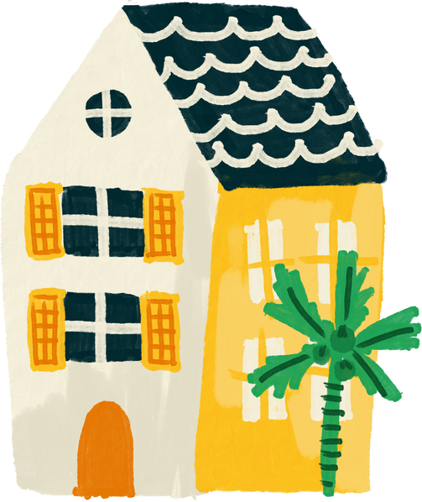

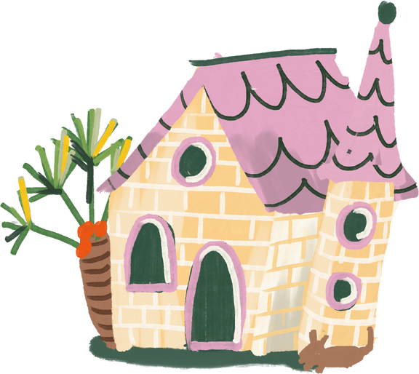
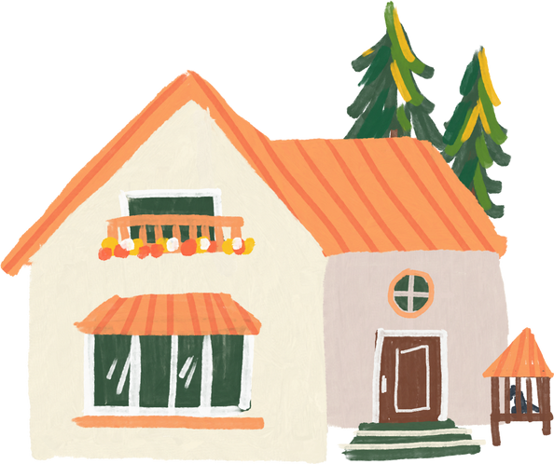
Warm-up and review

Slide 3


55
49
45

Slide 4
17
79
97

Slide 5
135
153
159

Slide 6
376
267
276

Slide 7
77
17
70

Slide 8
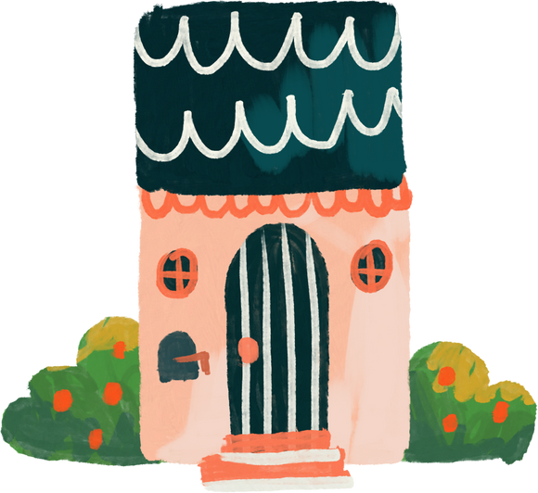
4.Listen and circle.

Slide 9
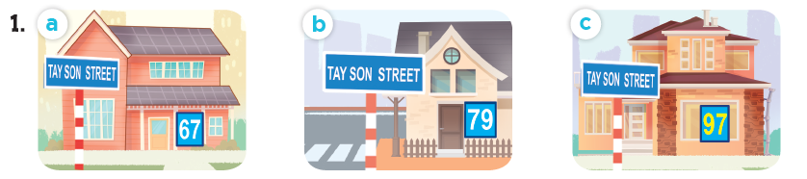
Look and say the number.
sixty-seven
seventy-nine
ninety-seven

Slide 10
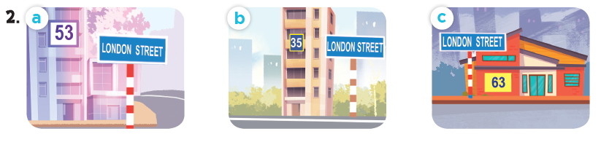
Look and say the number.
fifty-three
thirty-five
sixty-three

Slide 11
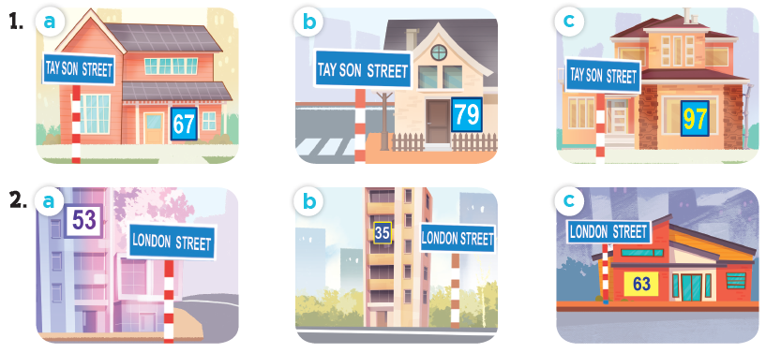
Listen and circle.

Slide 12
5.Read and complete.

Slide 13
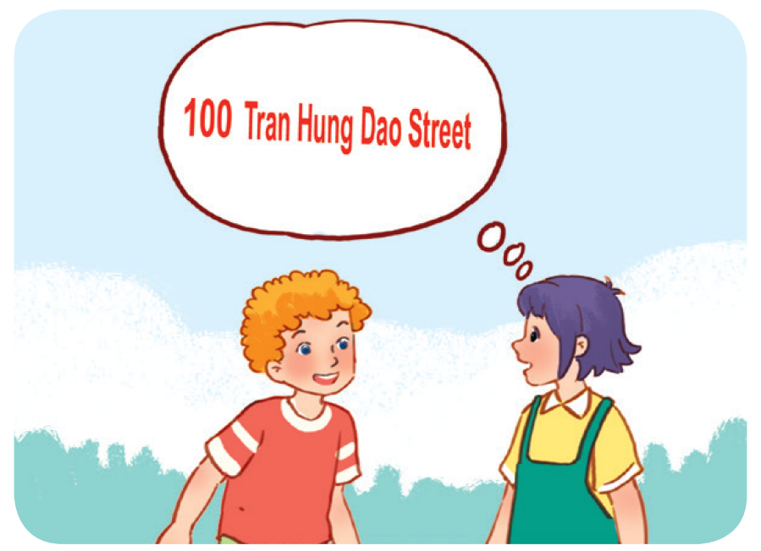
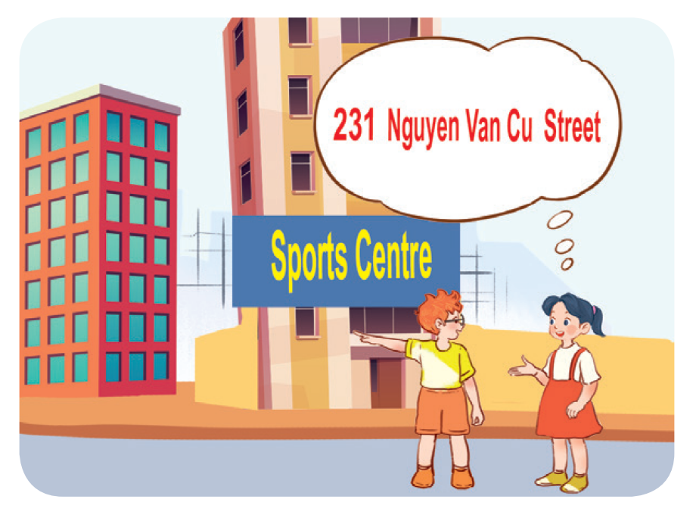
Work in pairs. Read and complete.
1. A: What’s your address?
B: It’s ________________.
A: Is it far ________________ here?
B: Yes, it is. It’s about ten kilometres from here.
2. A: I live in ________________ building over there.
B: Oh, it’s near the sports centre.
A: ________________ do you live?
B: I live far from here, in District 5.
A: ________________ your address?
B: It’s ________________.

Slide 14
Work in pairs. Read and complete.
1. A: What’s your address?
B: It’s ________________________.
A: Is it far ______ here?
B: Yes, it is. It’s about ten kilometres from here.
100 Tran Hung Dao Street
from

Slide 15
Work in pairs. Read and complete.
2. A: I live in ______________ building over there.
B: Oh, it’s near the sports centre.
A: _________ do you live?
B: I live far from here, in District 5.
A: ________ your address?
B: It’s _________________________.
that
Where
What’s
231 Nguyen Van Cu Street

Slide 16
6.Listen, complete and sing.

Slide 17

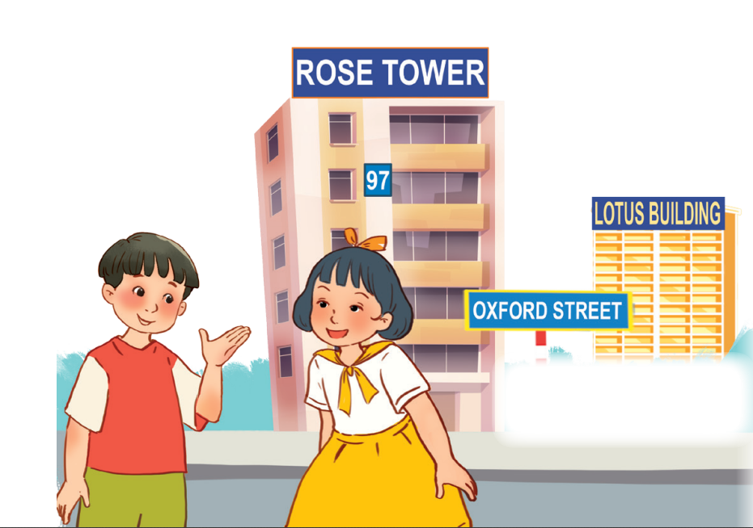
Let’s sing.
Look and read.
Listen and complete.
building
Do you live in that (1) _______?
No, I don’t.
Do you live in this (2) ______?
Yes, I do.
What’s your address?
It’s (3) _____ Oxford Street.
tower
19

Slide 18
05
Fun corner and wrap-up

Slide 19

Where do I live?

Slide 20













boys
girls
Notes:
Teacher can insert a picture of her/ his address behind the puzzles. After the game, students know teacher’s address.

Slide 21
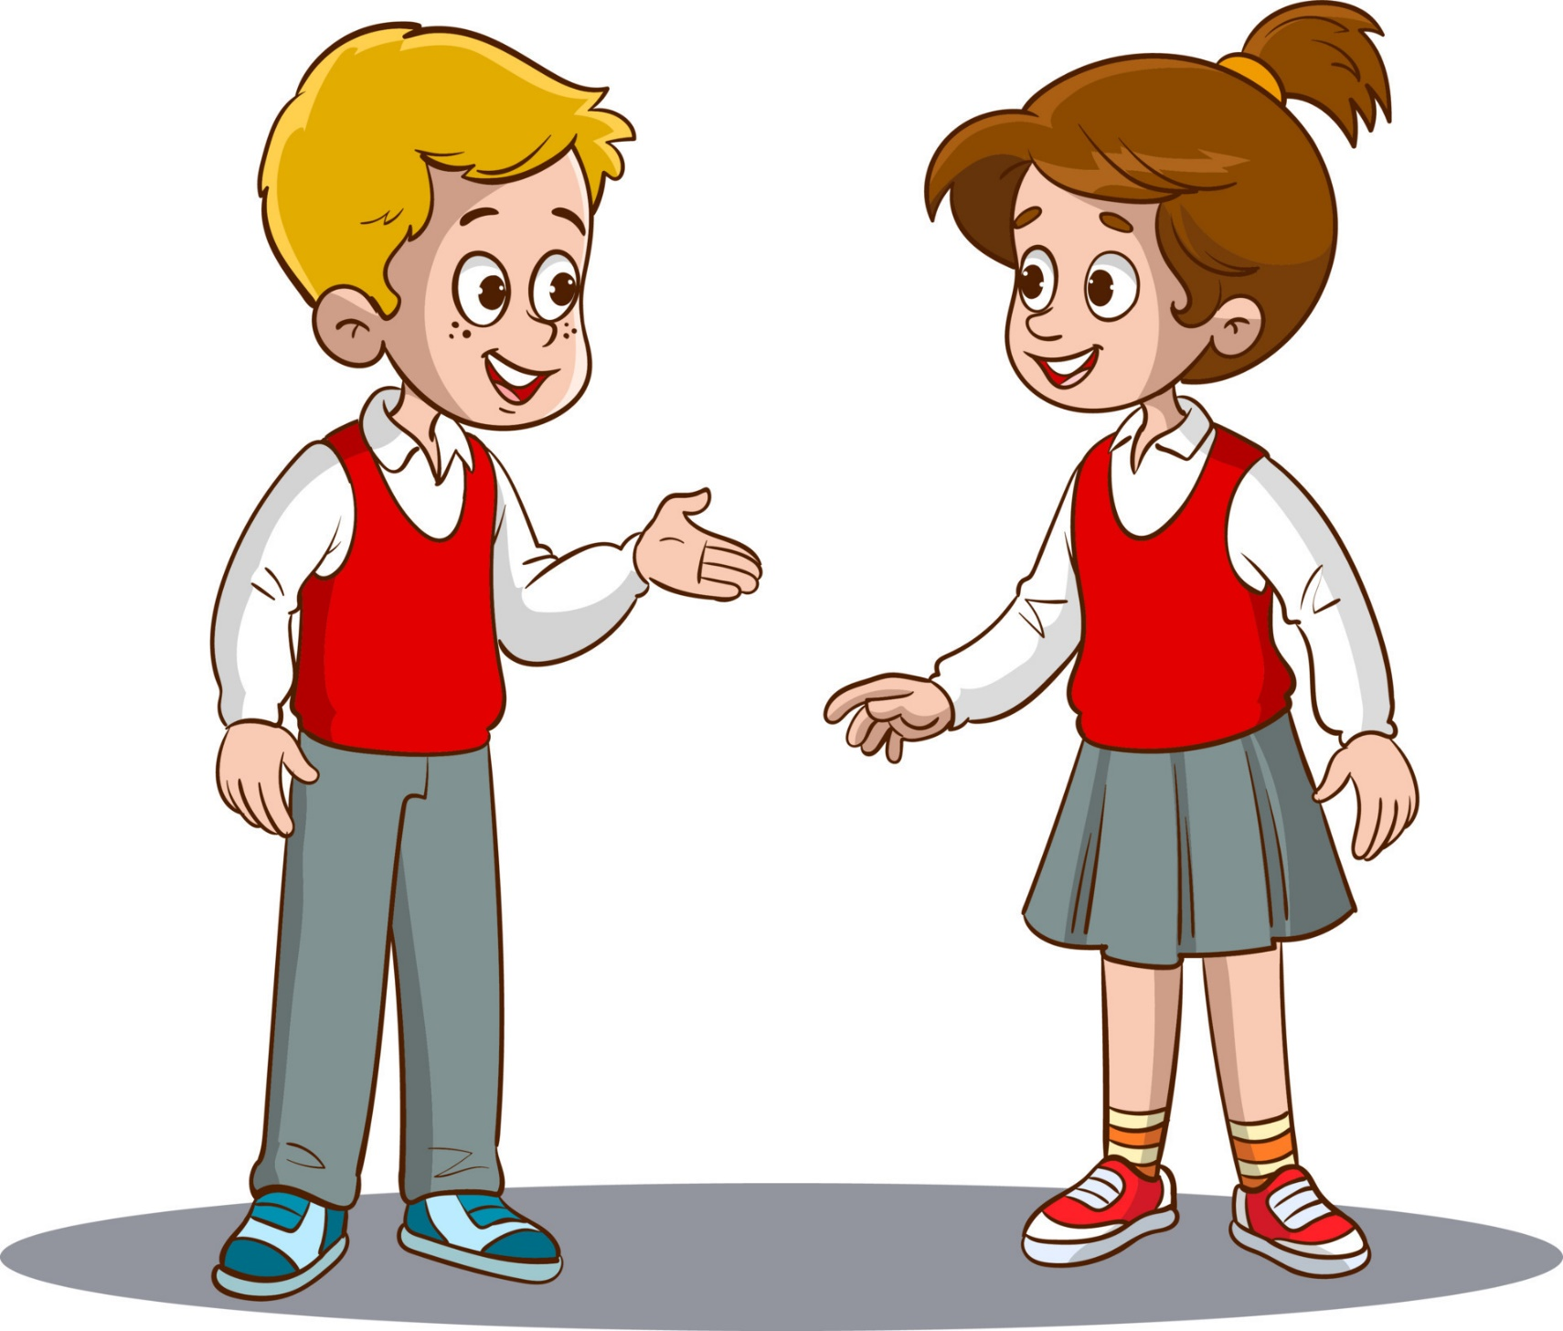

______ is your address?
What
It’s 23 London Street.

Slide 22




Slide 23
I live in Sports Centre Building.
Where
______ do you live?

Slide 25

It’s 126 Tran Phu Street.
What is your _______?
address

Slide 27
No, it isn’t.
Is it far _____ here?
from

Slide 29
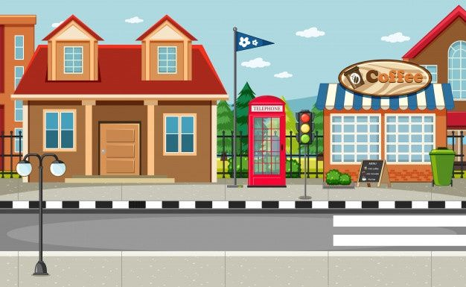

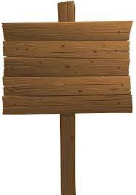
What’s your address?
32
Oxford
It’s _________________.
32 Oxford Street

Slide 31
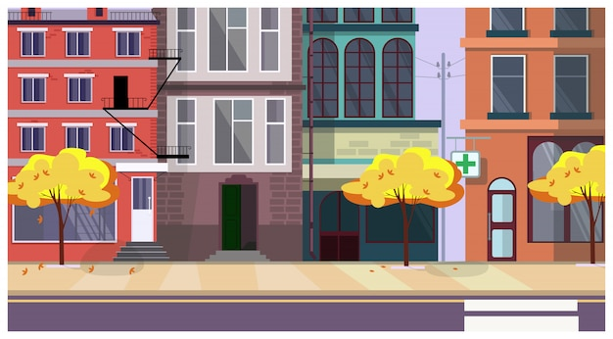
London
I live on London _______.
Street

