Slide 1
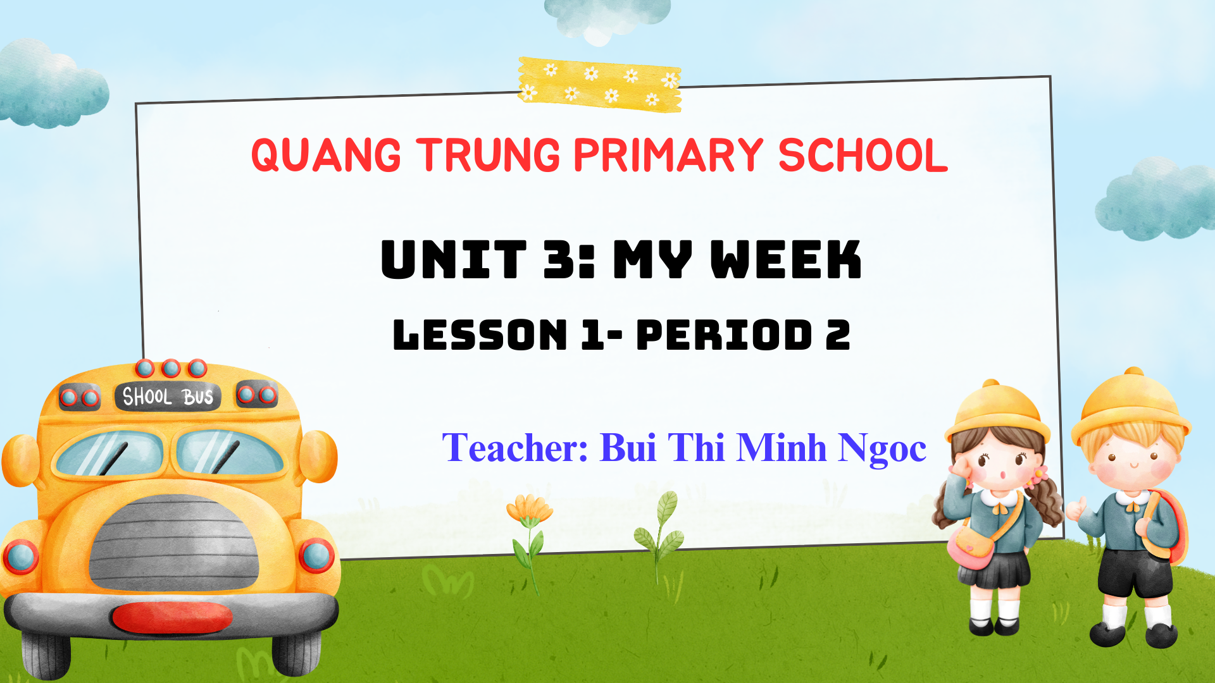

Slide 2



My week
3
LESSON 1 - PERIOD 2
SUNDAY
SUNDAY
MONDAY
TUESDAY
WEDNESDAY
THURSDAY
FRIDAY
SATURDAY

Slide 3
Table of contents
01
Warm-up
04
02
03
Let’s play.
Listen and tick.
05
Fun corner & wrap-up
Look, complete and read.

Slide 4
01
Warm-up Look and guess.

Slide 5
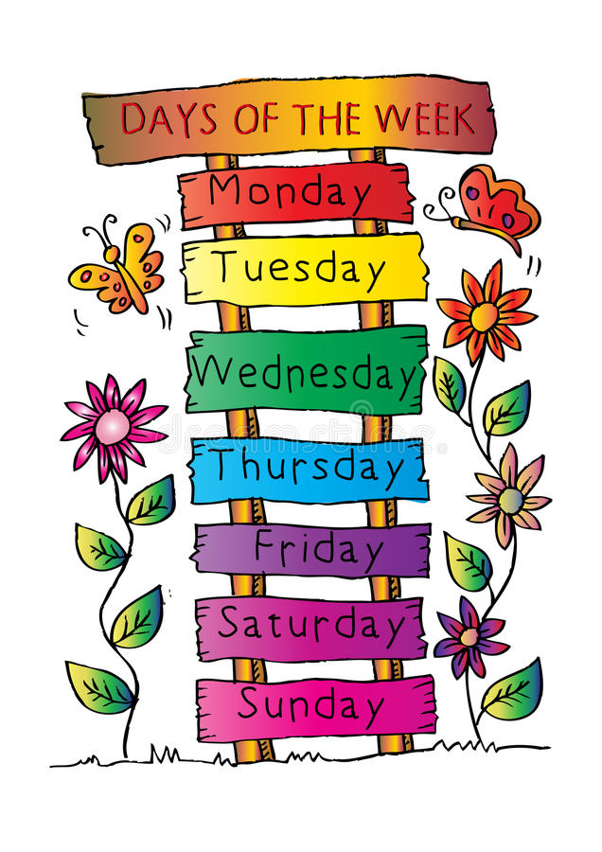
What day is it today?
What day is it today?
What day is it today?
Notes:
chant the question
correct pronunciation if possible

Slide 6


What day is it today?

Slide 7


What day is it today?

Slide 8

What day is it today?

Slide 9


What day is it today?

Slide 10
02
Activity 4 Listen and tick.

Slide 11
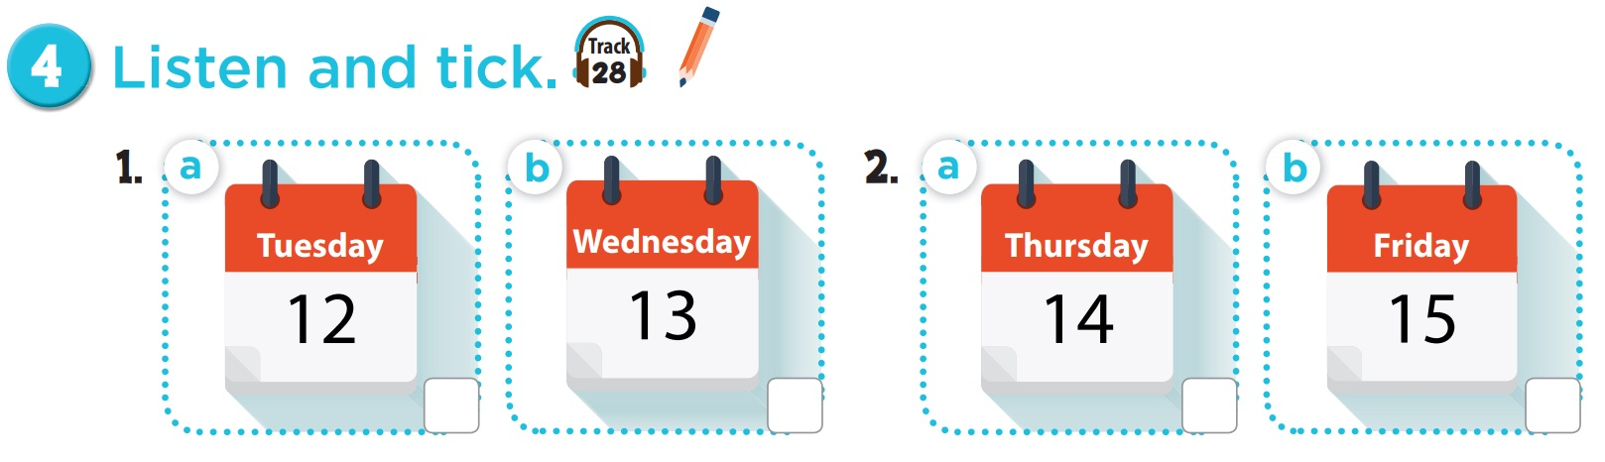



Slide 12
1. Ms Hoa: Hello, Nam.
Nam: Hello, Ms Hoa. Ms Hoa: What day is it today? Nam: It’s Wednesday. Ms Hoa: OK.
2. Mr Long: Hello, Mai. Mai: Hello, Mr Long. Mr Long: What day is it today?
Mai: It’s Thursday. Mr Long: Good.

Slide 13
03
Activity 5 Look, complete and read.

Slide 14
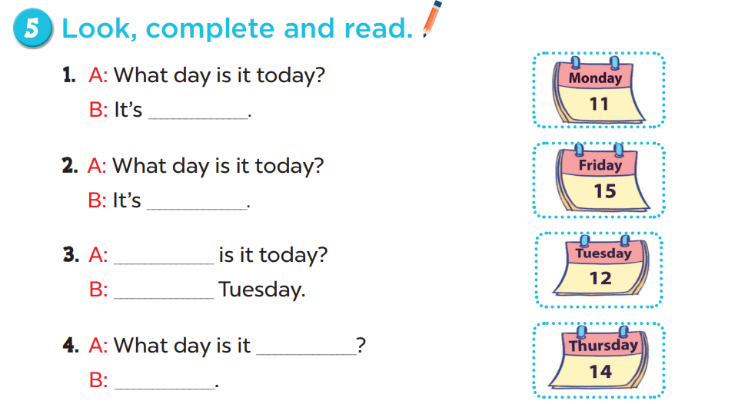
Monday
Friday
What day
It’s
today
It’s Thursday

Slide 15
04
Activity 6 Let’s play.

Slide 16
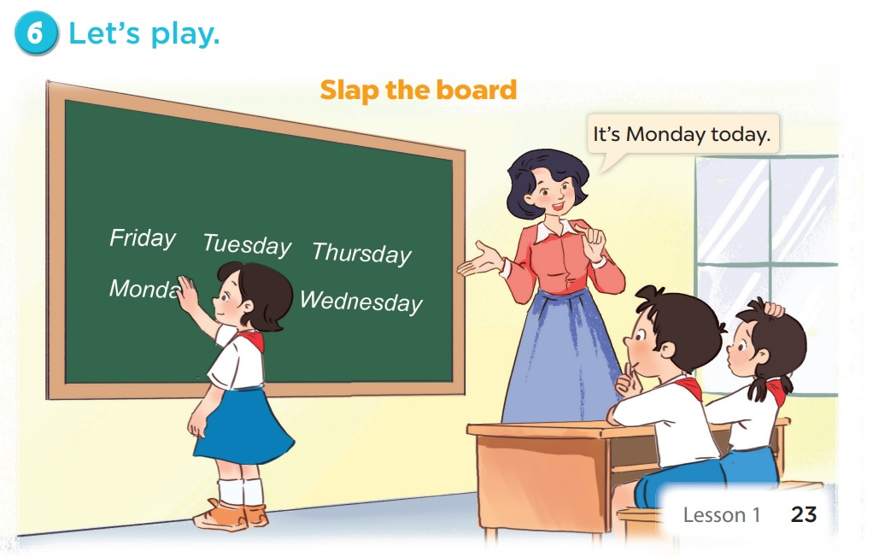

Slide 17
05
Fun corner & wrap-up

Slide 18


GUESS THE WORDS.

Slide 19

5 seconds to find it

Slide 20
10 seconds to spell and say the word out loud

Slide 21
5 seconds to say the word out loud

Slide 22
Which letter is missing?

