Slide 1


QUANG TRUNG PRIMARY SCHOOL
Unit 3: At the seaside
Lesson 3 – Period 3
Teacher: Bui Thi Minh Ngoc

Slide 2

TABLE OF CONTENTS
1. Warm-up & Review
2. Activity 6. Listen and repeat.
3. Activity 7. Let’s talk.
4. Activity 8. Let’s sing.
5. Fun corner & Wrap-up

Slide 3
01
WARM-UP & REVIEW
Game: A magic apple

Slide 4








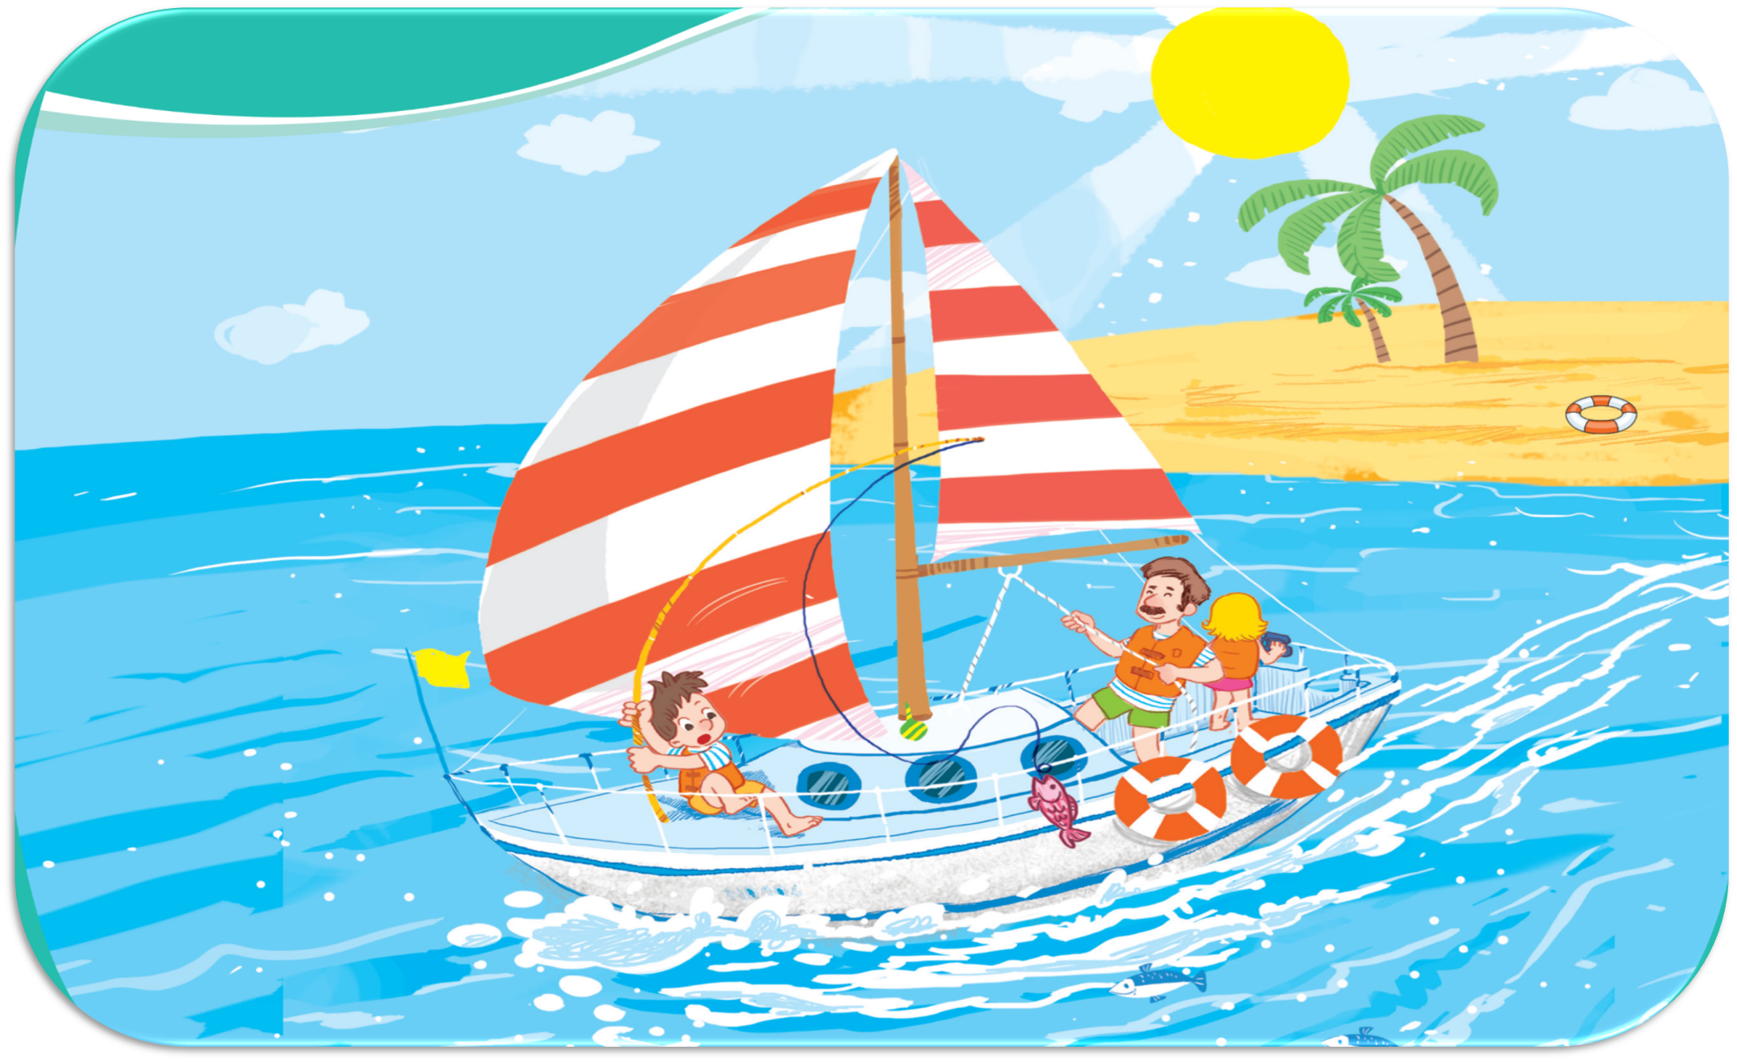



Oops, Try again!
3
2
5
4
6
1
Let’s look at the sail!
Let’s look at the seaside!
Let’s look at the sun!
7
Let’s look at the sand!
Let’s look at the sea!
TEAM 1
TEAM 2
Notes:
Click the apple to see the picture then say the sentences
Click the pictures to see the right sentences
Click the pictures again to clear them
Click the Team 1/ 2 to get points/ presents

Slide 5

Team 1
3
2
5
4
6
1
7
Back

Slide 6
Team 2
3
2
5
4
6
1
7
Back

Slide 7


Team …

Slide 8
02
Activity 6
Listen and repeat.

Slide 9





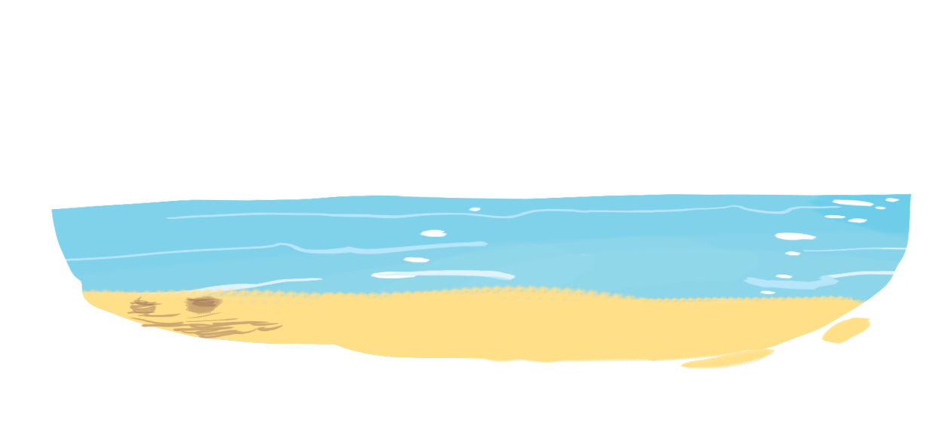
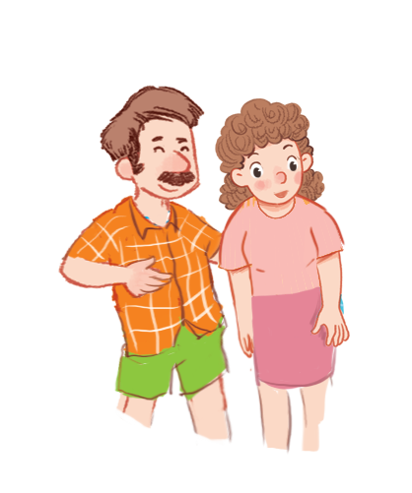

Unit
6. Listen and repeat.
Let’s look at the sea!

Slide 10
03
Activity 7
Let’s talk.

Slide 11





Unit
7. Let’s talk.
Let’s ____ !
a
b
c

Slide 12

Unit
7. Let’s talk.
Let’s ____ !
a

Slide 13

Unit
7. Let’s talk.
Let’s ____ !
b

Slide 14

Unit
7. Let’s talk.
Let’s ____ !
c

Slide 15
04
Activity 8
Let’s sing.

Slide 16


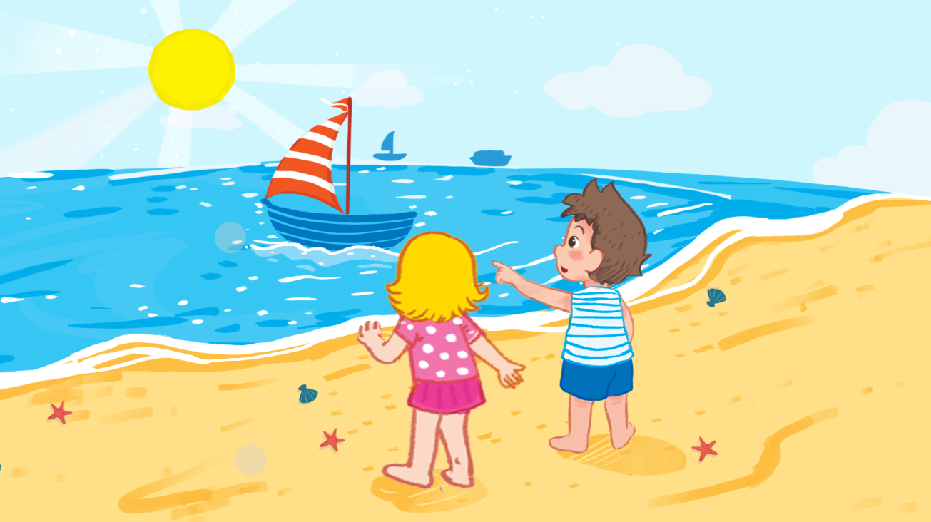

Unit
Let’s sing!

Slide 17

Unit
Let’s sing!
Saturday

Slide 18

Unit
Let’s sing!
sunny

Slide 19
Unit
Let’s sing!
It’s Saturday.
It’s a sunny day.
We’re at the seaside.
Let’s look at the sail!
It’s Sunday.
It’s a sunny day.
We’re at the seaside.
Let’s look at the sand!

Slide 20



Slide 21


Watch and sing along

Slide 22
05
Fun corner & Wrap-up
Game: Lucky numbers

Slide 23
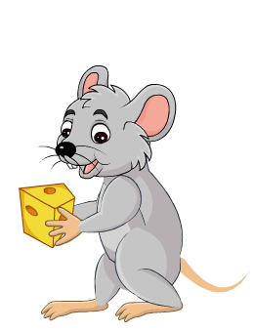




Game: Lucky numbers
1
2
3
4
You get points
5
6
7
8

Slide 24

Let’s ____________!
look at the sea

Slide 25

see the sail
I can __________.

Slide 26

I can __________.
see the sand

Slide 27

sunny
It’s a ____ day.

Slide 28


Slide 29


