Slide 1
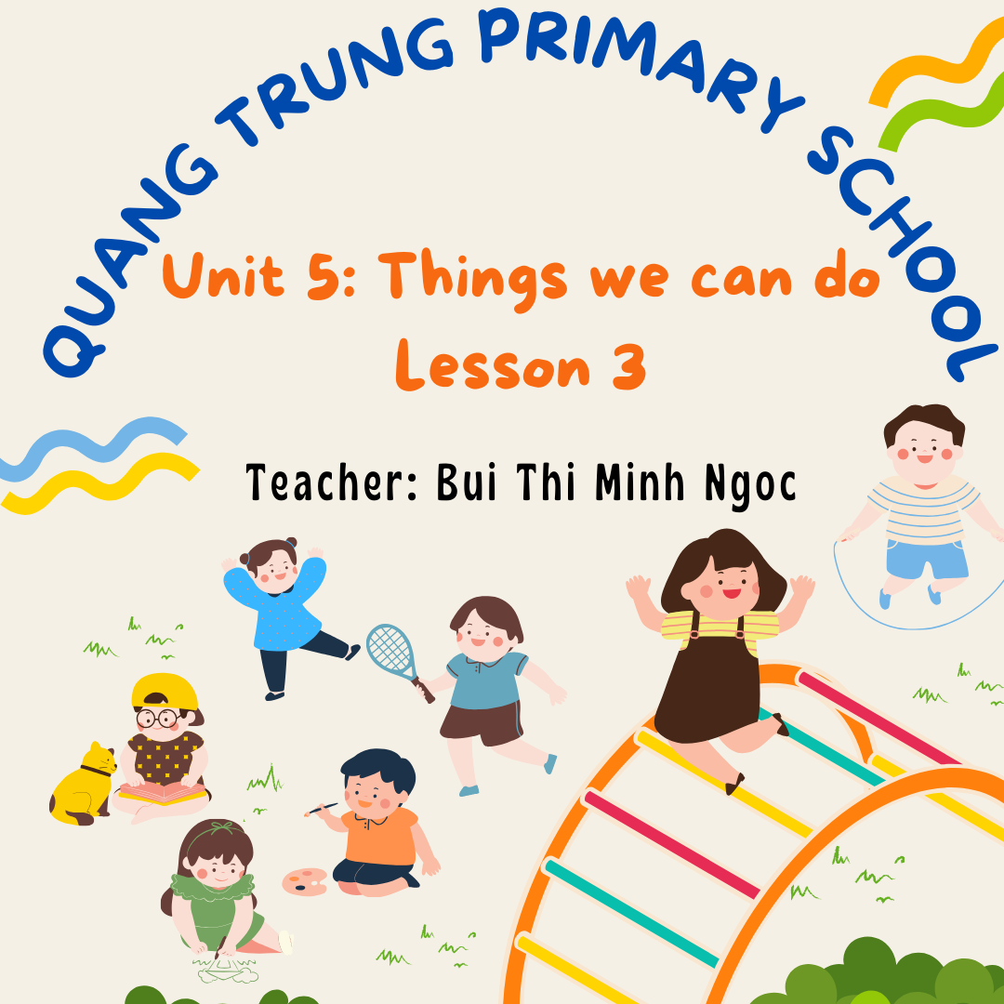

Slide 2



Things we can do
5
LESSON 3 PERIOD 6

Slide 3
Contents
01
Warm-up
04
Game
Activity 1
02
03
Activity 2
05
Project
Read and tick.
Let’s write.

Slide 4
01
Warm-up

Slide 5
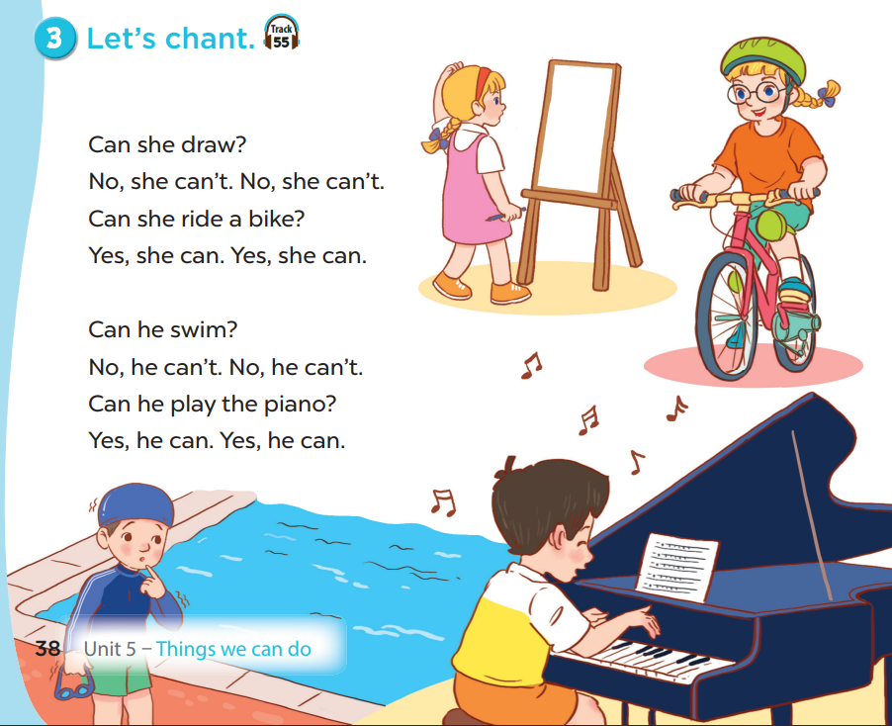


Slide 6
02
Activity 1
Read and tick.

Slide 7



She can sing.
She can’t write.
She can sing but she can’t write.

Slide 8
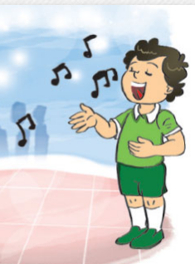
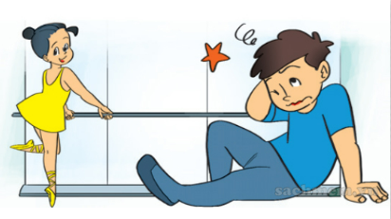
He can sing.
He can’t dance.
He can sing but he can’t dance.

Slide 9
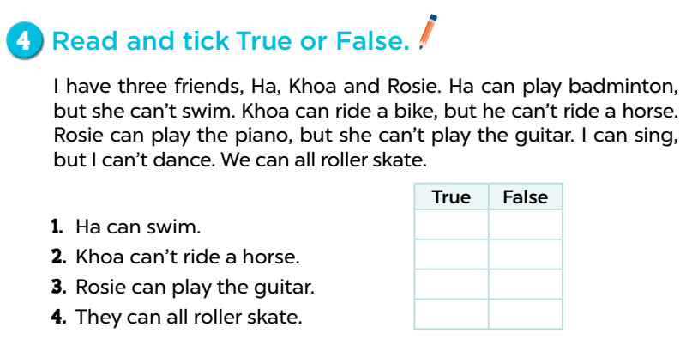








Slide 10
03
Activity 2
Let’s write.

Slide 11
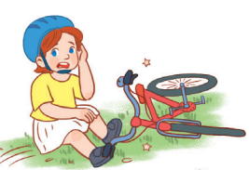

Lucy
Can Lucy ride a bike?
No, she can’t.
She can’t ride a bike.

Slide 12
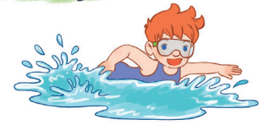
Ben
Can Ben swim?
Yes, he can.

Slide 13
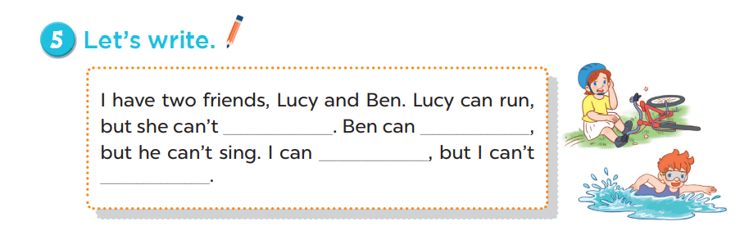
ride a bike
swim

Slide 14
04
Game

Slide 15








TEAM 1:
TEAM 2:
TEAM 3:

Slide 16



Point
+10
Lose all points

Slide 17
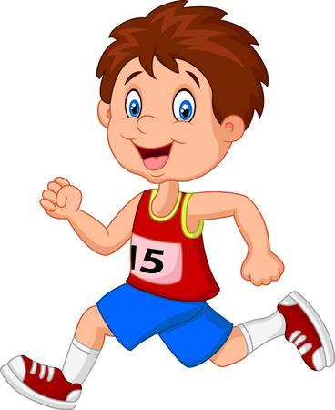
What can he do?.
He can run..

Slide 18

What can she do?
She can drive a car..

Slide 19

Can she play the piano?
No, she can’t..

Slide 20

Can he skateboard?.
Yes, he can..

Slide 21
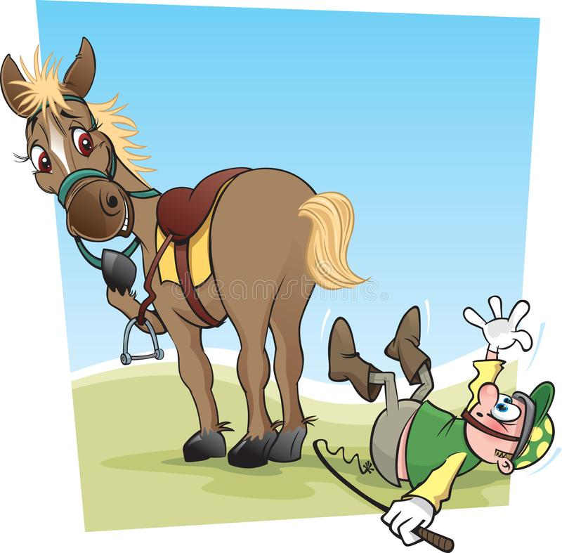
What can’t he do?
He can’t ride a horse..

Slide 22
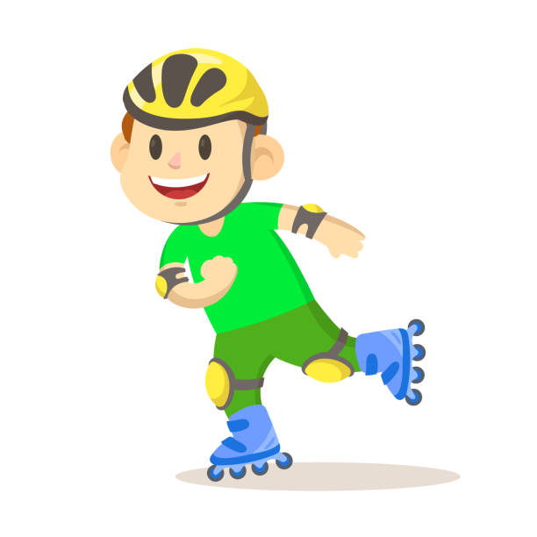

Make a sentence..
He can roller skate but
he can’t climb a tree.
…. but …

Slide 23

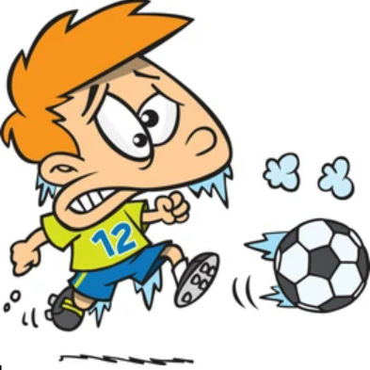
Make a sentence..
He can play badminton but
he can’t play football.
… but …

Slide 24
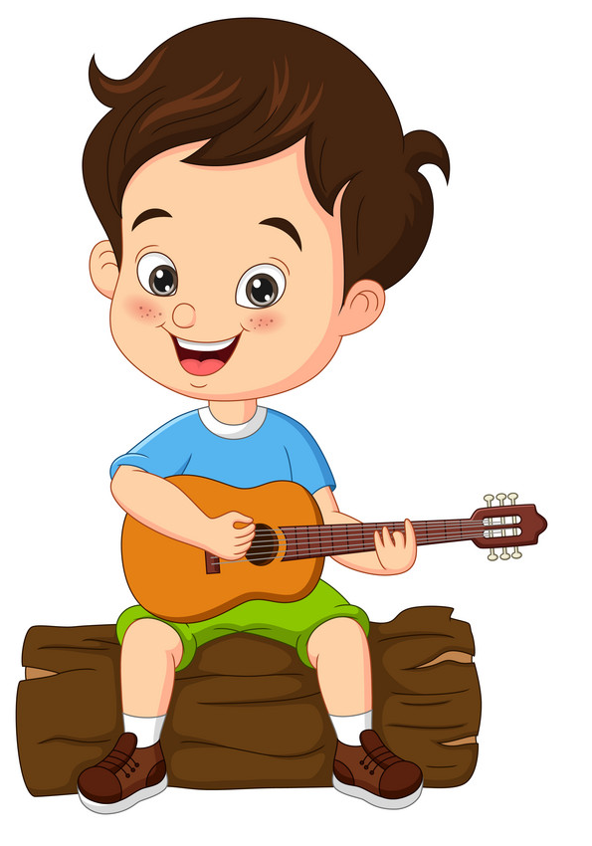
What can he do?
He can play the guitar..

Slide 25
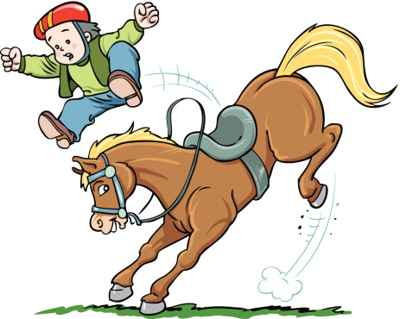
What can’t he do?.
He can’t ride a horse.

Slide 26
05
Project

Slide 27
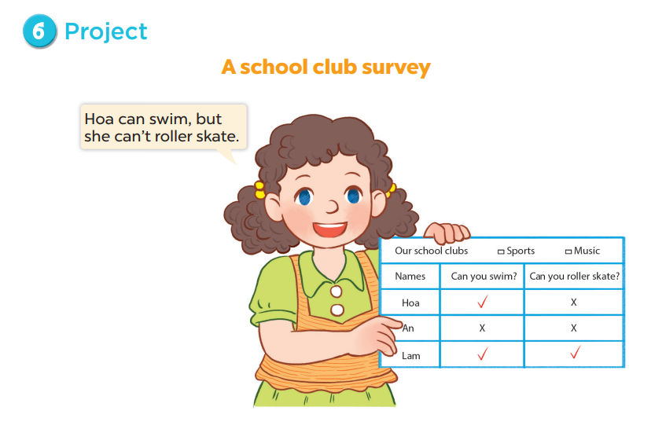

Slide 28


Work in group of 4 or 5.
Choose a club.
Complete the survey.
Present to the class.

Slide 29
Our school club | SPORT MUSIC | MUSIC
Names | Can you …………………? | Can you …………………?

Slide 30

Presentation

Slide 31


