Slide 1
QUANG TRUNG PRIMARY SCHOOL
Extension
activities
Teacher: Bui Thi Minh Ngoc

Slide 2
TABLE OF CONTENTS
01
02
03
Warm-up
Look and write.
Look and write.
04
05
Read the questions. Then tick the answers.
Game

Slide 3
01
Warm-up

Slide 4
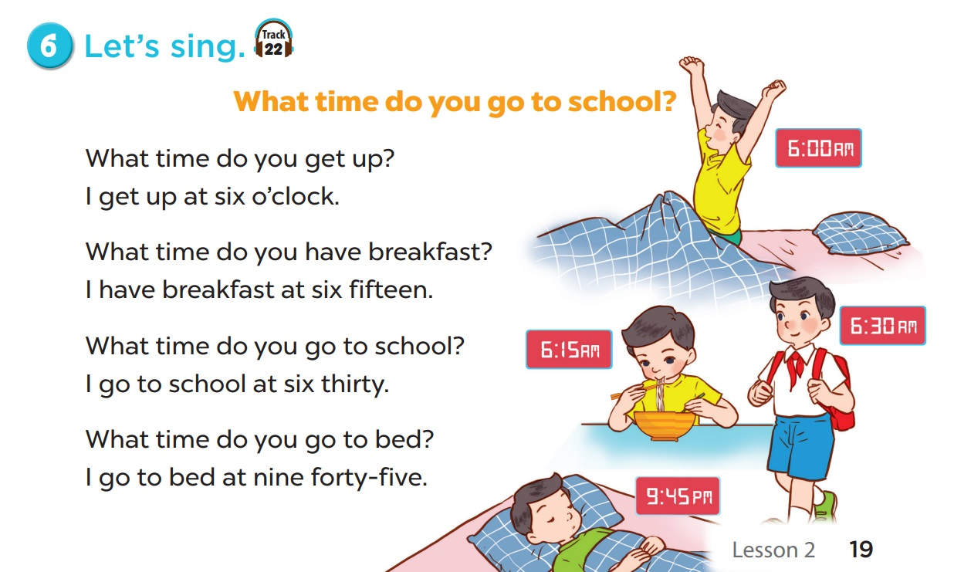

Notes:
Teacher may let pupils watch the animation video of the song and have them sing along.
https://www.youtube.com/watch?v=-GAWoPPtI8c&list=PL8_ETpRL2xNay3h-a-vBjWhplE1wXFpSJ&index=

Slide 5
02
Look and write.

Slide 6
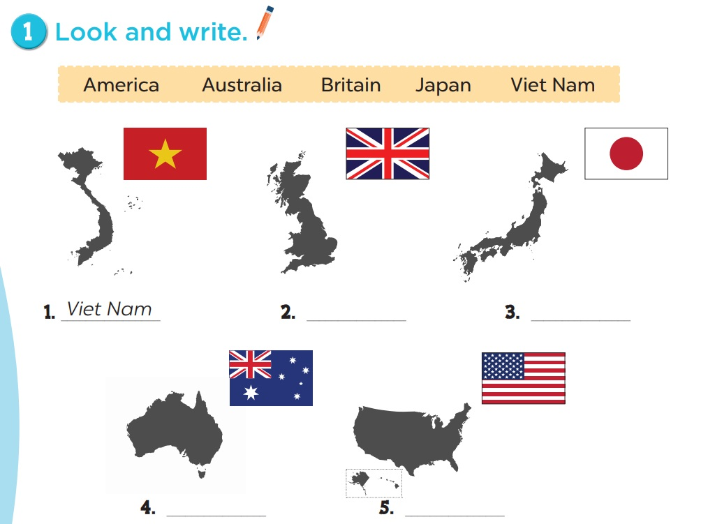
2. Britain
3. Japan
4. Australia
5. America

Slide 7
03
Look and write.

Slide 8
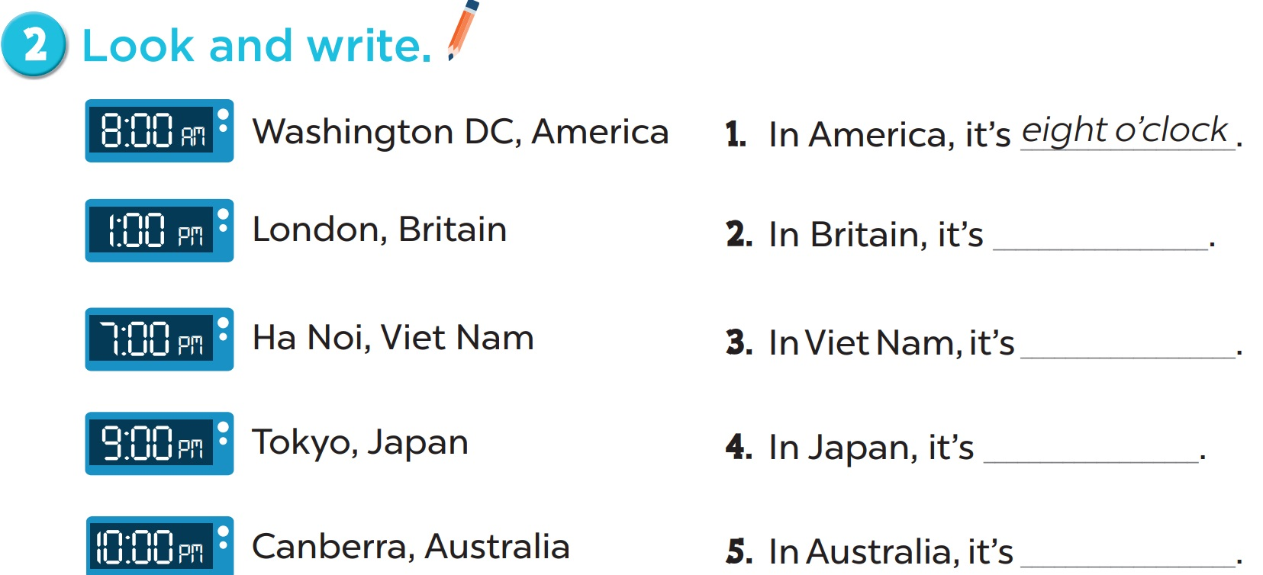
one o’clock
seven o’clock
nine o’clock
ten o’clock

Slide 9
04
Read the questions. Then tick the answers.

Slide 10
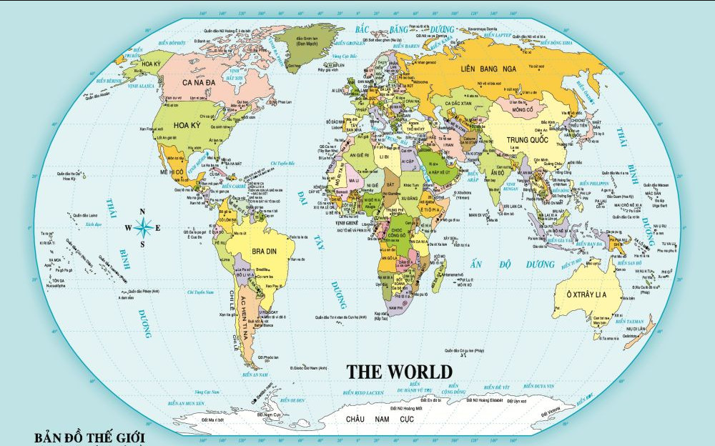
Where is Viet Nam?
Where is Viet Nam?
Where is USA?
Notes:
Ask pupils to look at the map and find the countries. Draw lines from countries to Viet Nam.

Slide 11
Where is Viet Nam?
Where is Russia?
Where is Viet Nam?
Notes:
Ask pupils to look at the map and find the countries. Draw lines from countries to Viet Nam.

Slide 12
Where is Viet Nam?
Where is Thailand?
Where is Viet Nam?
Notes:
Ask pupils to look at the map and find the countries. Draw lines from countries to Viet Nam.

Slide 13
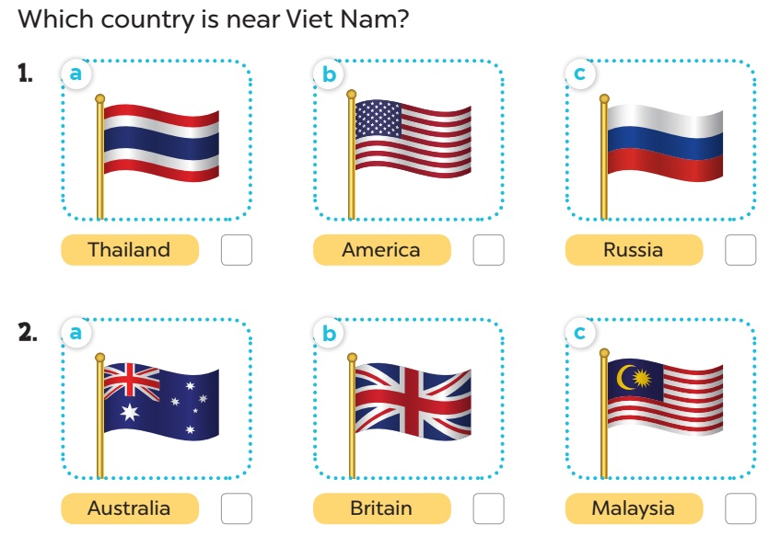


Slide 14
Where is Viet Nam?
Where is Australia?
Where is Viet Nam?
Notes:
Ask pupils to look at the map and find the countries. Draw lines from countries to Viet Nam.

Slide 15
Where is Viet Nam?
Where is Britain?
Where is Viet Nam?
Notes:
Ask pupils to look at the map and find the countries. Draw lines from countries to Viet Nam.

Slide 16
Where is Viet Nam?
Where is Malaysia?
Where is Viet Nam?
Notes:
Ask pupils to look at the map and find the countries. Draw lines from countries to Viet Nam.

Slide 17
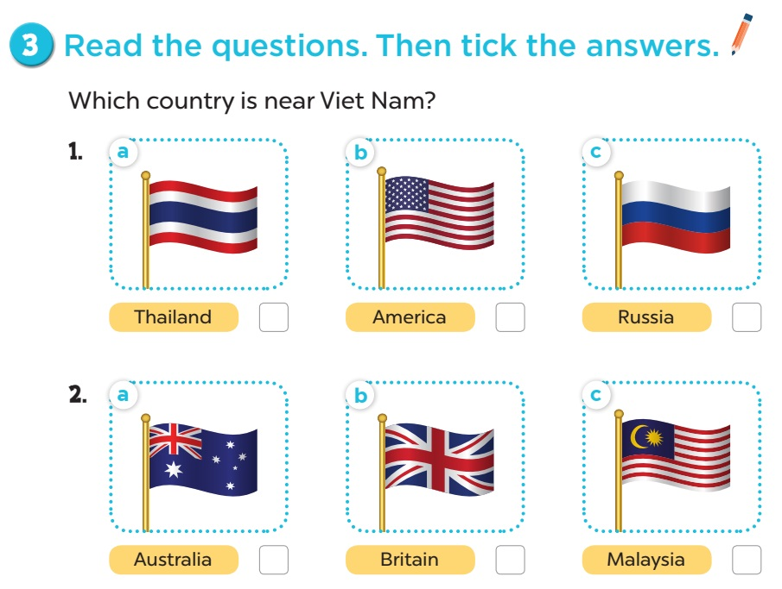

Slide 18
Where is Viet Nam?
Where is Canada?
Where is Viet Nam?
Notes:
Ask pupils to look at the map and find the countries. Draw lines from countries to Viet Nam.

Slide 19
Where is Viet Nam?
Where is Thailand?
Where is Viet Nam?
Notes:
Ask pupils to look at the map and find the countries. Draw lines from countries to Viet Nam.

Slide 20
Where is Viet Nam?
Where is Viet Nam?
Where is Singapore?
Notes:
Ask pupils to look at the map and find the countries. Draw lines from countries to Viet Nam.

Slide 21
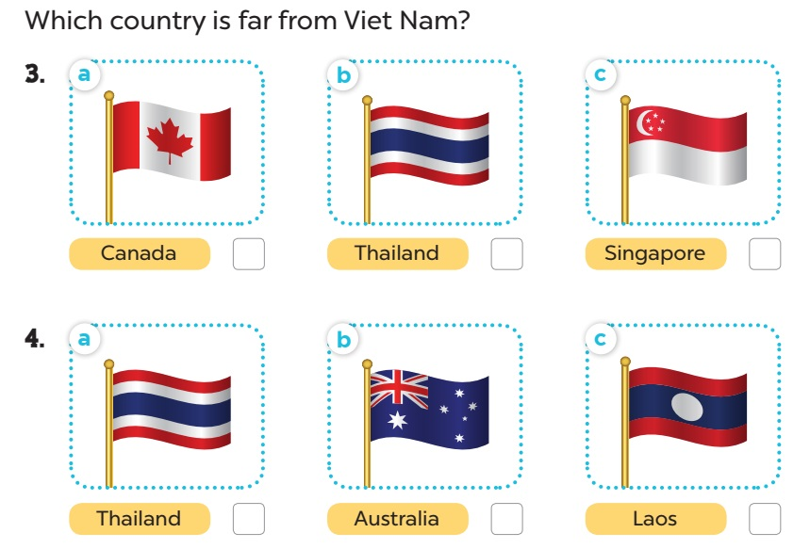

Slide 22
Where is Viet Nam?
Where is Viet Nam?
Where is Thailand?
Notes:
Ask pupils to look at the map and find the countries. Draw lines from countries to Viet Nam.

Slide 23
Where is Viet Nam?
Where is Australia?
Where is Viet Nam?
Notes:
Ask pupils to look at the map and find the countries. Draw lines from countries to Viet Nam.

Slide 24
Where is Viet Nam?
Where is Viet Nam?
Where is Laos?
Notes:
Ask pupils to look at the map and find the countries. Draw lines from countries to Viet Nam.

Slide 26
05
Game

Slide 27

Singapore

Slide 28

Thailand

Slide 29

Japan

Slide 30

Malaysia

Slide 31

Viet Nam

Slide 32

America

Slide 33

Britain

Slide 34

Australia

Slide 35




Look and guess.
Singapore
S_ _ _ _ _ _ _ _

Slide 36

Look and guess.
Thailand
T_ _ _ _ _ _ _

Slide 37

Look and guess.
A_s_ _ _l_ _
Australia

Slide 38

Look and guess.
C_n_d_
Canada

Slide 39

Look and guess.
Japan
J_ _ _ _

Slide 40

Look and guess.
_a_a_ _ _a
Malaysia

