Slide 1



Quang Trung Primary School
1
Hello
LESSON 3
Period 6
Teacher: DuongThi Bich Ngoc

Slide 2
Contents
1
2
Warm-up
Read and circle.
3
4
Let’s write.
Project
5
Fun corner and wrap-up

Slide 3
01
Warm-up
Let’s chant!

Slide 4

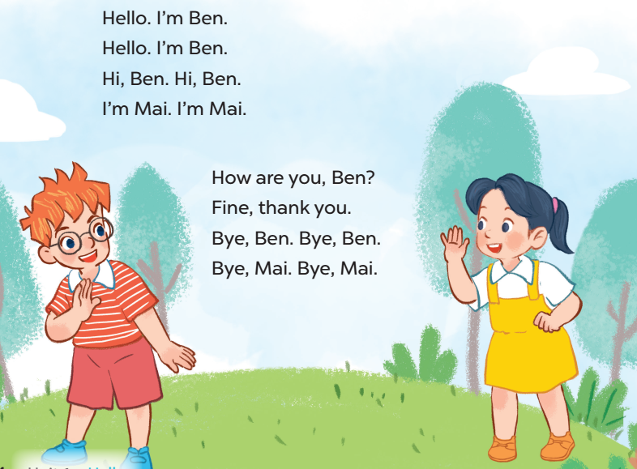


Slide 5
2
Read and circle.

Slide 6
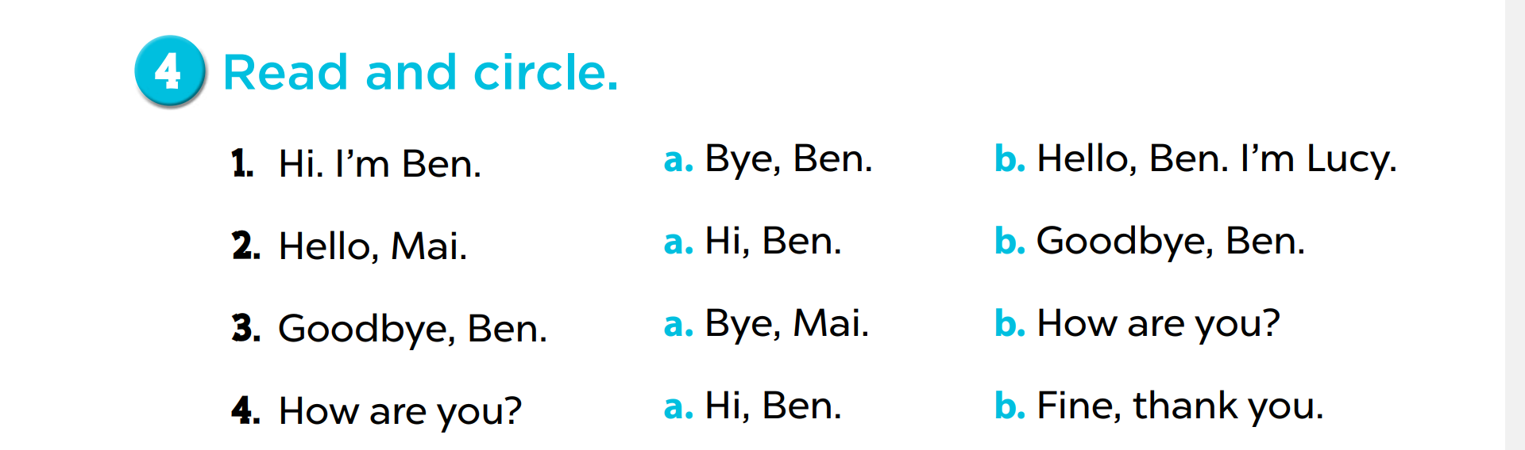

Slide 7
Let’s write.
3

Slide 8

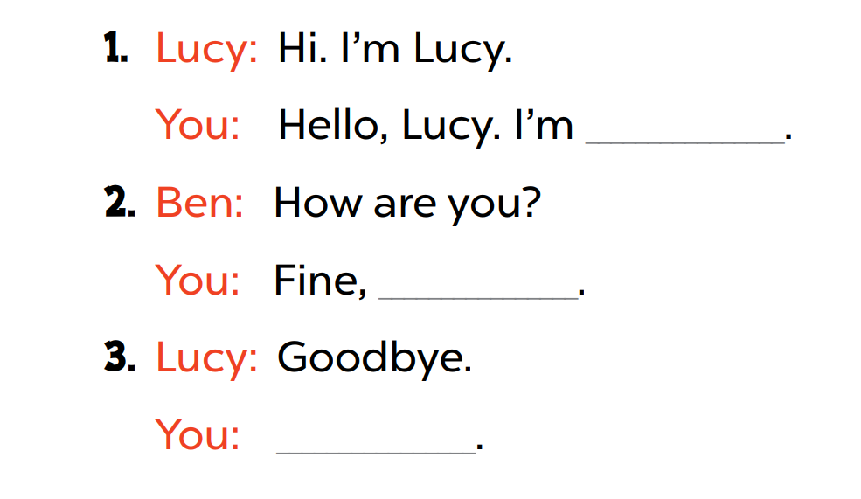
thank you
Bye

Slide 9

Game time!!!
Chinese whispers
Notes:
Step 1: Divide the class into 4 groups. Ask them to stand on 4 lines.
Step 2: Say a sentense to the first pupil at each line.
Step 3: Pupils speak quietly one by one. The one at the back of each line has to say the sentence out loud.
Step 4: Give points to the groups who can make it well. Encourage pupils practise speaking English.

Slide 10
4
Project

Slide 11

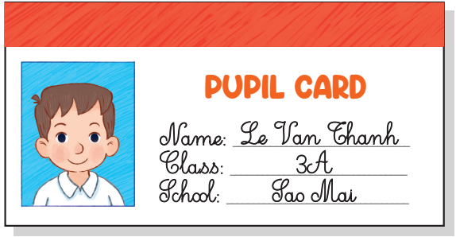
My pupil card

Slide 12
Pupil’s photo/
picture
Name:_____________
Class:_____________
School:____________

Slide 13
Fun corner and wrap-up
5

Slide 14


Game time!!!
Role play
Hello, I’m …
Hi, I’m …
How are you?
Fine, thank you.
Goodbye.
Bye.
Notes:
Divide the class into 4 teams. Invite each team to go to the board and role play using the given conversation Encourage pupils to practise speaking English. Give points to the teams.

