Slide 1


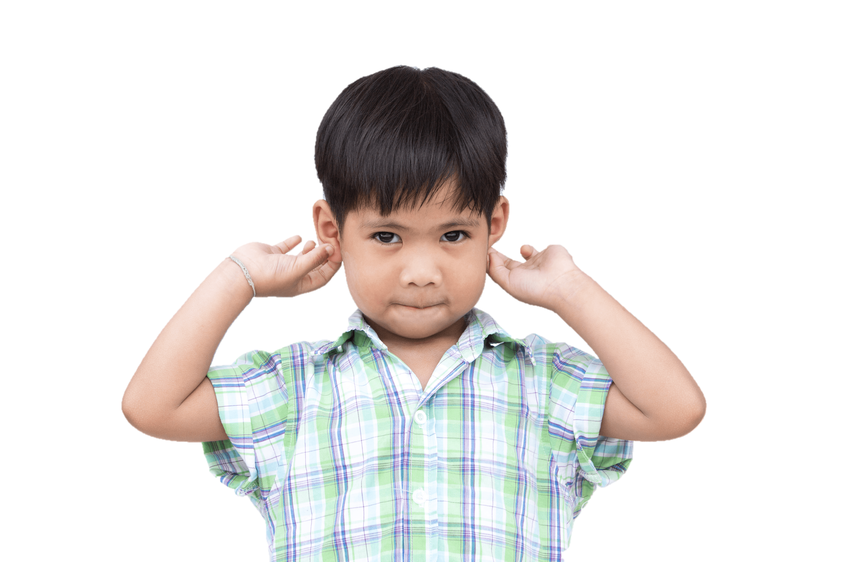


Quang Trung Primary School
4
Our bodies
LESSON 1
Period 1
Teacher: Duong Thi Bich Ngoc

Slide 2
Contents
1
Warm-up
4
Let’s talk.
2
Look, listen and repeat.
3
Listen, point and say.
5
Fun corner and wrap-up

Slide 3
1
Warm-up

Slide 4

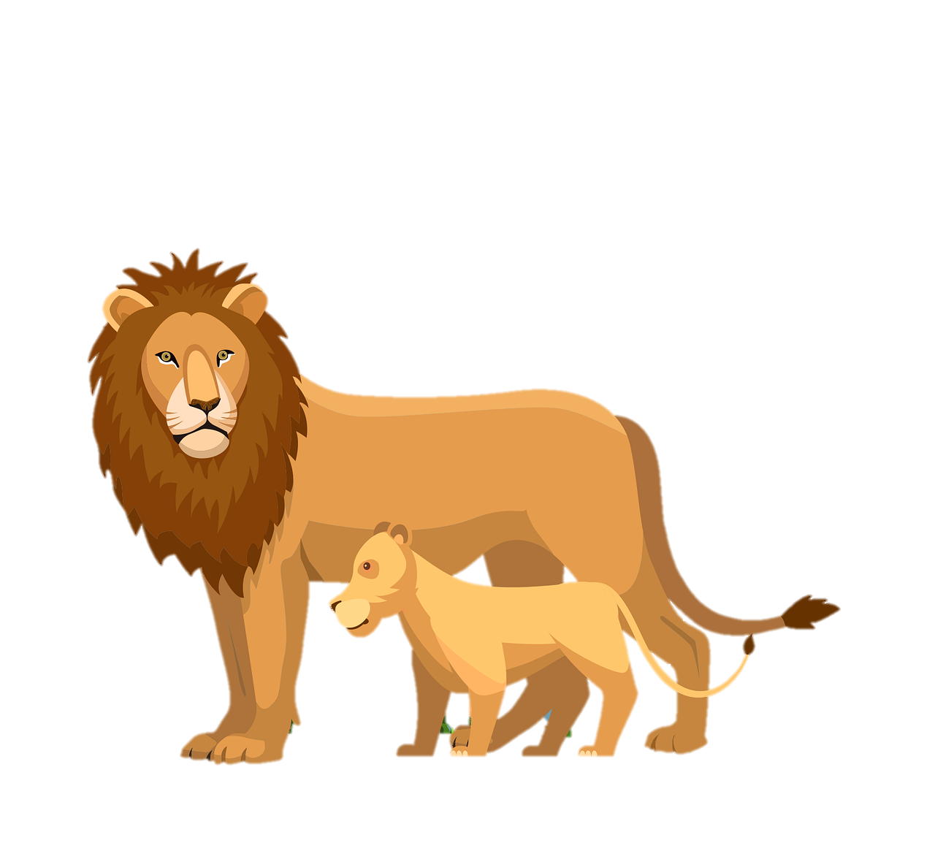
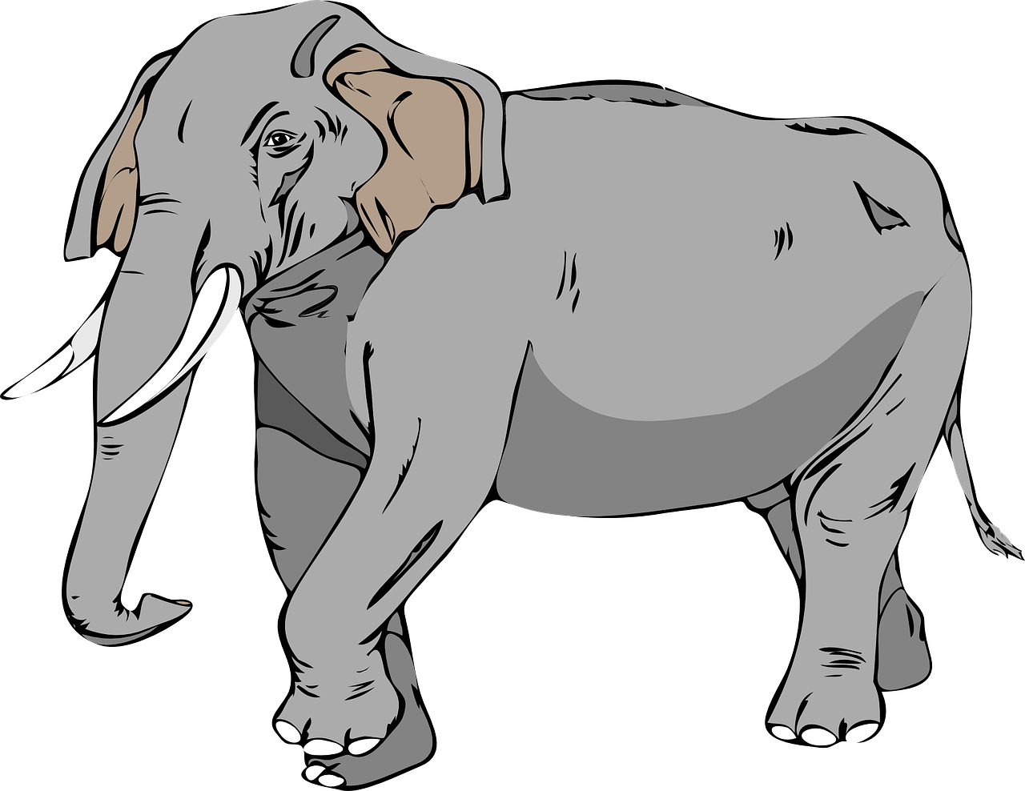
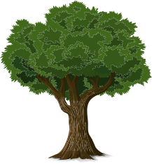
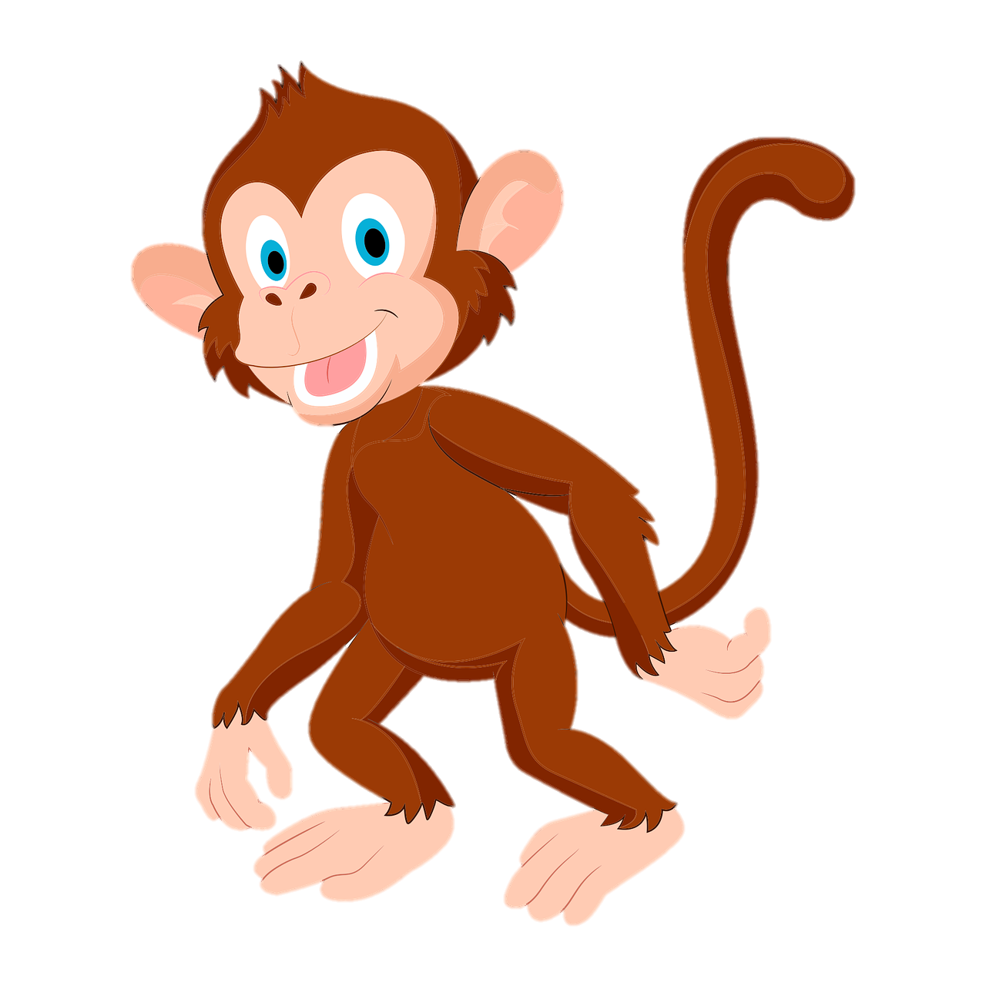
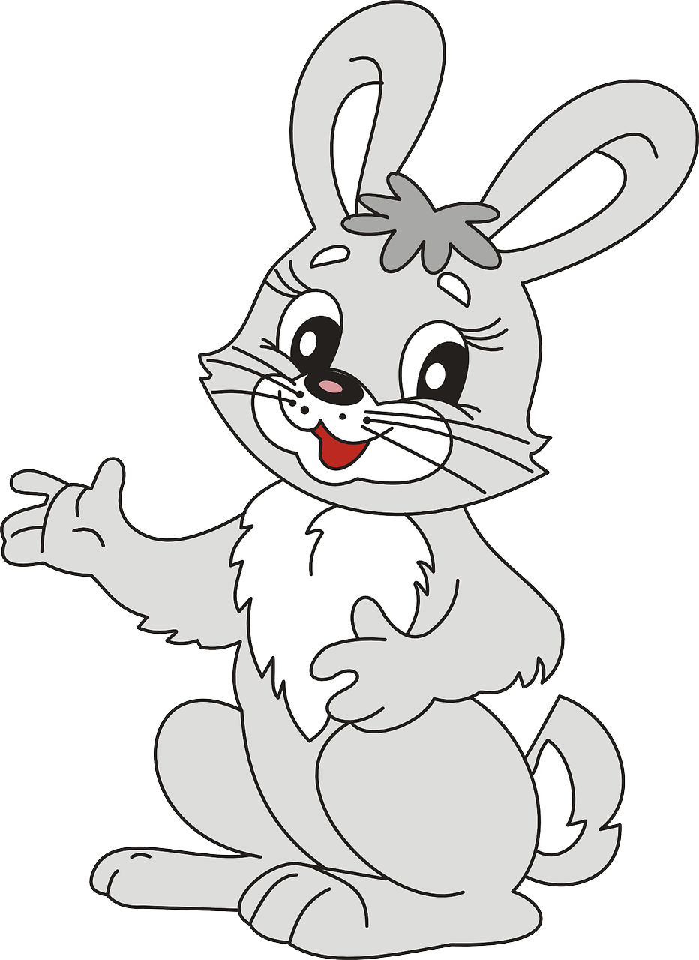

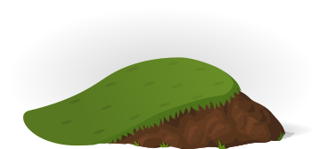
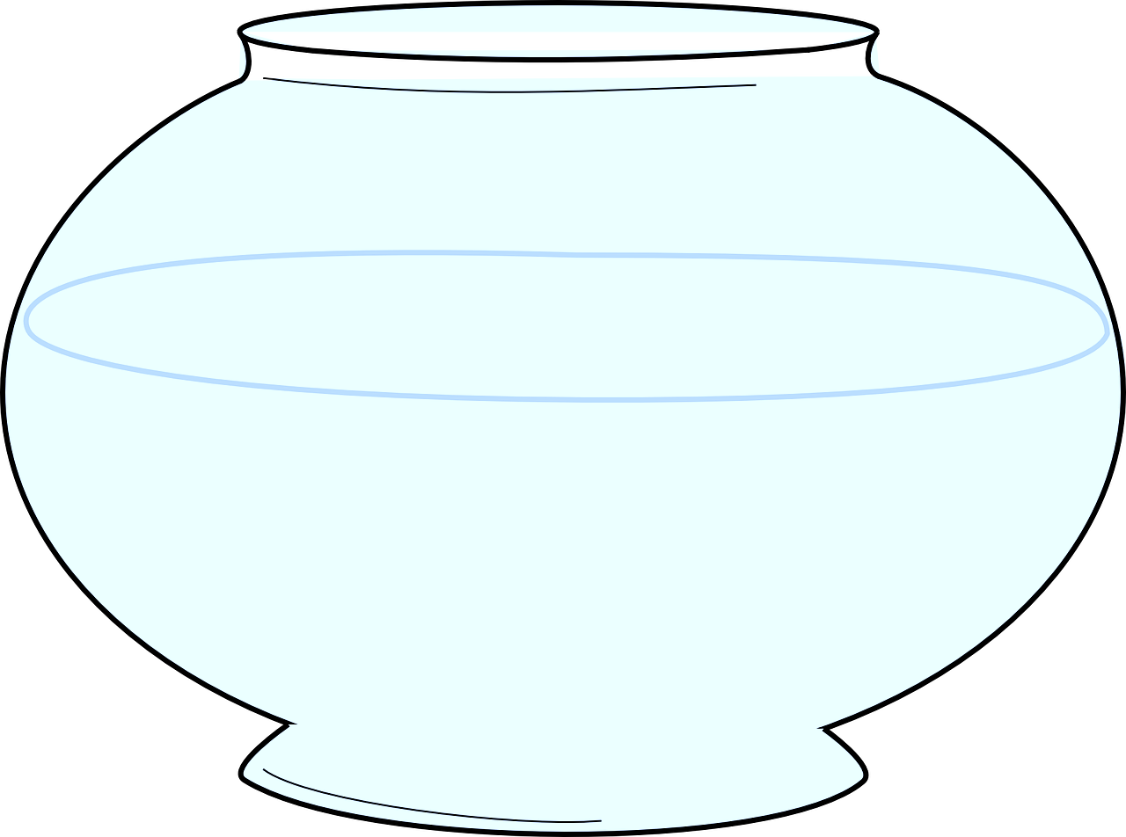



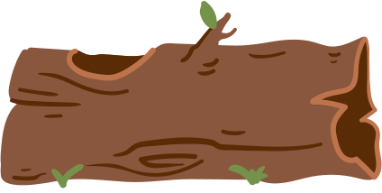


Notes:
Game: Animal and body parts
Step 1: Review the names of 5 animals
Step 2: Teacher gives a question (combined with descriptive gestures): Which animal has ...?
Step 3: Asks pupils to answer which animal is it.

Slide 5


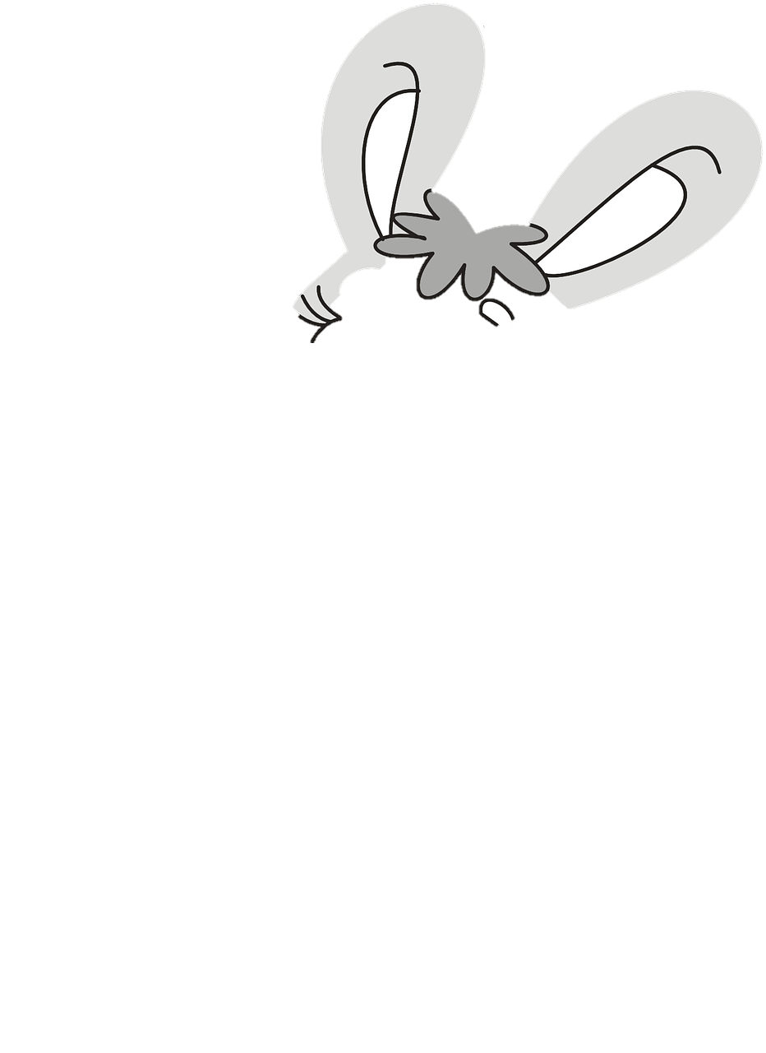
ears
Notes:
A rabbit has long ears.

Slide 6

eye
Notes:
A fish has round eyes.

Slide 7

hand
Notes:
A monkey has small hands.

Slide 8

nose
Notes:
Elephant has a long nose

Slide 9

face
Notes:
A lion has a big face.

Slide 10
2
Look, listen and repeat.

Slide 11
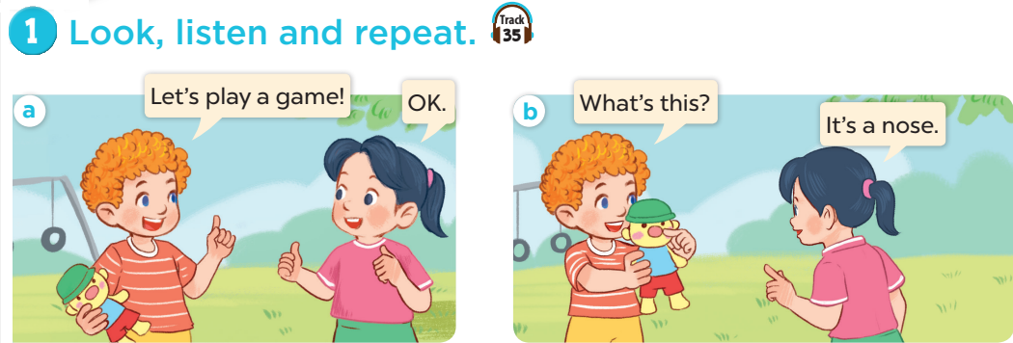

Slide 12
3
Listen, point and say.

Slide 13
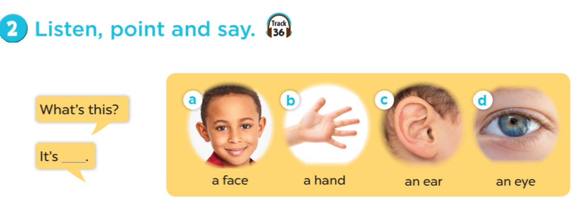

Slide 14
4
Let’s talk.

Slide 15
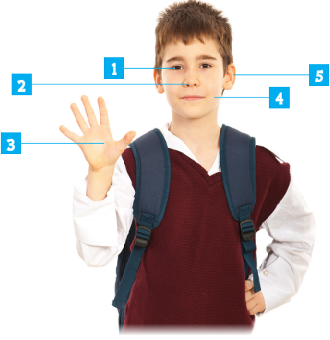
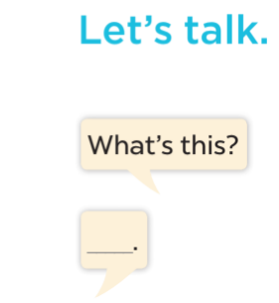

Slide 16

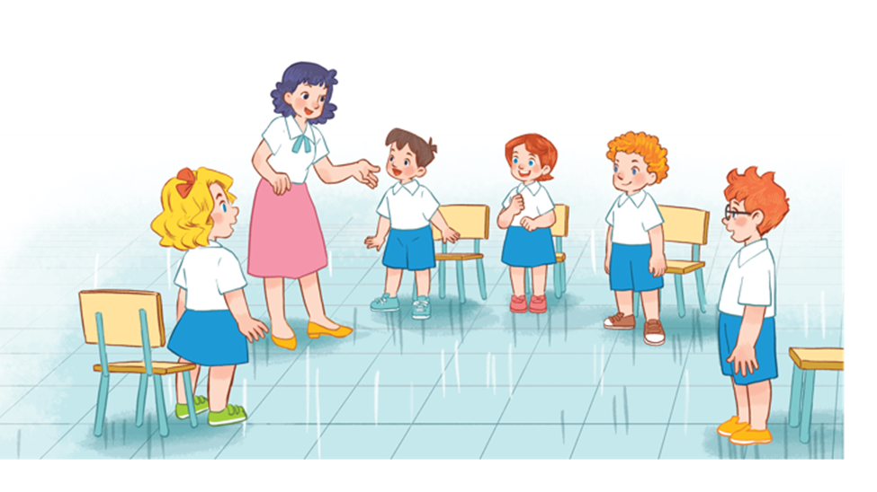

Notes:
Game: Pass the ball!
Goal: To practice asking and answering
Step 1: Divide class into 2 big groups, each group has a ball.
Step 2: While the music plays, pupils pass the ball around the class.
Step 3: When the music stops, the pupil in each group with the ball has to take turns to ask and answer: What’s this? (point to body part). It’s a ___.

Slide 17
5
Fun corner and wrap-up

Slide 18

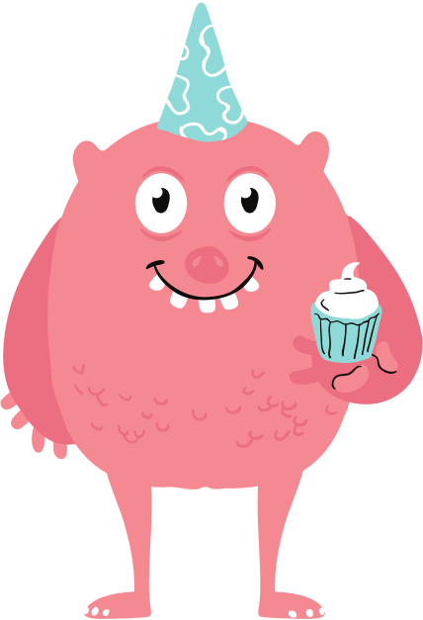



Draw your monster!
Notes:
Game: Draw your monster
- Review the new words.
- Ask students to draw a picture about their favourite monsters (with body parts that they learnt today).
- Then ask students to work with your partners, tell their friends about it.

Slide 19




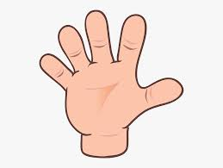
ear
face
nose
eye
hand

Slide 20
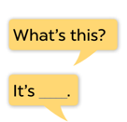
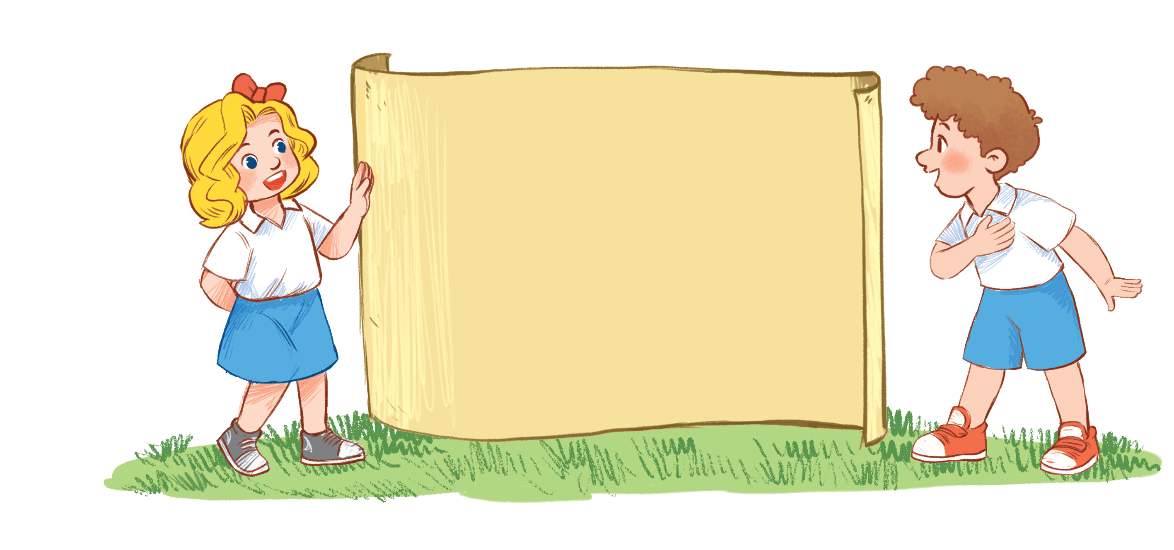
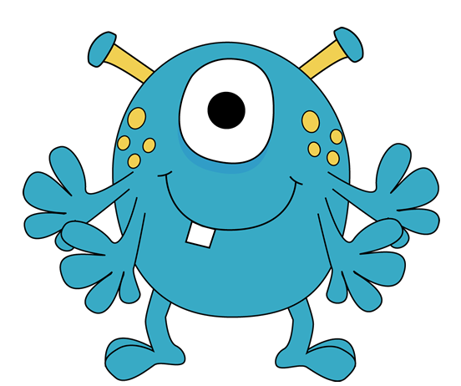
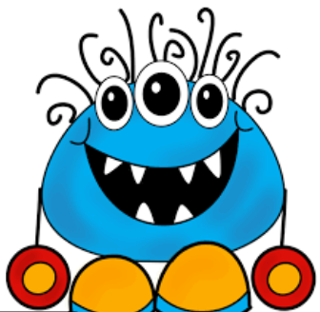
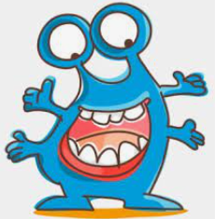
a face
an eye
a hand
an ear
a nose
Notes:
Hình ảnh (free): https://www.seekpng.com/ima/u2w7w7a9a9u2q8i1/

