Slide 1


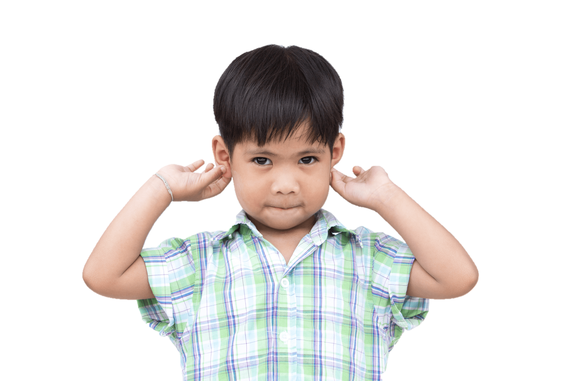


Quang Trung Primary School
4
Our bodies
LESSON 2
Period 4
Teacher: Duong Thi Bich Ngoc

Slide 2
Contents
1
2
3
Warm-up and review
Listen and number.
4
Fun corner and wrap-up
Look, match and read.
5
Let’s play.
Notes:
eyes

Slide 3
1
Warm-up and review

Slide 4

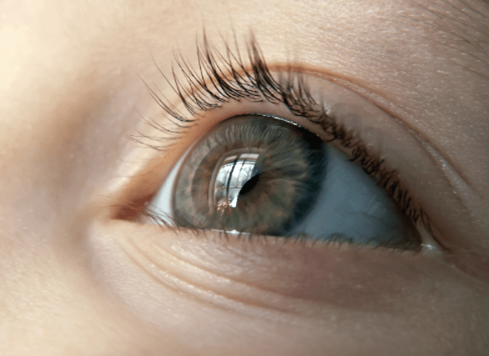
an eye
Notes:
Hidden Pictures Game
Step 1: Divide the class into 4 big groups.
Step 2: Each group takes turns to open a colored box and guess what the picture hidden behind it is.
The fastest group who answers correctly is the winner.

Slide 5

nose

Slide 6

a face

Slide 7
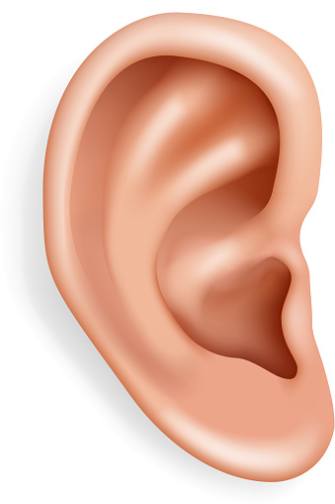
an ear

Slide 8
2
Listen and number.

Slide 9
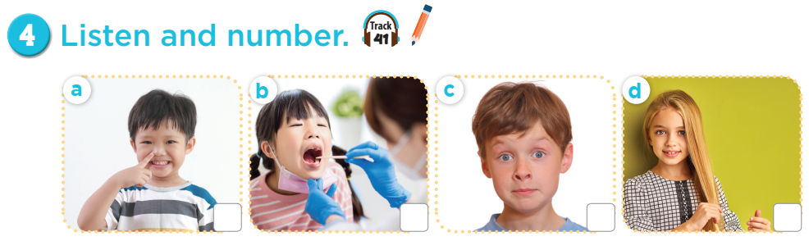
3
1
4
2

Slide 10
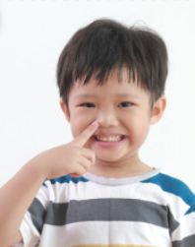

Notes:
Ask students to do the actions in the pictures.

Slide 11


Notes:
Ask students to do the actions in the pictures.

Slide 12
3
Look, match and read.

Slide 13
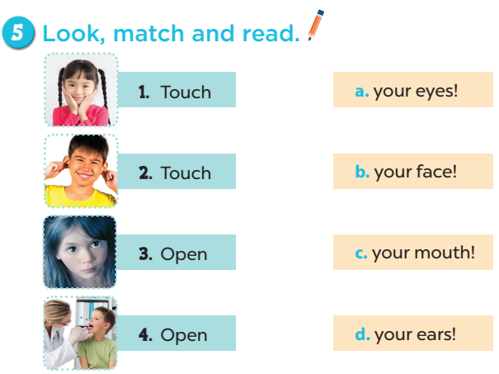
Notes:
Key: 1. b 2. d 3. a 4. c

Slide 14
4
Let’s play.

Slide 15
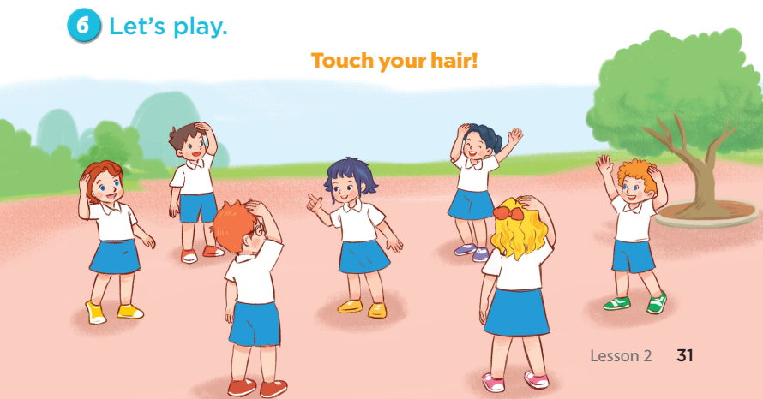

Slide 16
5
Fun corner and wrap-up

Slide 17
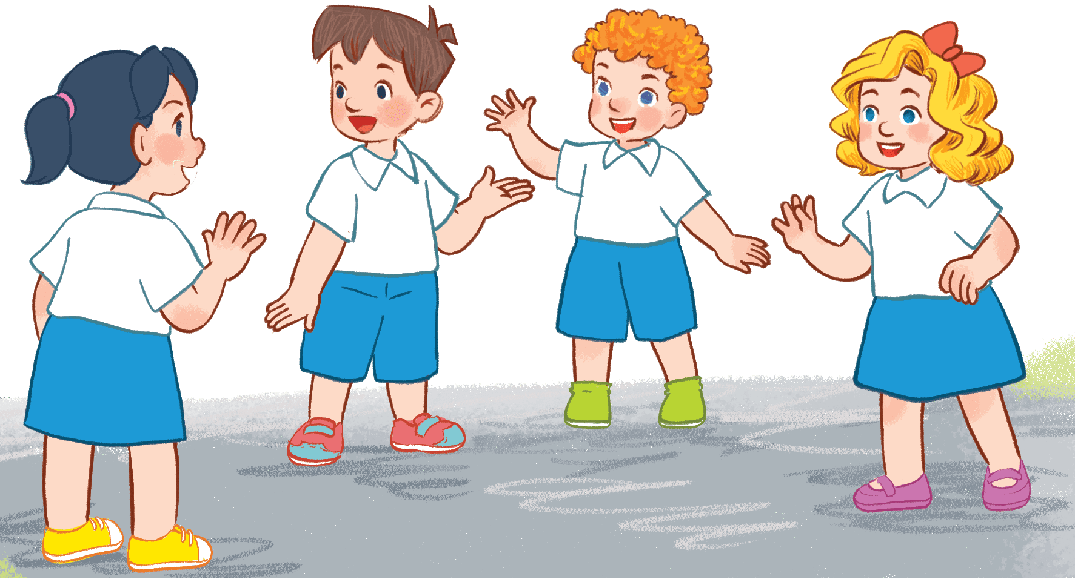
Listen and grab!!!
Listen and grab!!!
Notes:
Step 1: Pupils work in group of 4.
Step 2: Teacher gives out a set of mini flashcards to each group.
Step 3: Ask pupils listen carefully, then grab (as fast as they can) the correct flashcard that they heard.
The winner is the player with the most cards at the end of the game.

Slide 18
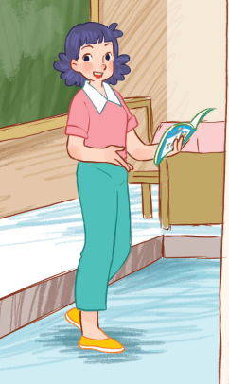
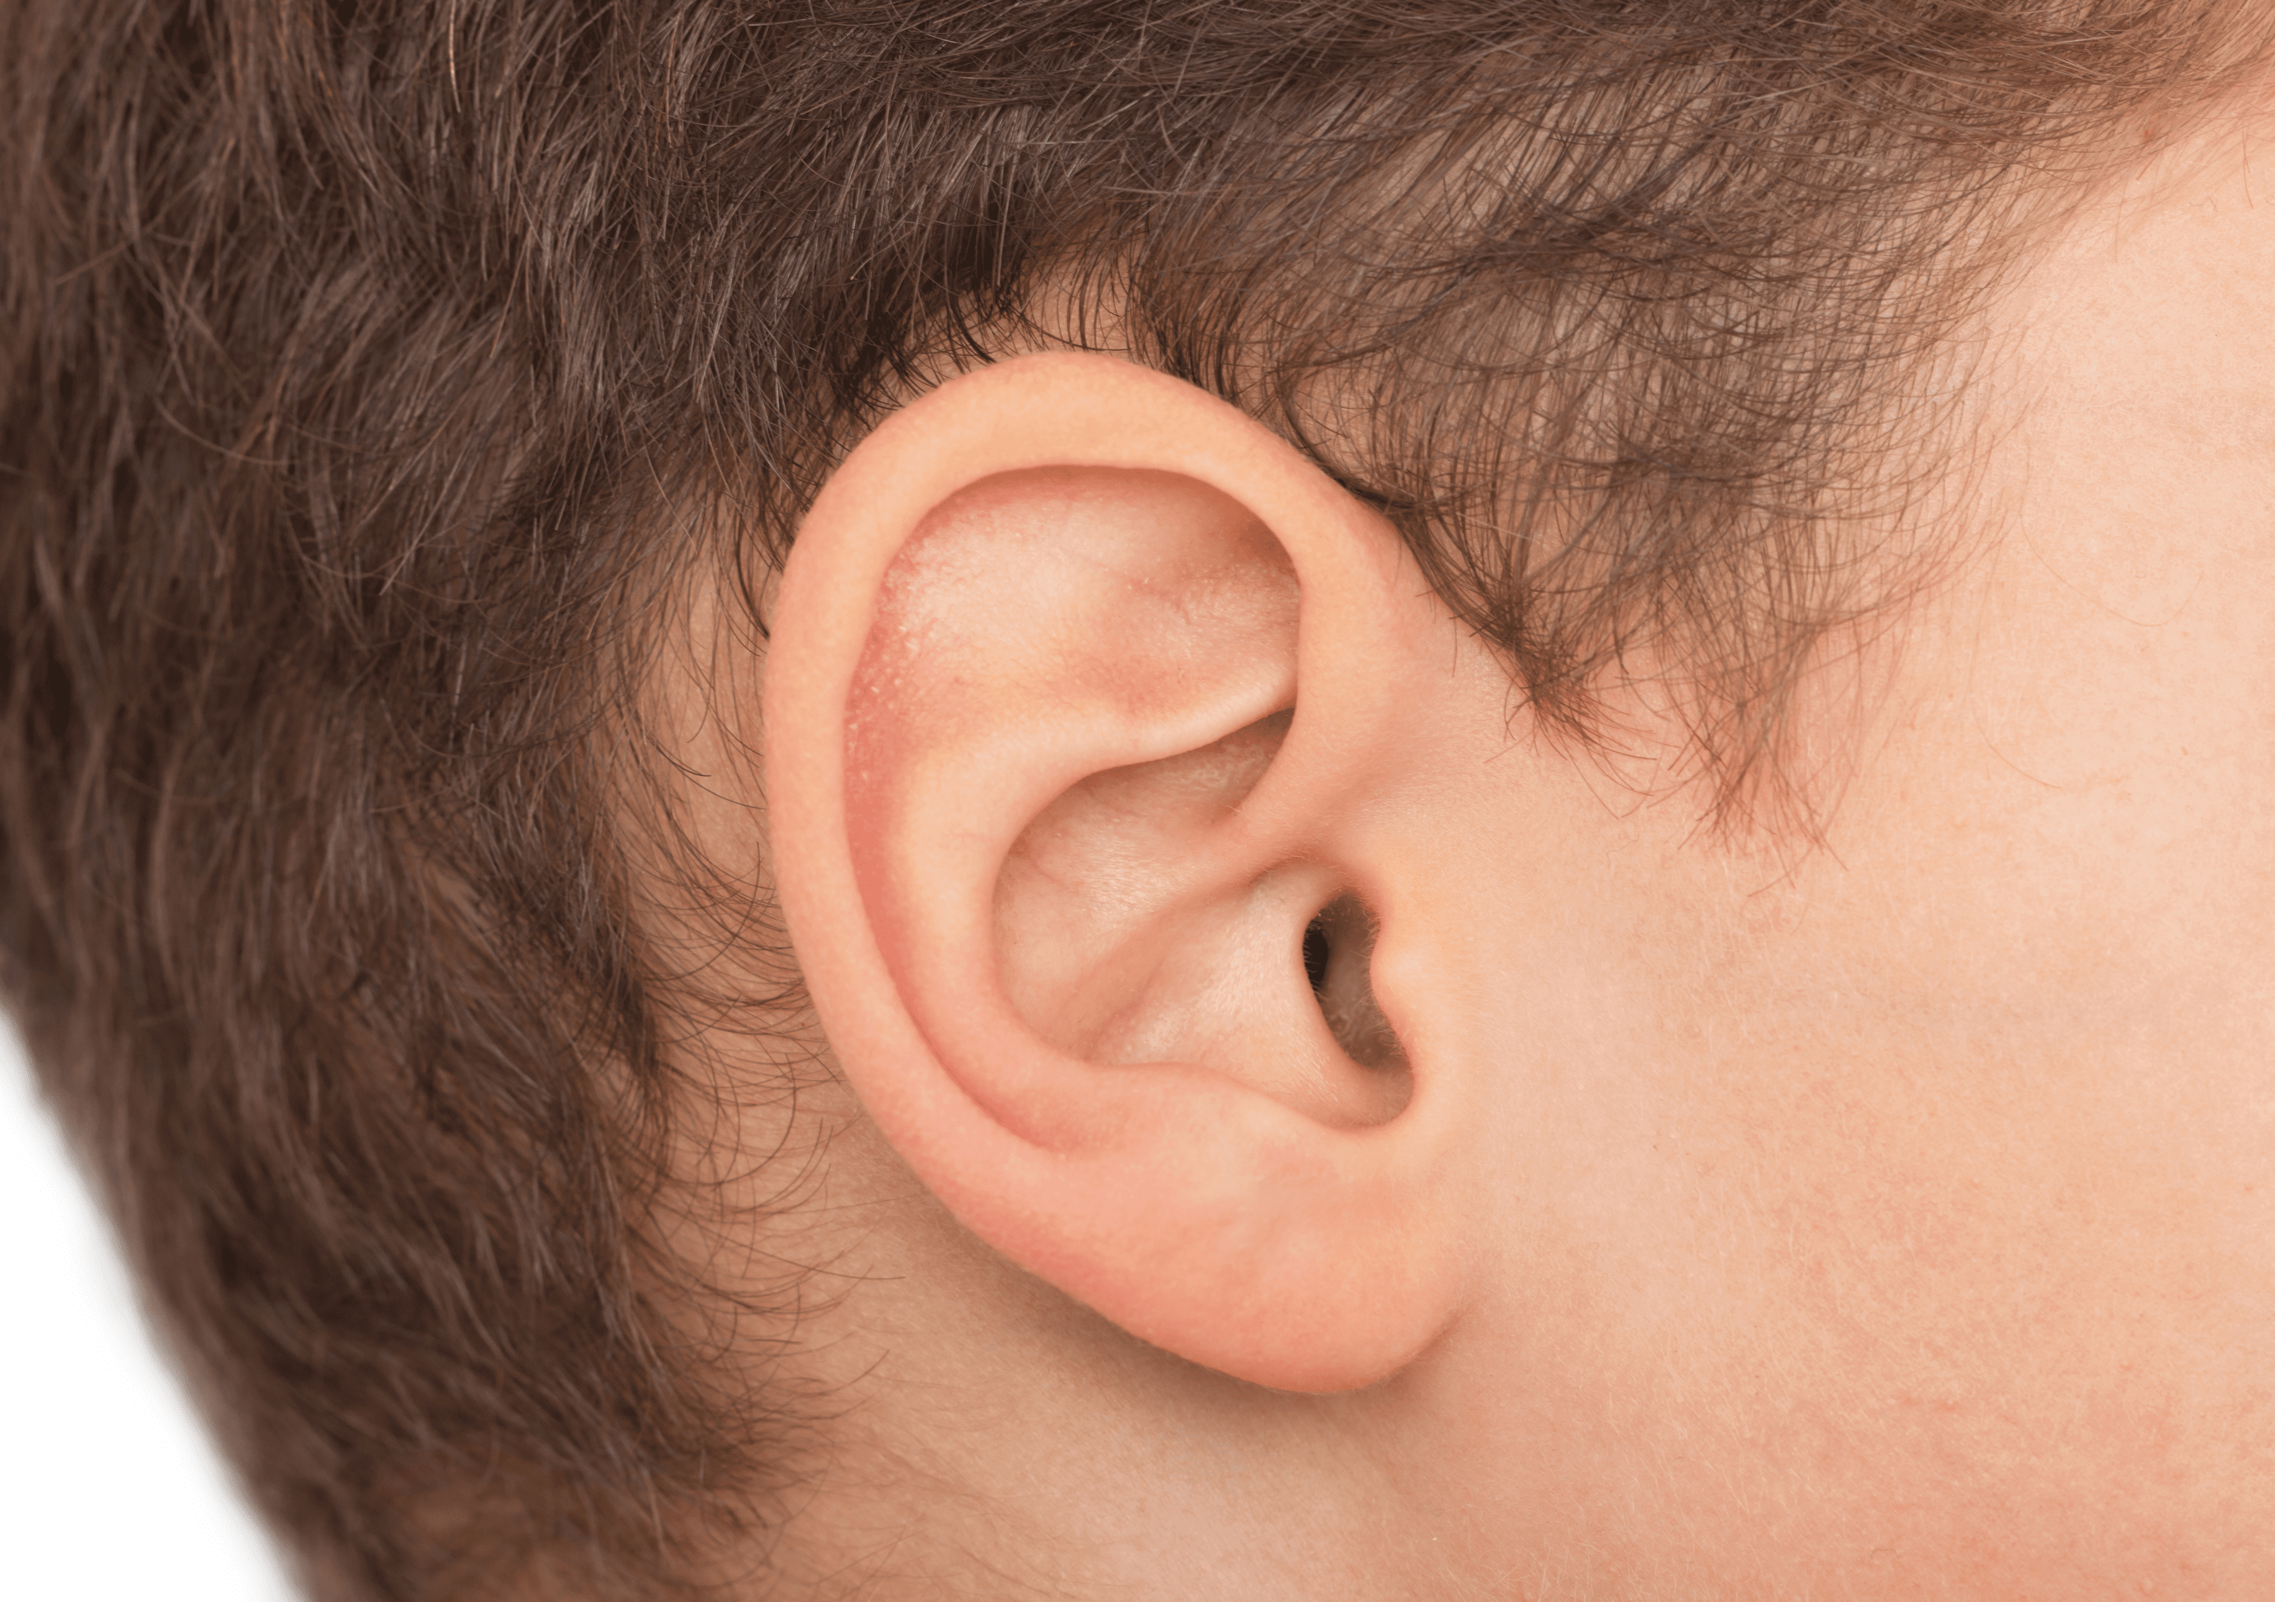
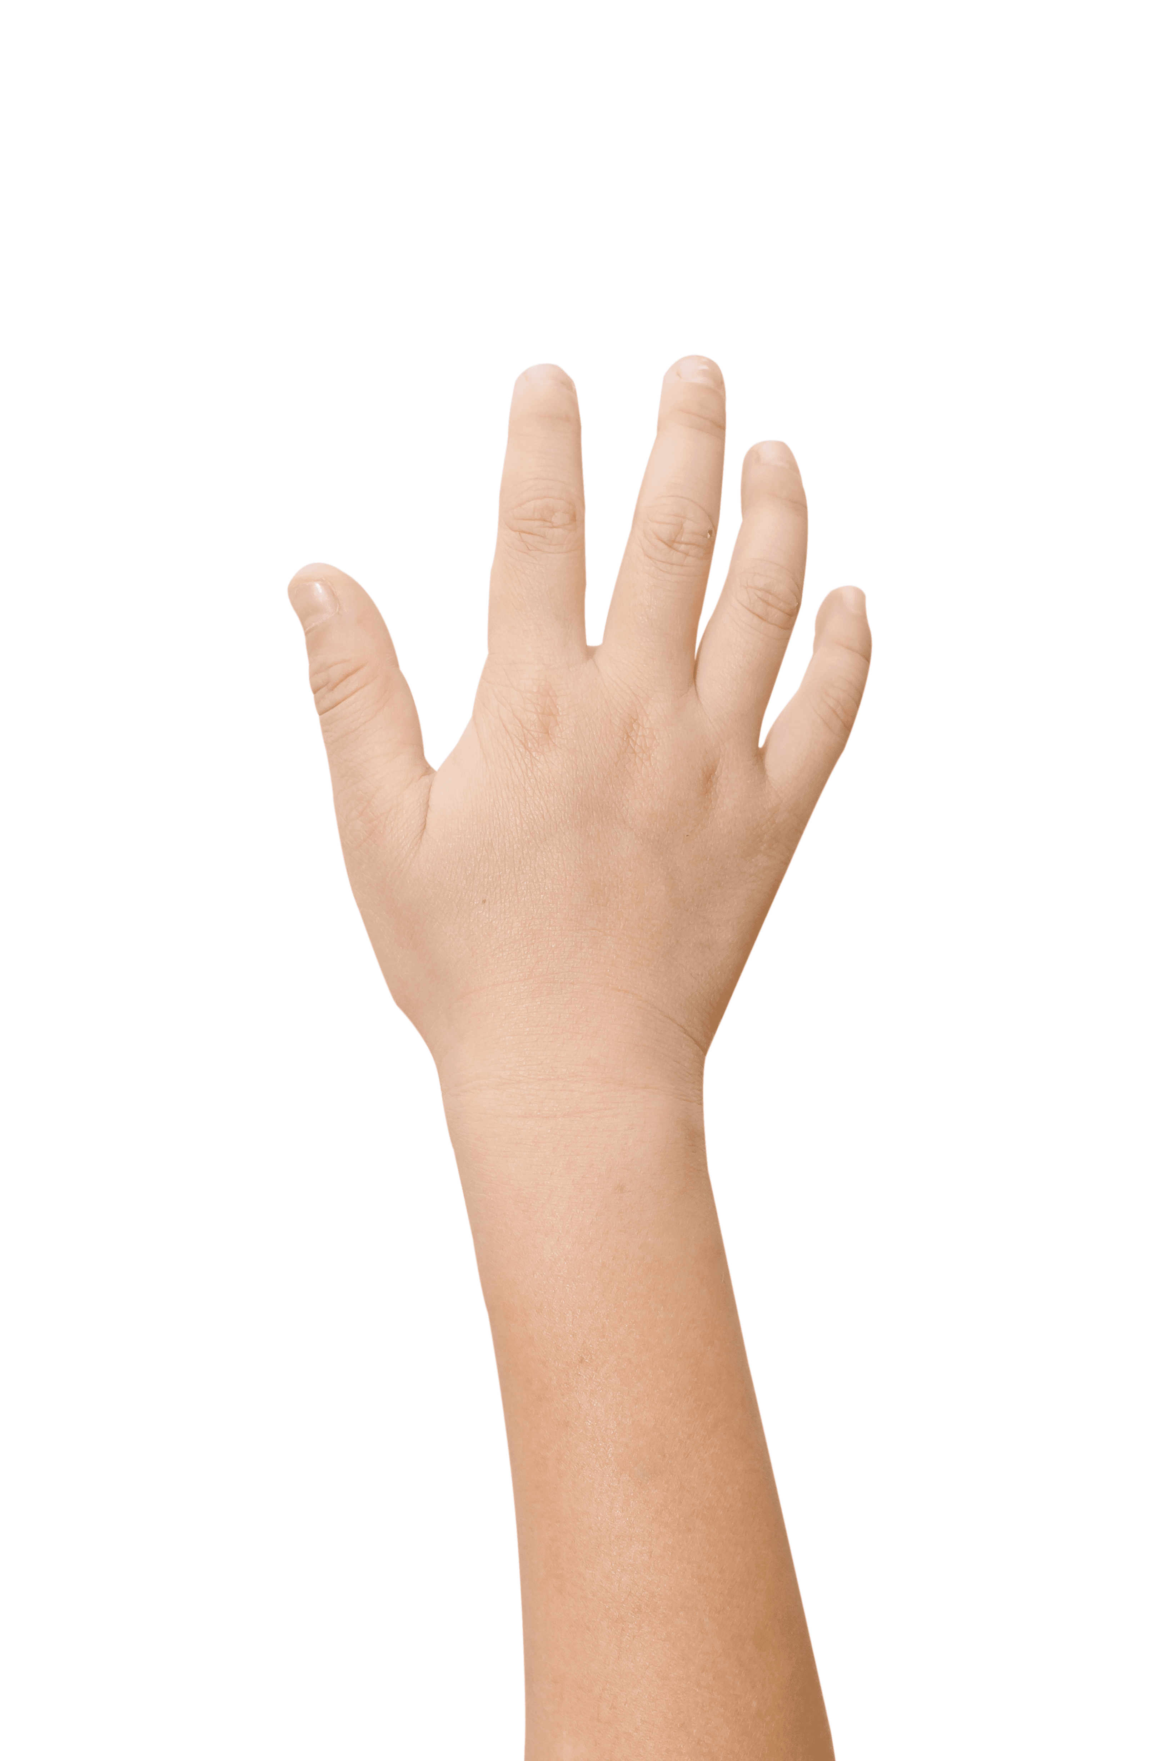
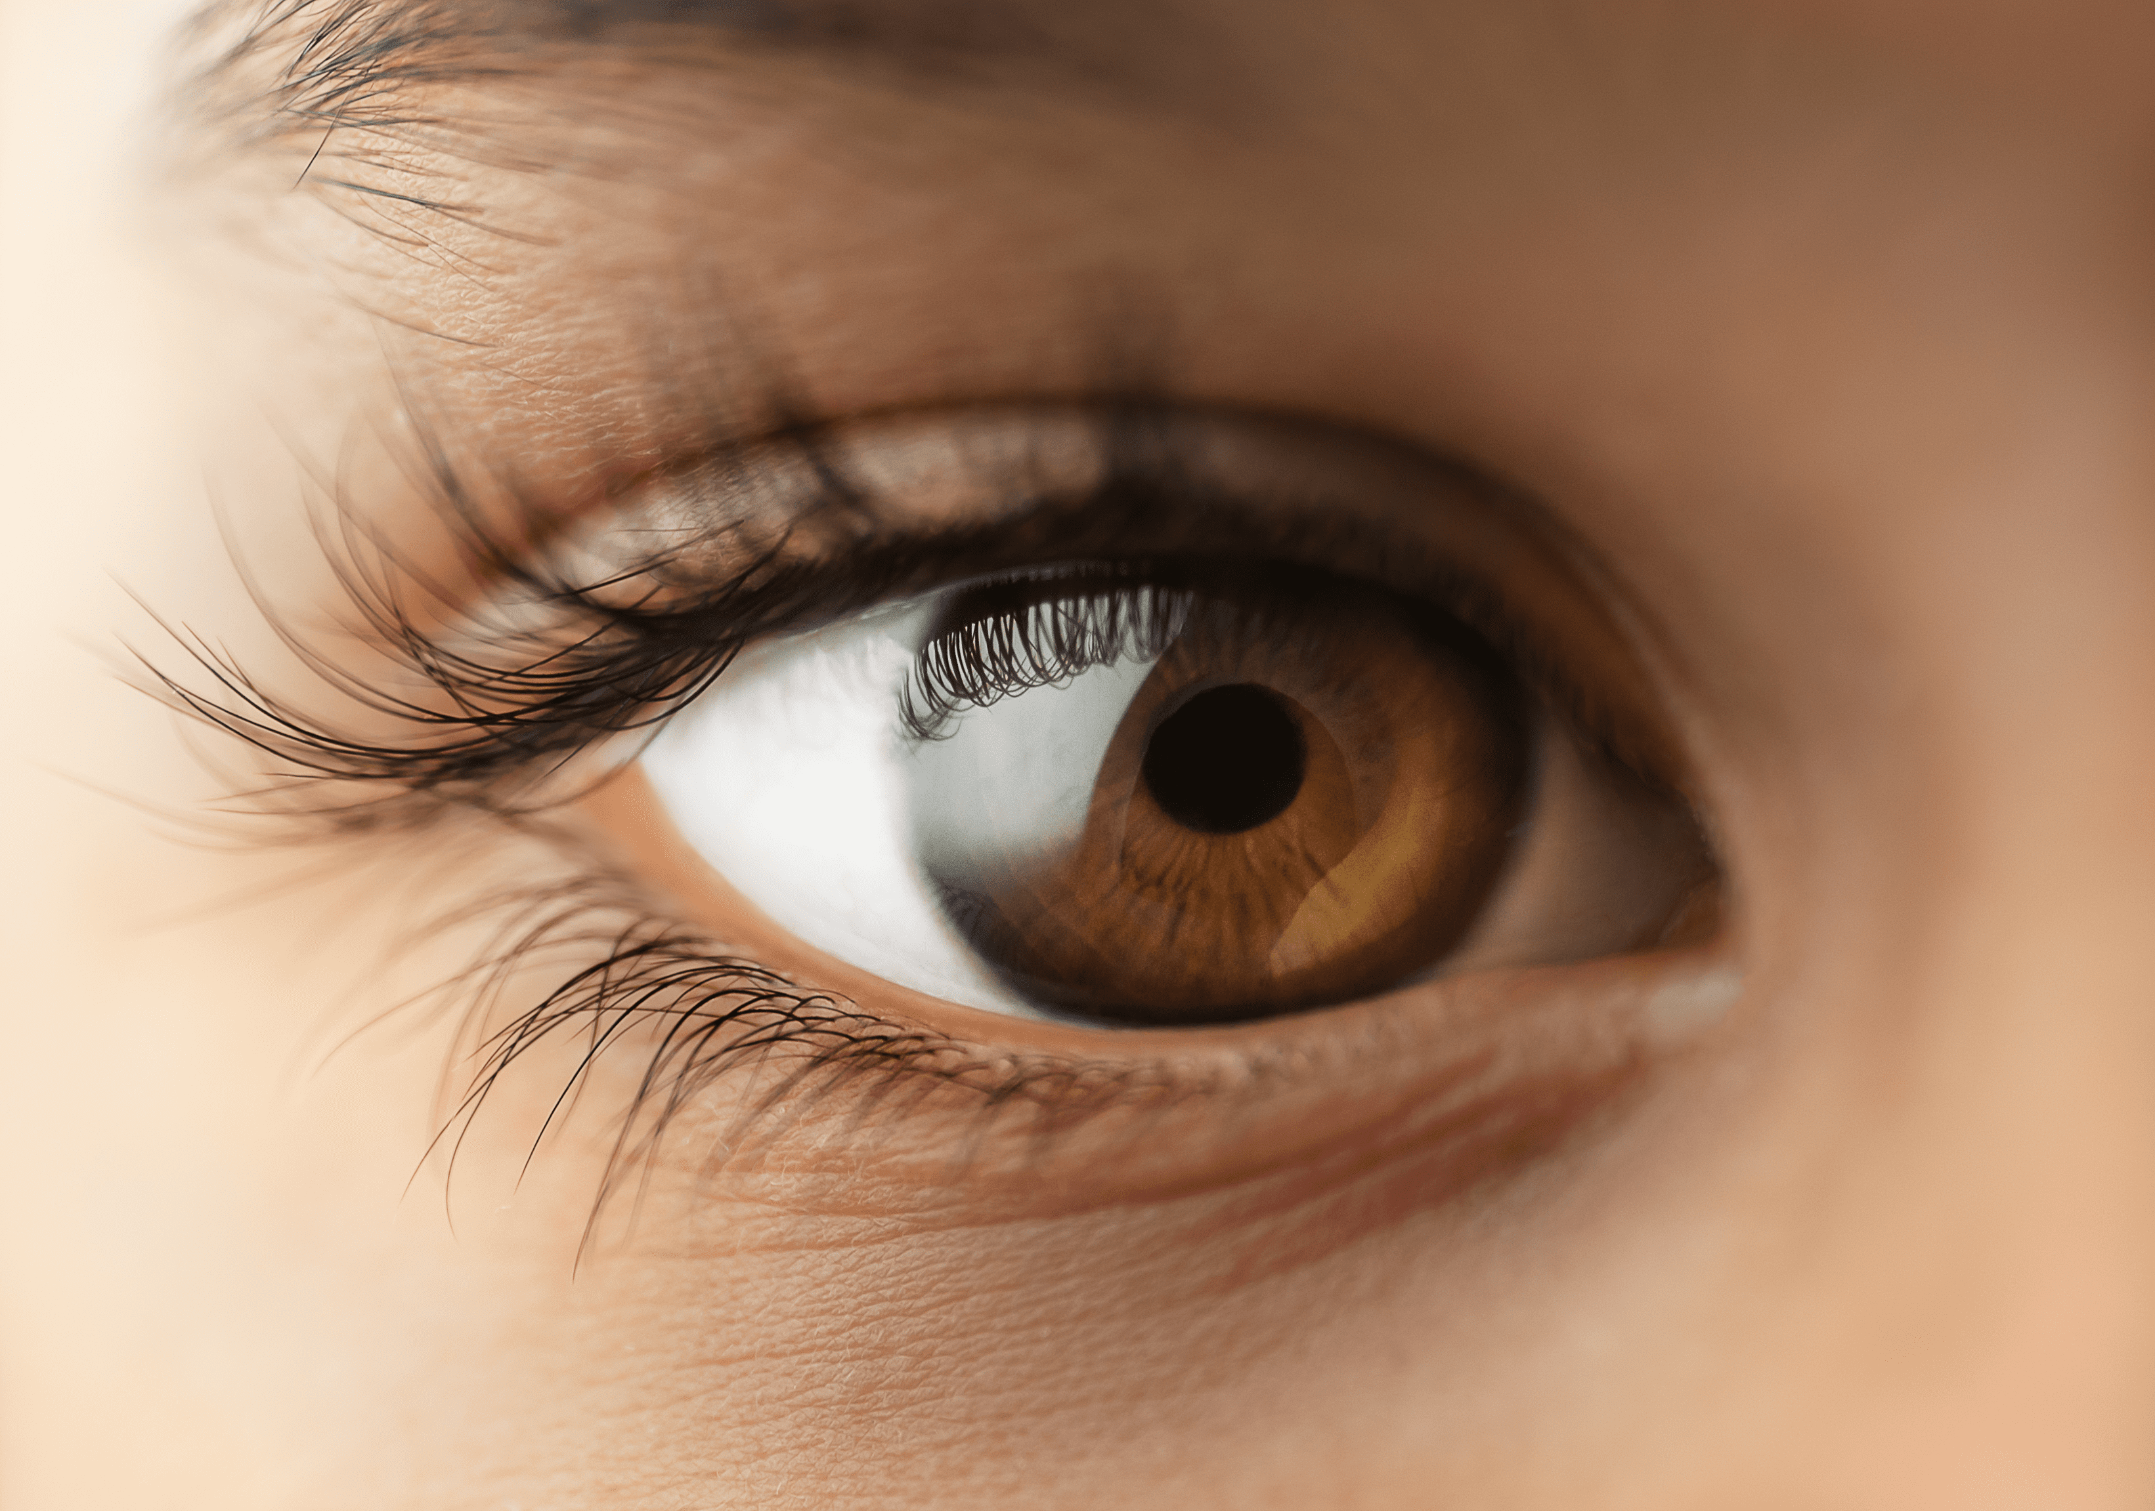

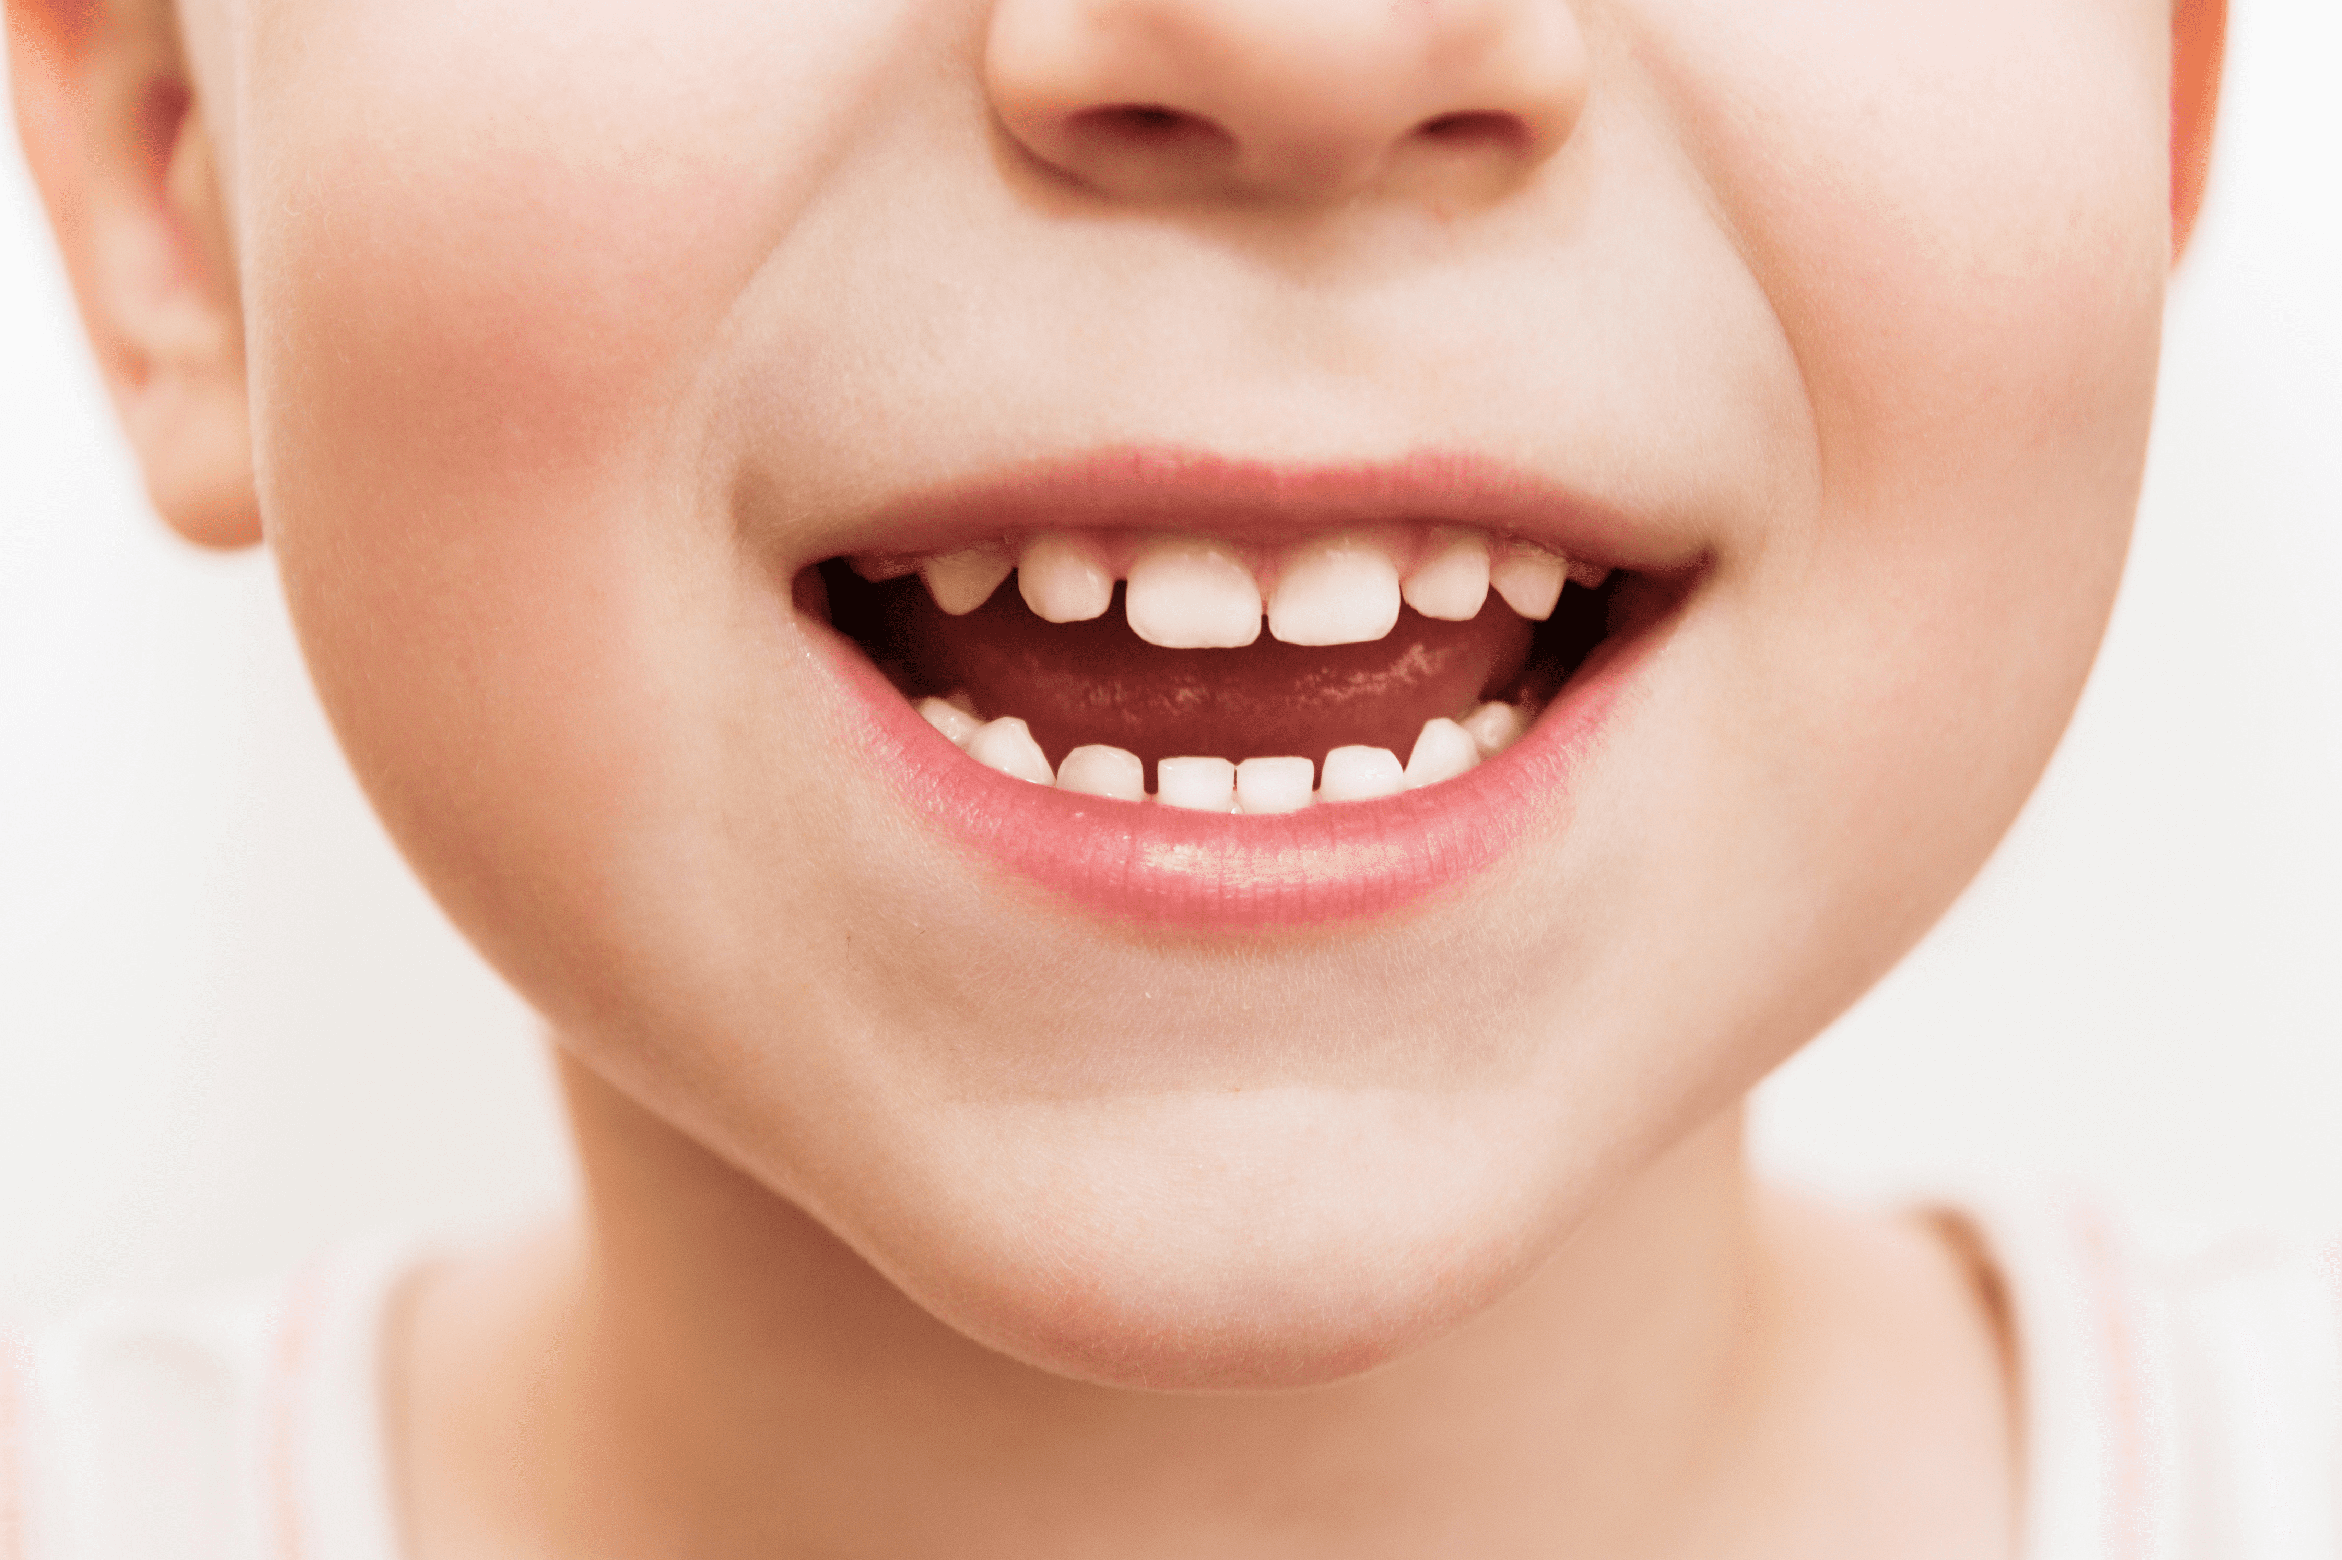
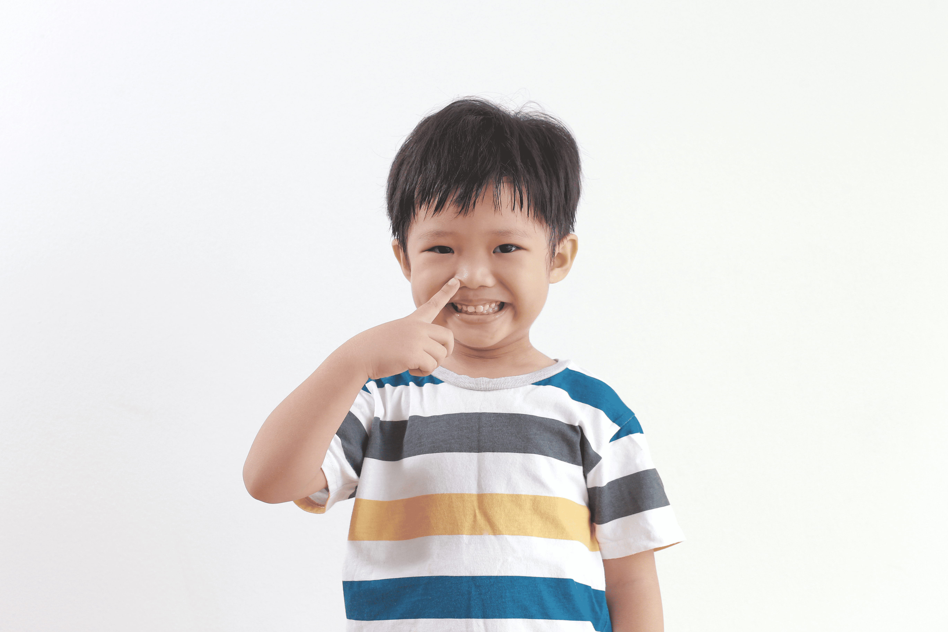
ear!

