Slide 1


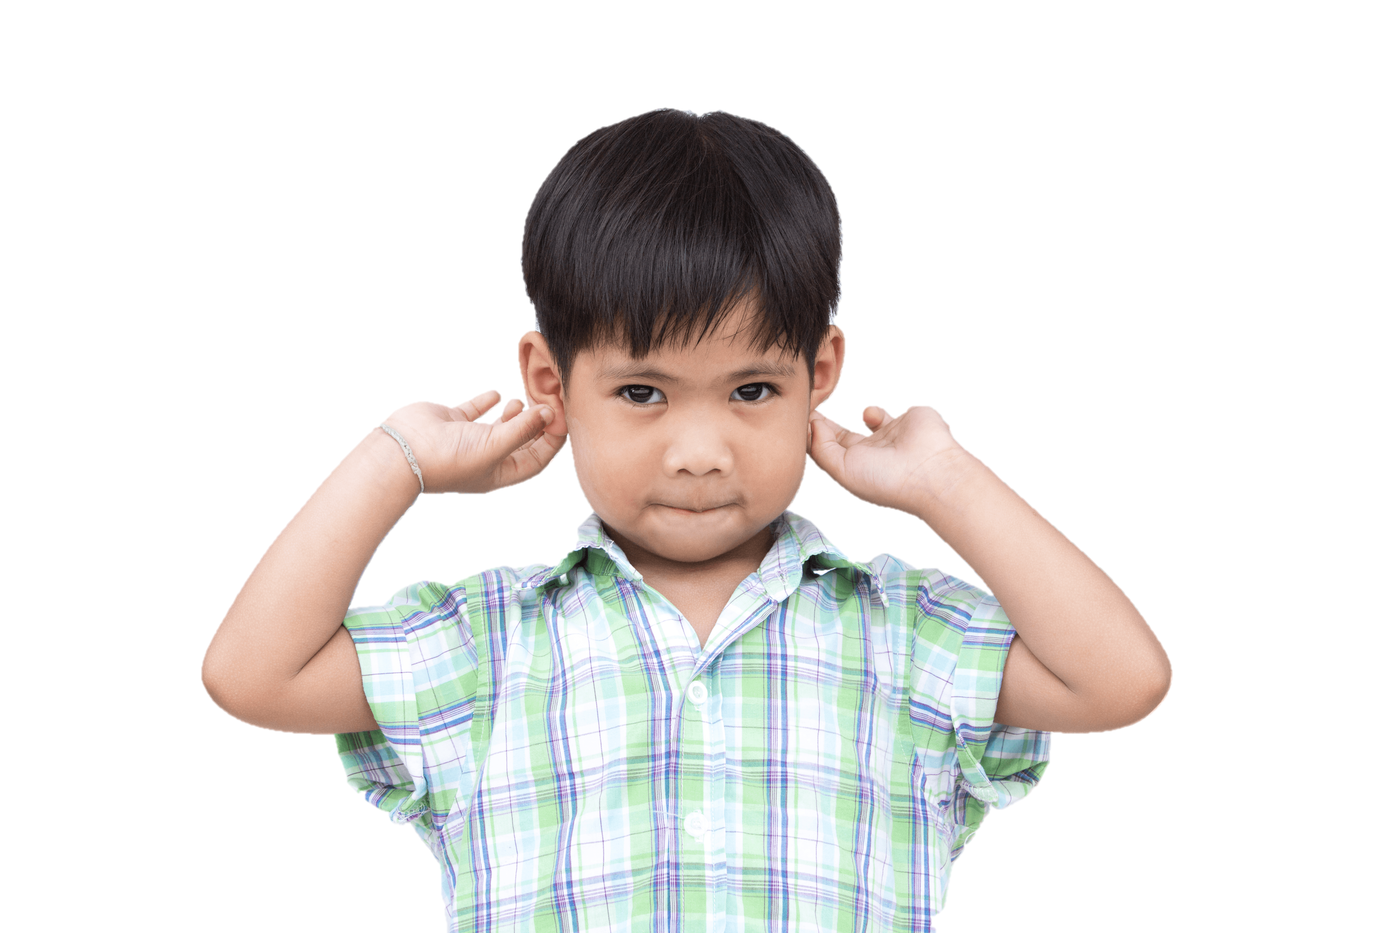


Quang Trung Primary School
4
Our bodies
LESSON 3
Period 6
Teacher: Duong Thi Bich Ngoc

Slide 2
Contents
1
2
Warm-up and review
Read and match.
3
4
Fun corner and wrap-up
5
Let’s write.
Project

Slide 3
1
Warm-up and review
Notes:
Game: Bodiless
- Review body parts with the students and introduce the “No (body part)” concept.
Step 1: Teacher says “No (body part)!”
Step 2: Pupils listen carefully, then cover the body part that they heard by hands.
Ex: No nose!
Pupils cover a nose by hand.

Slide 4

Arrange me!
1. an/ It’s/ eye/ .
2. your/ touch/nose/ !
3. mouth/ open/ ! /your
4. a/and/ face/ a/ hand/ .

Slide 5
Arrange me!
1. an/ It’s/ eye/.
It’s an eye.

Slide 6
Arrange me!
2. your/ touch/ nose/ !
Touch your nose !

Slide 7
Arrange me!
3. mouth/ open/ ! / your
Open your mouth!

Slide 8
Arrange me!
4. a/and/ face/a/ hand/.
A face and a hand.

Slide 9
2
Read and match.

Slide 10
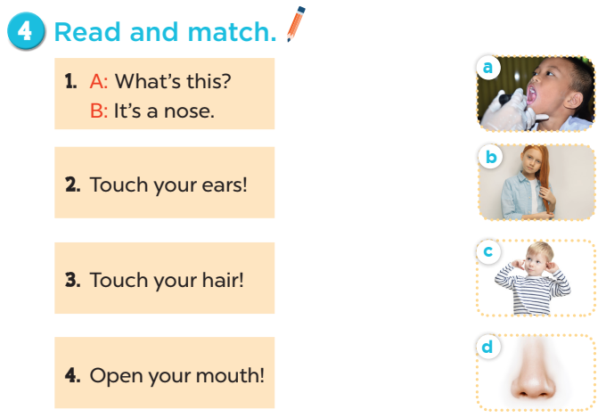
Notes:
Key: 1. d 2. c 3. b 4. a

Slide 11
3
Let’s write.

Slide 12
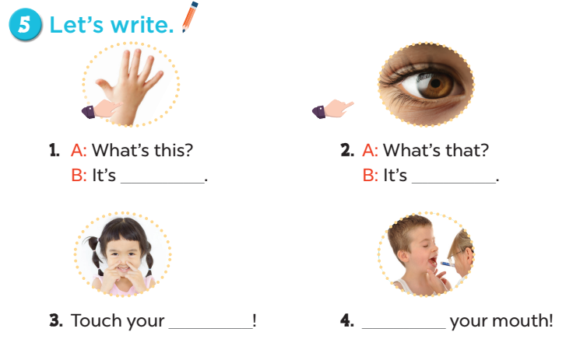
a hand
an eye
nose
Open
Notes:
Key: 1. a hand 2. an eye 3. nose 4. Open

Slide 13

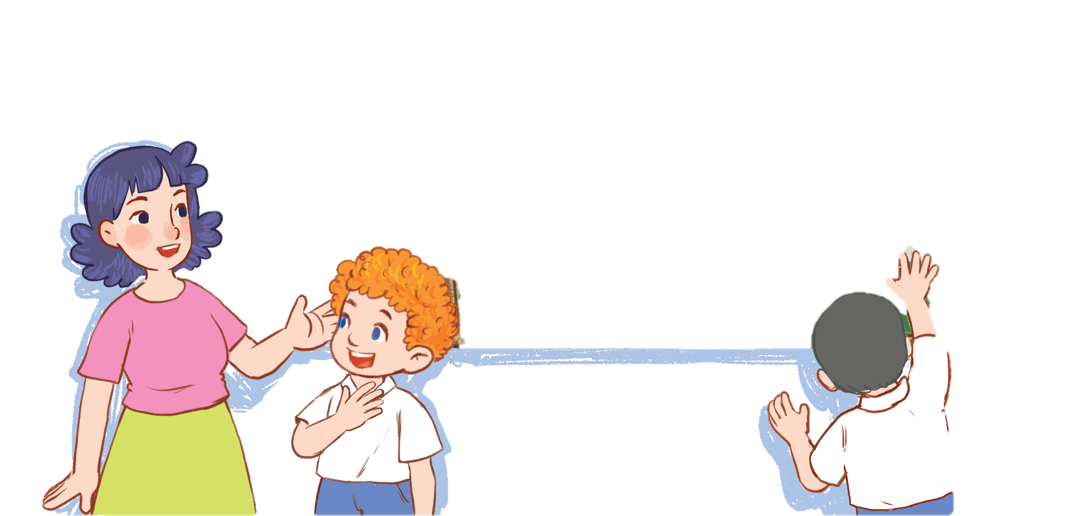
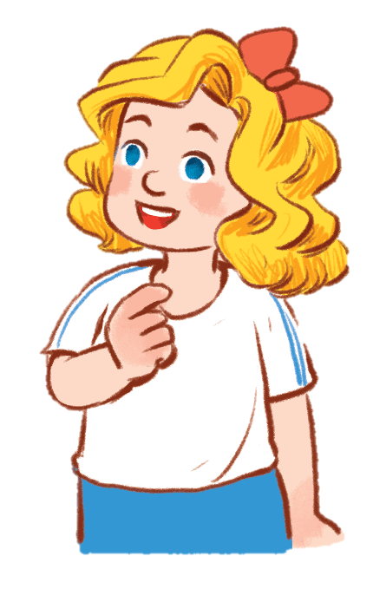
Board race
Who is the fastest writer?
Notes:
Game: Who is the fastest writer?
- Teacher asks 6-8 pupils to join this game.
- Teacher says out loud a word (twice).
- Pupils have to write as fast as they can.

Slide 14
4
Project

Slide 15
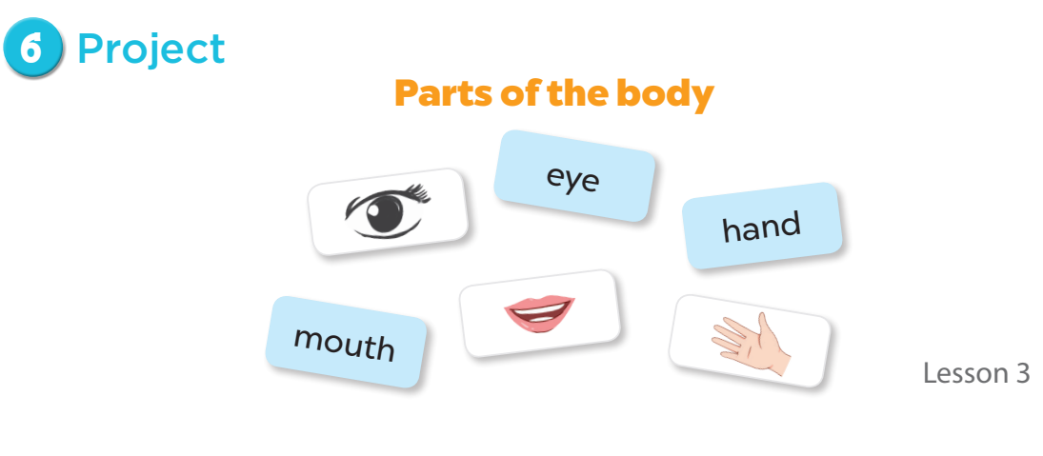

Slide 16
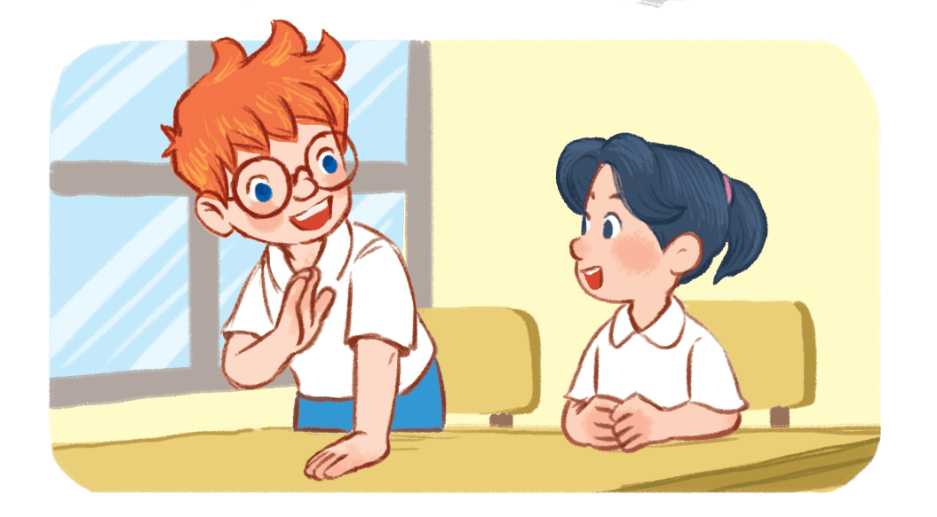

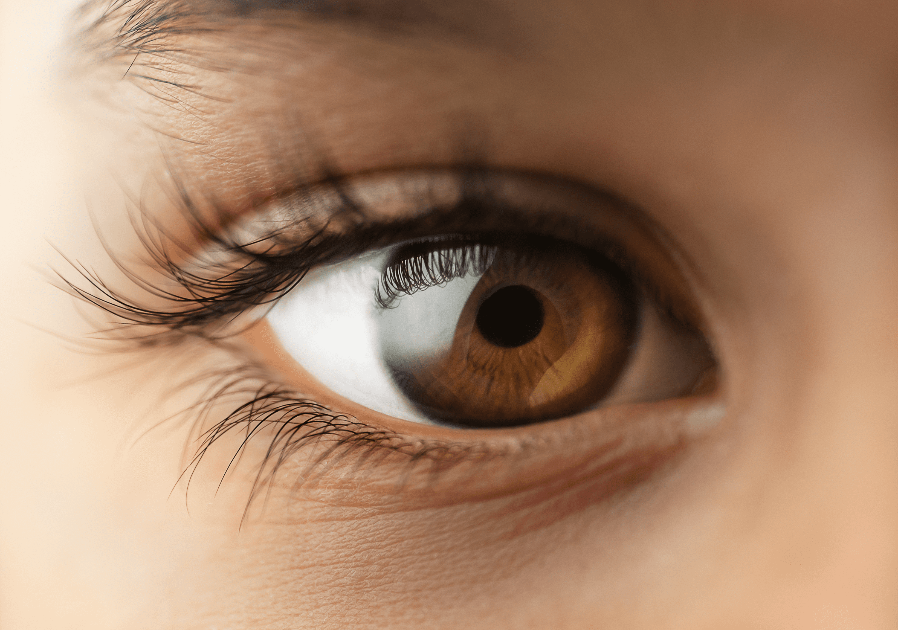
Project

Slide 17
5
Fun corner and wrap-up

Slide 18




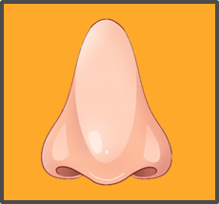
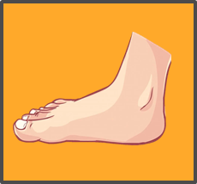









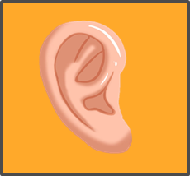

1
2
3
4
5
6
7
8
9
10
11
12
13
14
15
16
Notes:
Body Parts Memory Game
Step 1: Divide class into 4 groups.
Step 2: Teacher asks each group to choose a pair of numbers.
Step 3: Click on the box to reveal the hidden word. Then click on another box to reveal the picture.
Step 4: Once a correct match is made, that group will get 10 points.

