Slide 1



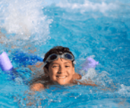

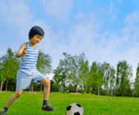

Quang Trung Primary School
5
My hobbies
LESSON 2
Period 3
Teacher: Duong Thi Bich Ngoc

Slide 2
Content
1
5
Warm-up
Fun corner and Wrap-up
4
2
3
Let’s talk.
Look, listen and repeat.
Listen, point and say.

Slide 3
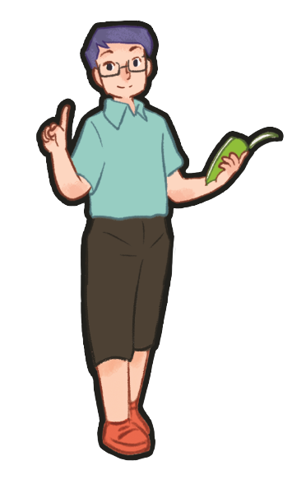
1
Warm-up
Game

Slide 4

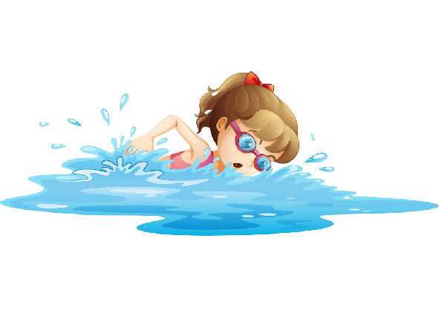
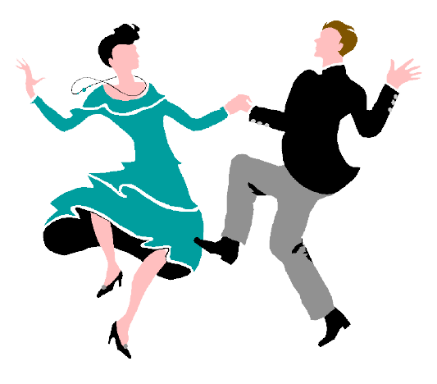

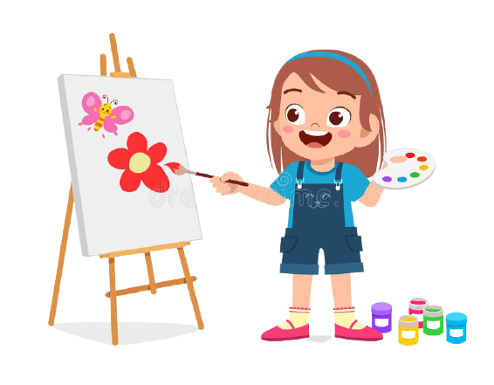


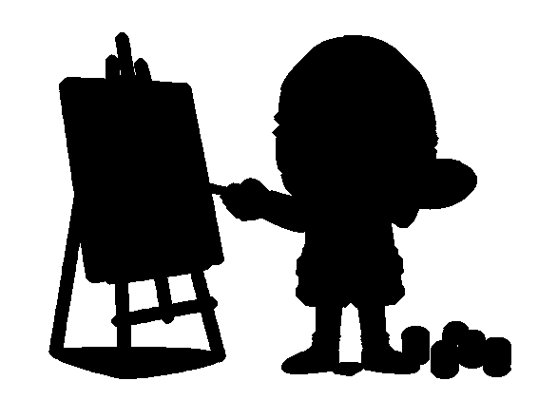
1
2
3
4
5
6
7
8
Notes:
- T divides class into 2 teams (Boys and Girls).
- Pupils in 2 teams take turn to open the boxes to match the shadows and their original pictures (open: click the numbers-close: click the red signs).
- Pupils of each team will get points if their matching is correct.
- Review hobbies: singing, drawing, dancing, swimming.

Slide 5
singing
Notes:
T shows the shadows with their pictures and say the words and gives sentences: “They are _____.”, “She is _____.”, “He is _____.”.

Slide 6
drawing
Notes:
T shows the shadows with their pictures and say the words and gives sentences: “They are _____.”, “She is _____.”, “He is _____.”.

Slide 7
swimming
Notes:
T shows the shadows with their pictures and say the words and gives sentences: “They are _____.”, “She is_____.”, “He is _____.”.

Slide 8
dancing
Notes:
T shows the shadows with their pictures and say the words and gives sentences: “They are _____.”, “She is _____.”, “He is _____.”.

Slide 9
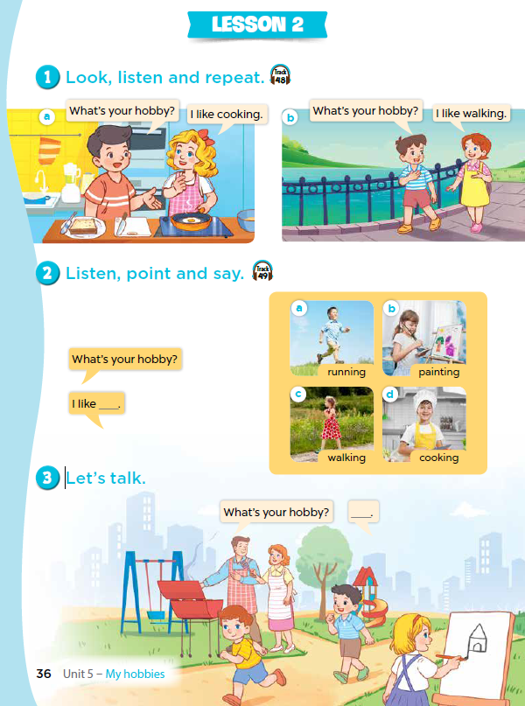
Notes:
T asks pupils to open their SB/ page 36.

Slide 10
2
Look, listen and repeat.
Notes:
Review Numbers 1-10 and Alphabet

Slide 11
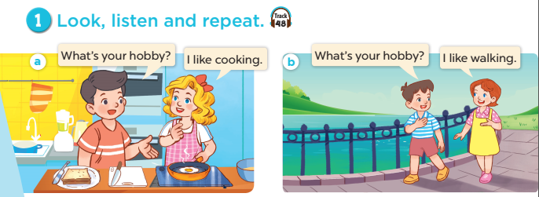
Notes:
Step 1: Have pupils look at Pictures a and b and identify the characters in the pictures.
Step 2: Ask pupils to look at Picture a. Play the recording for them to listen. Play the recording
again, sentence by sentence, for pupils to listen and repeat. Follow the same procedure with
Picture b. Correct their pronunciation where necessary.
Step 3: Play the recording again for pupils to listen and repeat in chorus sentence by sentence.
Step 4: Invite a few pairs to the front of the classroom to listen and repeat the sentences in the
recording.
Step 5: Draw their attention to the question What’s your hobby? and the answers I like cooking.
and I like walking. Tell pupils that they are a question and answers about hobbies.

Slide 12

Notes:
Step 1: Have pupils look at Pictures a and b and identify the characters in the pictures.
Step 2: Ask pupils to look at Picture a. Play the recording for them to listen. Play the recording
again, sentence by sentence, for pupils to listen and repeat. Follow the same procedure with
Picture b. Correct their pronunciation where necessary.
Step 3: Play the recording again for pupils to listen and repeat in chorus sentence by sentence.
Step 4: Invite a few pairs to the front of the classroom to listen and repeat the sentences in the
recording.
Step 5: Draw their attention to the question What’s your hobby? and the answers I like cooking.
and I like walking. Tell pupils that they are a question and answers about hobbies.

Slide 13
3
Listen, point and say.
Notes:
Review Numbers 1-10 and Alphabet

Slide 14
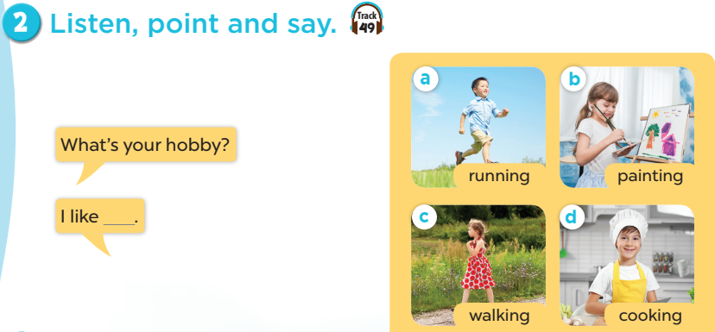
Notes:
Step 1: Have pupils look at the pictures and elicit the names of the hobbies.
Step 2: Have pupils point at Picture a (a boy running), listen to the recording and repeat the
word (running). Follow the same procedure with the other three pictures. Have the class
repeat the words a few times.
Step 3: Point at the bubble and have pupils listen and repeat after the recording (What’s your
hobby?). Point at Picture a and have pupils listen and repeat after the recording (I like
running.). Follow the same procedure with the other three pictures.
Step 4: Have pairs practise asking and answering the question What’s your hobby? – I like
_____.
Step 5: Invite a few pairs to point at the pictures and say the questions and answers in front of
the class.

Slide 15
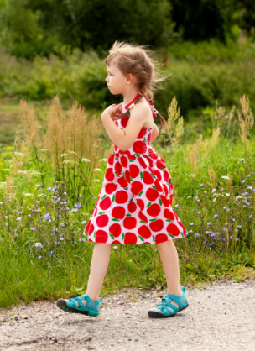
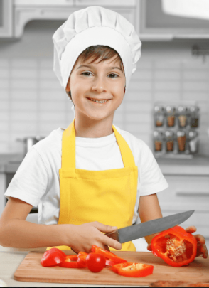
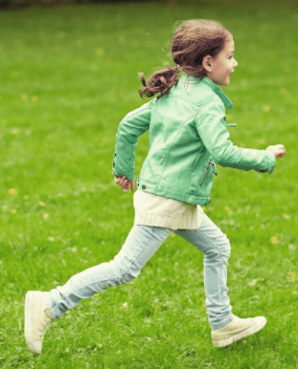
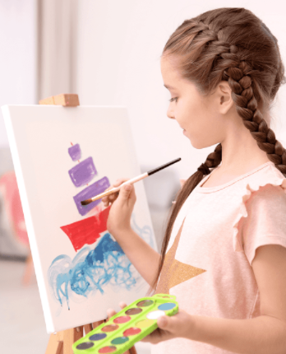
walking
cooking
painting
running
Notes:
Let pupils do the action and say.
Set group competition to make it more interesting.

Slide 16


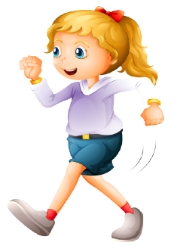
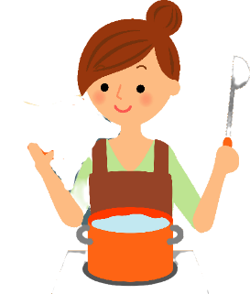
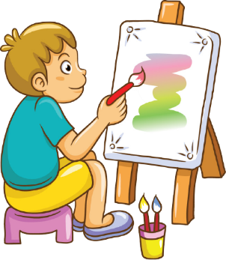
What’s your hobby?
running
walking
cooking
painting
Notes:
T shows 4 pictures on the board and asks pupils to practise more.

Slide 17
4
Let’s talk.

Slide 18
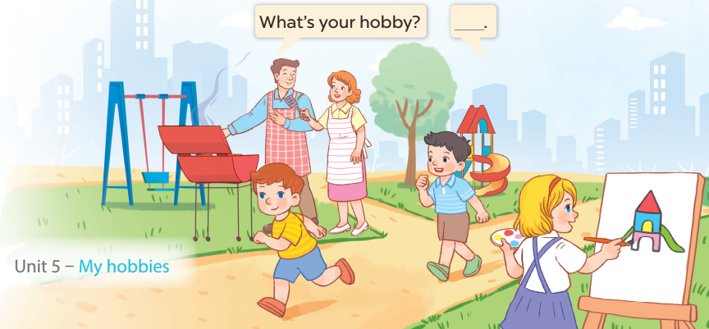
Notes:
Step 1: Draw pupils’ attention to the picture. Tell them about the activity. Ask questions to help
them understand the context (see Input).
Step 2: Put pupils into pairs and encourage them to ask and answer questions using the target
sentence patterns. Go around the classroom to offer support where necessary.
Step 3: Invite some pairs to stand up to perform their exchanges.

Slide 19


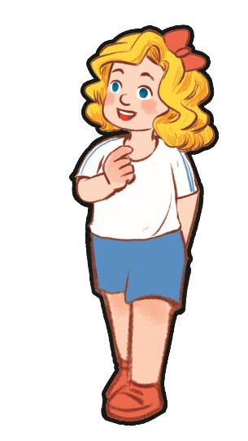
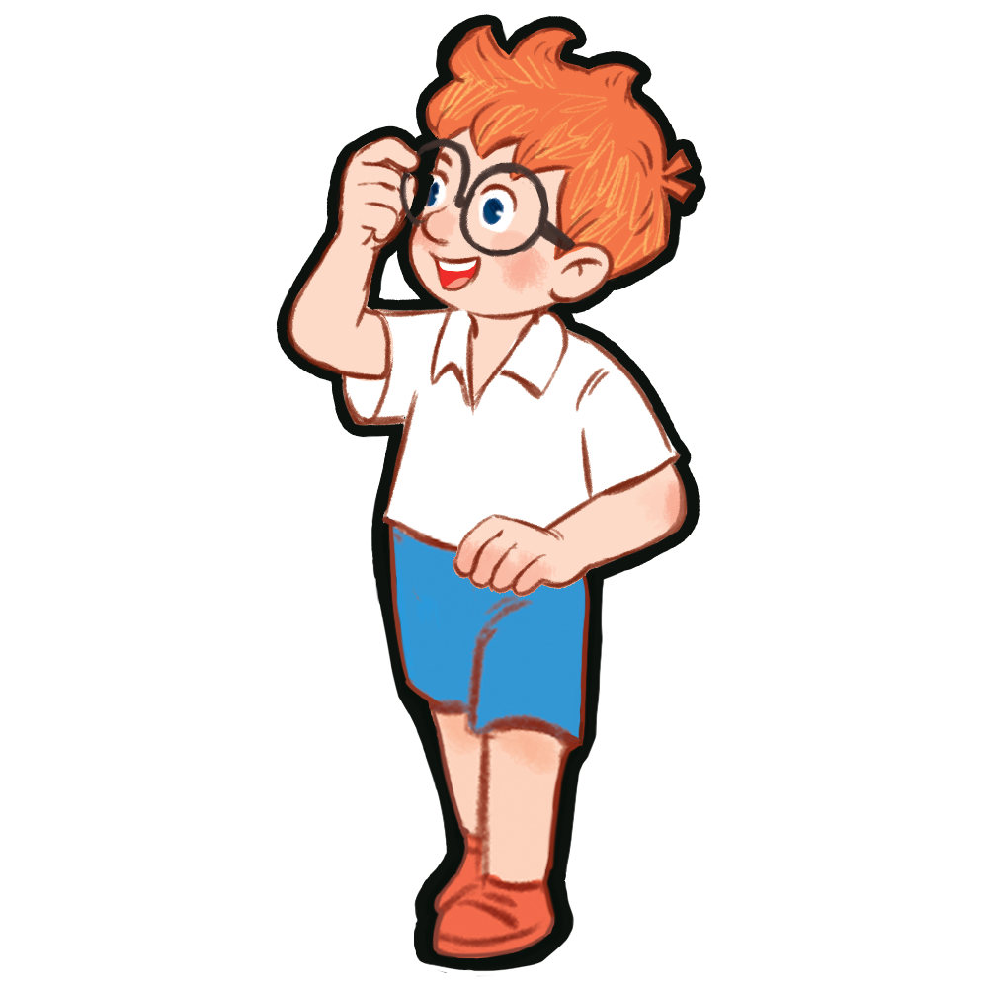
What’s your hobby?
I like ____.
Notes:
- T asks pupils to practise in pairs asking and answering.
- T asks some pairs to present in front of class.

Slide 20
Game time

Slide 21
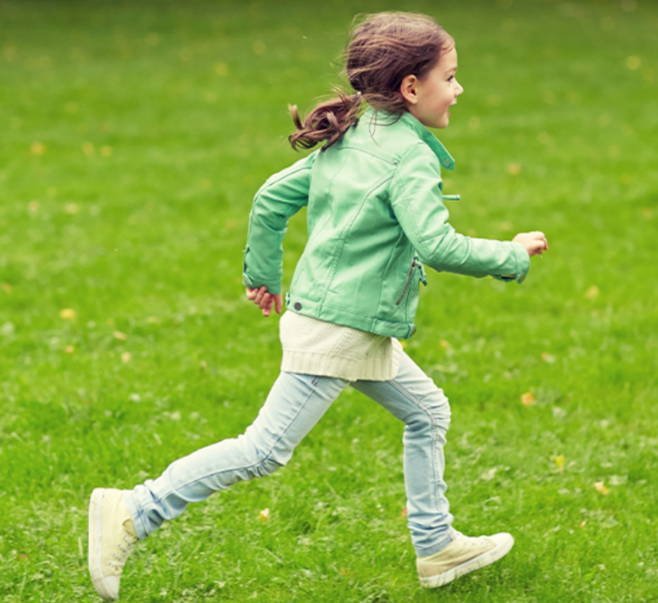
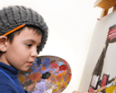
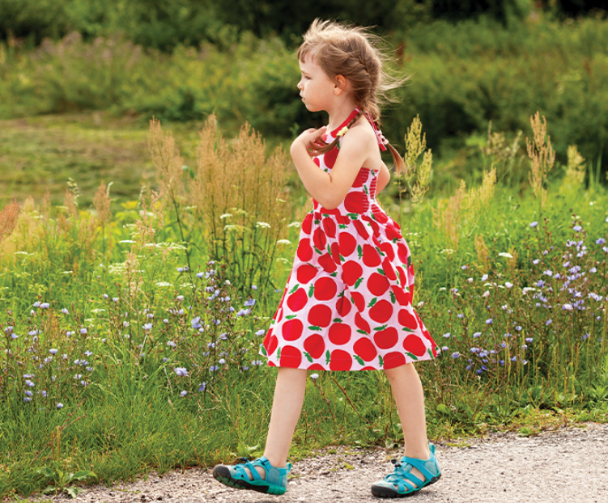
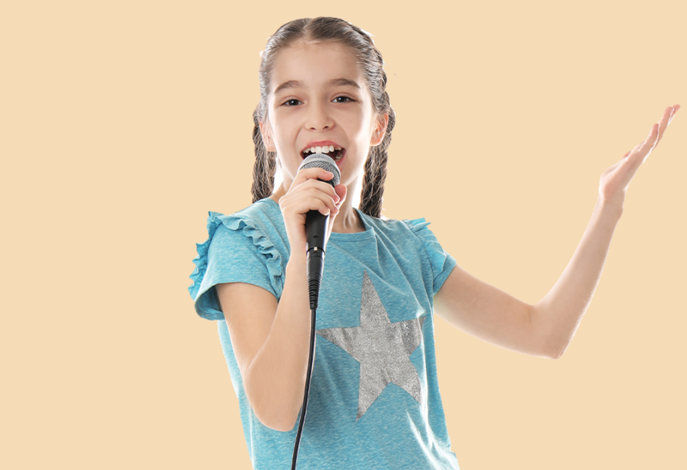
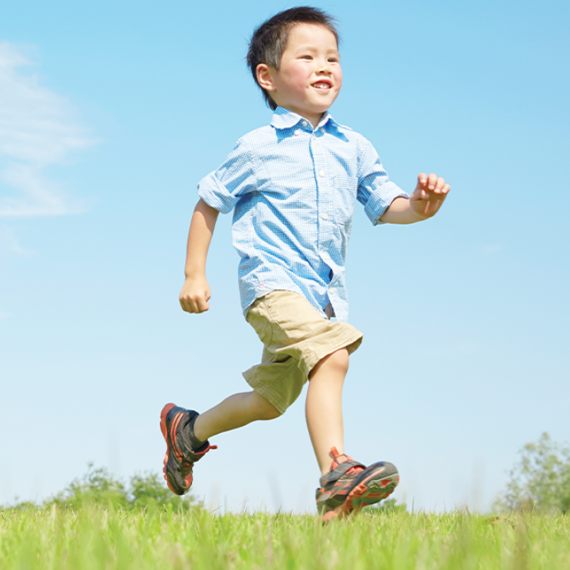
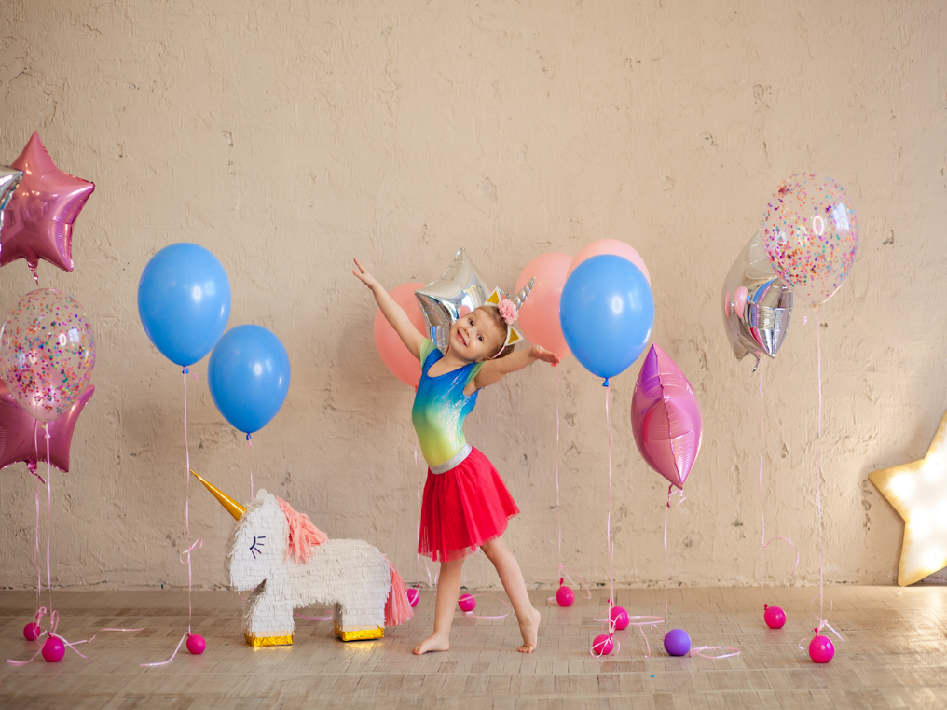
Notes:
T lets the pupils review the pictures of hobbies. (flash cards)

Slide 22





1
2
3
4
5
6
7
8
9
10
11
12
13
14
15
16
17
18
19
20
Notes:
- T divides class into 2 teams.
- Pupils in 2 teams take turn choosing a box and answer the questions: What’s your hobby? (T uses flash cards of hobbies and ask pupils to say out loud the hobbies-flash cards/ pictures of hobbies).
- T clicks on the box to reveal the points beneath.
- The team with the most points is the winner.

Slide 23

5
Fun corner and
Wrap-up
Notes:
Jigsaw puzzle:
Click on the puzzles and let the pupils get when the pictures of hobbies revealed.

Slide 24
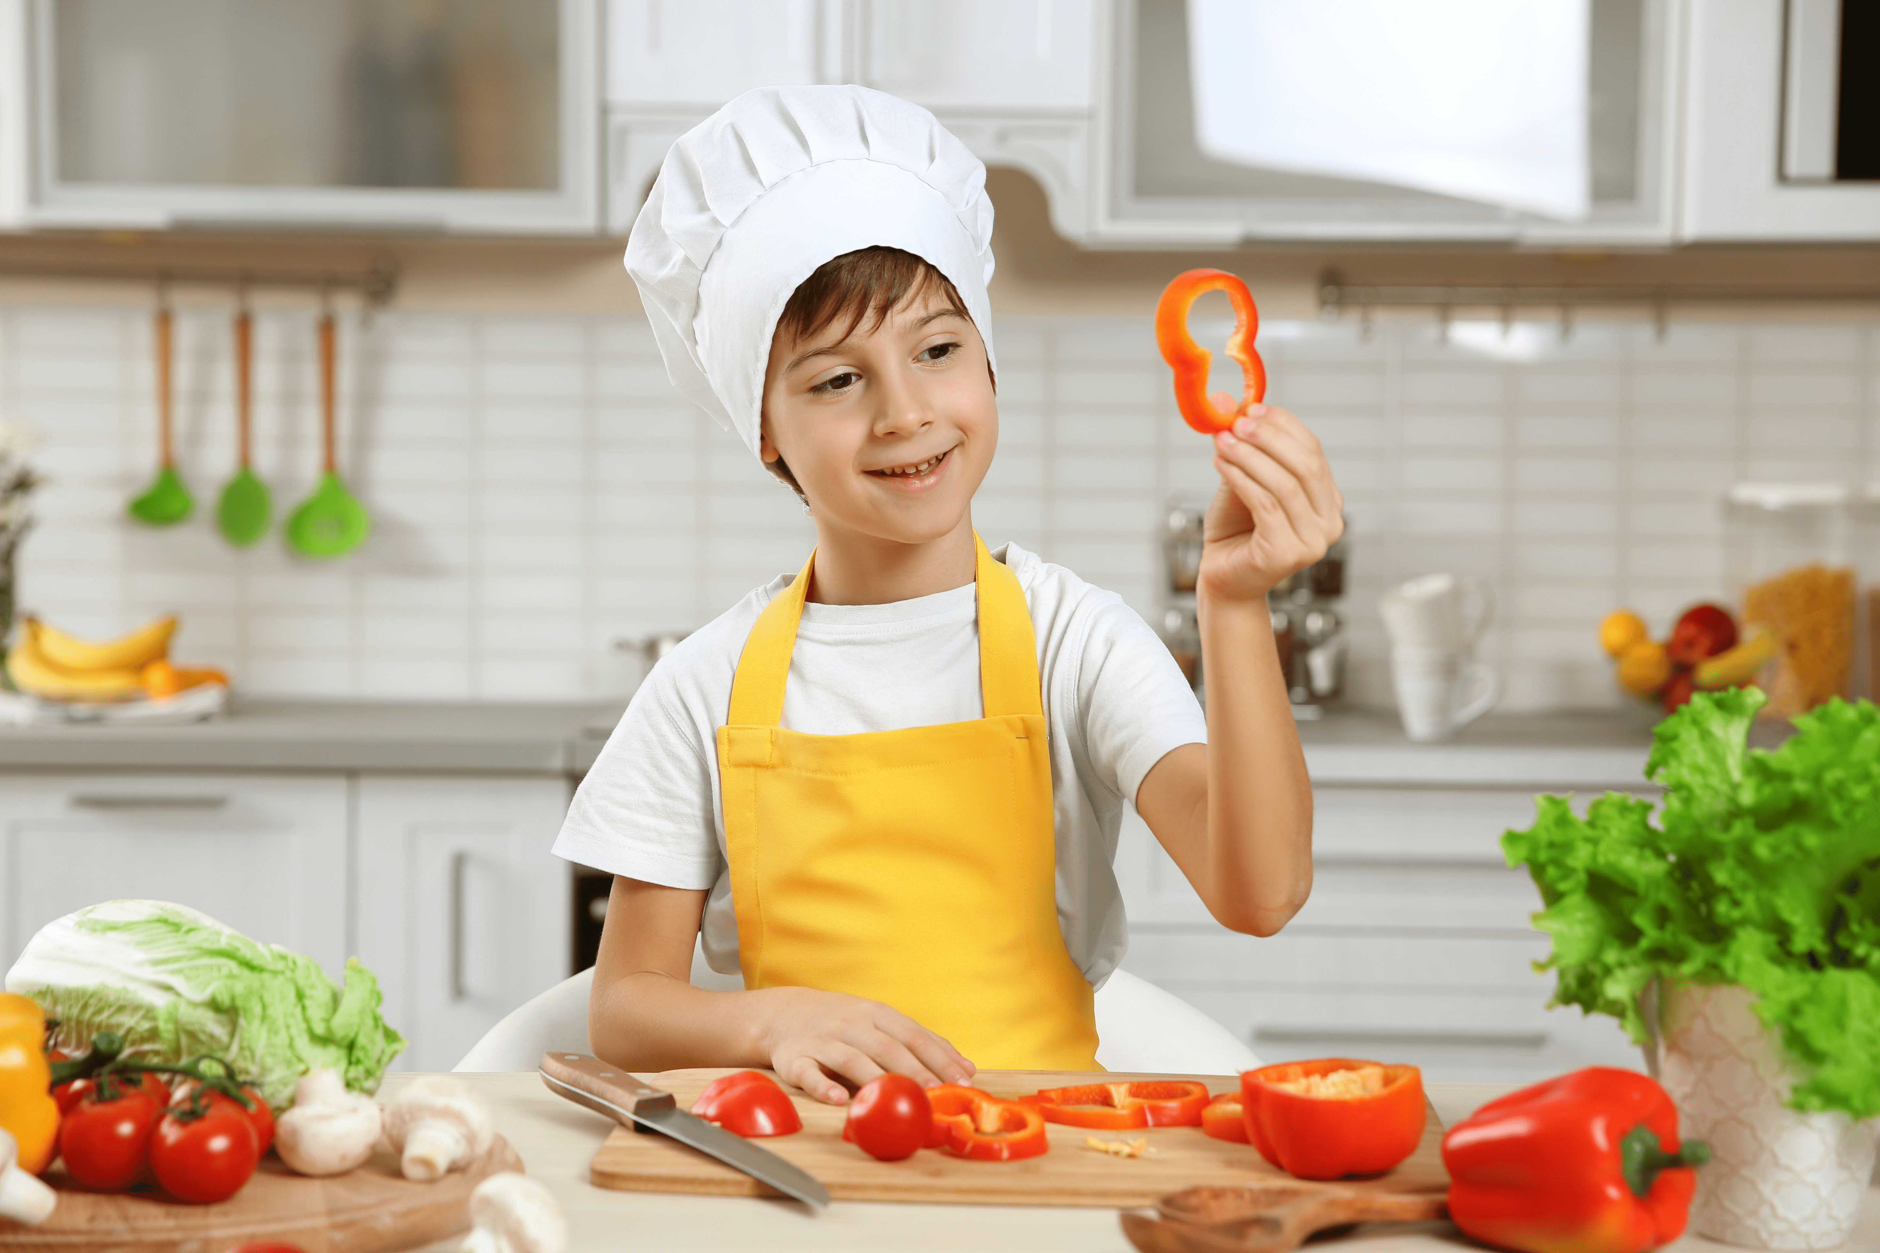
Notes:
Jigsaw puzzle:
Click on the puzzles and let the pupils get when the pictures of hobbies revealed.

Slide 25
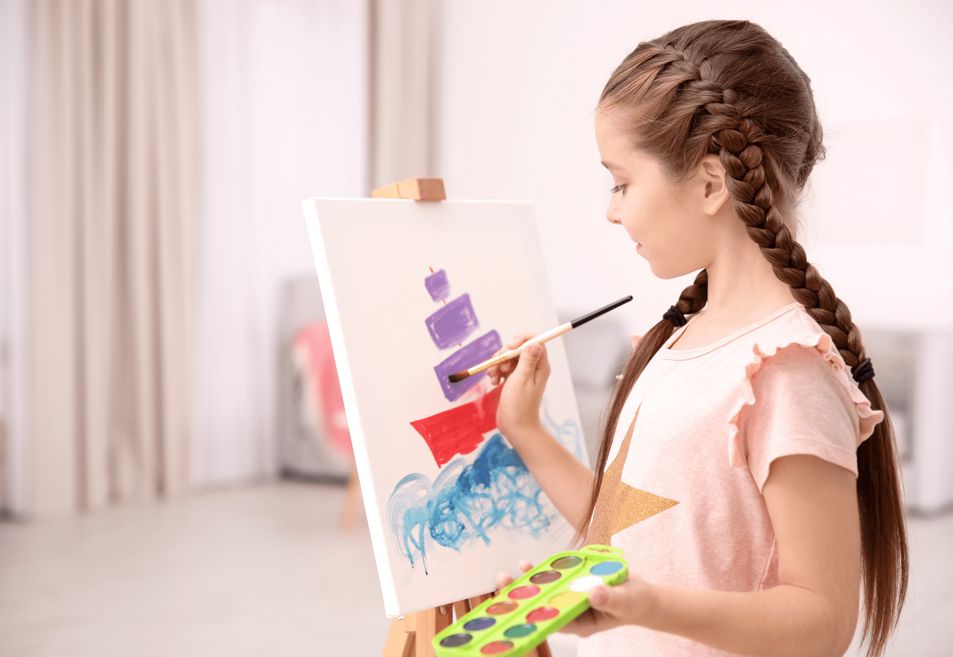
Notes:
Jigsaw puzzle:
Click on the puzzles and let the pupils get when the pictures of hobbies revealed.

Slide 26
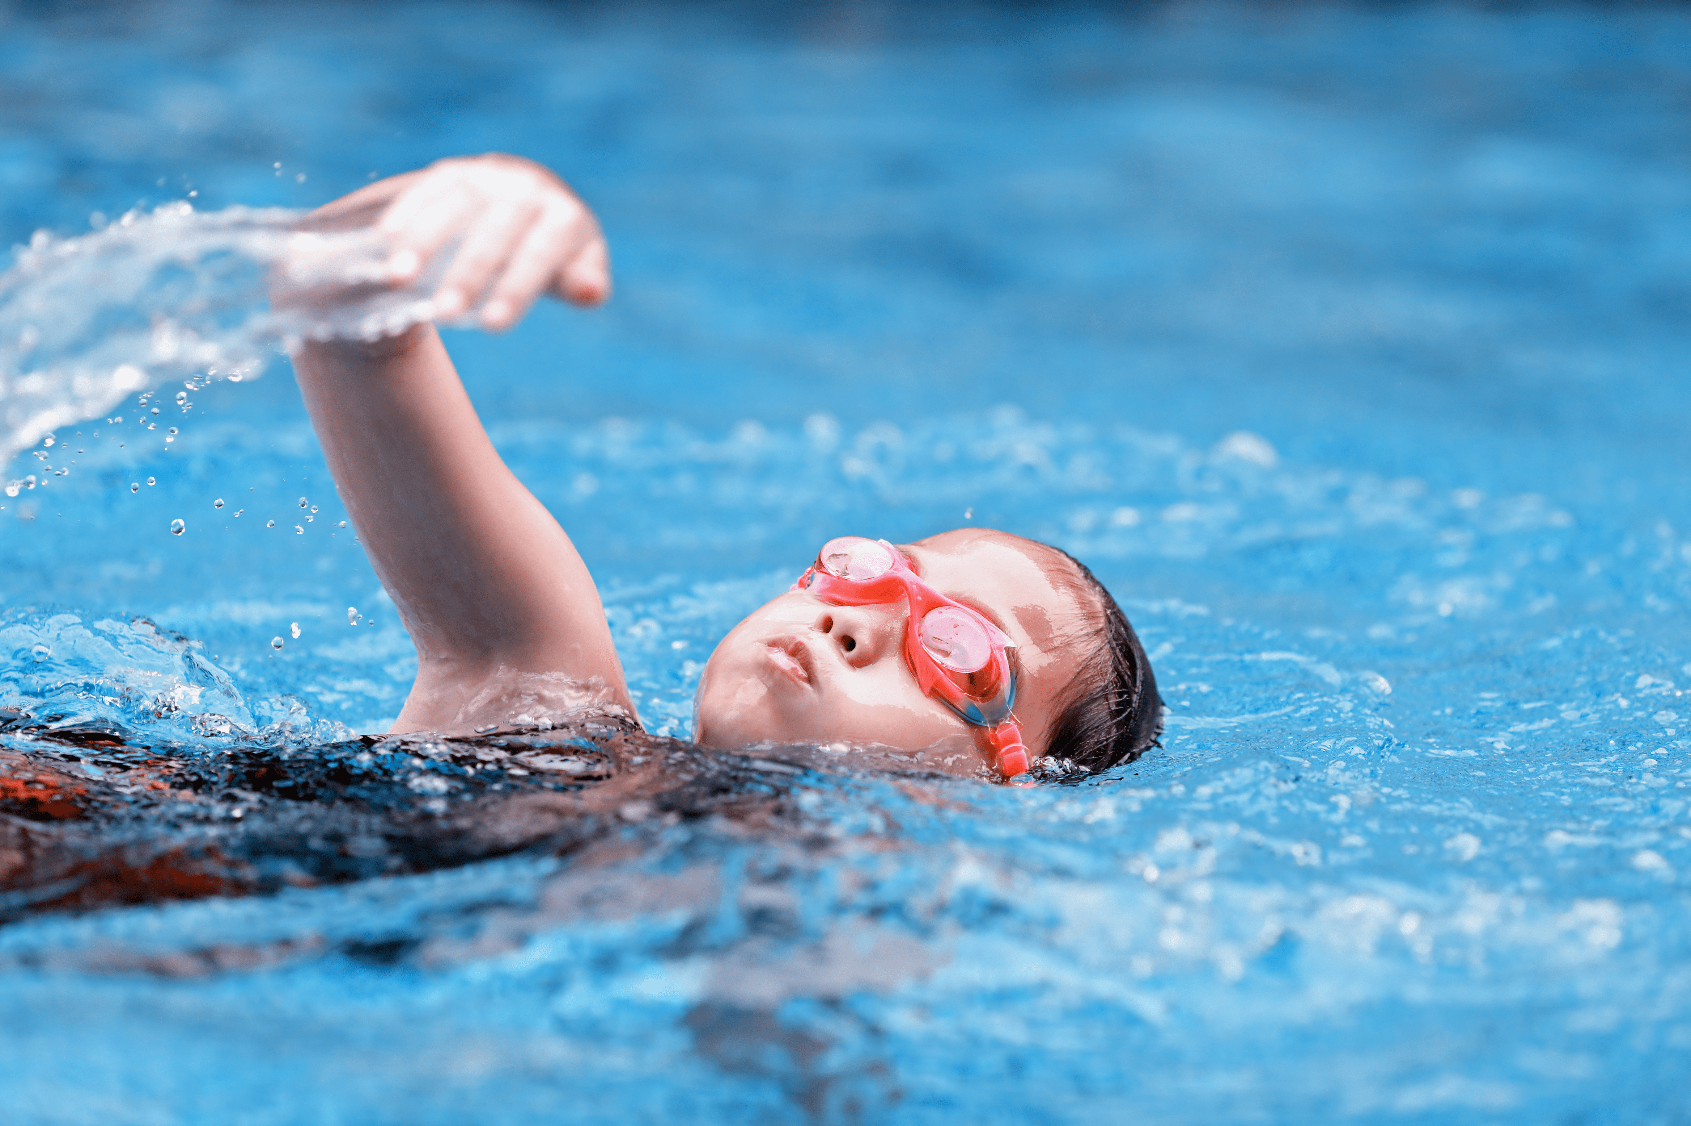
Notes:
Jigsaw puzzle:
Click on the puzzles and let the pupils get when the pictures of hobbies revealed.

Slide 27

Notes:
Jigsaw puzzle:
Click on the puzzles and let the pupils get when the pictures of hobbies revealed.

