Slide 1








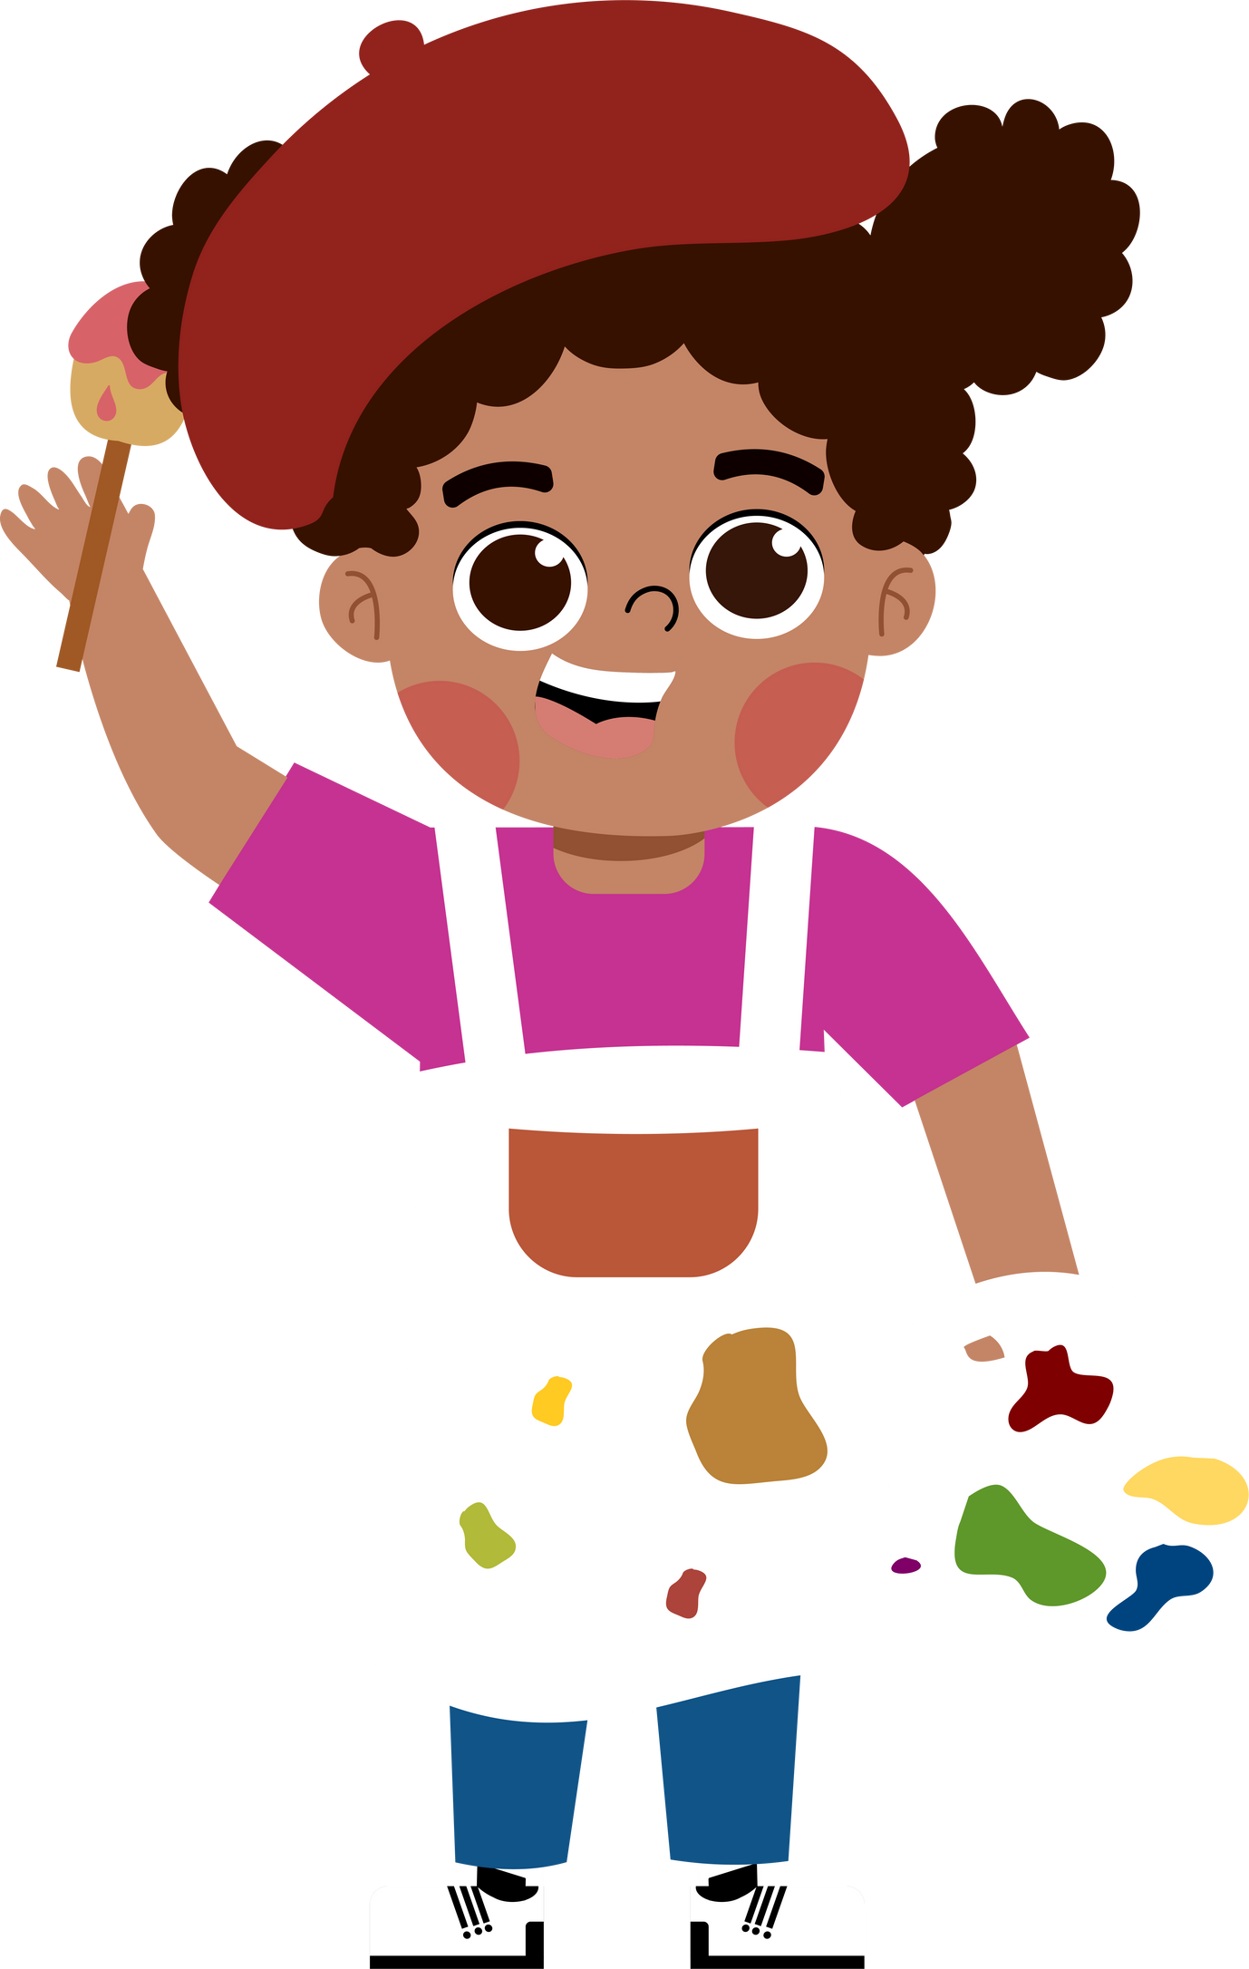








5
Quang Trung Primary School
My future job
Lesson 3 - Period 5
Teacher: Bui Thi Thuy Phuong

Slide 2





TABLE OF CONTENTs
01. Warm-up and Review
02. Listen and repeat.
03. Circle, listen and check.
04. Let's chant.
05. Fun corner and Wrap-up

Slide 3




01.
Warm-up and Review
Unscramble the letters.

Slide 4


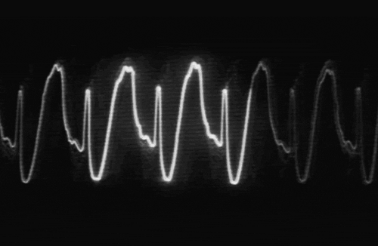


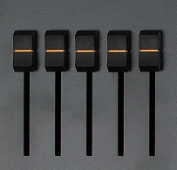




T R D C O O
DOCTOR
Notes:
Click on the red button to reveal the answer.

Slide 5
T I E R W R
WRITER
Notes:
Click on the red button to reveal the answer.

Slide 6
C H T R E A E
TEACHER
Notes:
Click on the red button to reveal the answer.

Slide 7
I S N T E D T
DENTIST
Notes:
Click on the red button to reveal the answer.

Slide 8
R I F E G T R E F H I
FIREFIGHTER
Notes:
Click on the red button to reveal the answer.

Slide 9
N E R D E R G A
GARDENER
Notes:
Click on the red button to reveal the answer.

Slide 10
R O R P E R E T
REPORTER
Notes:
Click on the red button to reveal the answer.

Slide 11





More jobs
Guess the job.

Slide 12
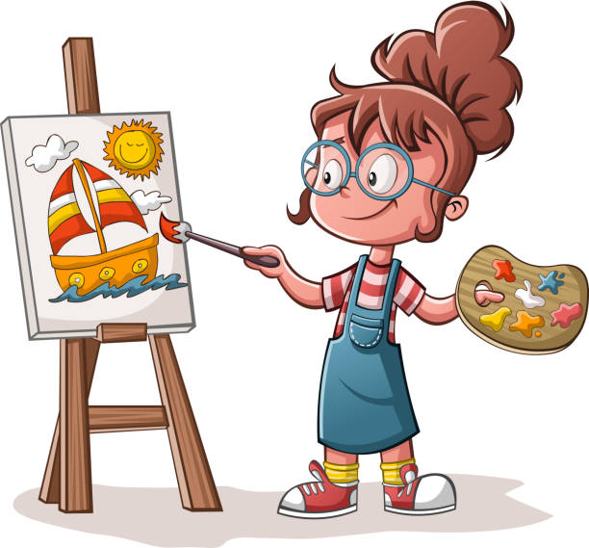
artist

Slide 13
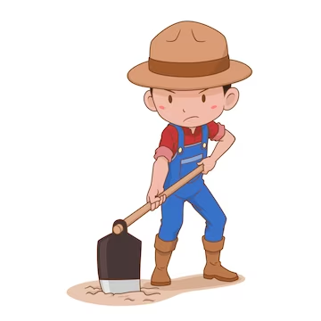
farmer

Slide 14
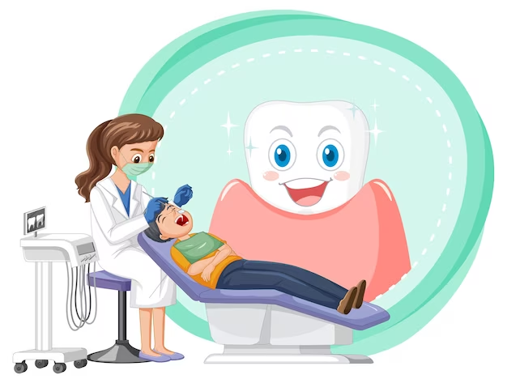
dentist

Slide 15

actor

Slide 16

pilot

Slide 17
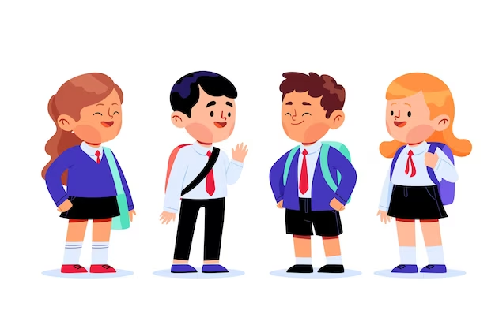
student

Slide 18




NOUNS
How many syllables?
artist
teacher
writer
gardener
pilot
dentist
actor
firefighter
doctor
student
farmer
reporter

Slide 19
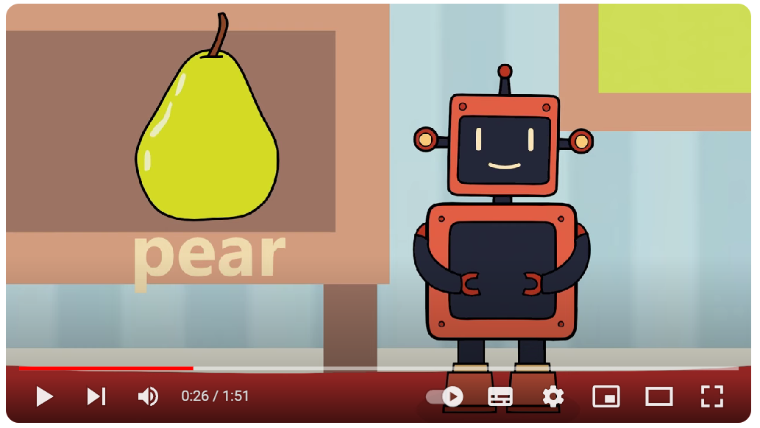
https://www.youtube.com/watch?v=UWaomqRcHuw

Slide 20
2syllables
3syllables
artist
teacher
writer
gardener
pilot
dentist
actor
firefighter
doctor
student
farmer
reporter

Slide 21
2syllables noun
Stress on the 1st syllable
artist
teacher
writer
artist
teacher
writer
pilot
dentist
actor
pilot
dentist
actor
doctor
student
farmer
doctor
student
farmer

Slide 22
02.
Listen and repeat.

Slide 23

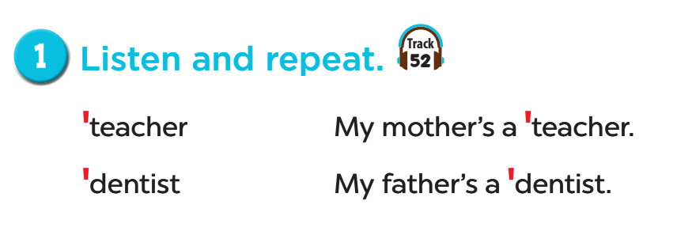
Listen and repeat.

Slide 24
03.
Circle, listen and check.

Slide 25
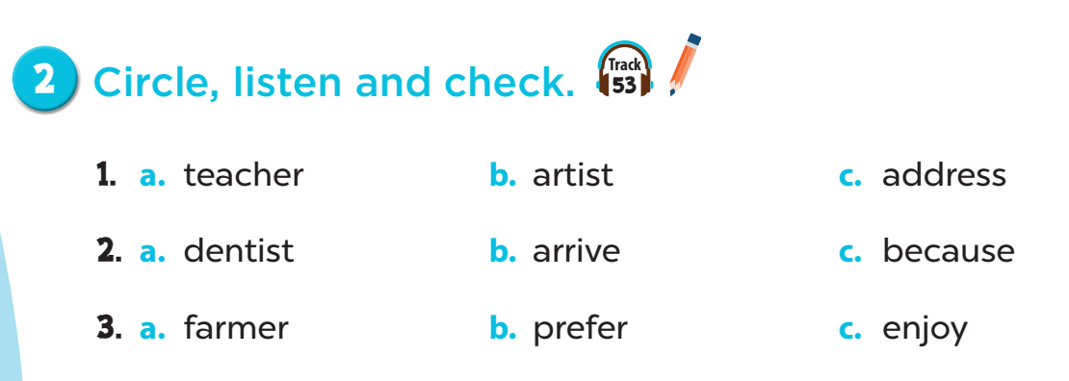
Listen and check.

Slide 26
04.
Let's chant!

Slide 27
1. Close your book.
2. Listen to the chant.
3. Listen again:
- Clap your hands on the stress.

Slide 28
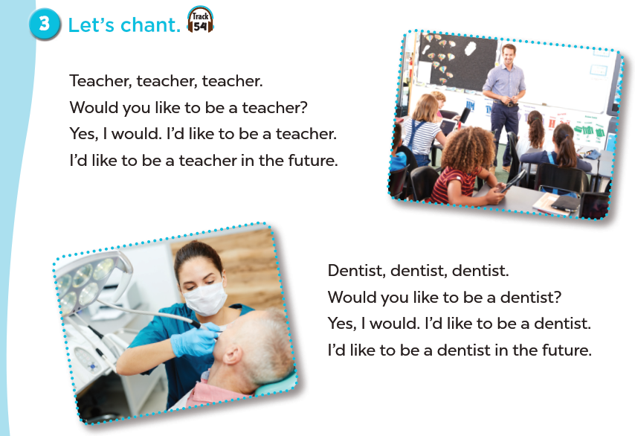

Slide 29
05.
Fun corner and Wrap-up

Slide 30

Let's chant like a robot!

