Slide 1








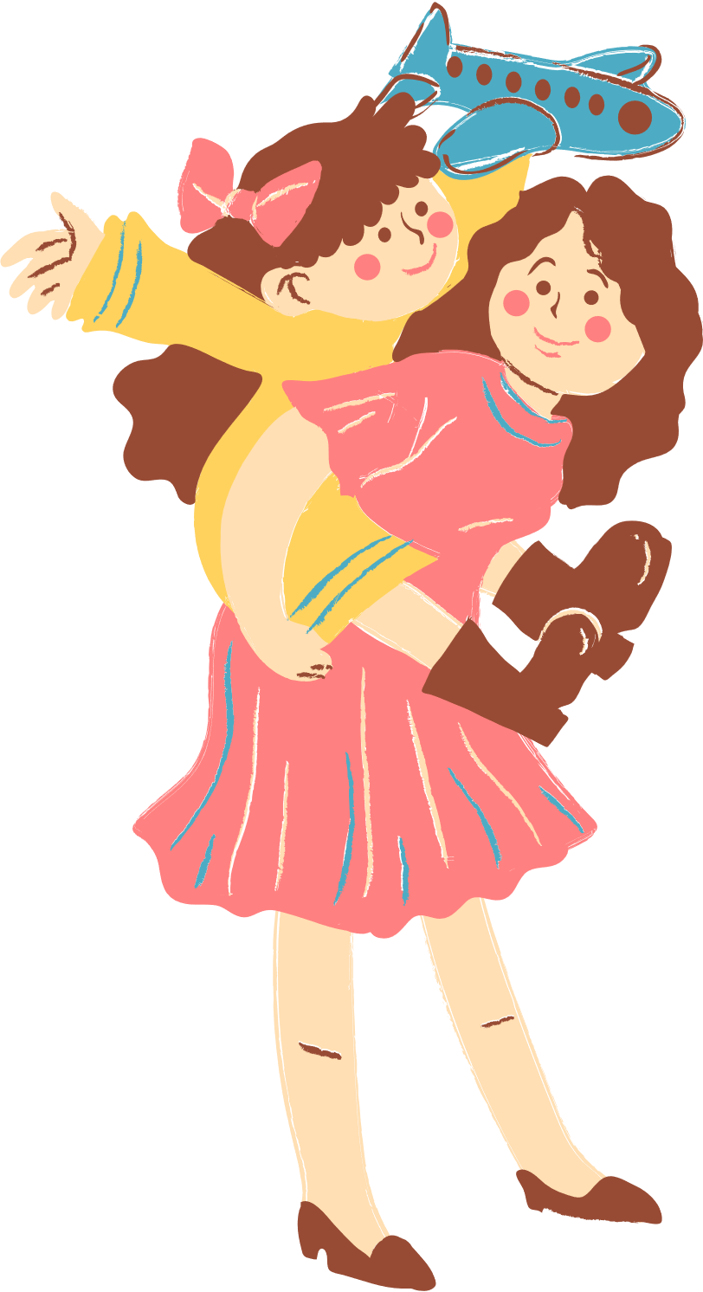
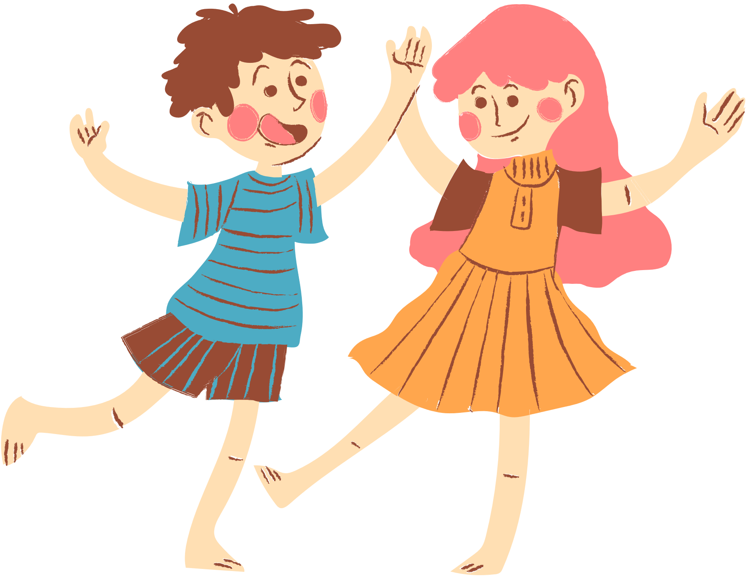
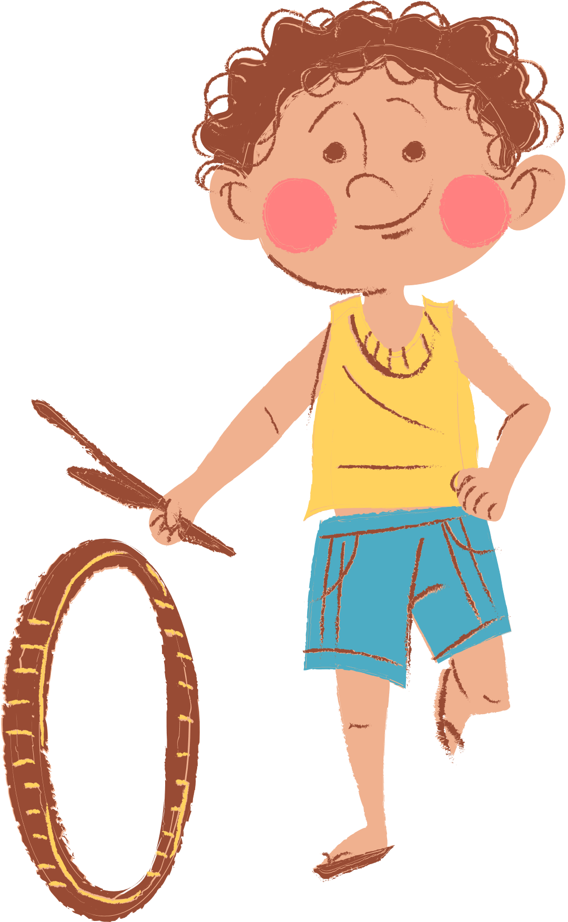
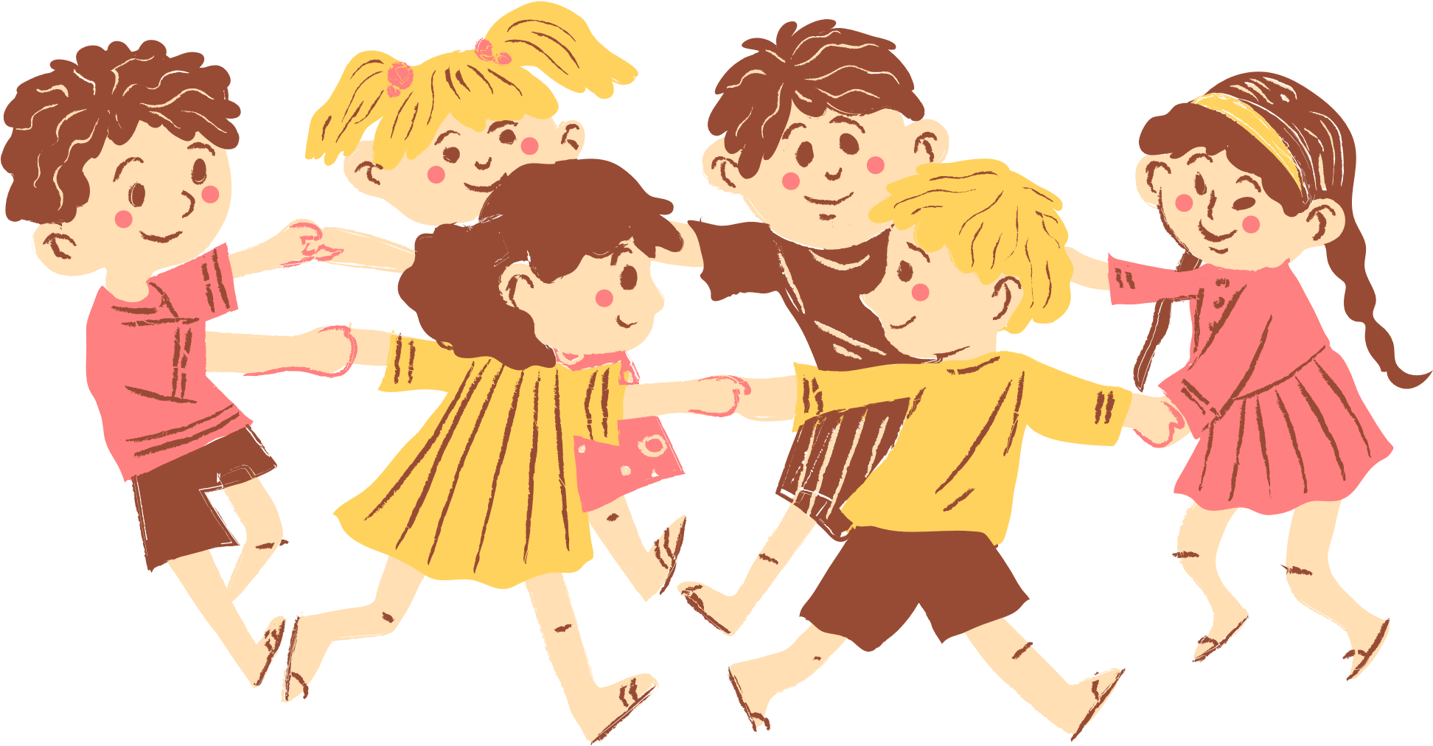
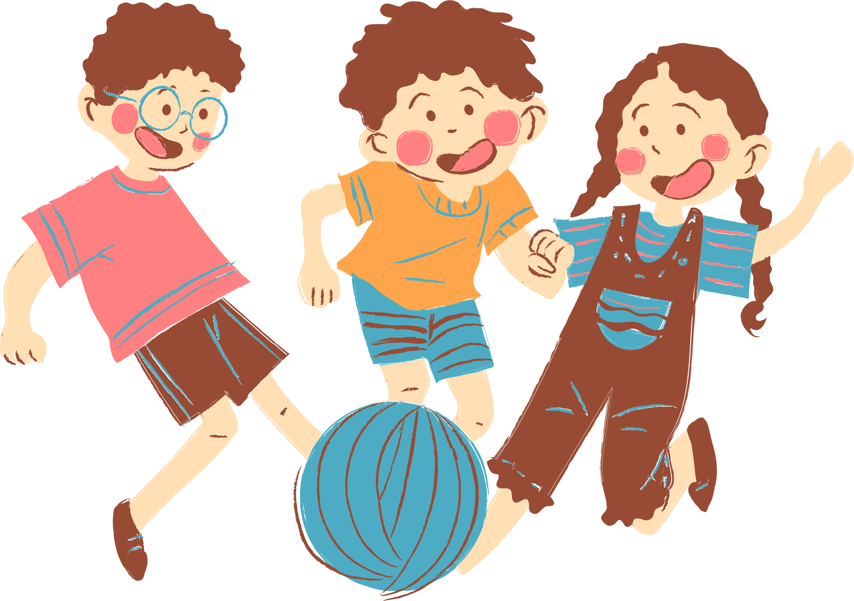
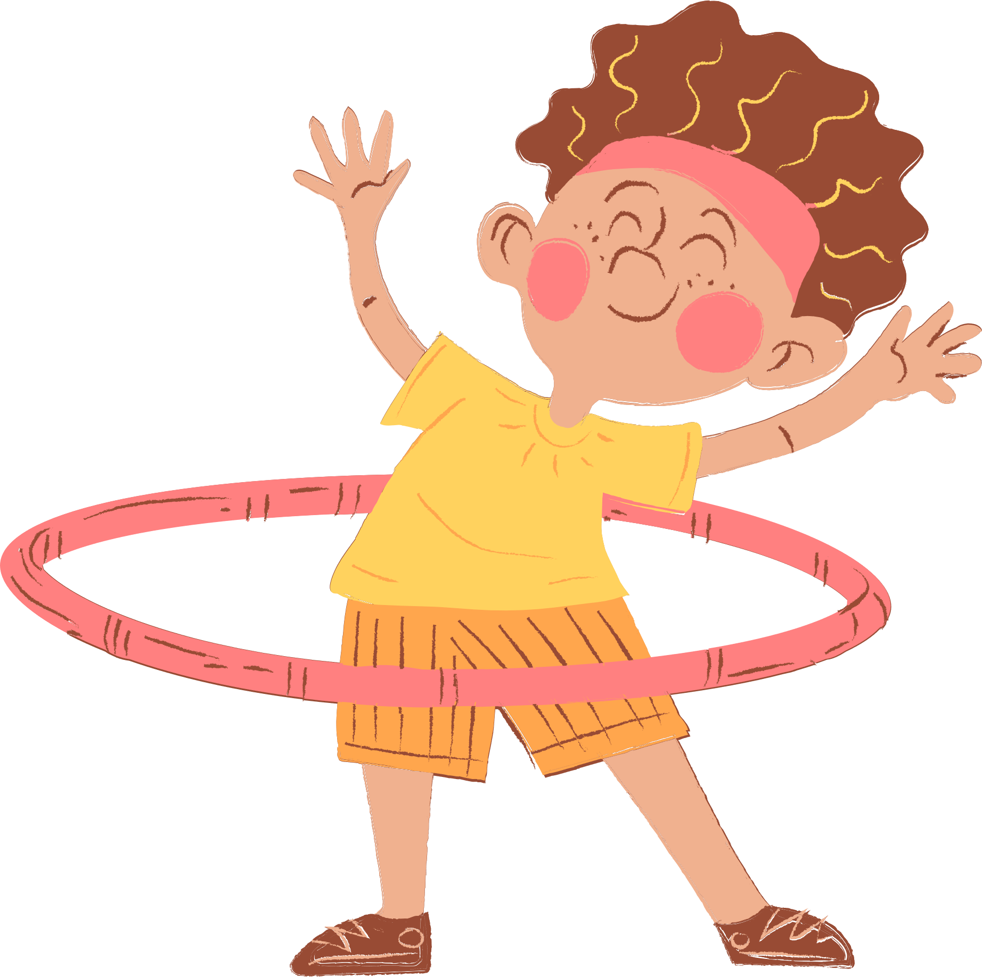
Quang Trung Primary School
4
Our free-time activities
Teacher: Bui Thi Thuy Phuong

Slide 2






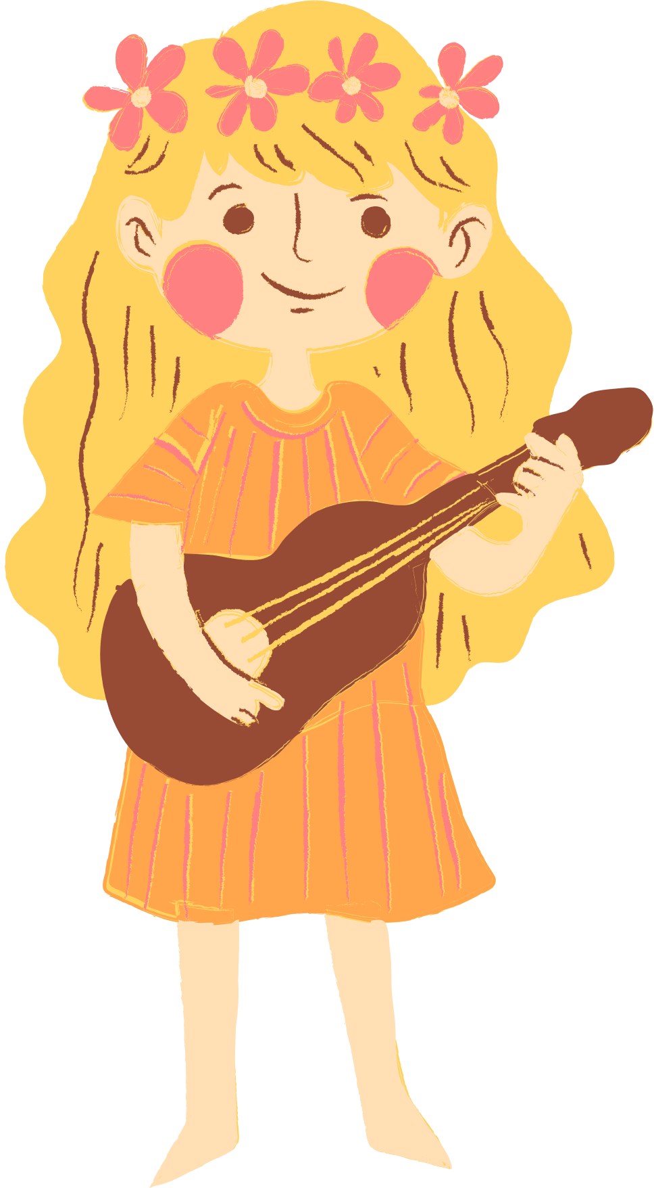
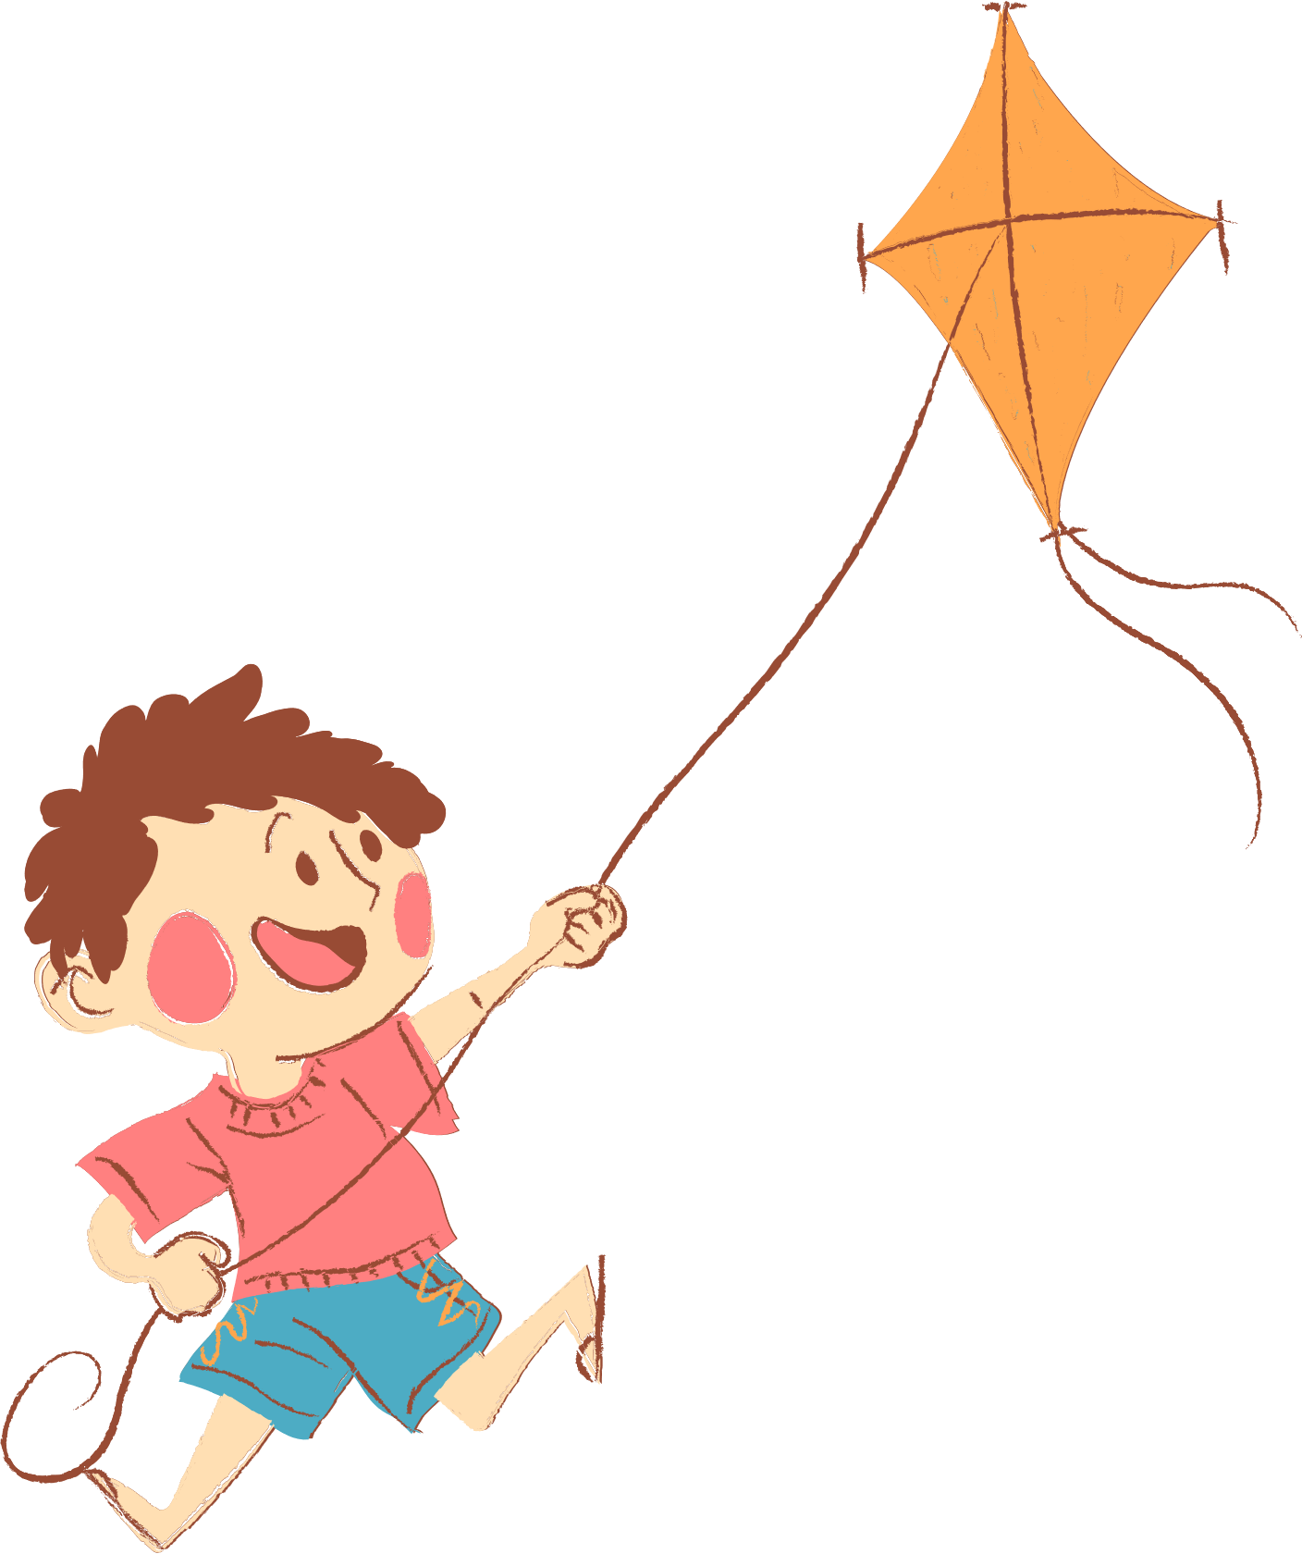
01. Warm-up and Review
02. Look, listen and repeat.
03. Listen, point and say.
04. Let’s talk.
05. Fun corner and Wrap-up

Slide 3
01. Warm-up and Review

Slide 4

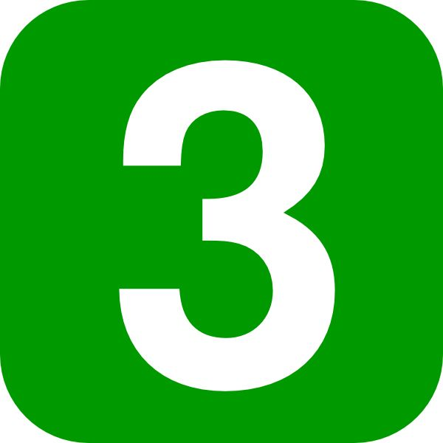


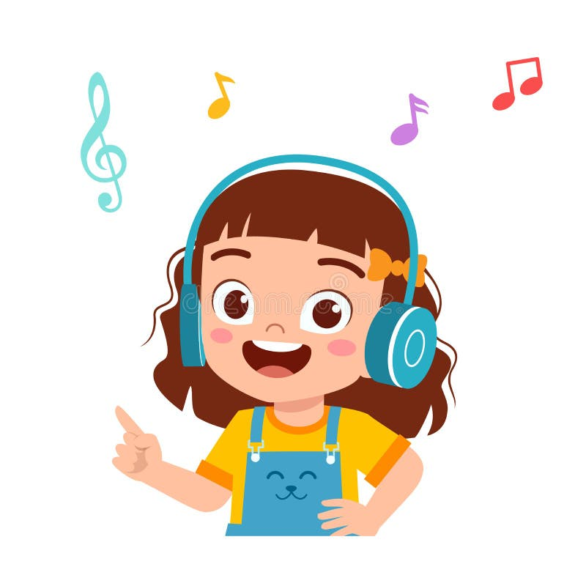
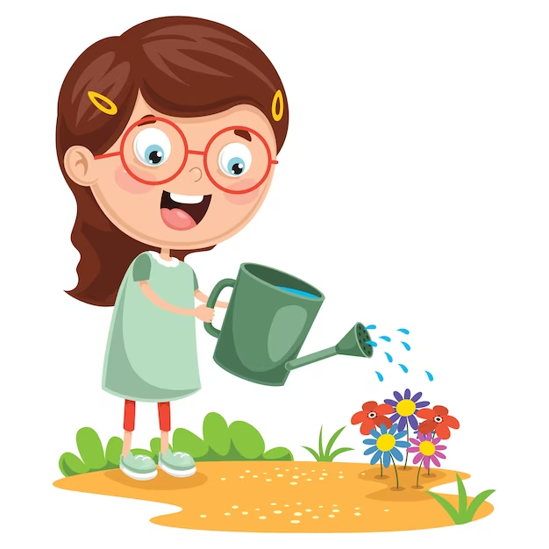
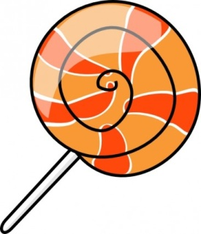
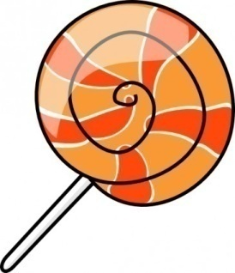

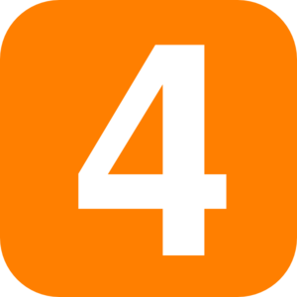

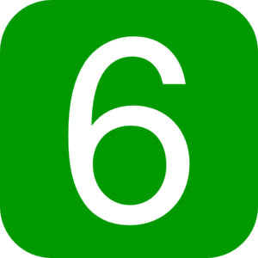
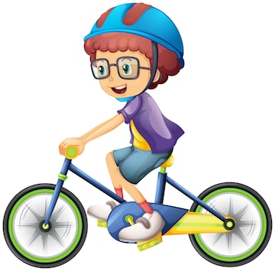
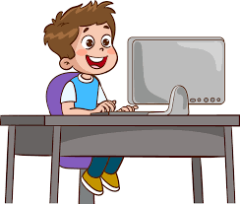
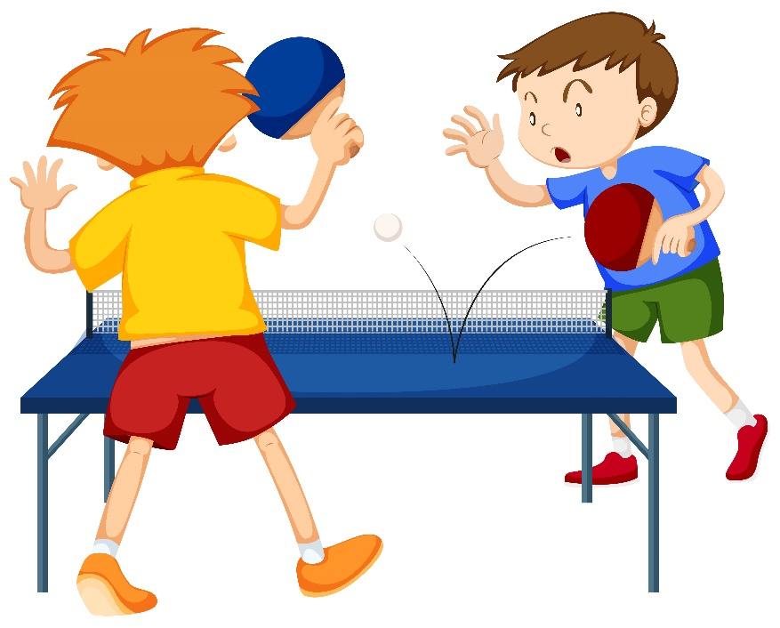
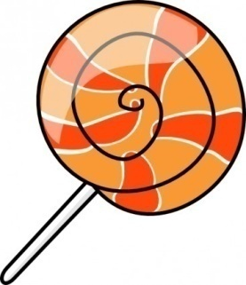

Slide 5
02. Look, listen and repeat.

Slide 6

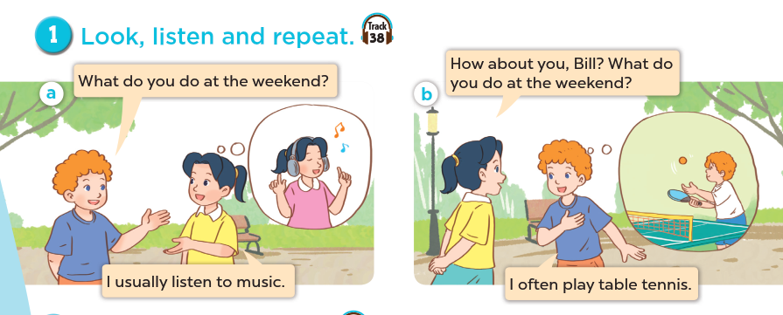
Who are they?
What are they doing?
Where are they?

Slide 7
03. Listen, point and say.

Slide 8
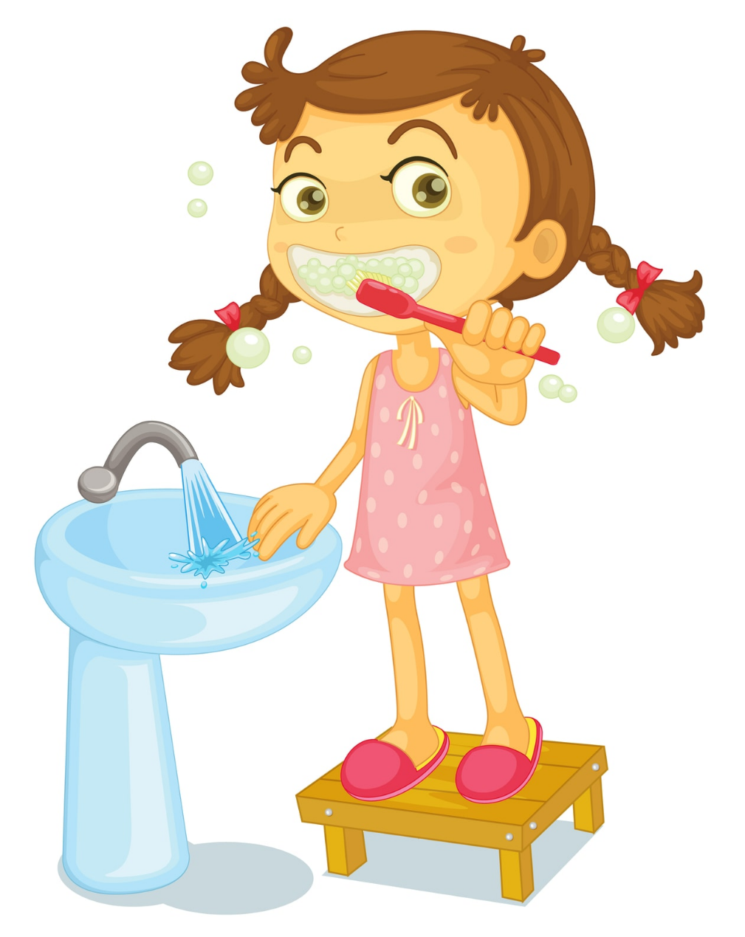

Sun
Mon
Tue
Wed
Thu
Fri
Sat
We always brush my teeth in the morning.

Slide 9

Sun
Mon
Tue
Wed
Thu
Fri
Sat
She usually go to school by bus.

Slide 10
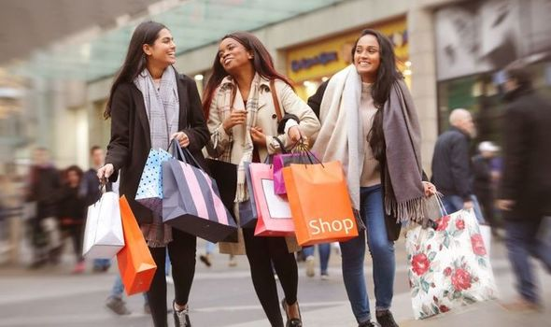
Mon | Tue | Wed | Thu | Fri | Sat | Sun
 | 1 | 2 | 3 | 4 | 5 | 6
7 | 8 | 9 | 10 | 11 | 12 | 13
14 | 15 | 16 | 17 | 18 | 19 | 20
21 | 22 | 23 | 24 | 25 | 26 | 27
28 | 29 | 30 | 31
We often go shopping on Sundays.

Slide 11
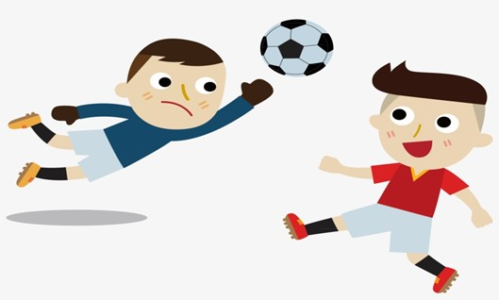
Sun
Mon
Tue
Wed
Thu
Fri
Sat
He sometimes plays football in his free time.

Slide 12

Remember:
always
usually
often
sometimes
0 %
100 %
90 %
70 %
50 %

Slide 13
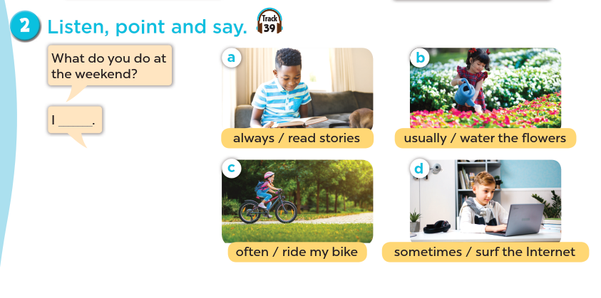

Slide 14
Extension

Slide 15
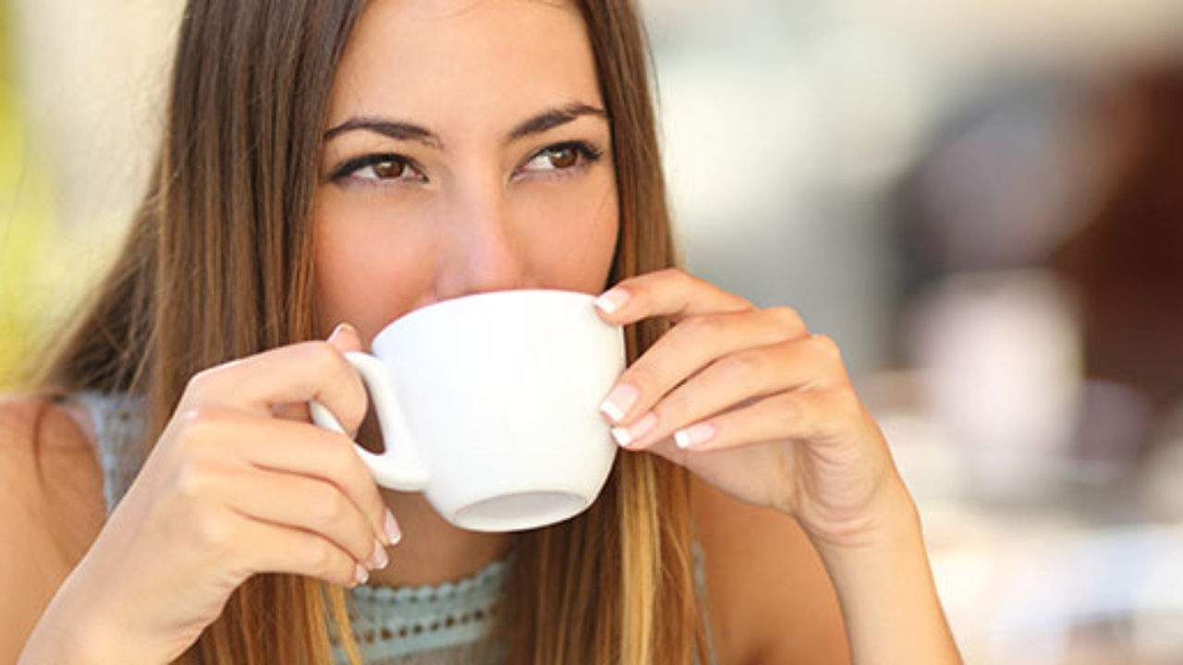
Mon | Tue | Wed | Thu | Fri | Sat | Sun
 | 1 | 2 | 3 | 4 | 5 | 6
7 | 8 | 9 | 10 | 11 | 12 | 13
14 | 15 | 16 | 17 | 18 | 19 | 20
21 | 22 | 23 | 24 | 25 | 26 | 27
28 | 29 | 30 | 31
My mother rarely drinks tea.

Slide 16
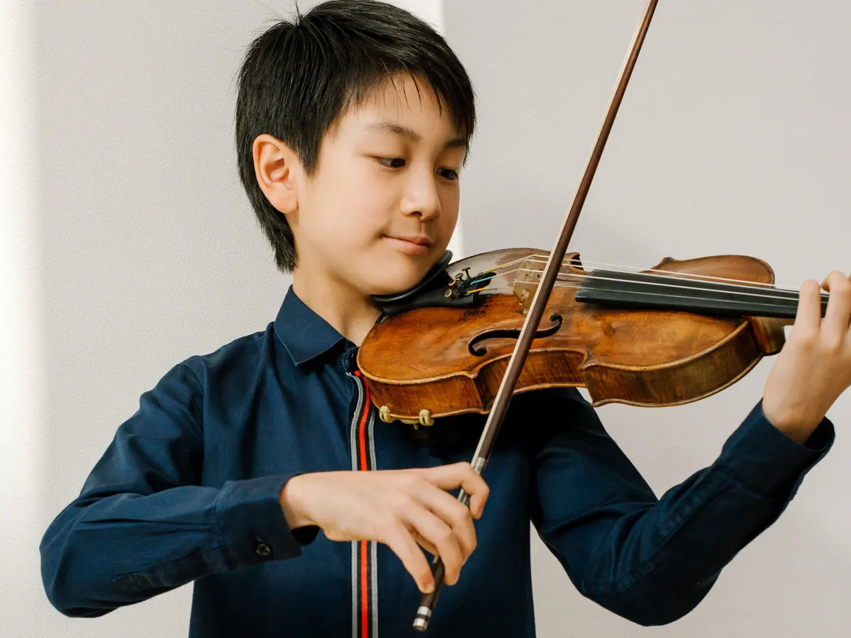
Mon | Tue | Wed | Thu | Fri | Sat | Sun
 | 1 | 2 | 3 | 4 | 5 | 6
7 | 8 | 9 | 10 | 11 | 12 | 13
14 | 15 | 16 | 17 | 18 | 19 | 20
21 | 22 | 23 | 24 | 25 | 26 | 27
28 | 29 | 30 | 31
My brother never plays the violin.

Slide 17
Remember:
always
usually
often
sometimes
rarely
never
100 %
90 %
70 %
50 %
5 %
0 %

Slide 18
04. Let’s talk

Slide 19
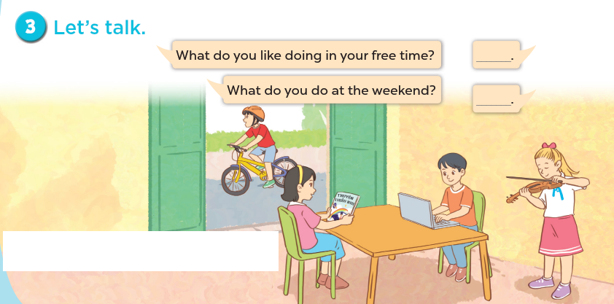

Slide 20
05. Fun corner and Wrap-up
Game: Who has more correct answers?

Slide 21
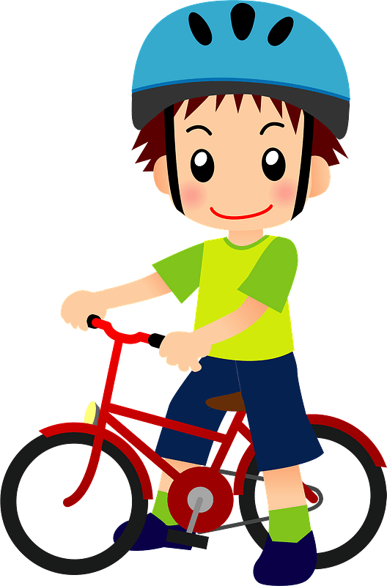
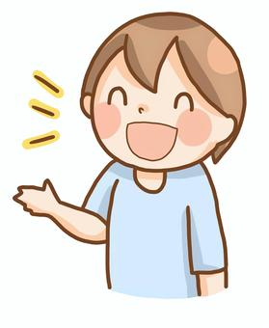
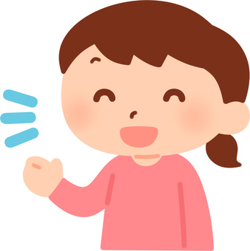
1. What do you do at the weekend?
100 %
I ……………… ride my bike.
A. always
B. never
C. usually

Slide 22

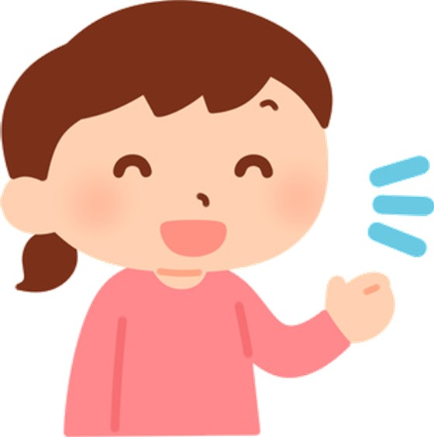
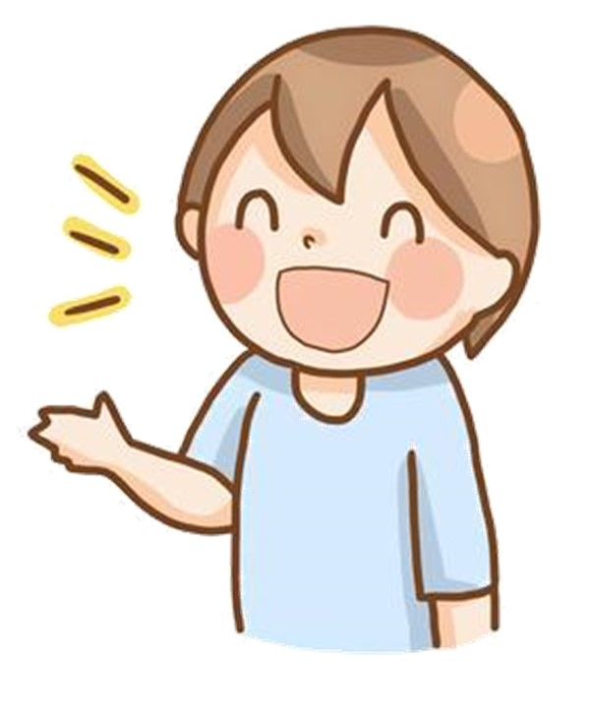
2. What do you do at the weekend?
50 %
I …………………… surf the Internet.
A. often
B. rarely
C. sometimes

Slide 23
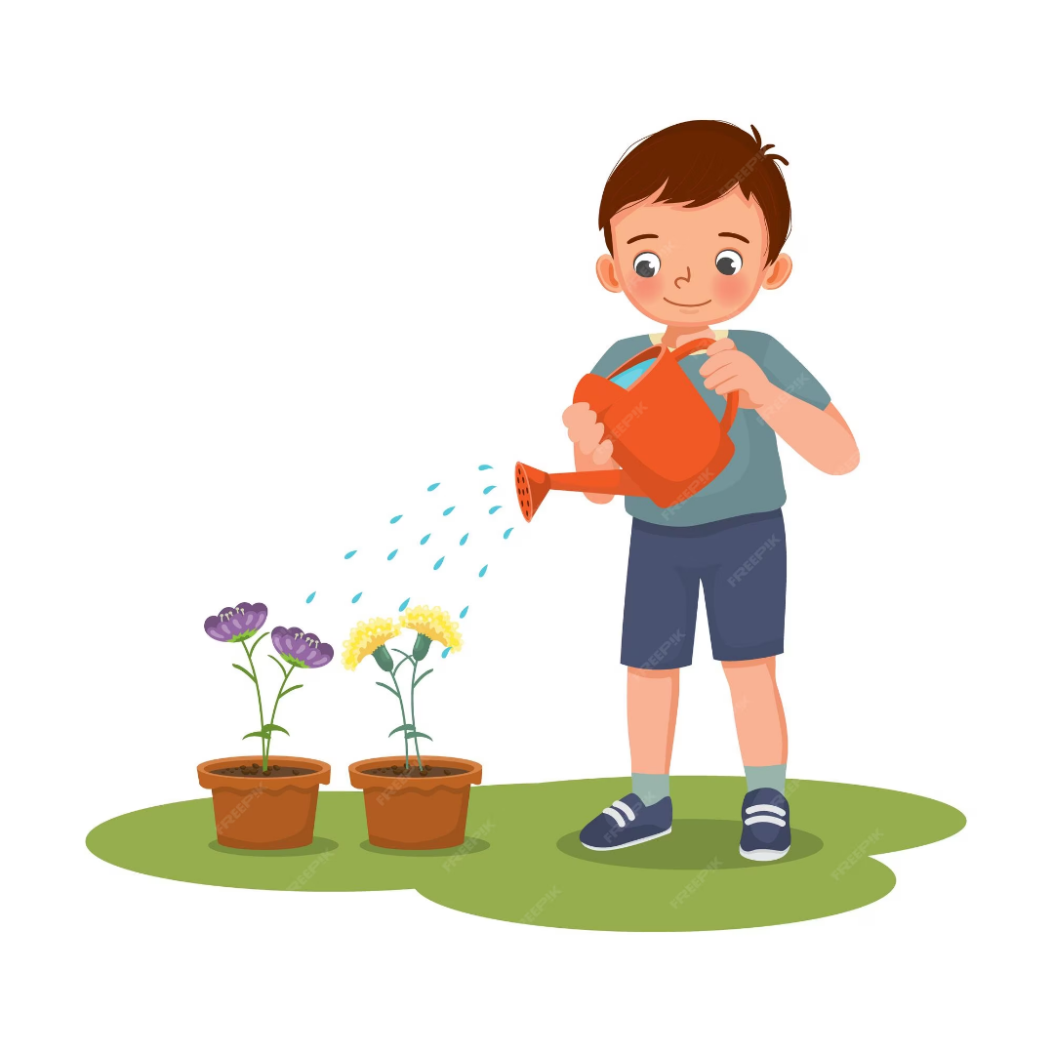
5 %
3. What do you do at the weekend?
I ……………. water the flowers.
A. always
B. rarely
C. often

Slide 24
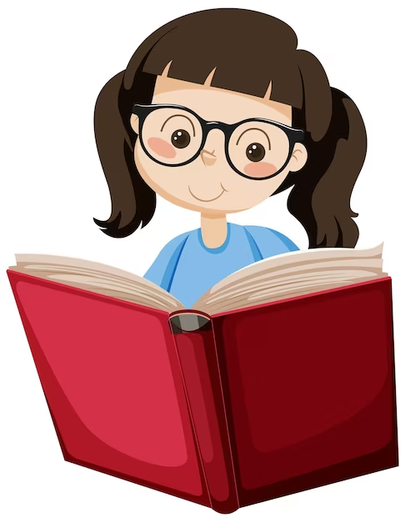
4. What do you do at the weekend?
90 %
I …………………. read stories.
A. sometimes
B. never
C. usually

Slide 25
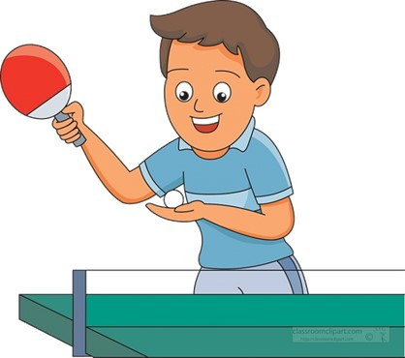
5. What do you do at the weekend?
0 %
I ……………… play table tennis.
A. never
B. often
C. usually

Slide 26
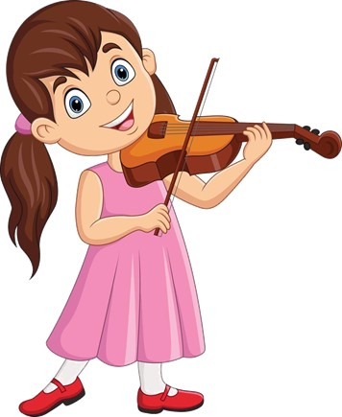
6. What do you do at the weekend?
70 %
I …………………… play the violin.
A. always
B. sometimes
C. often

Slide 27

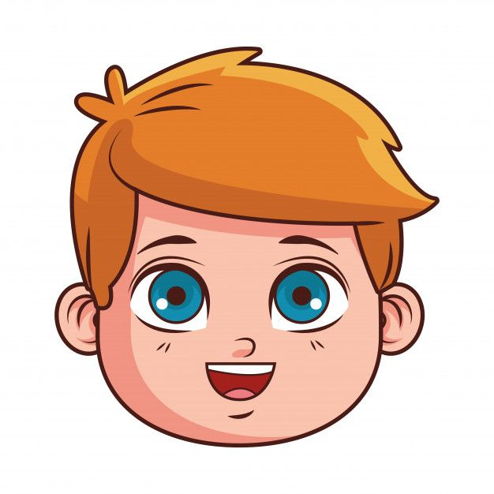
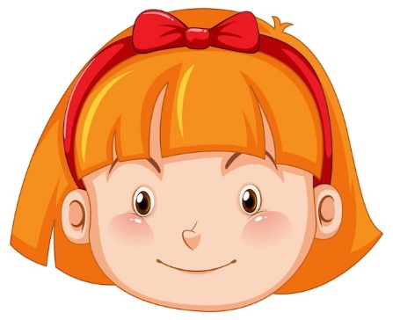
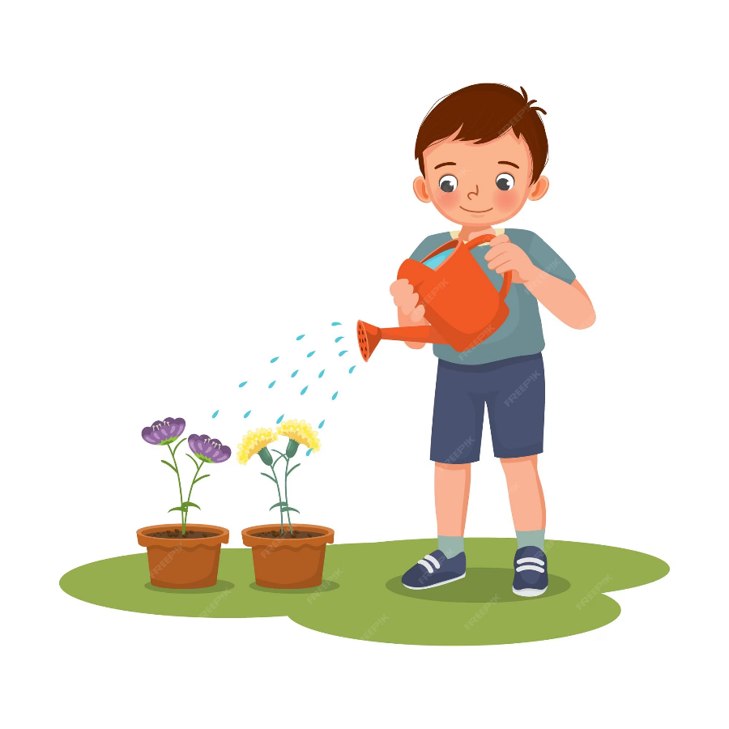


Pair work
What do you do at the weekend?
I …….. ……….

