Slide 1








Quang Trung Primary School
starter
Period 2 – Last summer
Teacher: Bui Thi Thuy Phuong

Slide 2


01
WARM-UP
and review

Slide 3
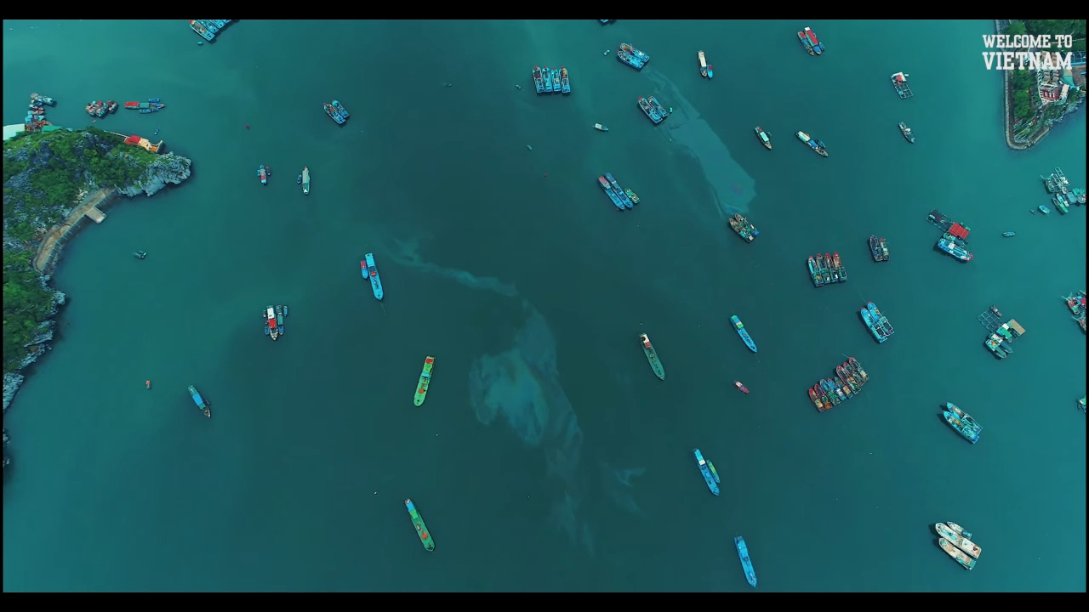

Let’s travel!
Ha Long Bay

Slide 4

Let’s travel!
Mount Everest

Slide 5
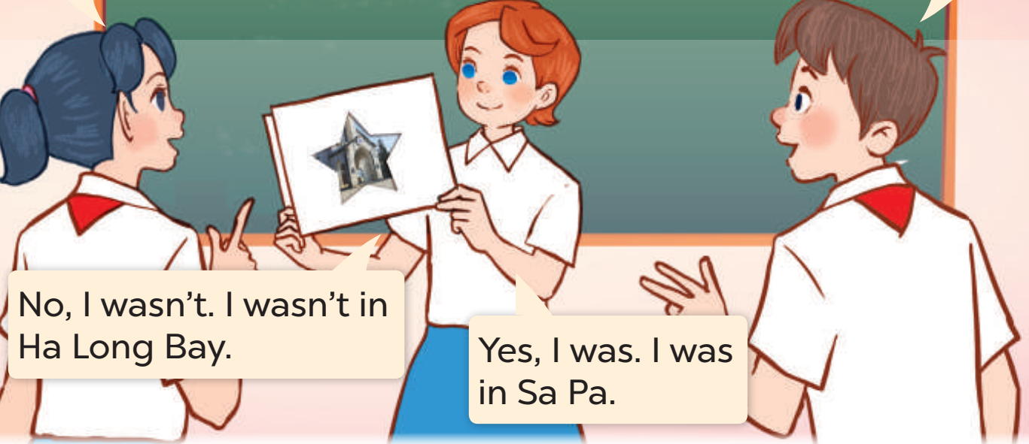
02
Let’s PLAY.

Slide 6

03
LISTEN
AND MATCH.

Slide 7
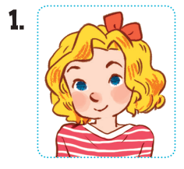
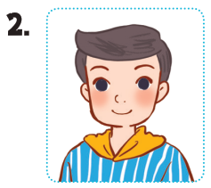
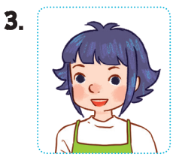
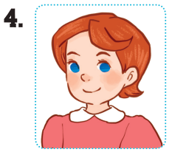




Look and Say.
Mary
Nam
Linh
Lucy
Tokyo
on a rainy day
Ha Long
Bay
Ho Chi Minh City
on a sunny day
mountains
Notes:
Step 1: Draw pupils’ attention to the pictures of the four characters, the places and weather. Identify them as a class.

Slide 8

LISTEN AND MATCH.
Notes:
Step 2: Play the recording for Exchange 1. Ask pupils to listen and identify the correct picture (a, b, c or d) and draw a line to match the character (Mary) to the correct place (Picture b).
Ask pupils to guess the answers for other sentences.

Slide 9
LISTEN AND MATCH.
Notes:
Play the recording a third time to give pupils another listening opportunity if needed.

Slide 10

Work in pairs.
Notes:
Pupils work in pairs to peer-check their answers and talk about children’s last summer.

Slide 11
Let’s check!
Notes:
*Key: 1. b, 2. a, 3. d, 4. c

Slide 12

04
LET’S TALK.

Slide 13
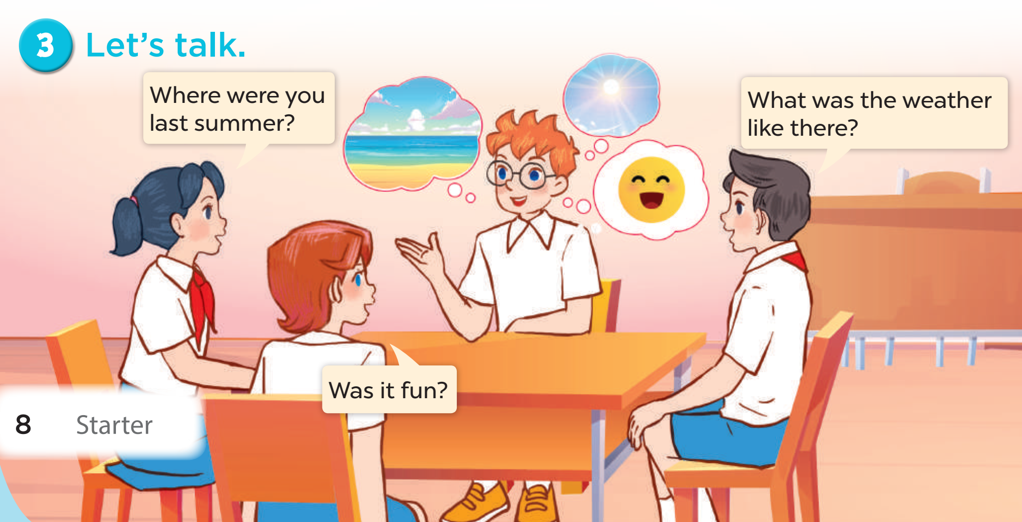


Look AND Read.
Where were you
last summer?
What was the weather
like there?
Was it fun?
Notes:
Step 2: Get pupils to read the speech bubbles and elicit possible answers.

Slide 14
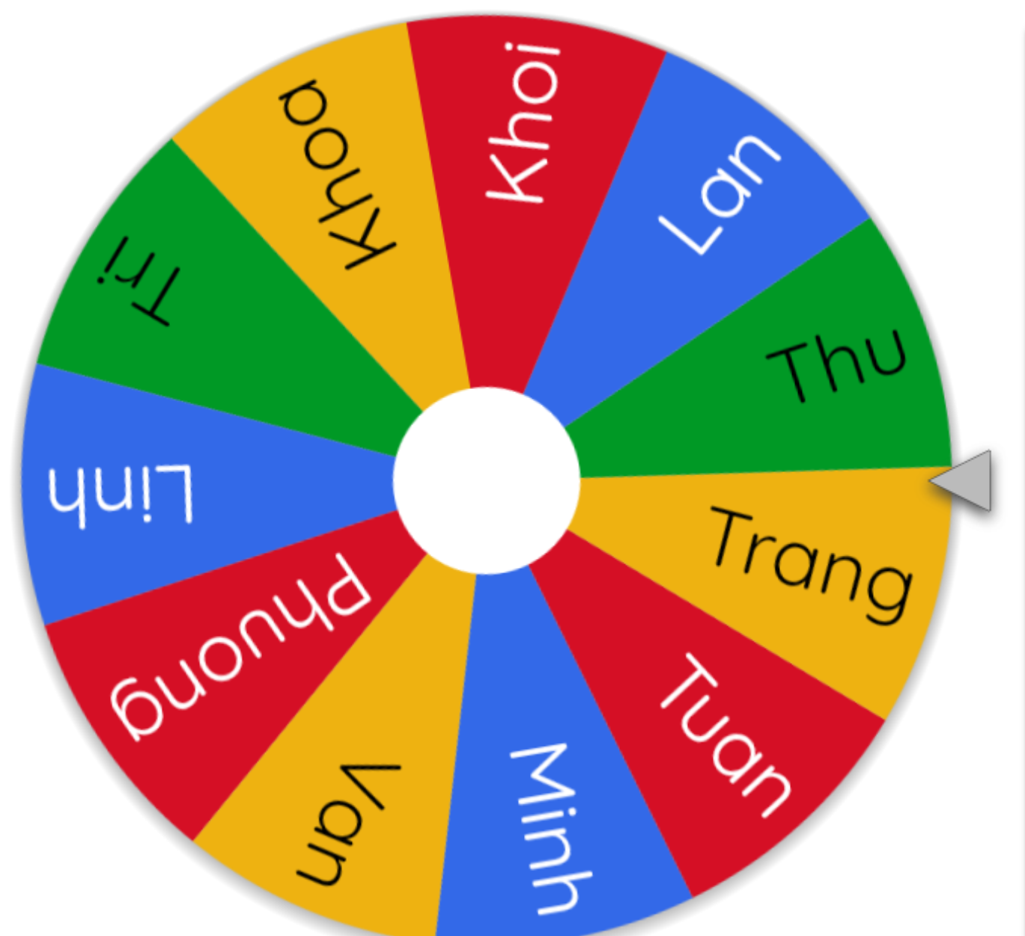
Let’s spin!
Notes:
Step 4: Invite a few pairs to the front of the classroom to ask and answer questions about their last summer.
Use this link to choose pupils in random: https://wheelofnames.com/

Slide 15

05
Fun corner and wrap-up

Slide 16
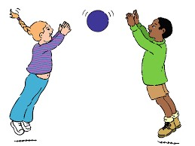
Pass the balls
TEAM B
Where were you last summer?
I was ………………………………
Notes:
Game: “Pass the balls”
- Choose a song Back to school (Track 1) and 2 balls: 1 red and 1 green.
- While the music plays, pupils pass the balls around the class.
- When the music stops, the pupil with the red ball asks a question: “Where were you last summer?”
- The pupil with the green ball answers the question: “I was on the beach.”
- Continue the game with other pupils.

Slide 17
Pass the balls
TEAM B
Where were you last summer?
I was ………………………………
Notes:
Continue playing this game.

