Slide 1



6
Our school
LESSON 1 PERIOD 1
Teacher: Duong Thi Bich Ngoc
Quang Trung Primary School

Slide 2
Warm-up

Slide 3

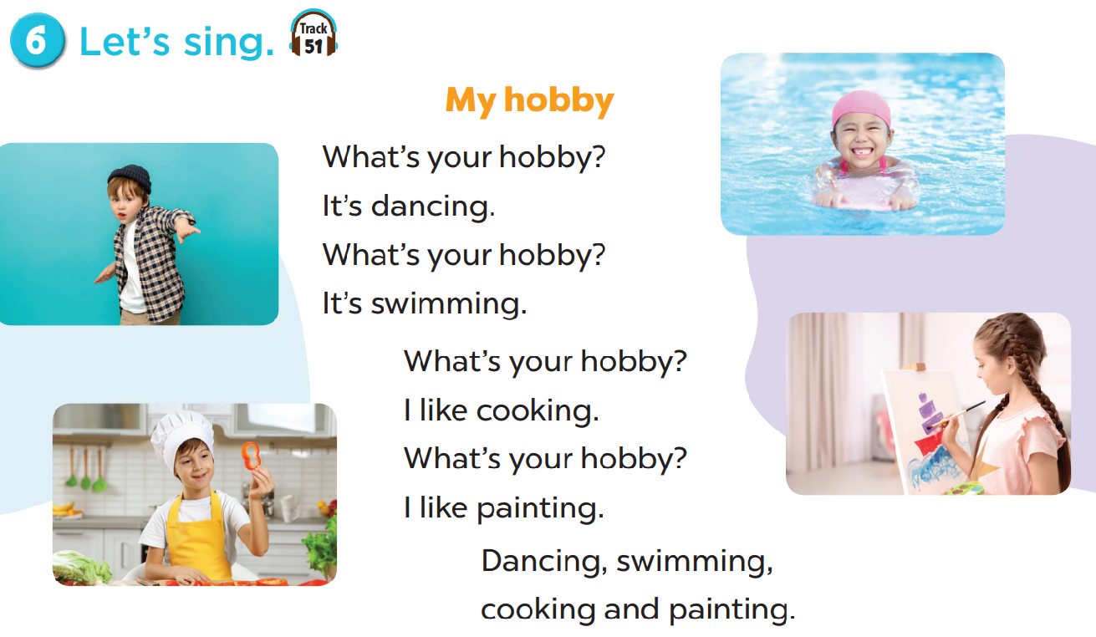

Slide 4

Look, listen and repeat.

Slide 5
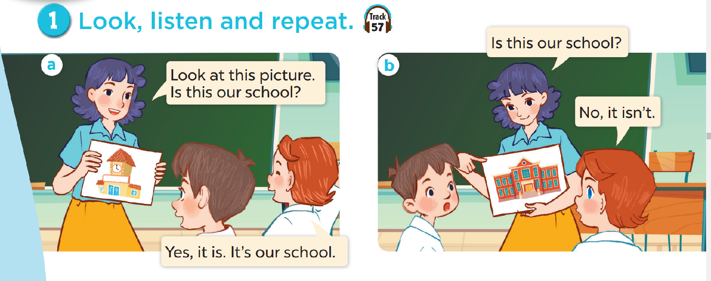
Look and answer the questions.
Where are they?
Who are they?
What are they doing?

Slide 6

Listen, point and say.

Slide 7
New words

Slide 8
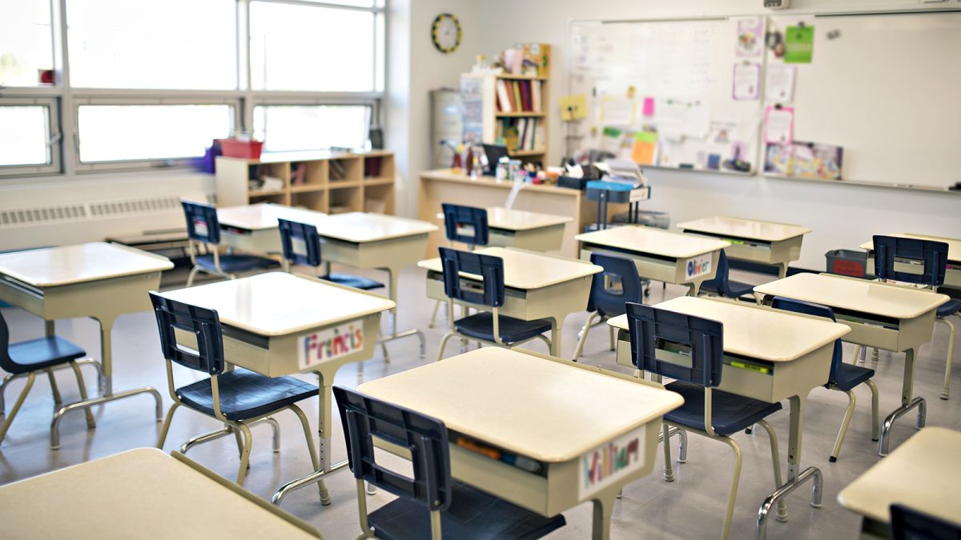
classroom

Slide 9
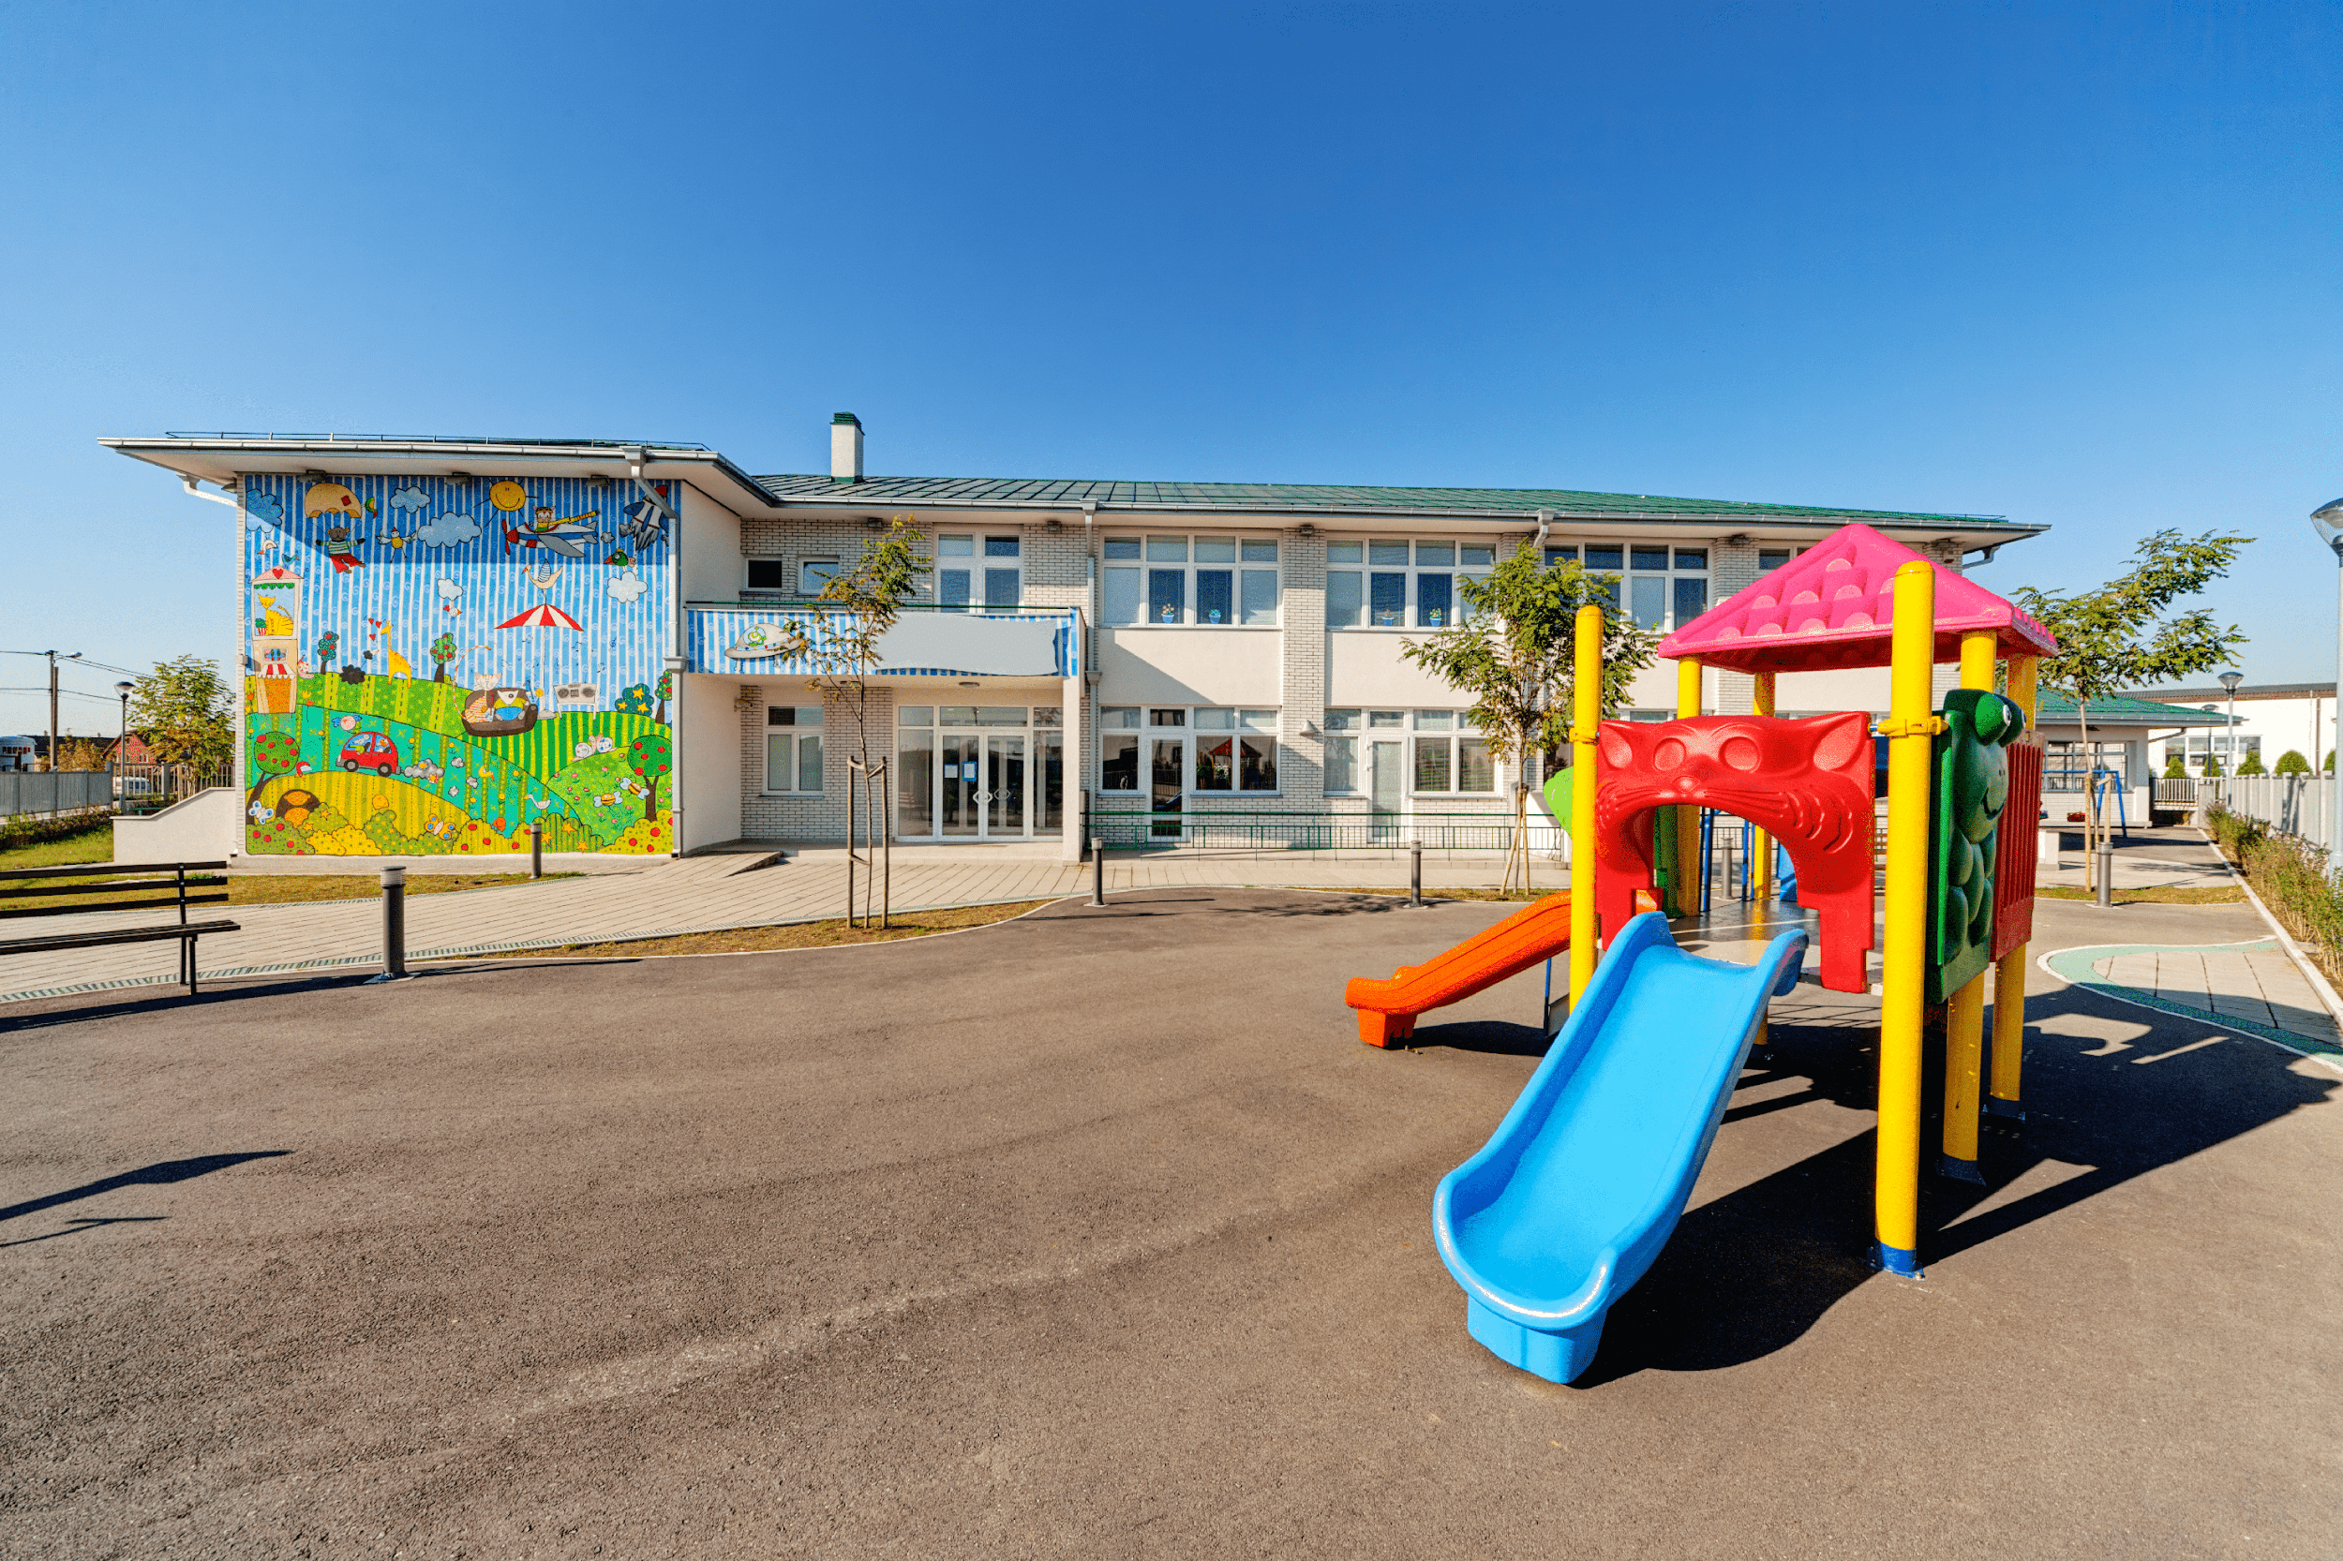
playground

Slide 10
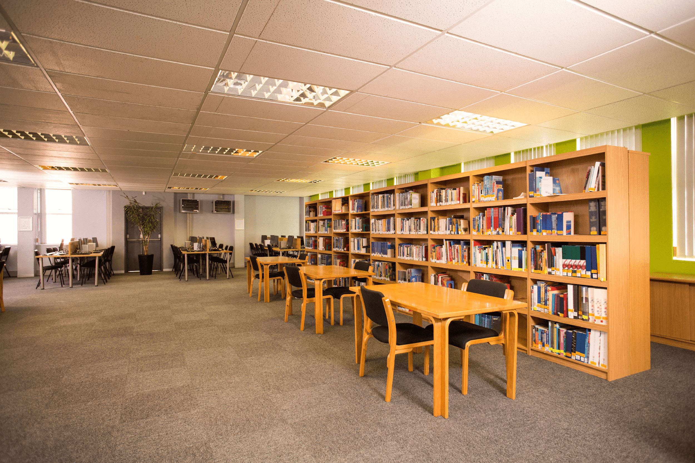
library

Slide 11
Look and guess.

Slide 12
playground

Slide 13
library

Slide 14


Is this our classroom?
No, it isn’t.
Yes, it is.

Slide 15

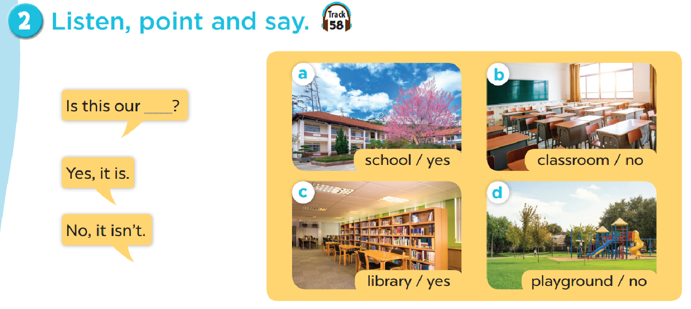
Work in pairs. Practise.

Slide 16

Let’s talk.

Slide 17
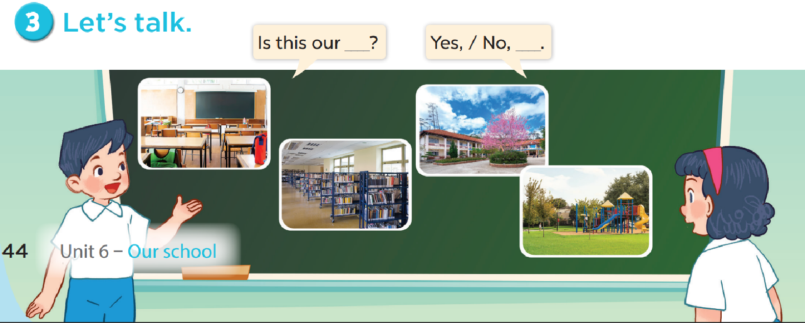

Slide 18

Fun corner

Slide 19
Let’s play a game!
3 points
10 points
No
Yes
classroom
library
4
bomb
playground
No
school
3
2
1
Yes
5
10 points
8
school
library
7
school
- 3 points
6
Yes
Yes
playground
1 point
No
Yes
4 points
Notes:
Gv chia 2 đội.
Hs chọn số, 1 bạn đặt câu hỏi, 1 bạn trả lời với từ cho sẵn và nhận điểm

