Slide 1



6
Our school
LESSON 1 - PERIOD 2
Teacher: Duong Thi Bich Ngoc
Quang Trung Primary School

Slide 2

WARM-UP AND REVIEW

Slide 3
Warm-up

Slide 4
Is this our…….?
1
2
3
Notes:
Divide the class into 3 teams.
Each team has 1 sticky ball.
Play the music. Pupils in each team take turns to pass the ball. After the music ends, 3 pupils who have the ball stand up and say the words school, classroom, library, playground, then make sentences using the sentence model.

Slide 5

LISTEN AND TICK.

Slide 6


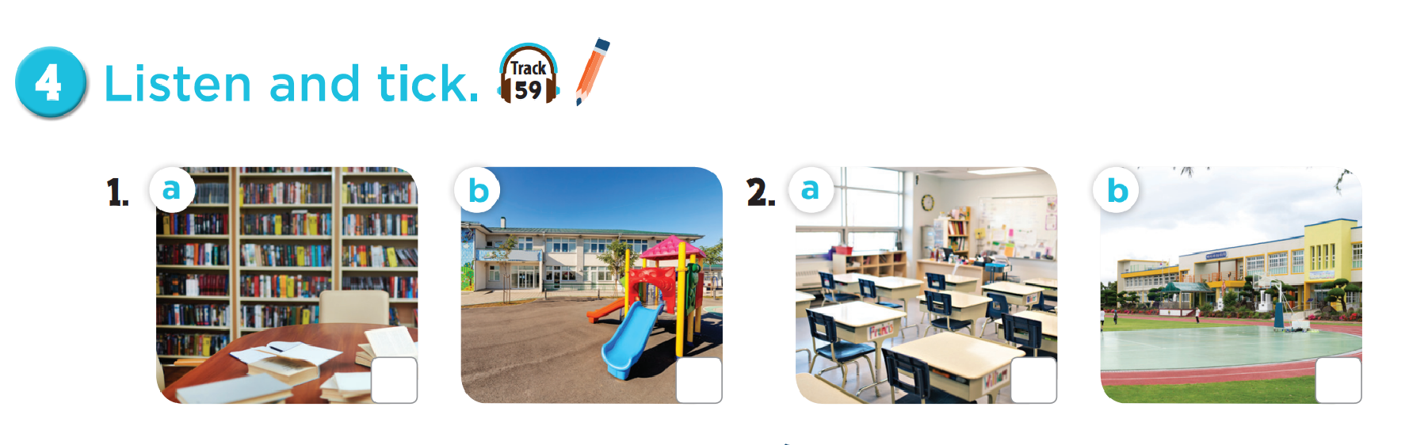

Slide 7

LOOK, COMPLETE AND READ.

Slide 8
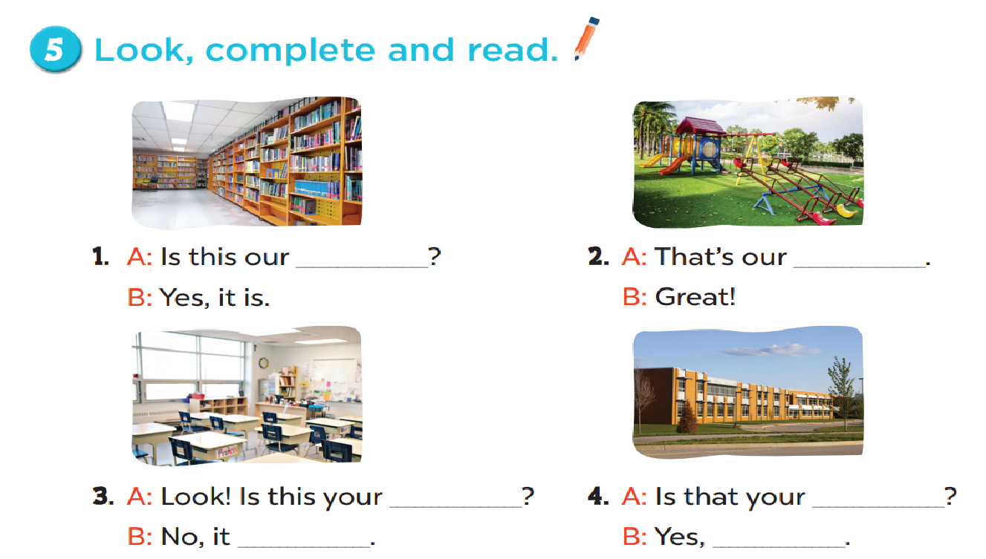
library
playground
classroom
school
isn’t
it isn’t

Slide 9

LET’S SING.

Slide 10
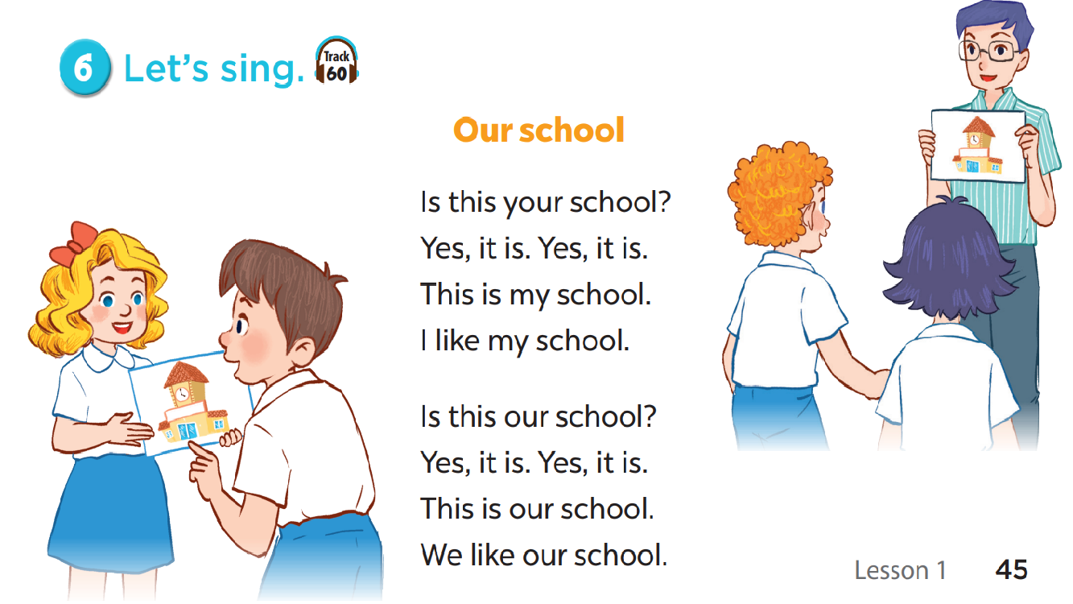

Slide 11

FUN CORNER

Slide 12







5
10
15
20
15
25
10
🡪

Slide 13
Read and choose.
………… this your classroom?
Is
Is
Are

Slide 14
Read and choose.
That is our…………………………
playground
playground
classroom

Slide 15
Read and choose.
Is ……….your classroom?
they
that
that

Slide 16
Read and choose.
Is that your library?
Yes, it isn’t.
Yes, it is.

Slide 17
Read and choose.
Is that ………….school?
look
your
your

Slide 18
Read and choose.
Is this our playground?
No, it isn’t.
No, it is.

Slide 19
Read and choose.
Is that your……………..?
library
school
school

