Slide 1



6
Our school
LESSON 2 PERIOD 3
Teacher: Duong Thi Bich Ngoc
Quang Trung Primary School

Slide 2
Warm-up

Slide 3

Let’s sing.

Slide 4

Look, listen and repeat.

Slide 5
Look and answer the questions.
Where are they?
What are they doing?
Who are they?

Slide 6

Listen, point and say.

Slide 7
New words

Slide 8

computer room

Slide 9
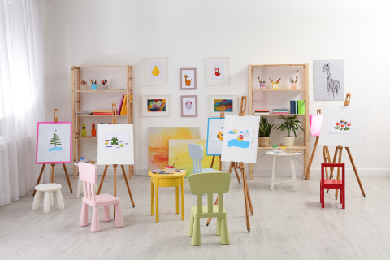
art room

Slide 10
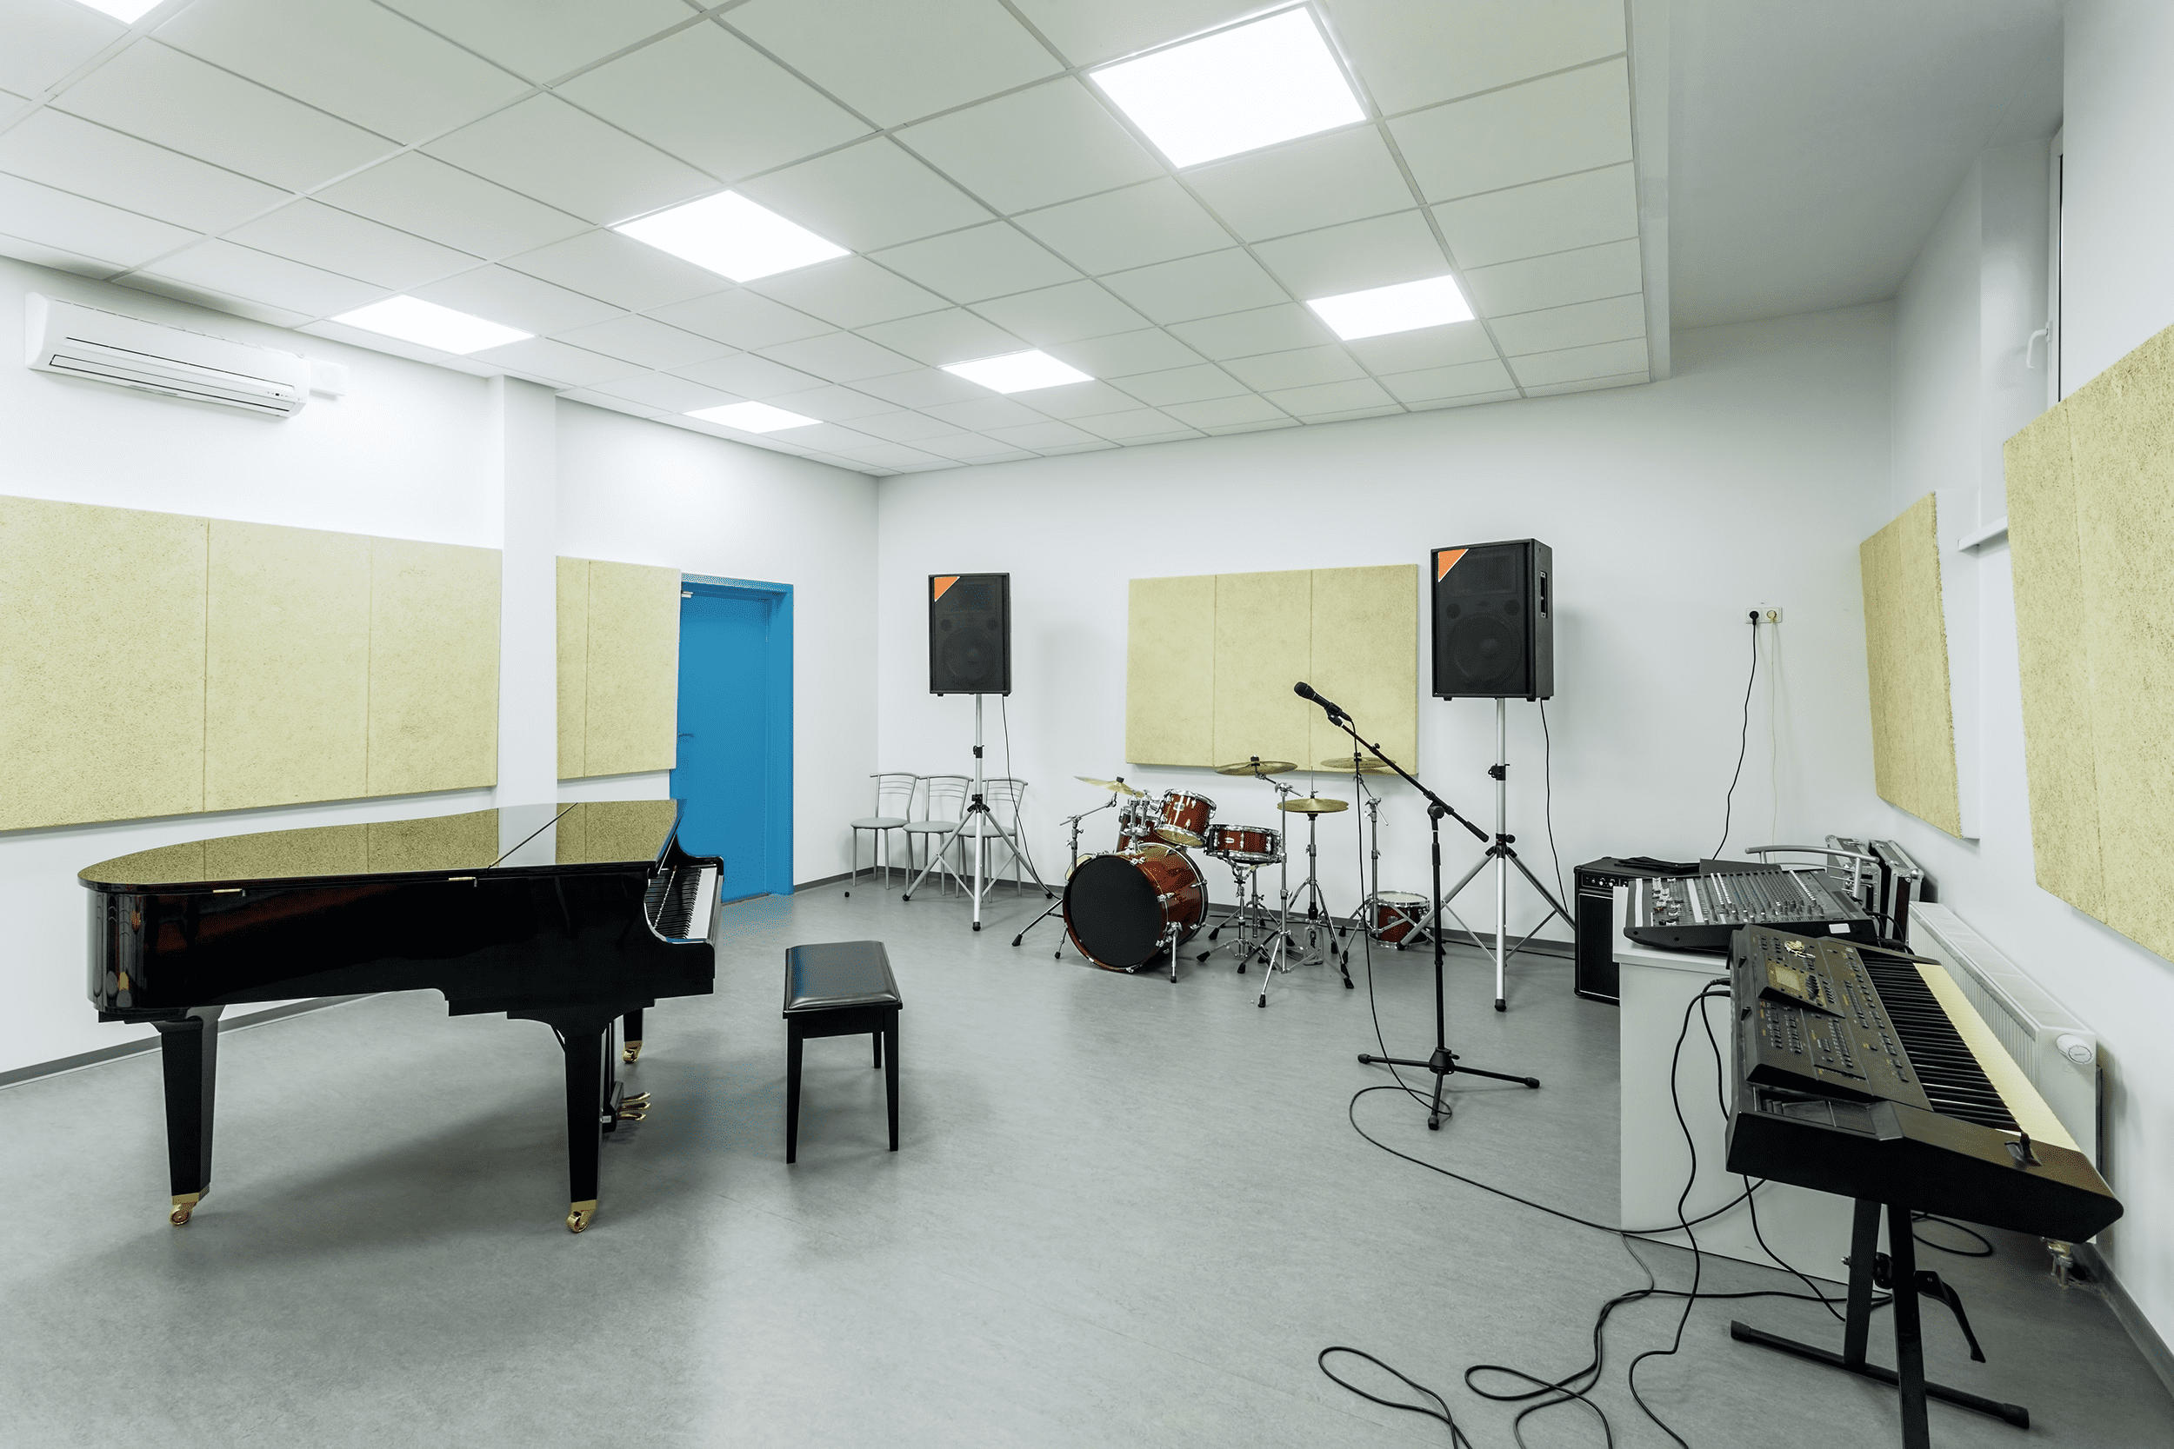
music room

Slide 11
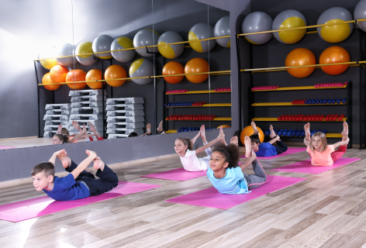
gym

Slide 12
Work in pairs. Practise.

Slide 13

Let’s talk.

