Slide 1



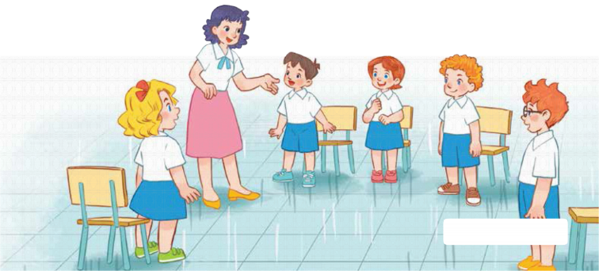
7
Classroom instructions
LESSON 3 – PERIOD 6
Teacher: Duong Thi Bich Ngoc
Quang Trung Primary School

Slide 2
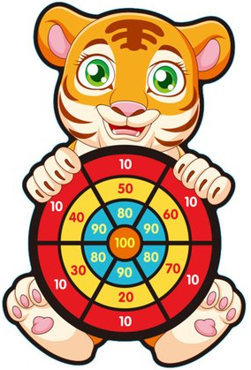

Listen and
choose!
Warm-up and review
0
1
2
3
4
5
6
7
8
0
9
1
2
3
4
5
6
7
8
0
9
1
2
3
4
5
6
7
8
9
GIRLS
0
1
2
3
4
5
6
7
8
0
9
1
2
3
4
5
6
7
8
0
9
1
2
3
4
5
6
7
8
BOYS
9
Notes:
- Divide the class into 2 teams. Each team chooses one arrow to go to the question. Have pupils listen and choose the right sentence. They will get points for the right answers.
- Back to the menu for another question.
- Pupils take turns to play until they get all the arrows.
- The team with more points is the winner.

Slide 3




Listen and choose.
A. May I open the book?
B. May I close the book?
C. May I read the book?
Notes:
Click the headphone to play the recording.
Click each answer to check.
Click the arrow to go back.

Slide 4
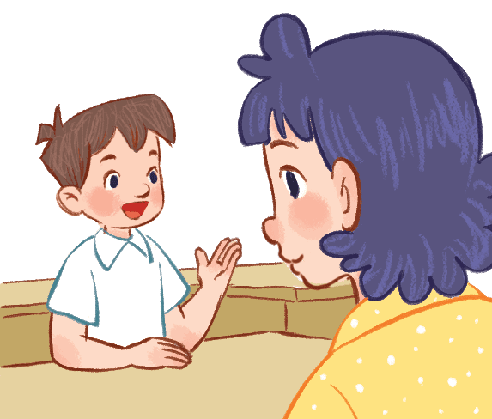

Listen and choose.
A. May I speak English?
B. May I speak Vietnamese?
C. May I come in?
Notes:
Click the headphone to play the recording.
Click each answer to check.
Click the arrow to go back.

Slide 5
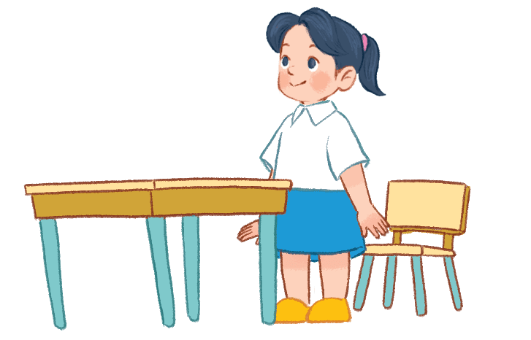

Listen and choose.
A. May I come in?
B. May I stand up?
C. May I sit down?
Notes:
Click the headphone to play the recording.
Click each answer to check.
Click the arrow to go back.

Slide 6
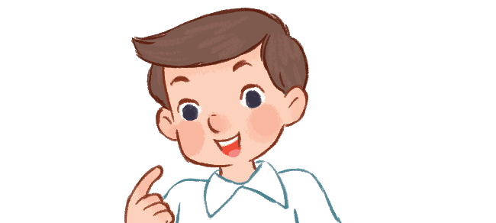

Listen and choose.
A. Speak English, please!
B. Speak Vietnamese, please!
C. Speak aloud, please!
Notes:
Click the headphone to play the recording.
Click each answer to check.
Click the arrow to go back.

Slide 7

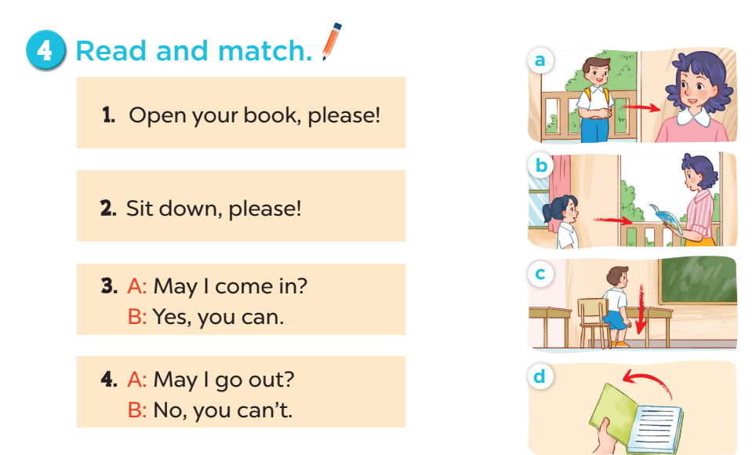


Slide 8
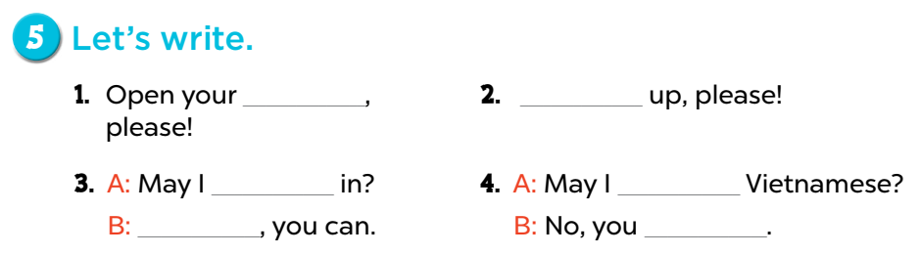
books
Stand
come
speak
Yes
can’t

Slide 9
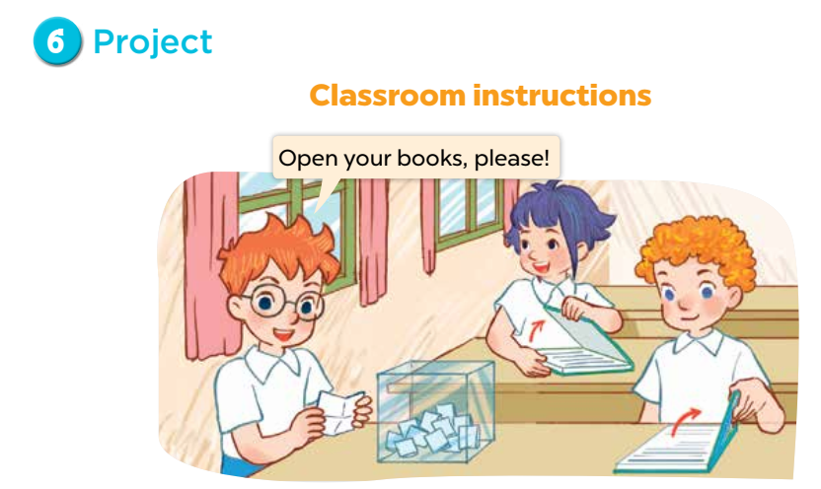

Slide 10
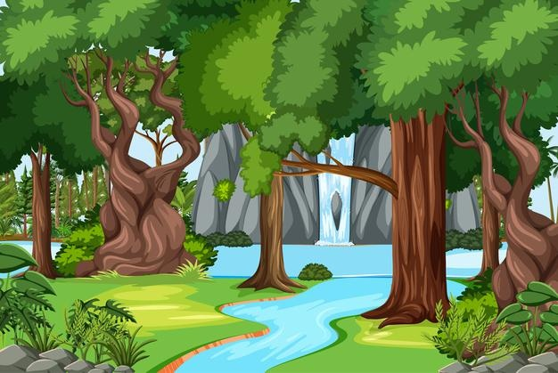

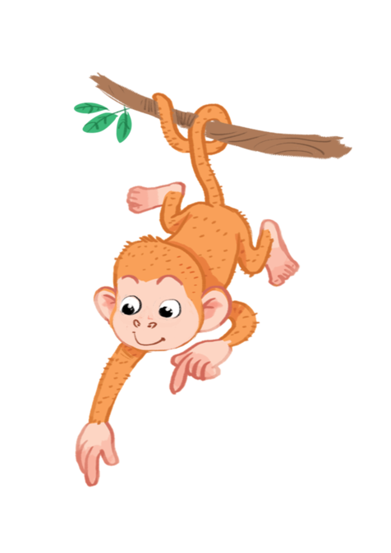


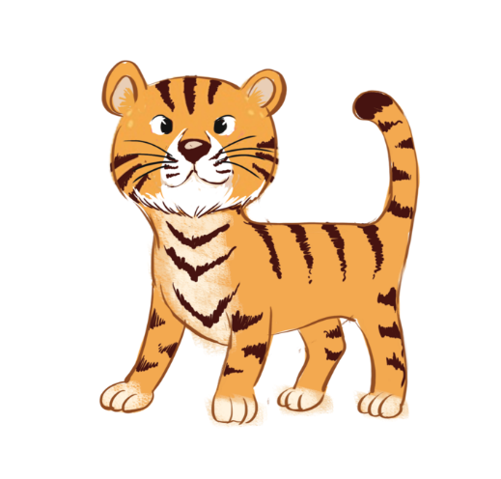
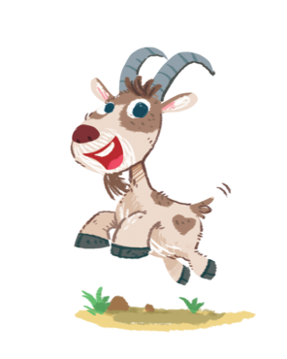





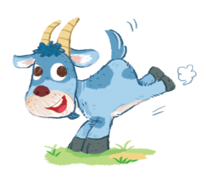


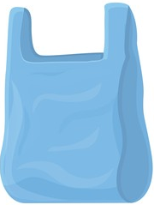




Let’s clean up!
Fun corner and
wrap- up
Notes:
- Divide the class into 2 teams.
- Each team chooses one rubbish thing to go to the question.
- Have pupils look, read and choose the right word/phrase to complete the sentence.
- Back to the menu for another question.
- The team who cleans the environment better is the winner.

Slide 11






Open your ____________, please!
A. book
B. pen
C. desk

Slide 12

________________ up, please!
A. Read
B. Sit
C. Stand

Slide 13
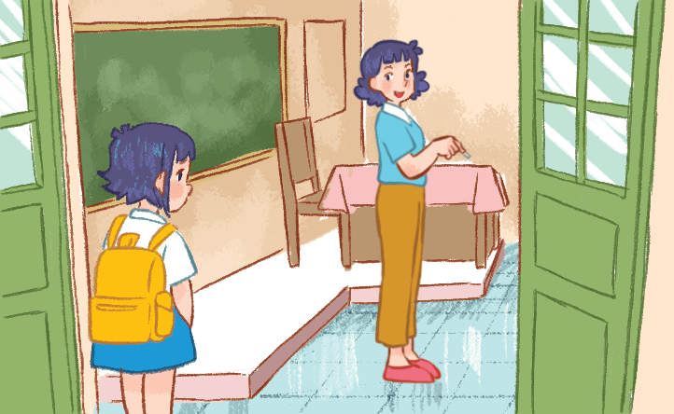
May I ________________ in?
A. go
B. come
C. study

Slide 14
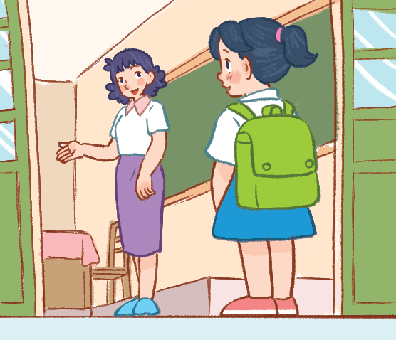
May I come in?
________, you ____.
A. Yes, ___ can.
B. Yes, ___can’t
C. Yes, ___ can.

Slide 15
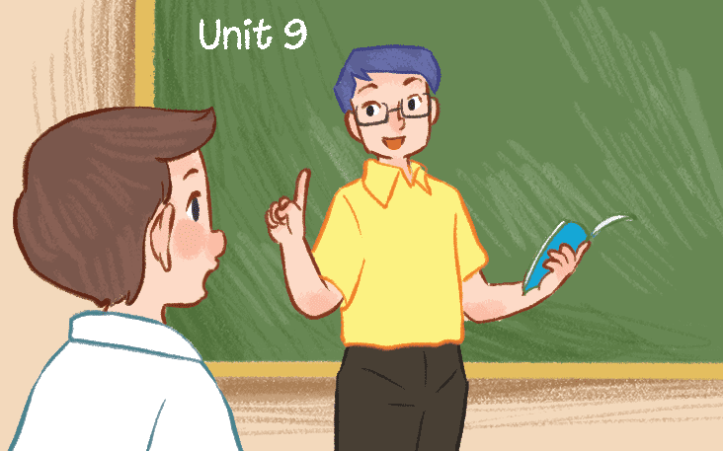
May I ___________ Vietnamese?
A. say
B. speak
C. stand

Slide 16
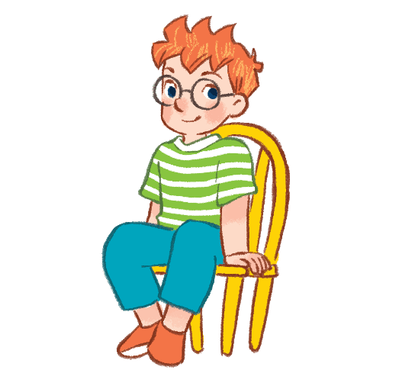
May I____________?
Yes, you can.
A. stand up
B. sit down
C. study

