Slide 1

All about me!
Unit 1
Lesson 2 – activity 1,2,3

Slide 2






Who’s faster
PLAY

Slide 3

SURFING
NEXT
STOP
basketball

Slide 4

SURFING
NEXT
STOP
Blue

Slide 5
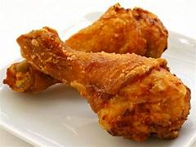
SURFING
NEXT
STOP
Chicken

Slide 6

SURFING
NEXT
STOP
tiger

Slide 7
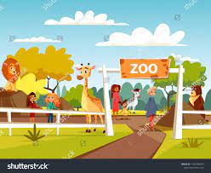
SURFING
NEXT
STOP
zoo

Slide 8

All about me!
1
Lesson 2 – activity 1,2,3

Slide 9
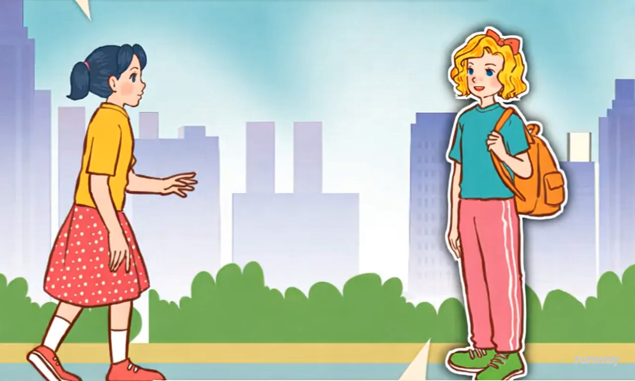

Slide 11
What’s your favourite sport?
It’s basketball.

Slide 12
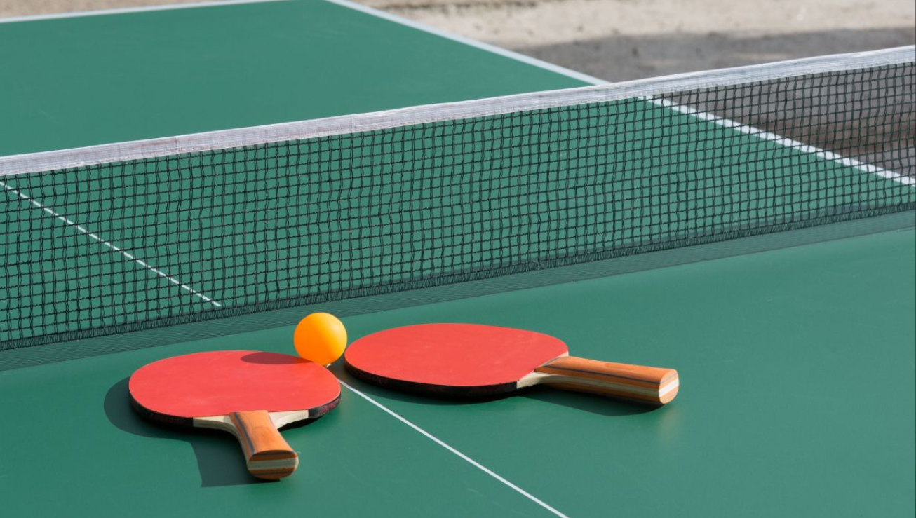
table tennis

Slide 13
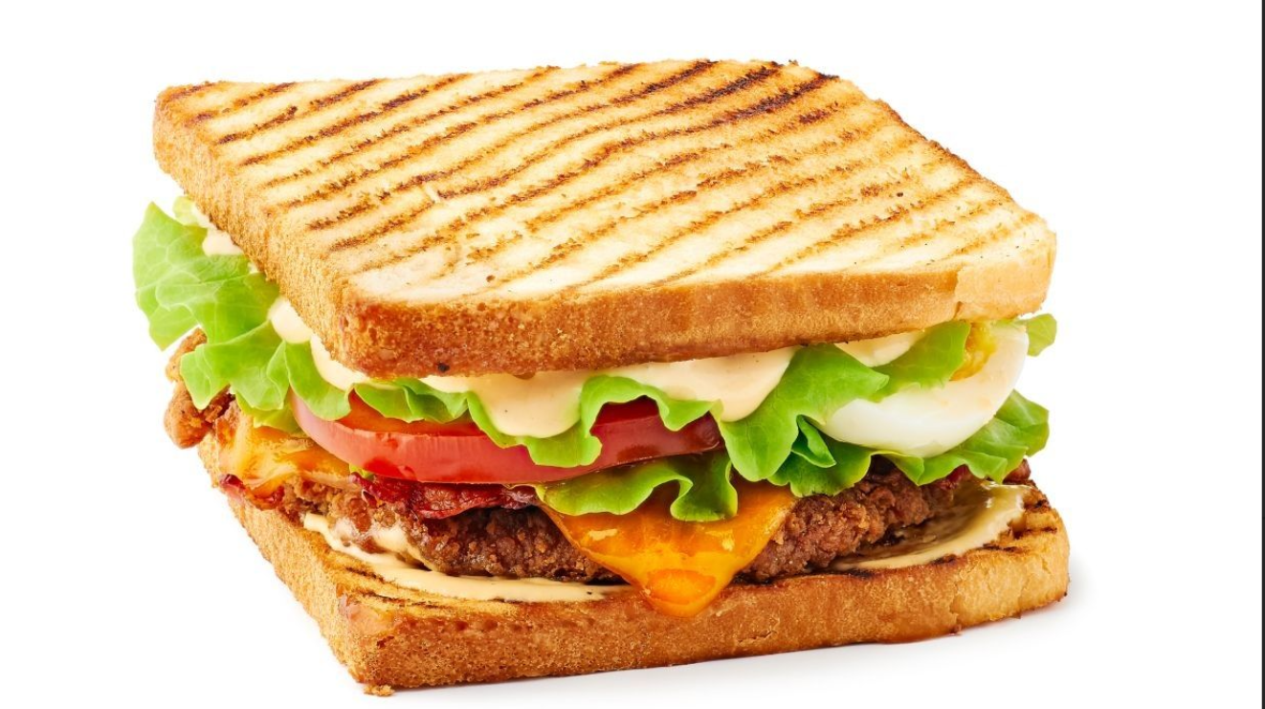
a sandwich

Slide 14
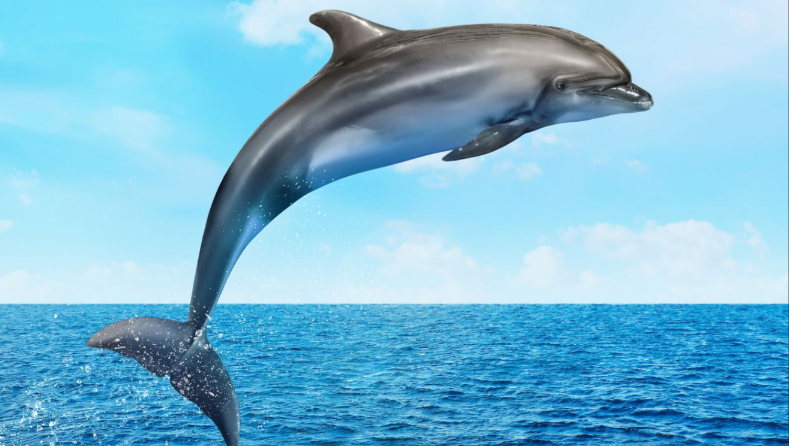
a dolphin

Slide 15




Slide 16

animal
sport
What’s your favourite ?
basketball
a dolphin
It’s

Slide 17

colour
What’s your favourite ..………?
pink
It’s………………...

Slide 18
Game: blooket

Slide 19
Let’s talk
3.

Slide 20

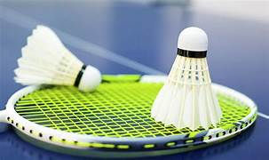


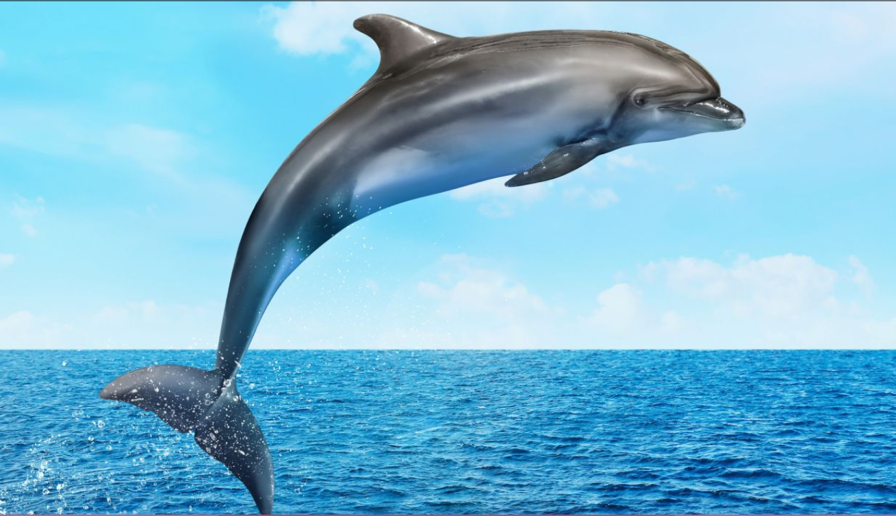
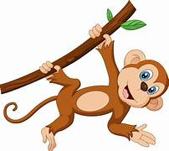
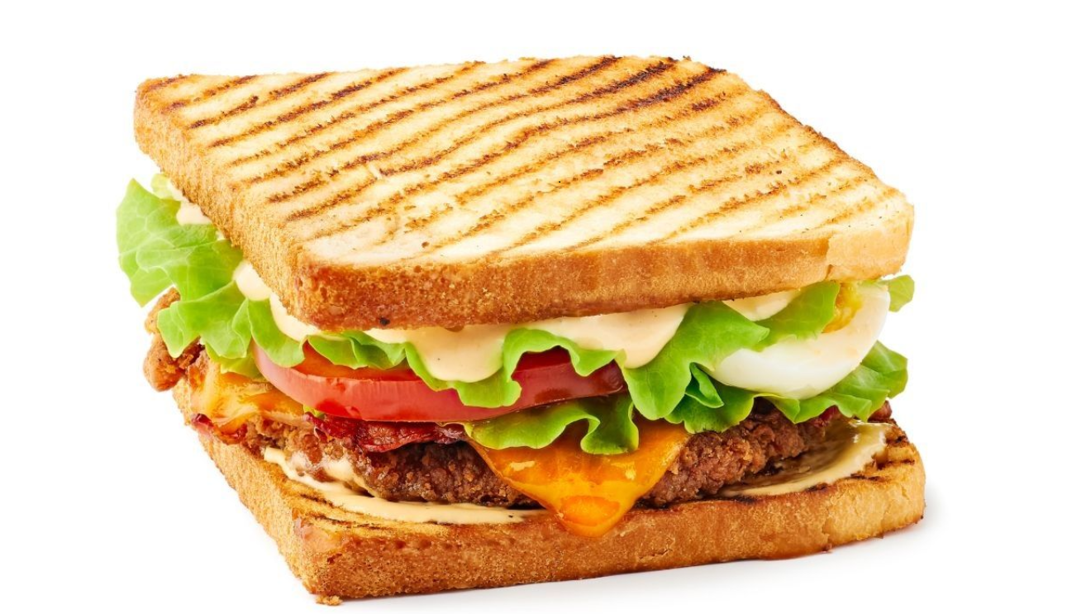
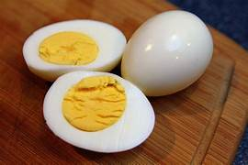
Sports
Colour
What’s your favourite _ ?
It’s _____
Animals
Food

Slide 21
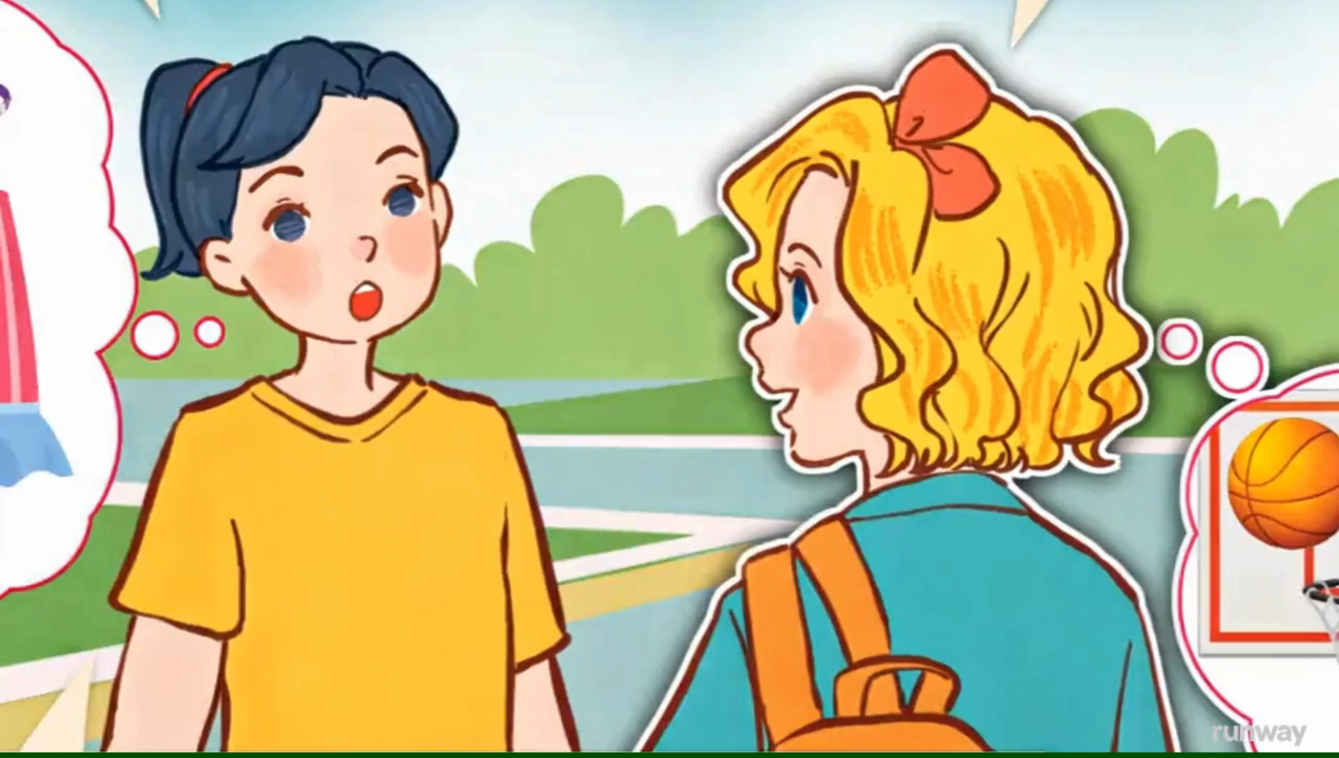

Slide 22
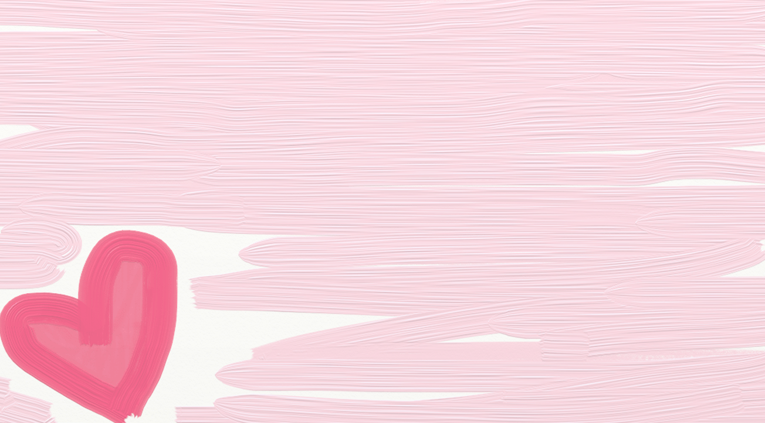

2
4
6
1
3
5
LUCKY STAR
Exit

Slide 23
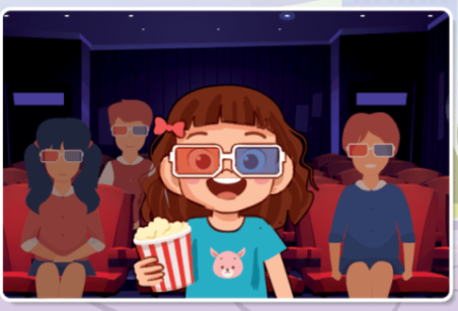


GO HOME

Slide 24
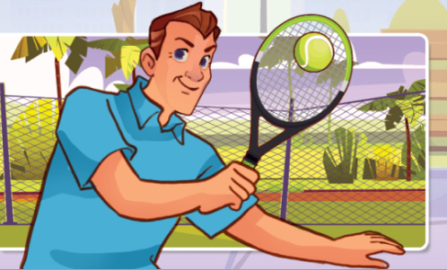
GO HOME

Slide 25
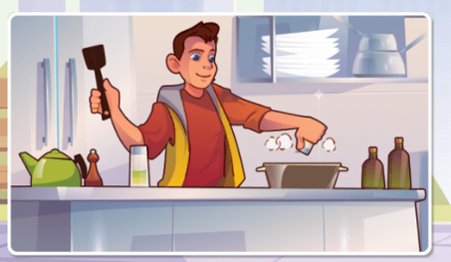
GO HOME

Slide 26
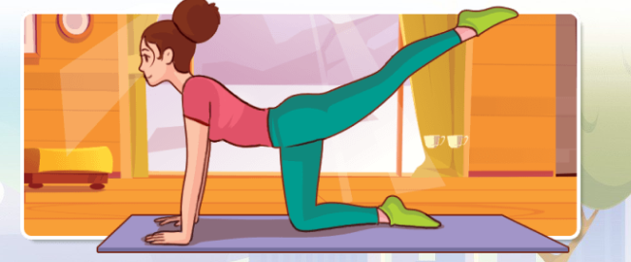
GO HOME

Slide 27

GO HOME

Slide 28
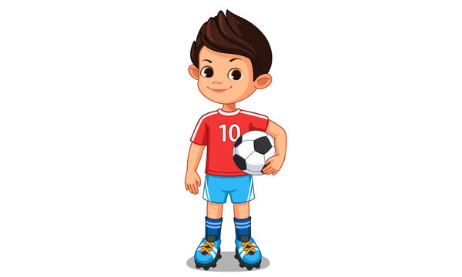
GO HOME

Slide 29


