Slide 1



Welcome to my English class
Teacher: Bui Thi Thuy Phuong
Class: 5D
Quang Trung primary school

Slide 2


Starter
A. Back to school

Slide 3
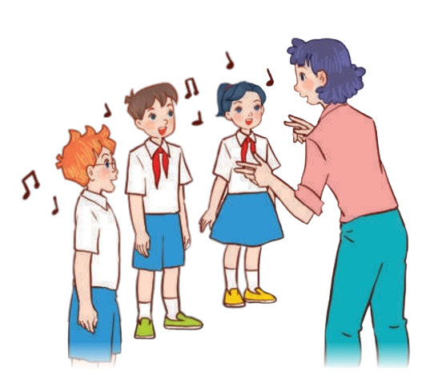
1.Let’s sing.

Slide 4


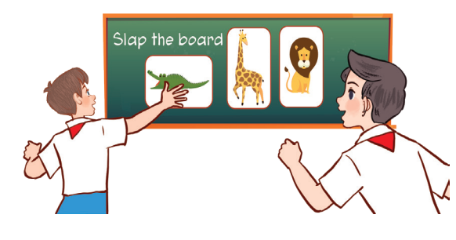
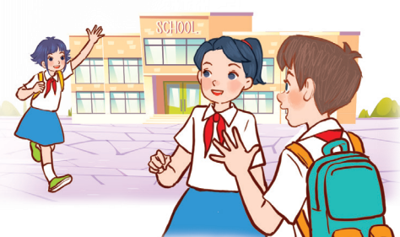

Look and say.
What can you see?
Happy to learn and play!
Happy to see friends!

Slide 5



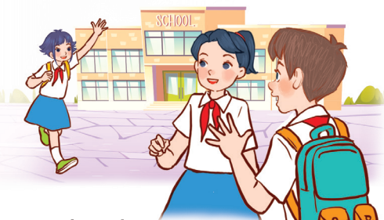
Let’s listen.
Back to school
Back to school.
Happy to see my friends!
Back to school.
Learning and playing are really cool!
Back to school.
Happy to see my teachers!
Back to school.
Learning and playing are really cool!

Slide 6
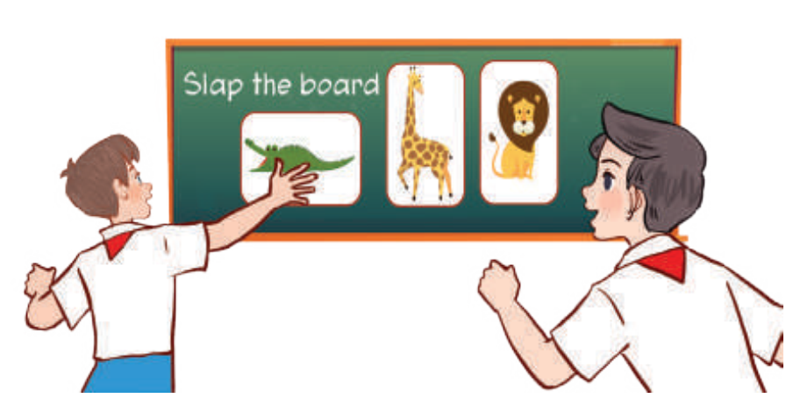
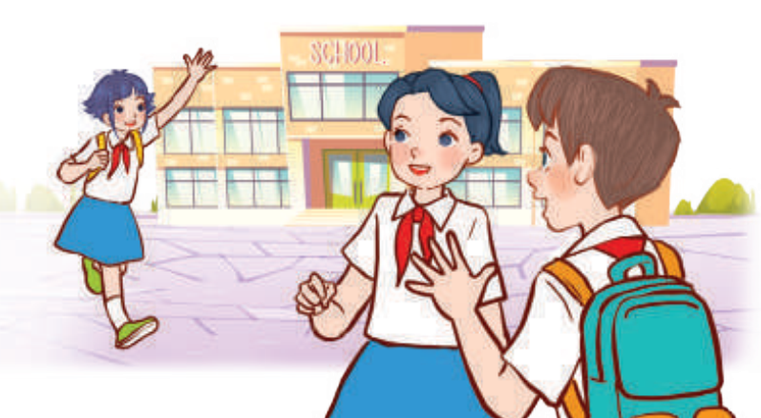

Let’s sing.
Back to school
Back to school.
Happy to see my friends!
Back to school.
Learning and playing are really cool!
Back to school.
Happy to see my teachers!
Back to school.
Learning and playing are really cool!

Slide 7









PractiSe the actions.
Back to school
Back to school.
Happy to see my friends!
Back to school.
Learning and playing are really cool!
Back to school.
Happy to see my teachers!
Back to school.
Learning and playing are really cool!

Slide 8
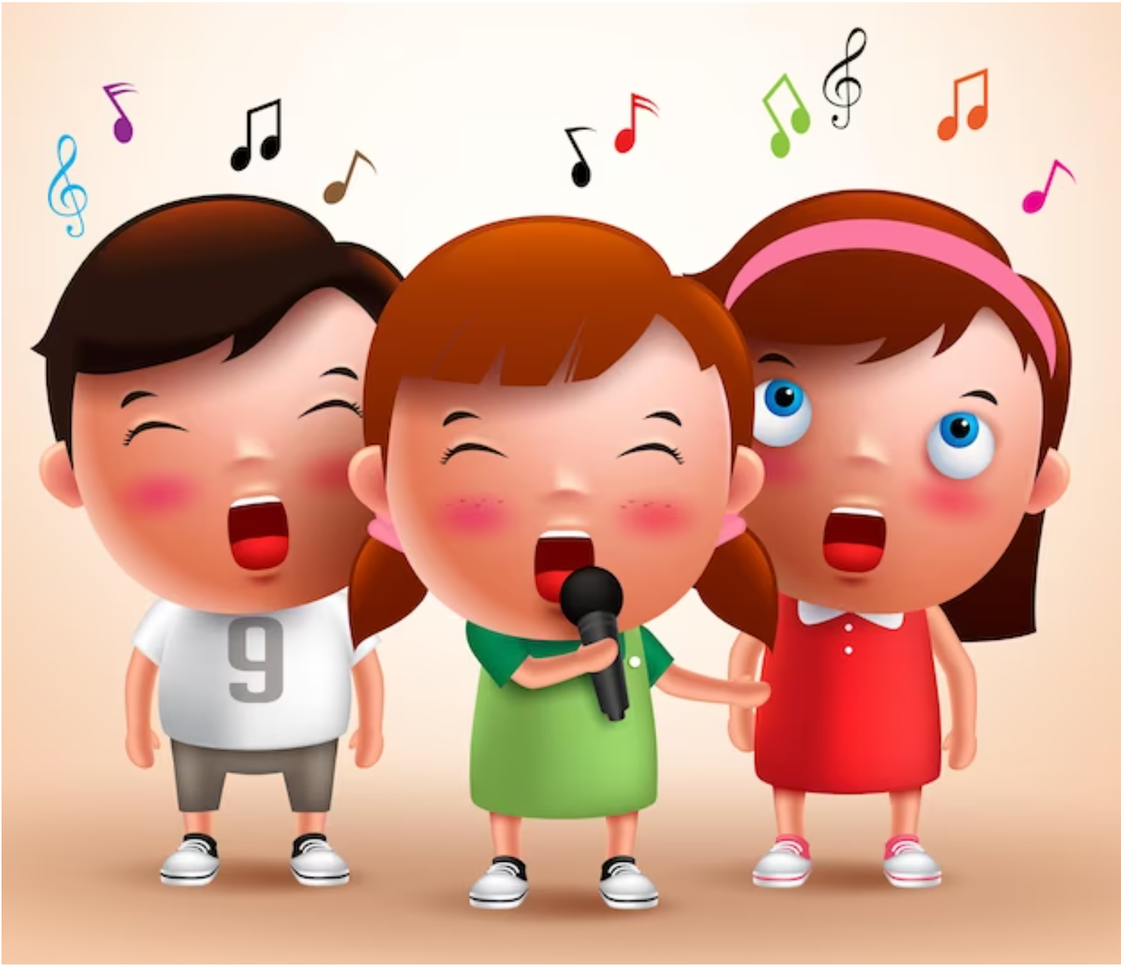
Let’s sing in groups.
Back to school
Back to school.
Happy to see my friends!
Back to school.
Learning and playing are really cool!
Back to school.
Happy to see my teachers!
Back to school.
Learning and playing are really cool!
Notes:
.

Slide 9
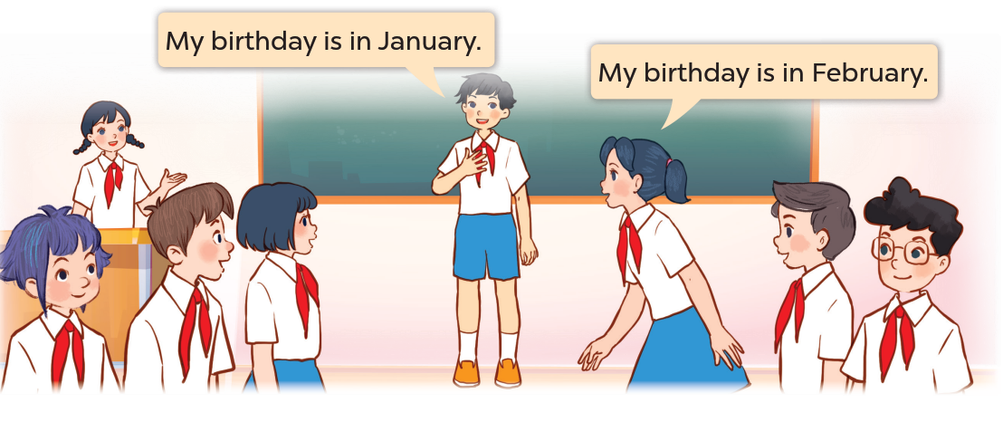

2
Let’s play.

Slide 10













Look and Say.

Slide 11





Classroom
Birthdays

Slide 12
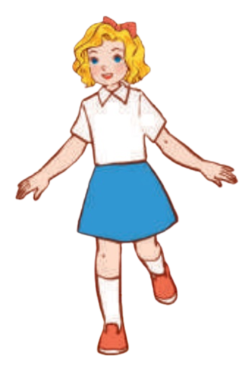
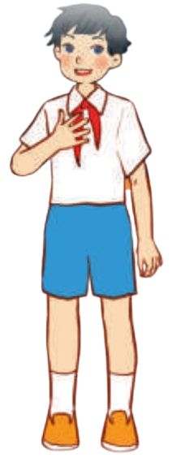












Birthday line-up
My birthday is in February.
TEAM A
1
2
3
4
5
6
My birthday is in January.
TEAM B
1
2
3
4
5
6

Slide 13








Let's sing "Happy Birthday“!
Notes:
Let’s sing Happy birthday! to all the pupils.

Slide 14

3.Write and share

Slide 15







L
E
A
R
N
I
N
G
Notes:
Introduce Learning Goals to pupils.

Slide 16
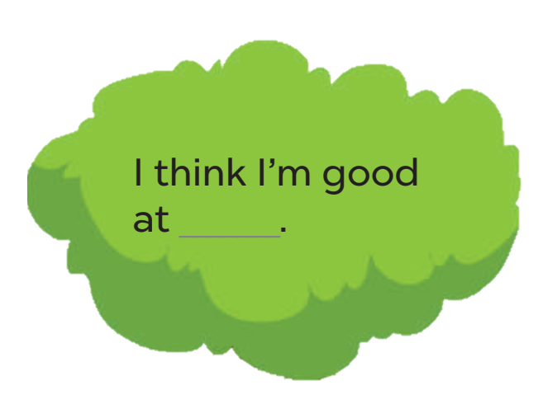

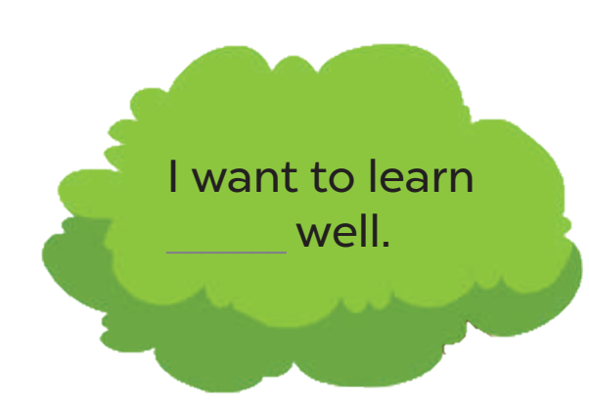
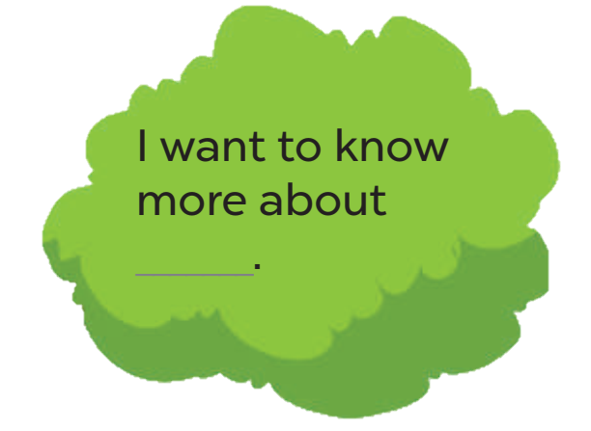
Write and share.
My Goal Tree
English.

Slide 17

Write and share.
Work in pairs.
Notes:
Step 4: Get pupils work in pairs to share their learning goals.

Slide 18

4
Fun corner and wrap-up

Slide 19





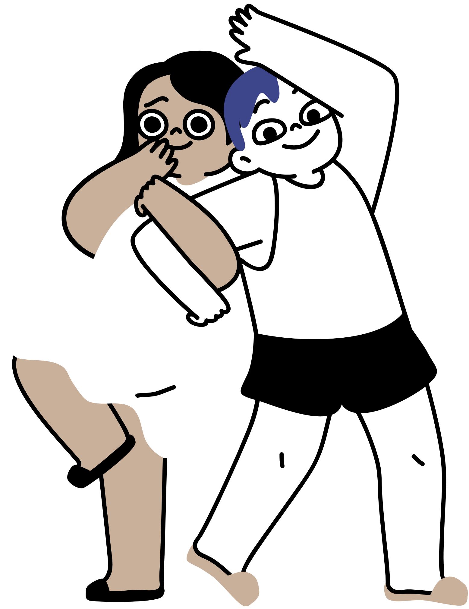
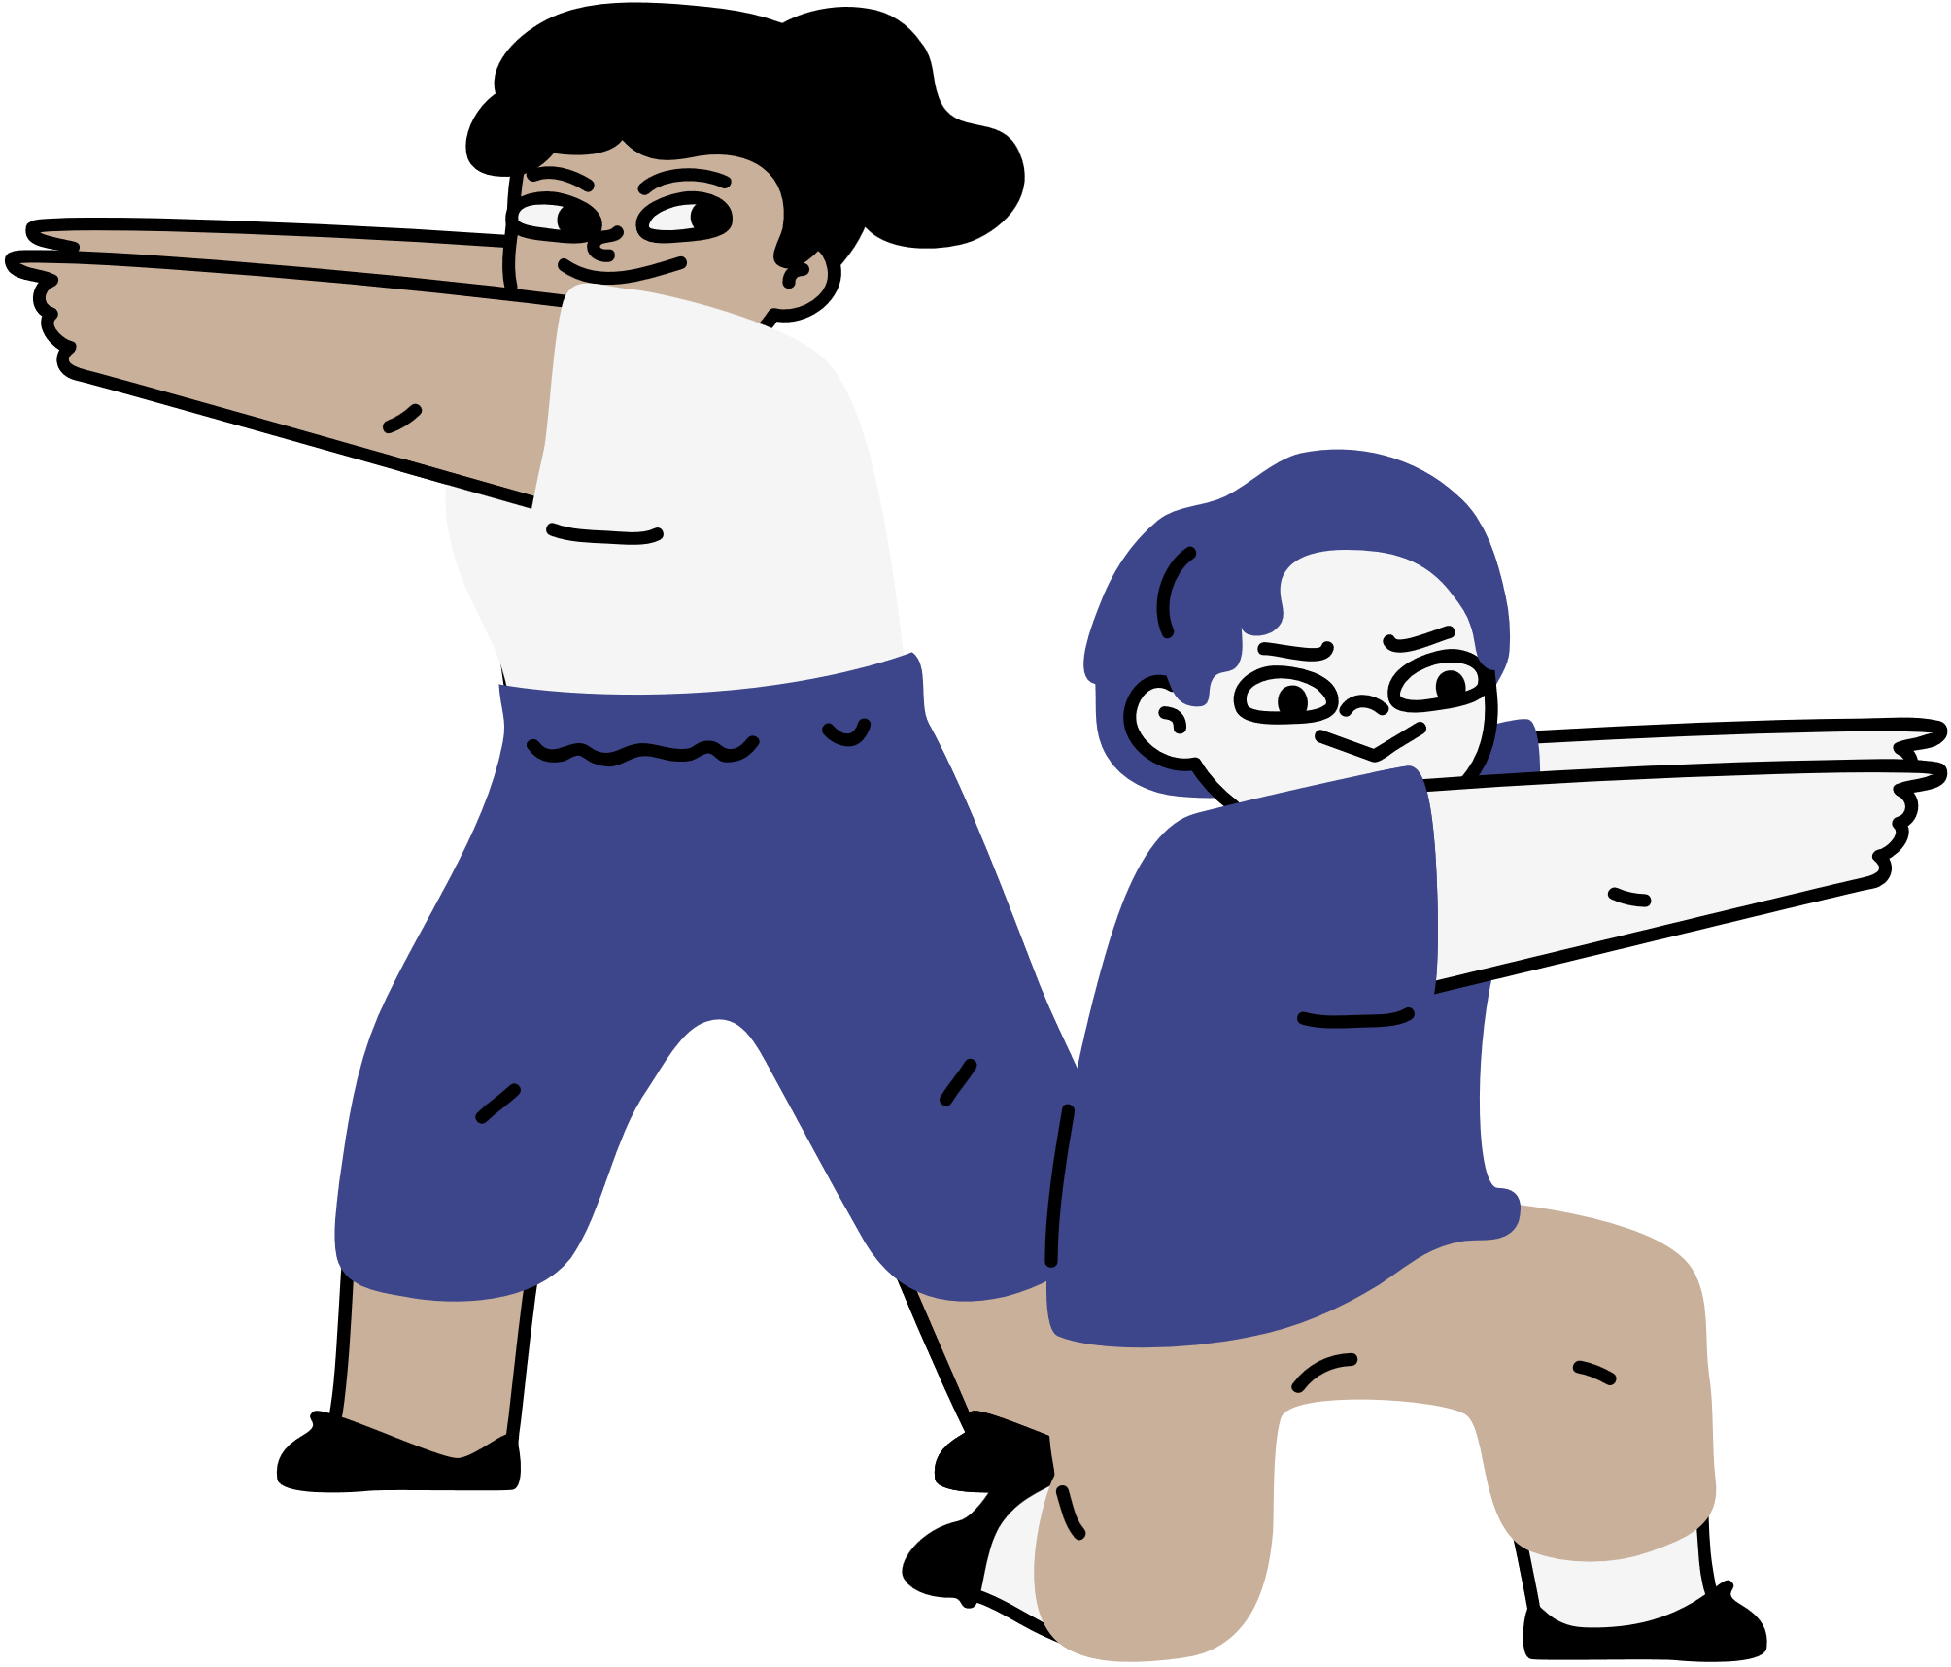
Let’s play Bingo!

Slide 20
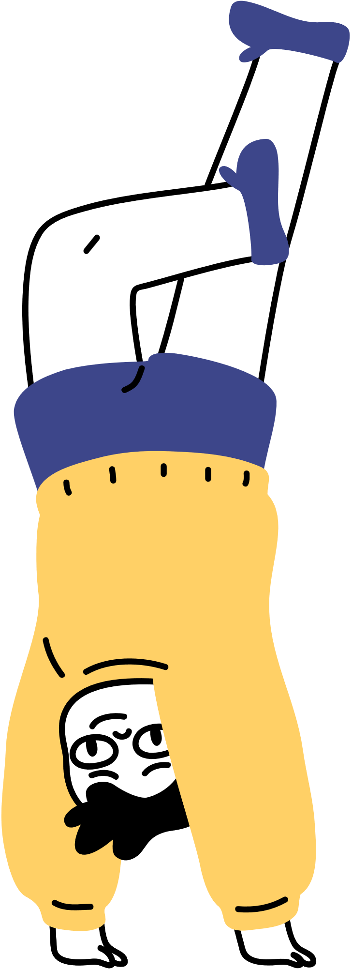

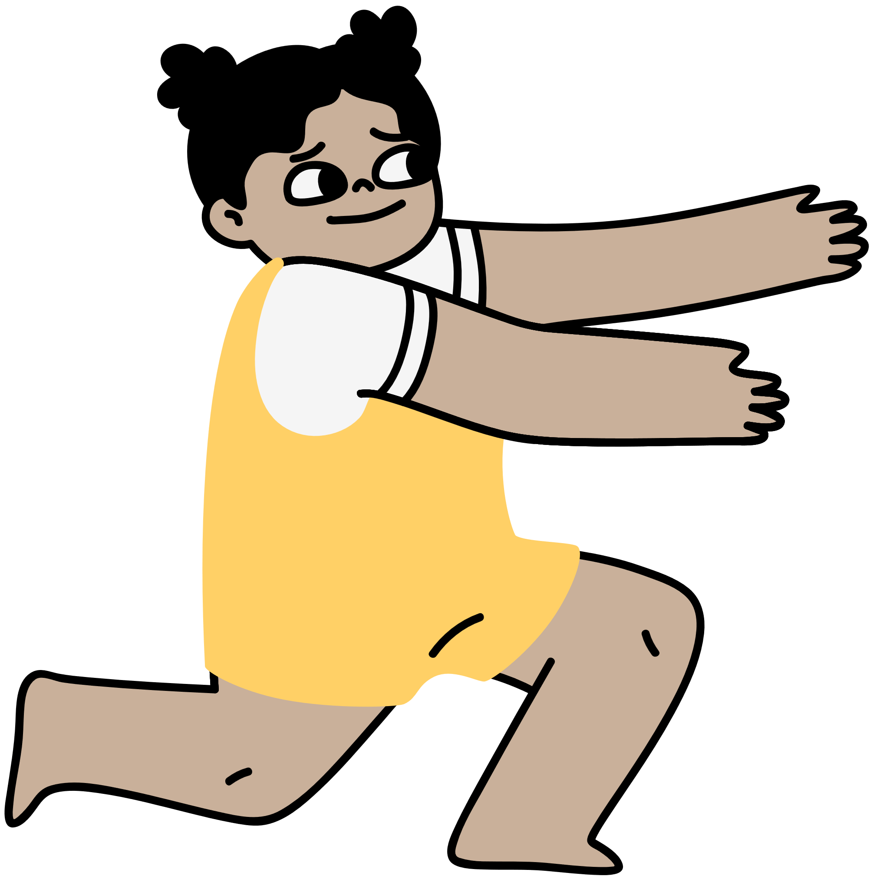
January
February
March
April
May
June
July
August
September
October
November
December
B
I
N
G
O
March
August
December
May

