Slide 1

WARMLY WElcome to my class
TEACHER: ĐÀO THỊ LIỄU
QUOC TUAN PRIMARY SCHOOL

Slide 2



Slide 3


Our names
2
9
LESSON 3 – PERIOD 5

Slide 4
TABLE OF CONTENTS
01
02
03
04
05
WARM-UP
ACTIVITY 1
ACTIVITY 2
ACTIVITY 3
FUN TIME

Slide 5
WARM-UP
01

Slide 6

GAME

Slide 7
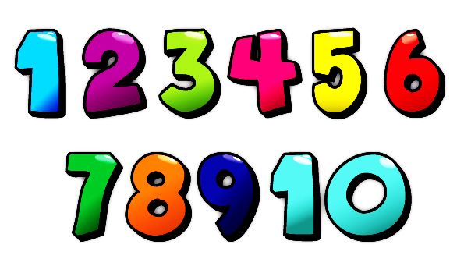

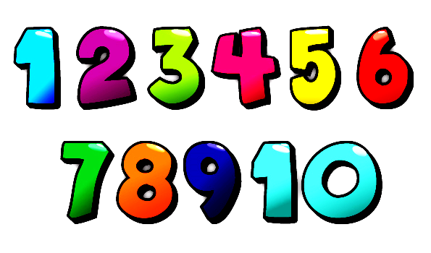

Notes:
CLICK THE CLOUD – GO TO ACTIVITY 1

Slide 8
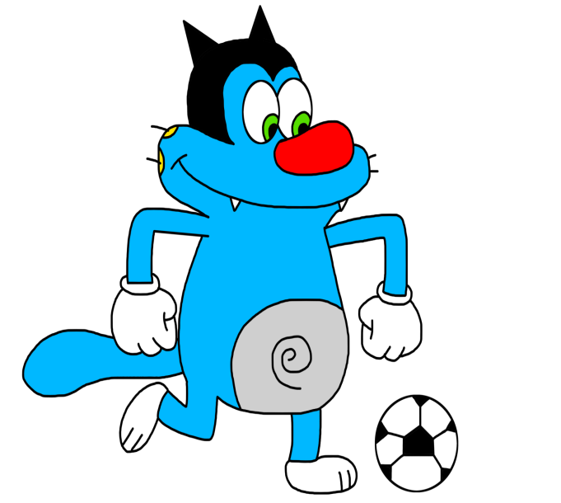


What’s your name?
Oggy
My name is ______ .

Slide 9
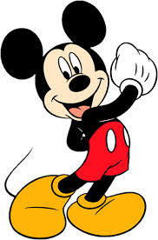

What’s your name?
Mickey
My name is ________.

Slide 10
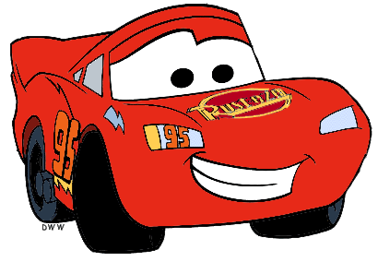
What’s your name?
Mc. Queen
My name is _________.

Slide 11
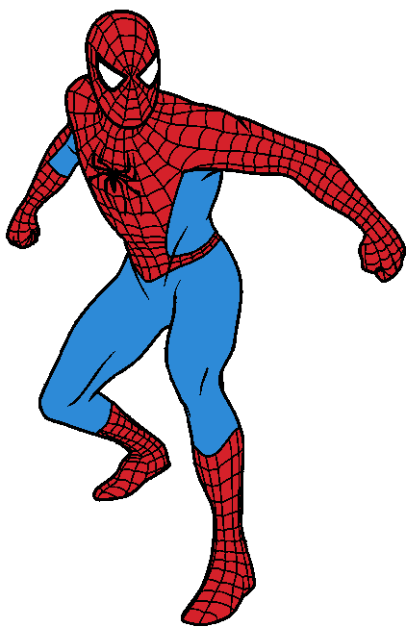
What’s your name?
Spiderman
My name is __________.

Slide 12
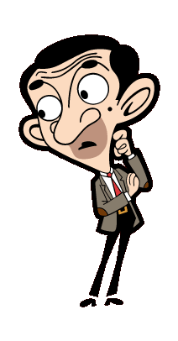
What’s your name?
My name is _________.
Mr Bean

Slide 13
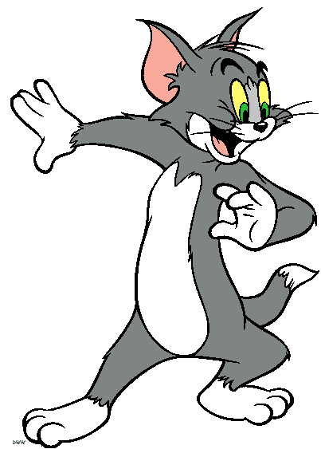
What’s your name?
Tom
My name is ______.

Slide 14
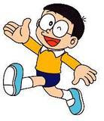
What’s your name?
Nobita
My name is _______.

Slide 15
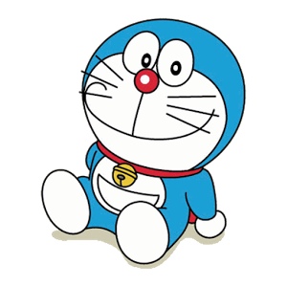
What’s your name?
Doraemon
My name is __________.

Slide 16
ACTIVITY 1
02

Slide 17
Let’s learn some sounds!
m
ary
M

Slide 18
Let’s learn some sounds!
n
N
am

Slide 19
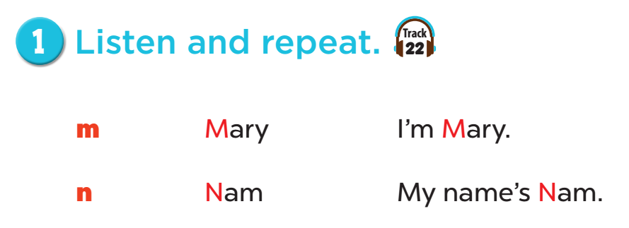

Slide 20
ACTIVITY 2
03

Slide 21
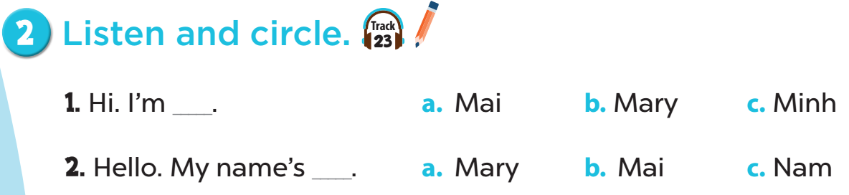

Slide 22
ACTIVITY 3
04

Slide 23
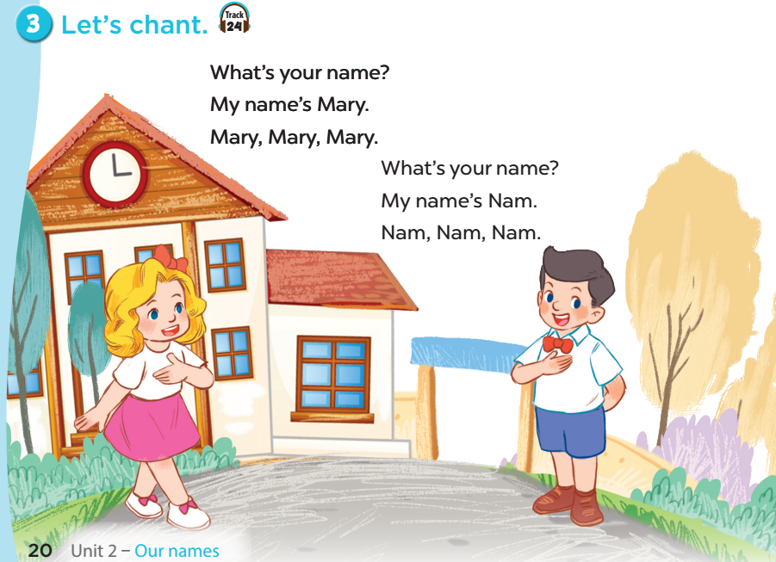

Slide 24
FUN TIME
05

Slide 25
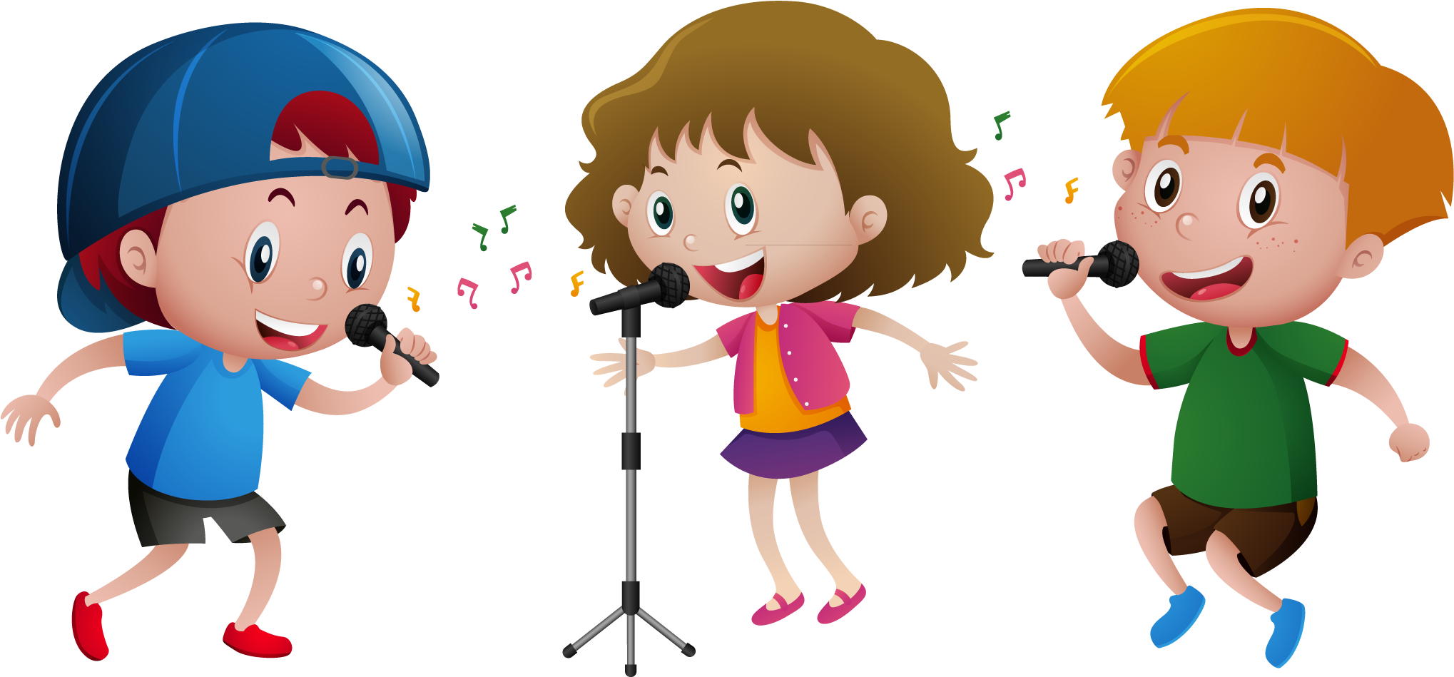
Let’s chant together!

Slide 26


