Slide 1

WELCOME TO MY CLASS
Teacher: Trần Thị Trang
Quoc Tuan Primary School

Slide 2





Slide 3



Things we can do
5
LESSON 1 PERIOD 1

Slide 4
Table of contents
Warm-up Say a chant.
04
01
02
03
Activity 2 Listen, point and say.
New words
05
Activity 3 Let’s talk.
Activity 1 Look, listen and repeat.
06
Games

Slide 5
01
Warm-up

Slide 6

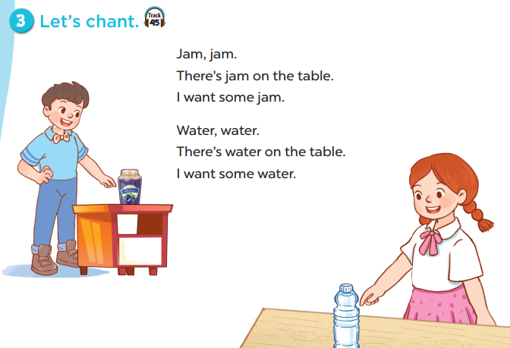

Slide 7

New words

Slide 8
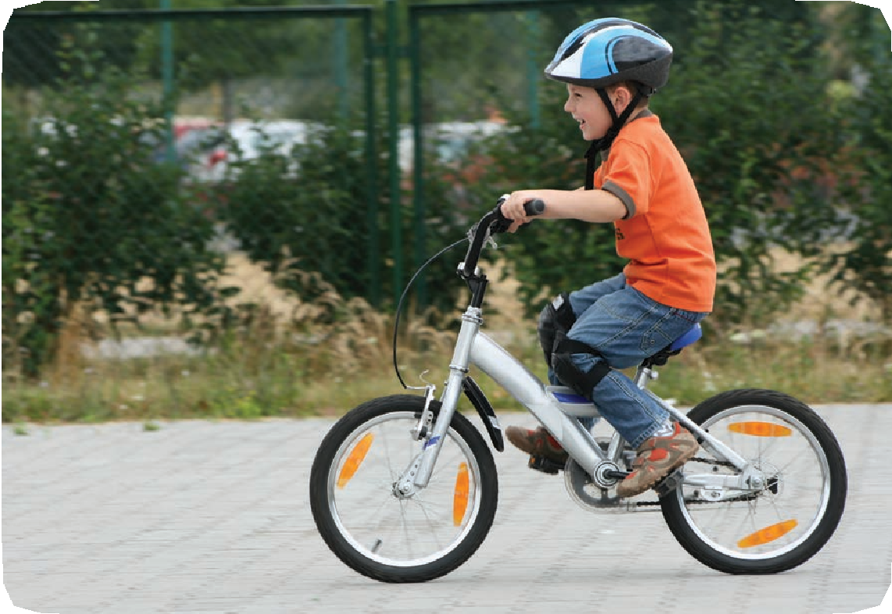
ride a bike

Slide 9
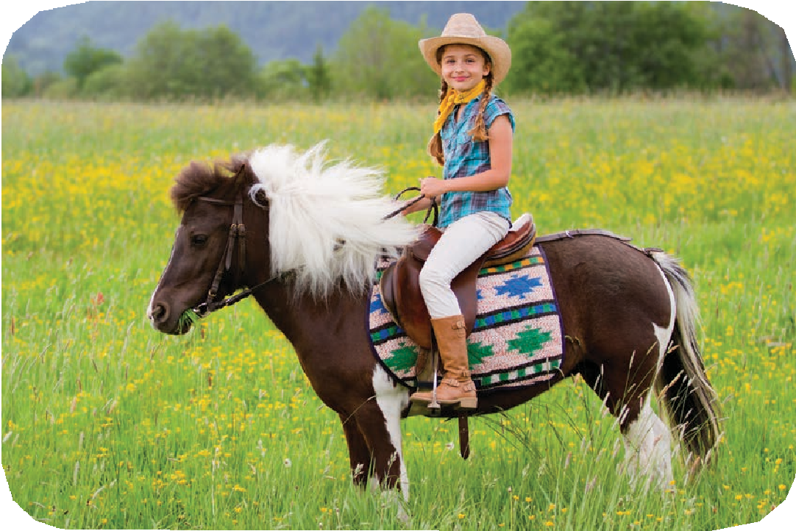
ride a horse

Slide 10
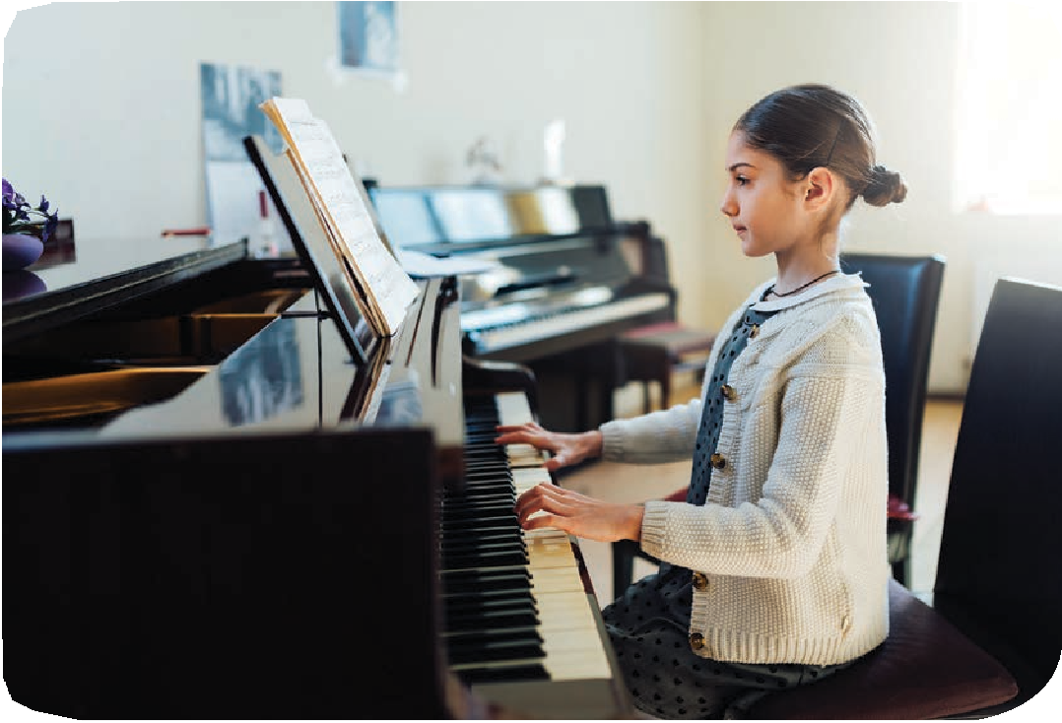
play the piano

Slide 11
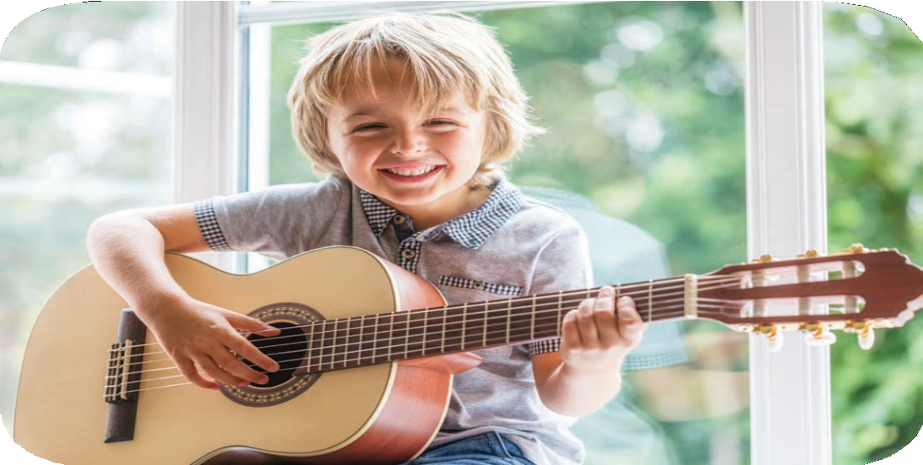
play the guitar

Slide 12
Look and guess.

Slide 13
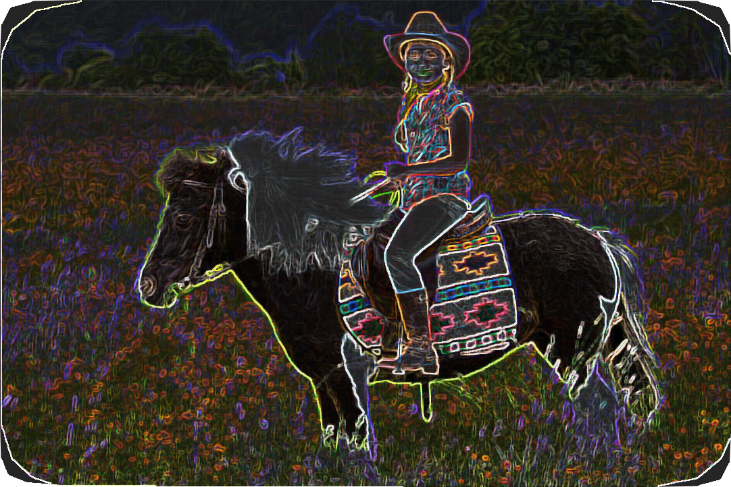
ride a horse

Slide 14
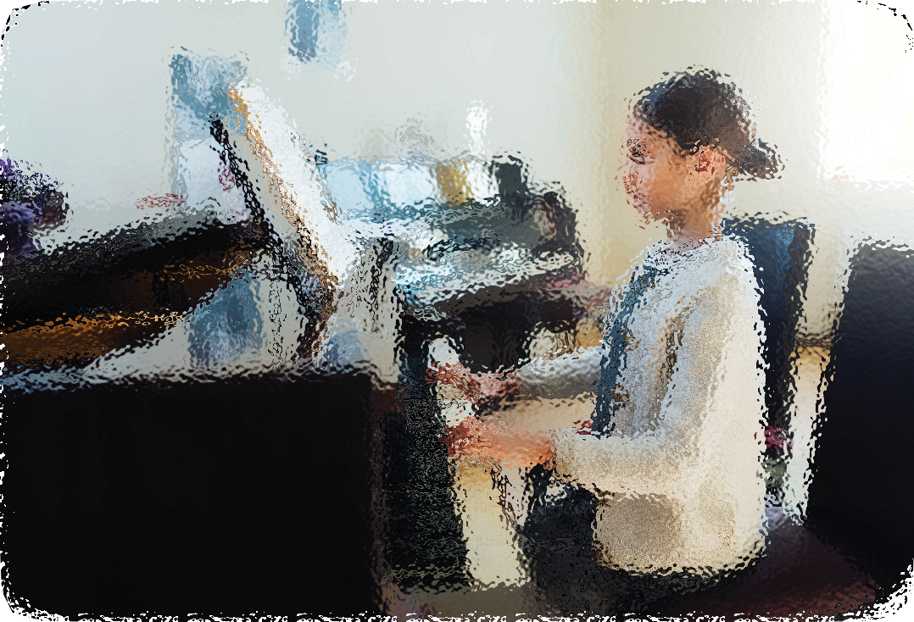
play the piano

Slide 15
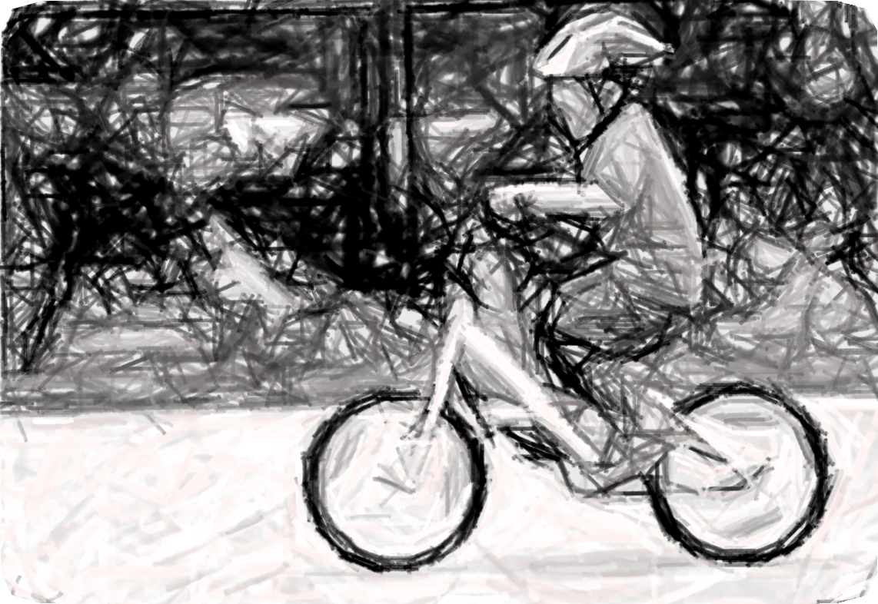
ride a bike

Slide 16
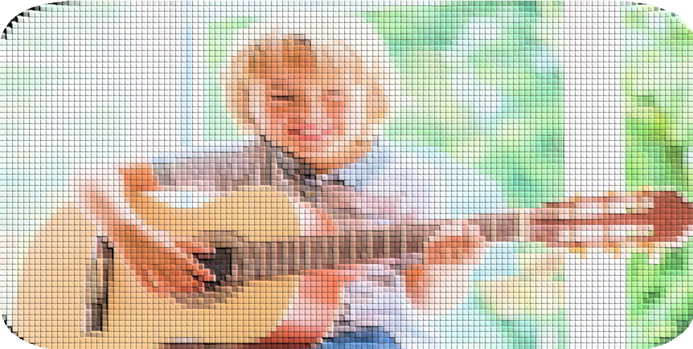
play the guitar

Slide 17
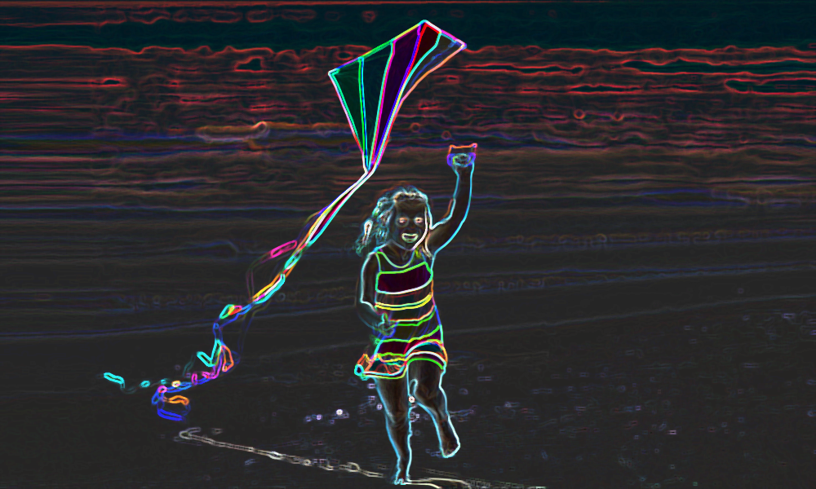
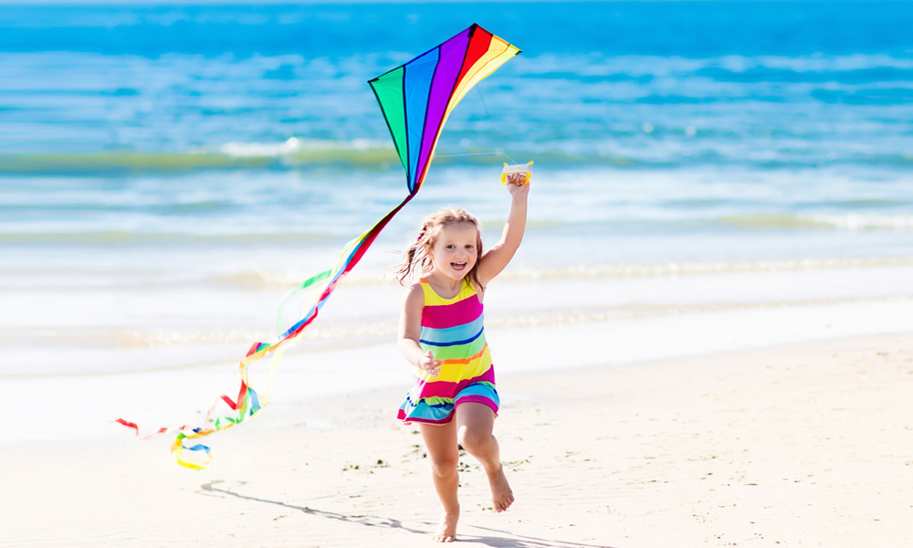
fly a kite

Slide 18
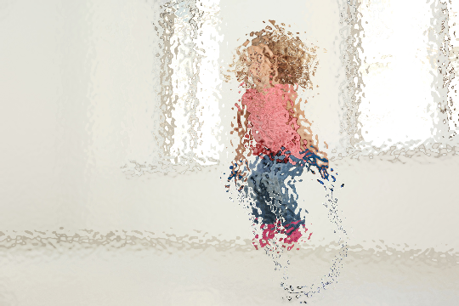

jump rope

Slide 19
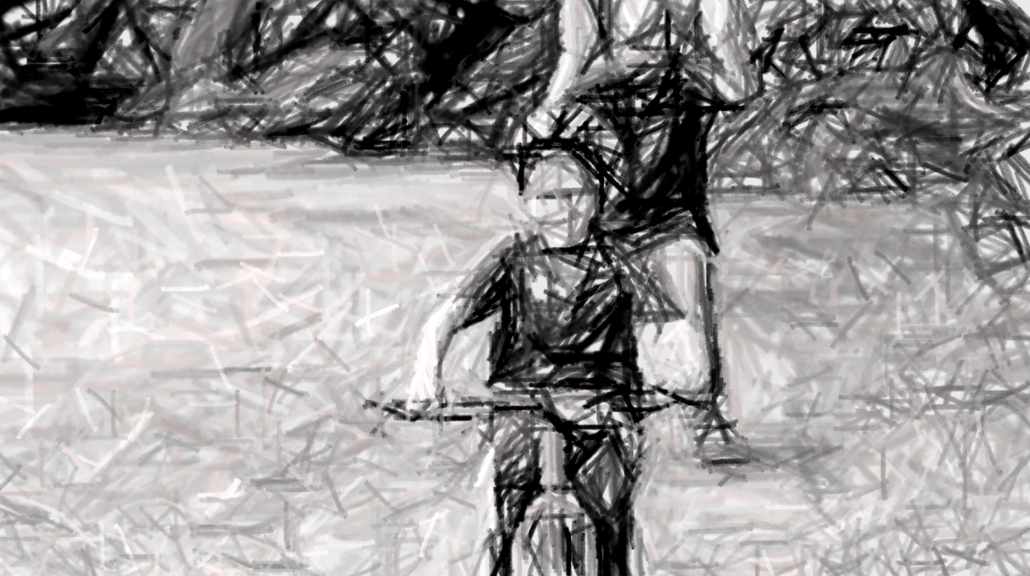
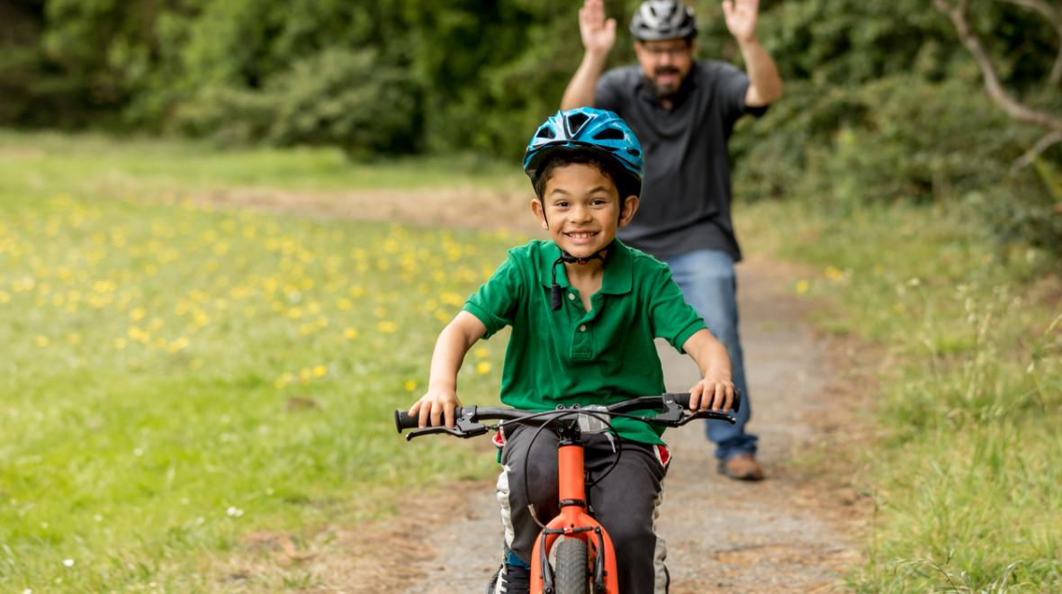
ride a bike

Slide 20
03
Activity 1 Look, listen and repeat.

Slide 21
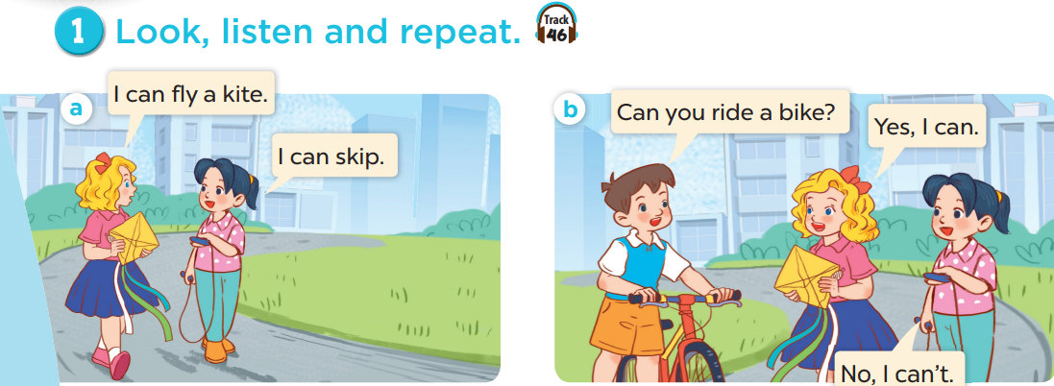
What does Mary have?
What does Mai have?
What does Minh have?
Who are they?

Slide 22
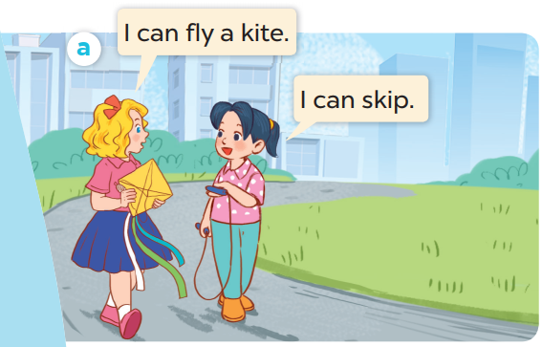
Listen and repeat.

Slide 23
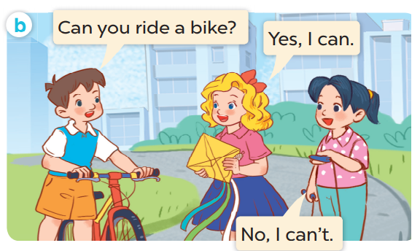
Listen and repeat.

Slide 24
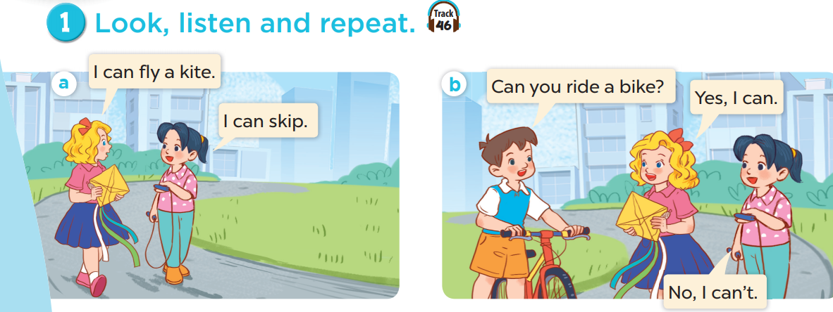
Work in pairs. Practise.
Listen and repeat.

Slide 25
04
Activity 2 Listen, point and say.

Slide 26
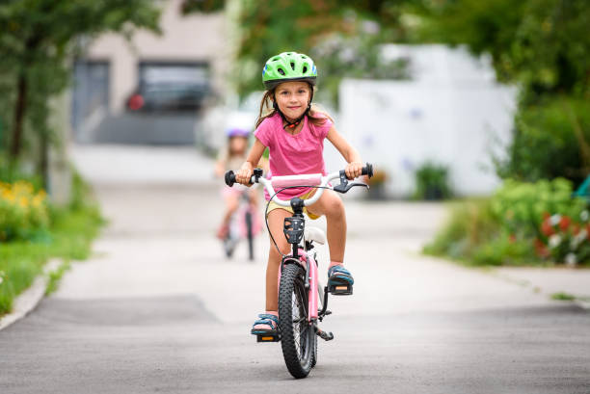

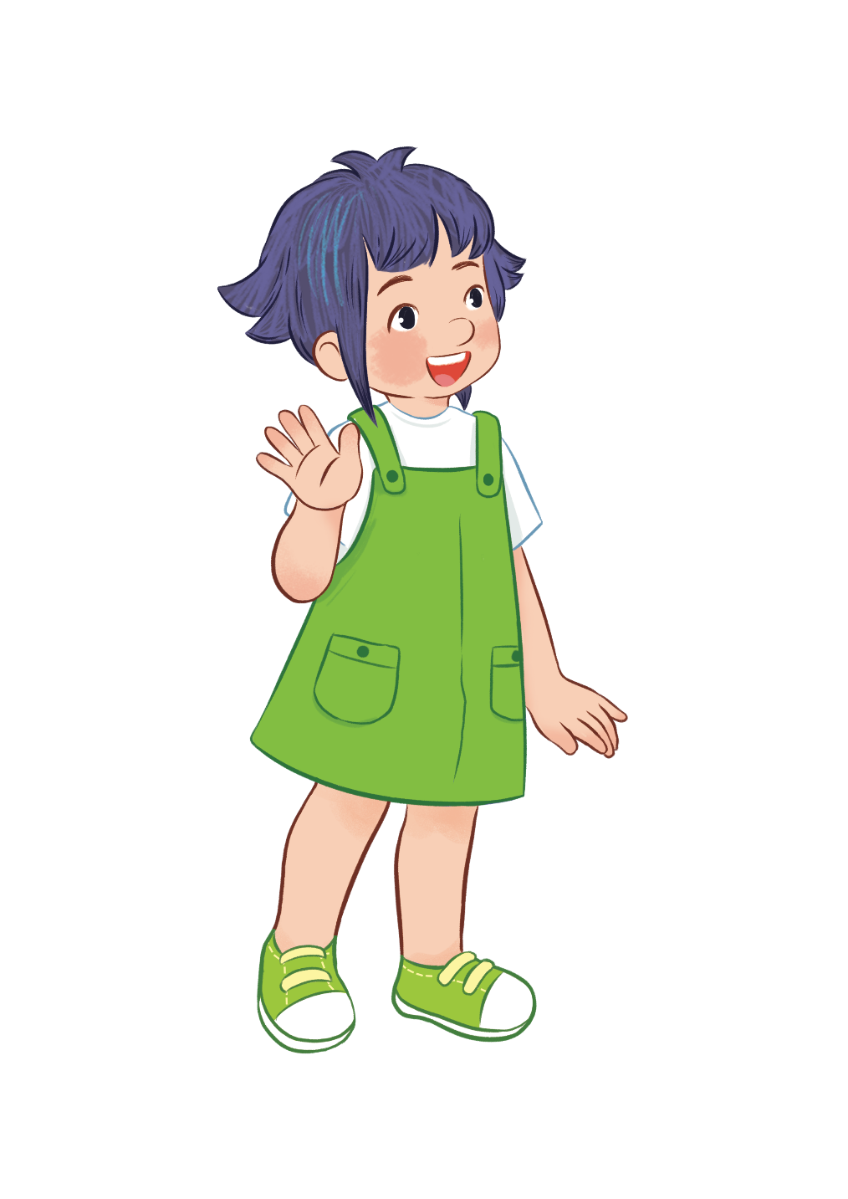
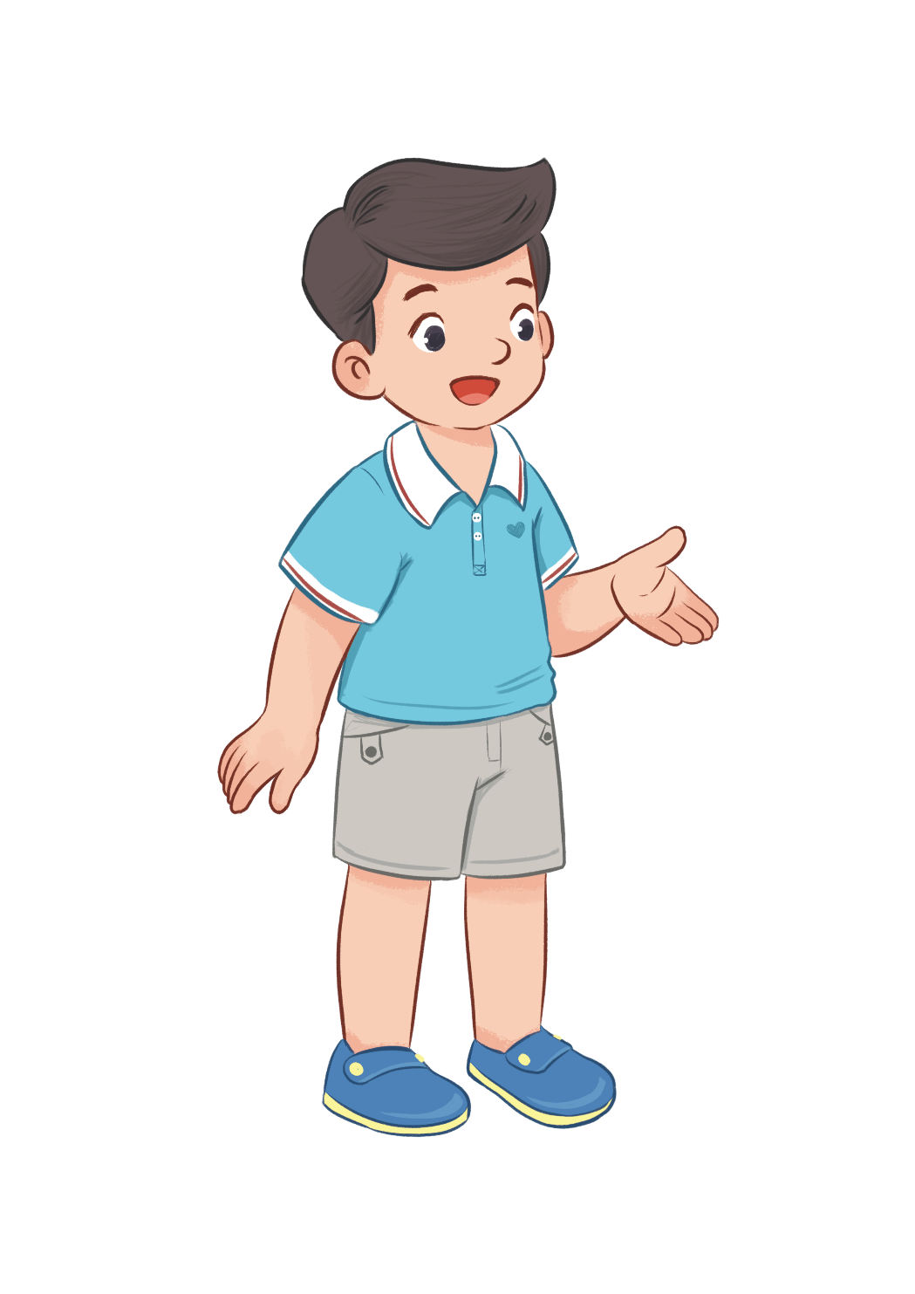
Can you ride a bike?
Yes, I can.

Slide 27
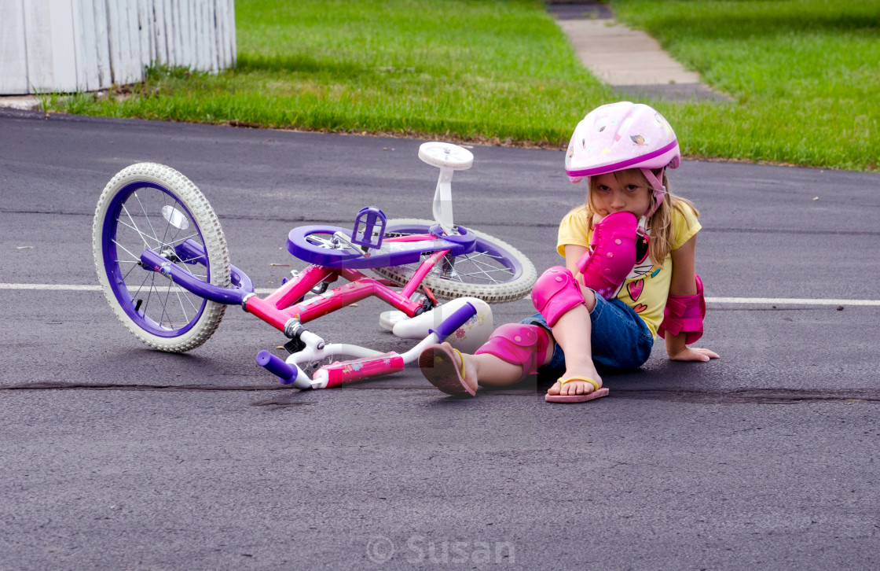

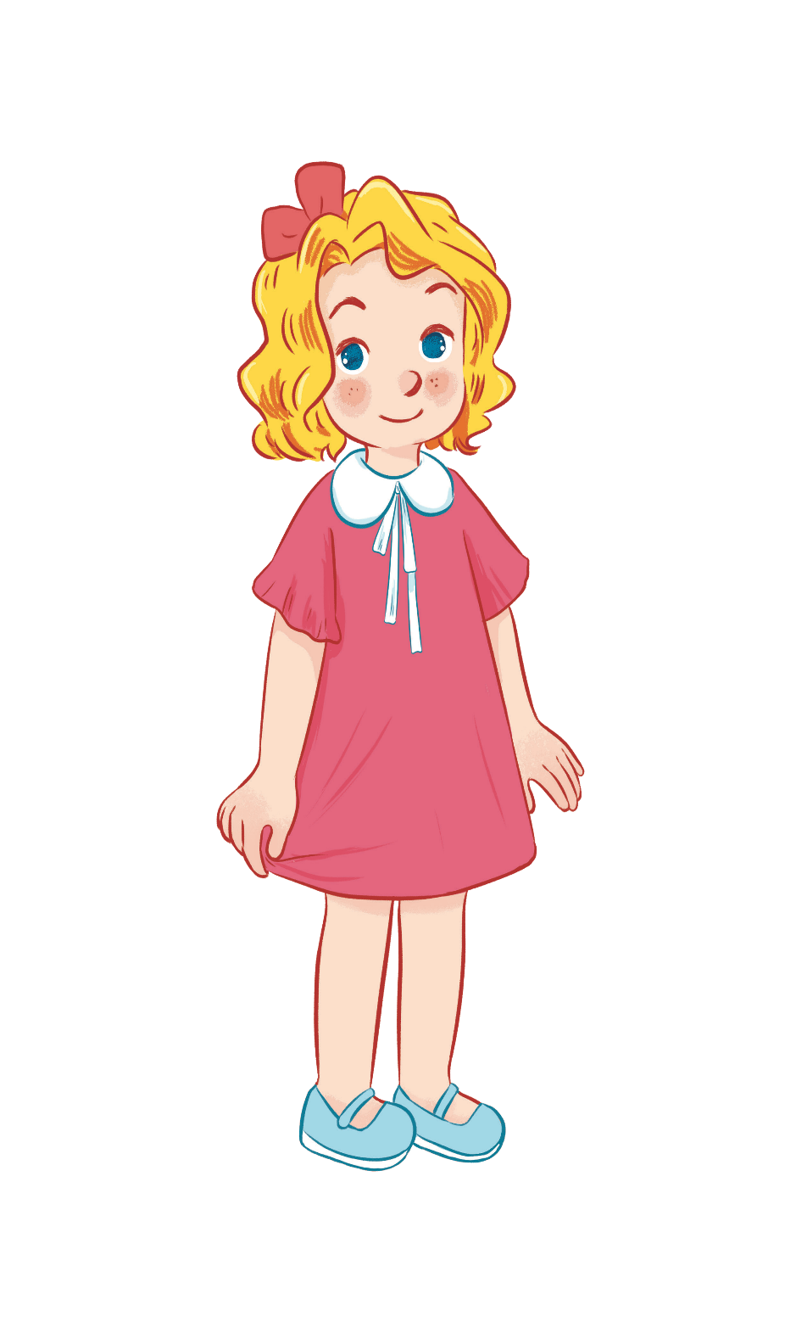
Can you ride a bike?
No, I can’t.

Slide 28
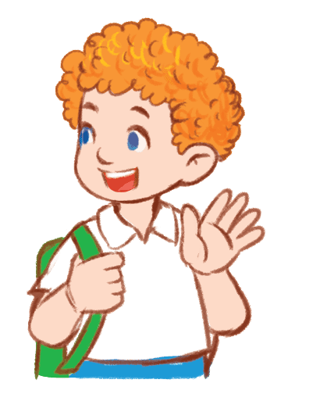
Can you play the guitar?
Yes, I can.

Slide 29
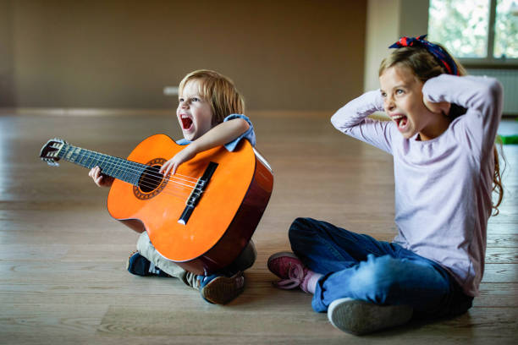
Can you play the guitar?
No, I can’t.

Slide 30
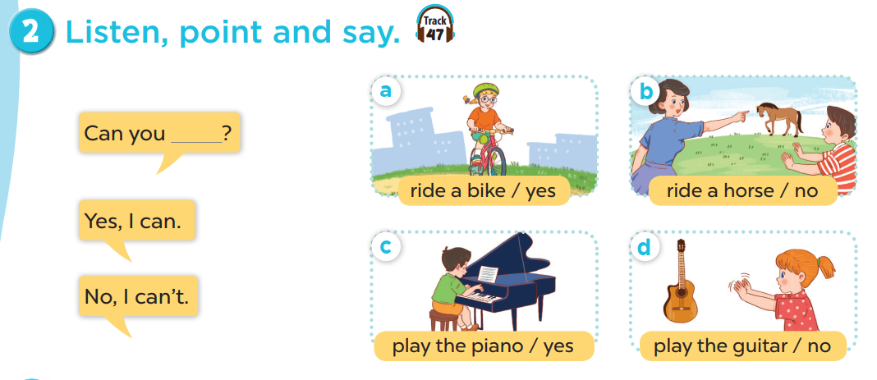
Work in pairs. Practise.
Listen, point and say.

Slide 31
05
Activity 3 Let’s talk.

Slide 32
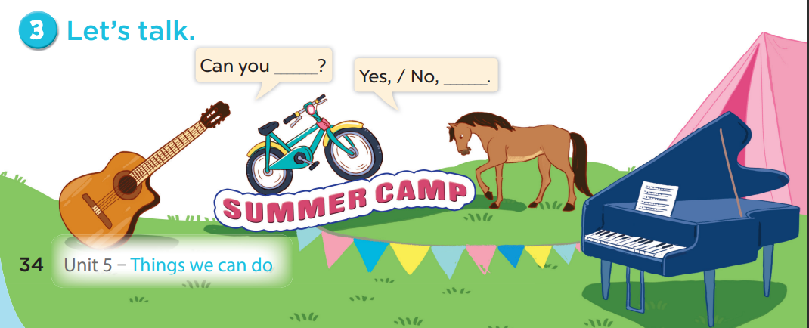

Slide 33
06
Games

Slide 34
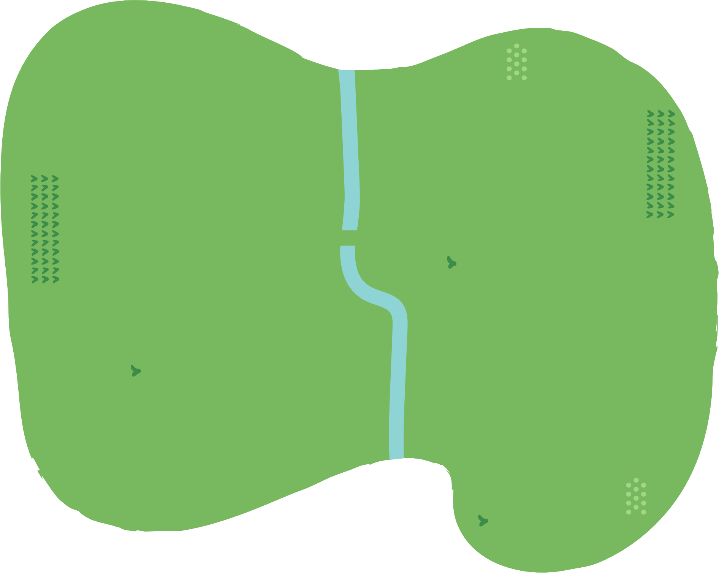





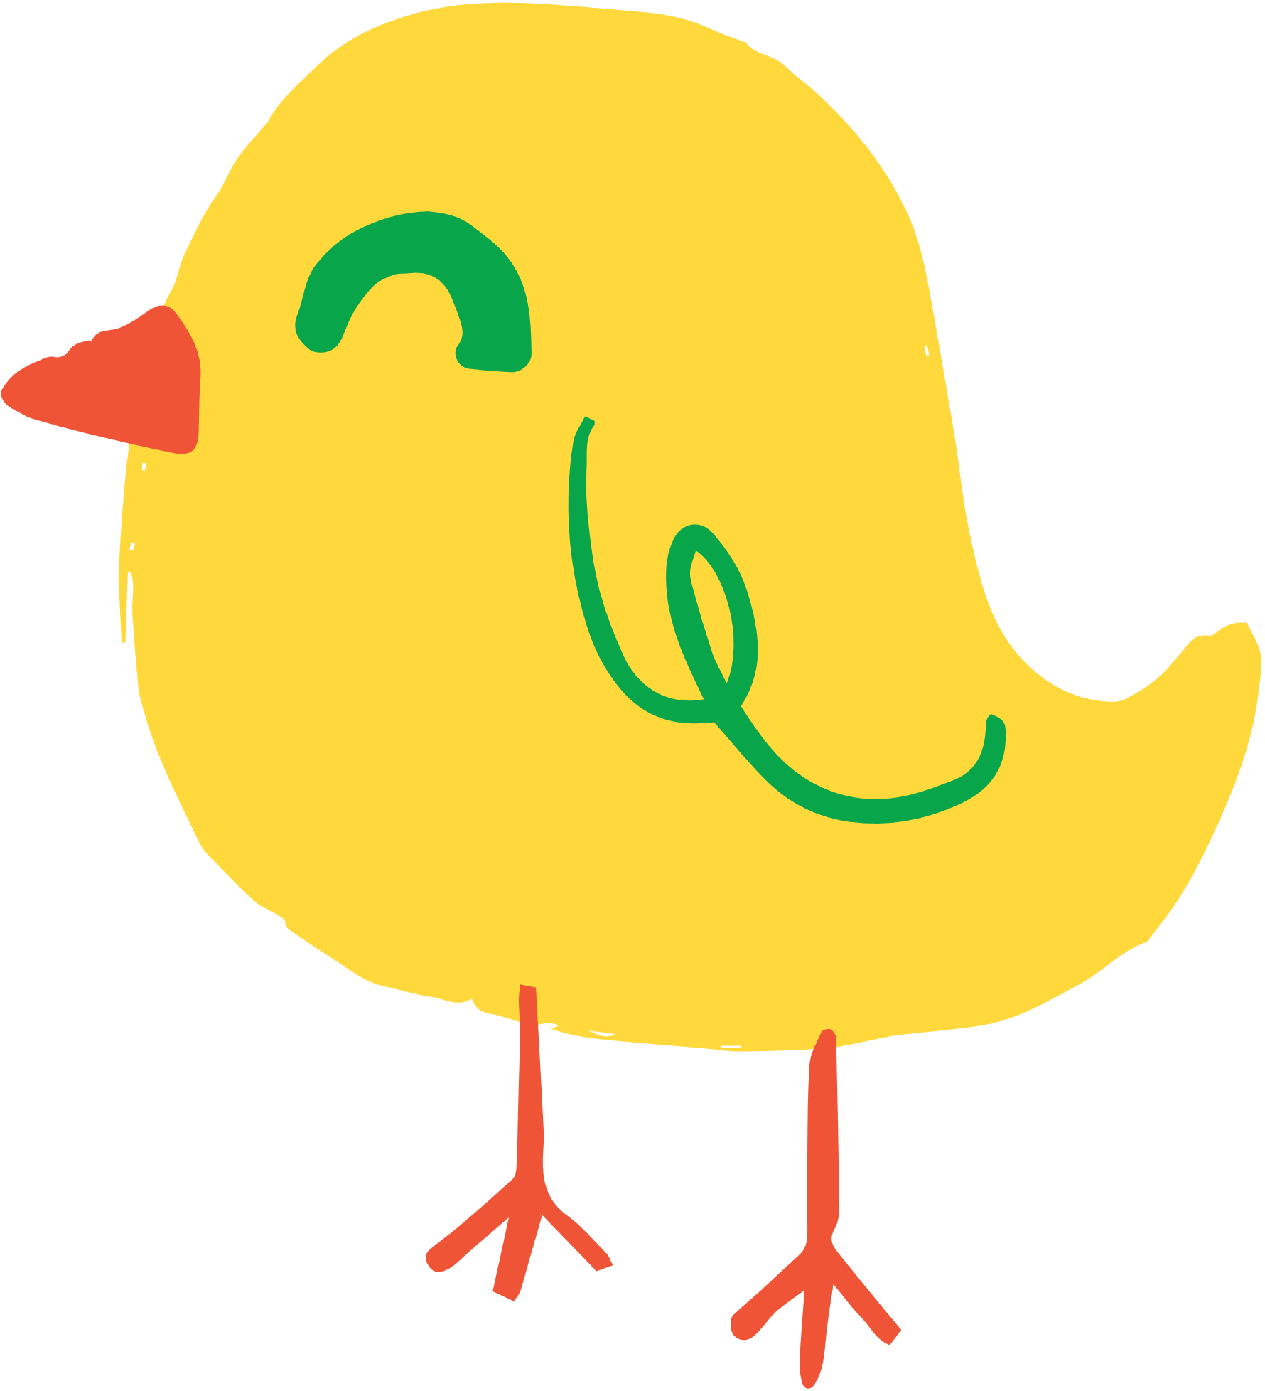















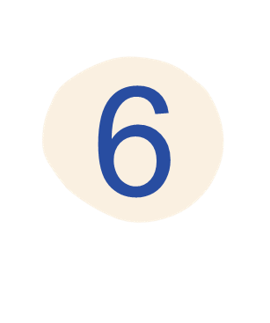




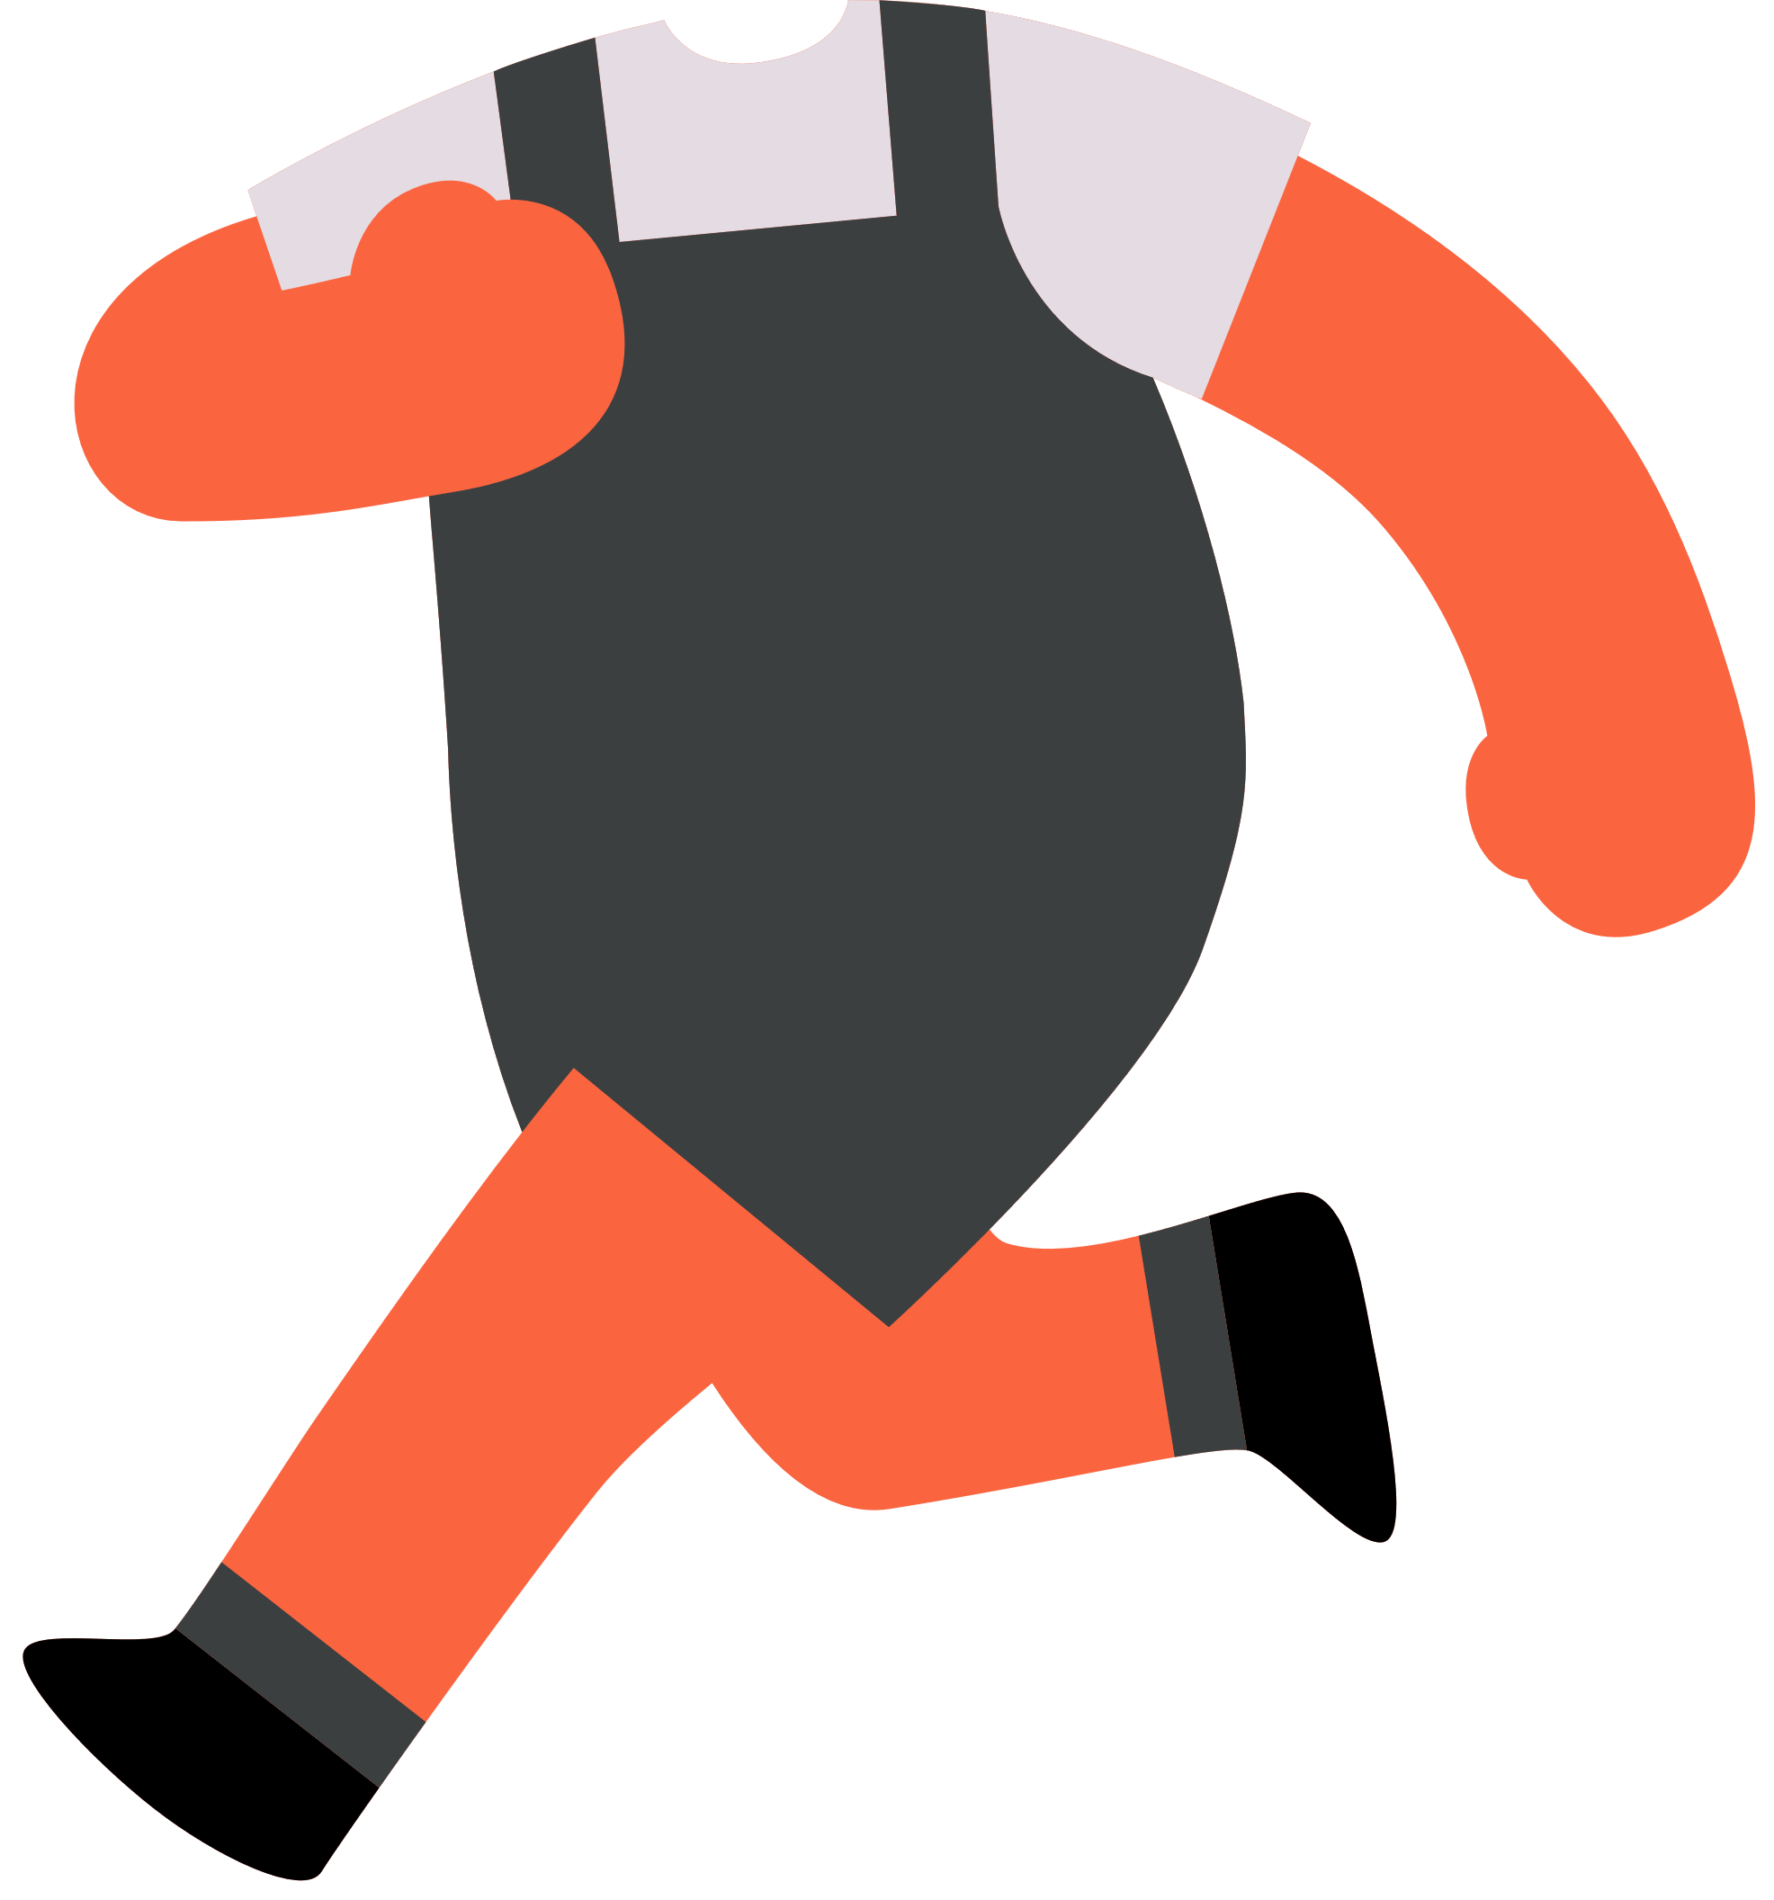




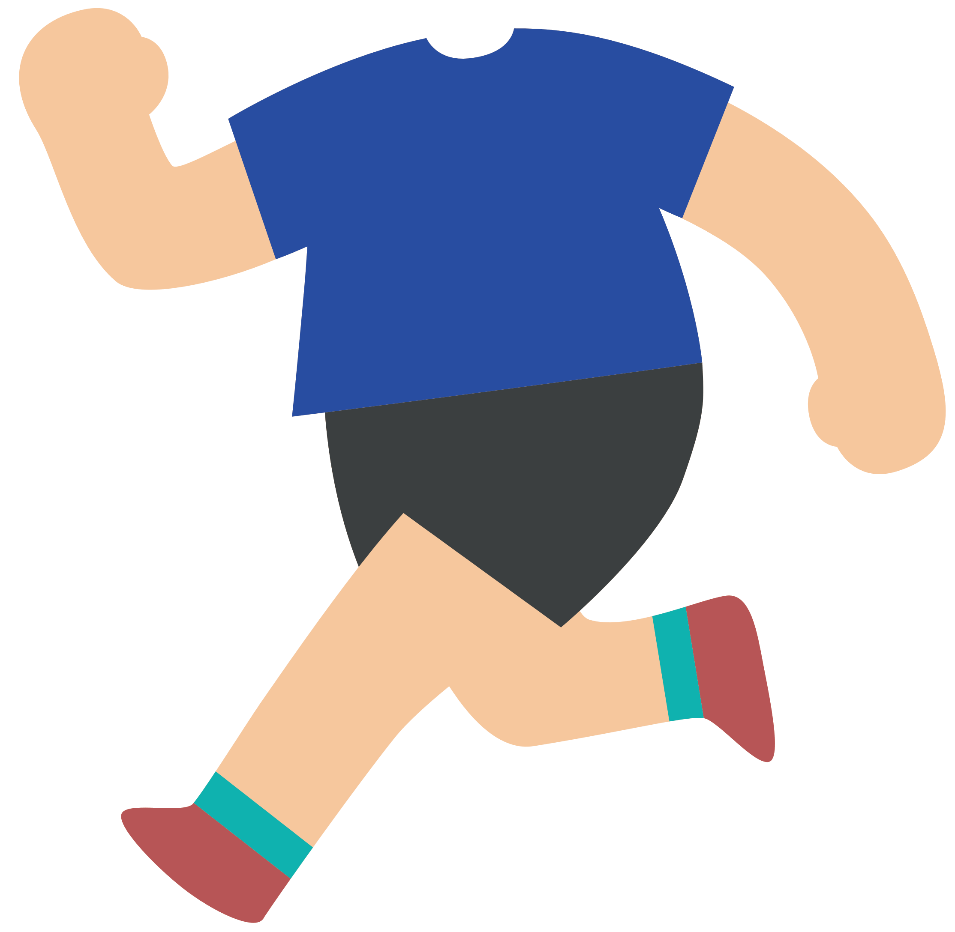



Slide 35
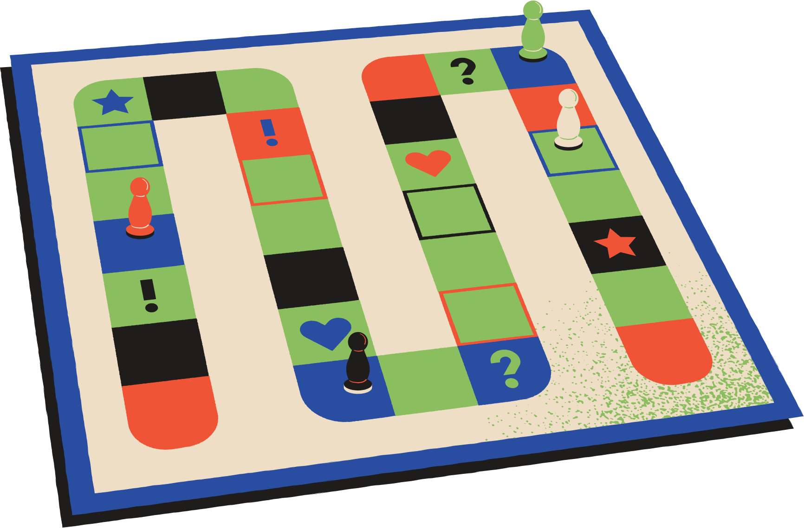




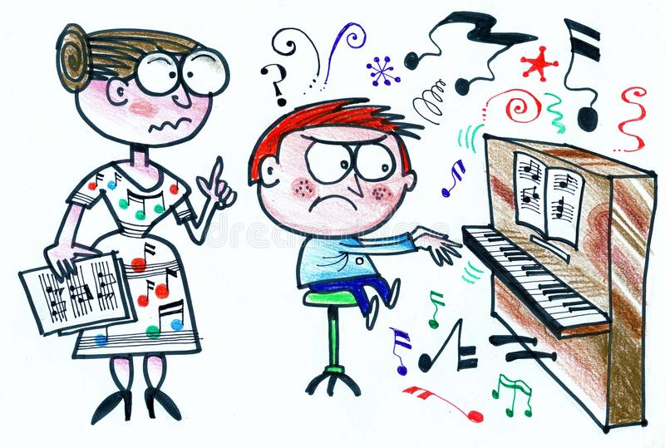

Can you play the piano?
Insert one question here
No, I can’t.

Slide 36
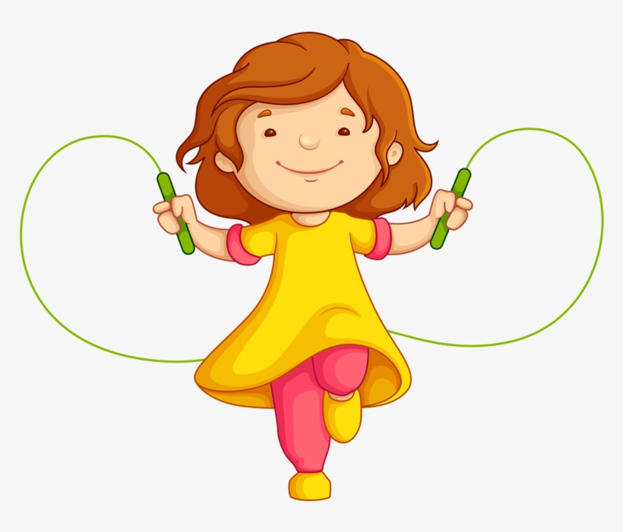
Can you jump rope?
Insert one question here
Insert one question here
Insert one question here
Yes, I can.

Slide 37
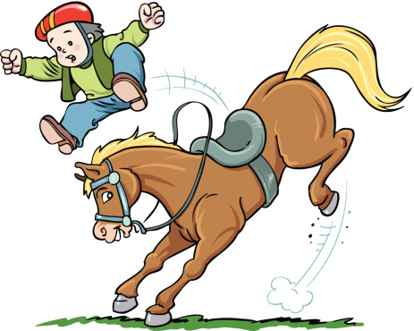
Can you ride a horse?
Insert one question here
Insert one question here
Insert one question here
No, I can’t.

Slide 38
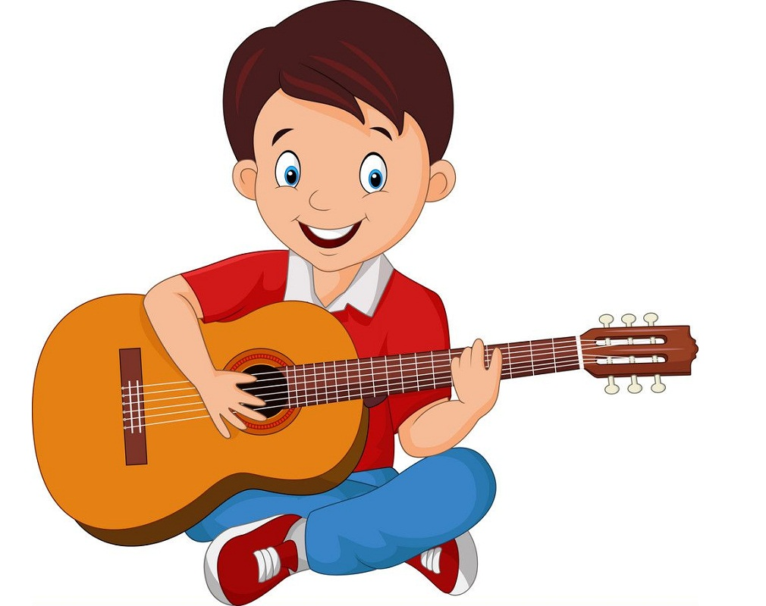
Can you play the guitar?
Insert one question here
Insert one question here
Insert one question here
Yes, I can.

Slide 39
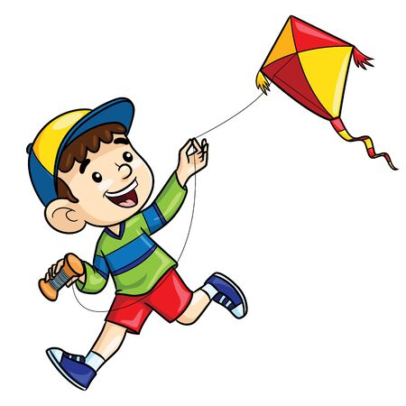
Can you fly a kite?
Insert one question here
Insert one question here
Insert one question here
Yes, I can.

Slide 40
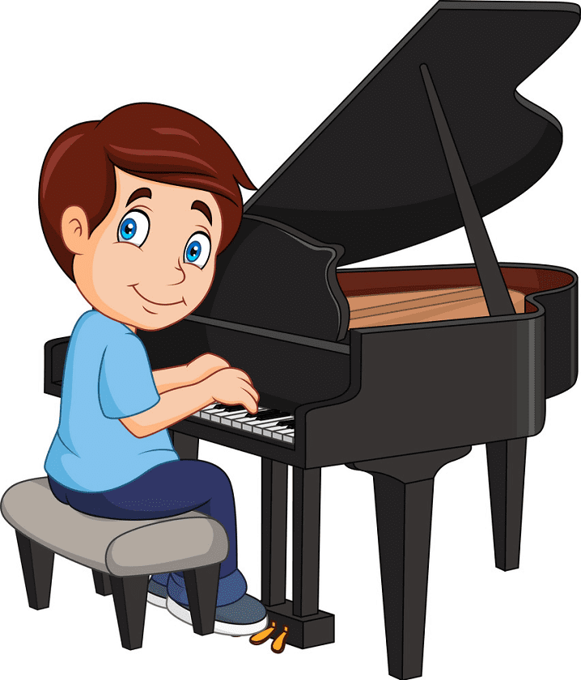
Can you play the piano?
Insert one question here
Insert one question here
Insert one question here
Yes, I can.

Slide 41
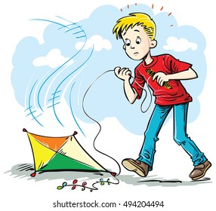
Can you fly a kite?
Insert one question here
Insert one question here
Insert one question here
No, I can’t.

Slide 42
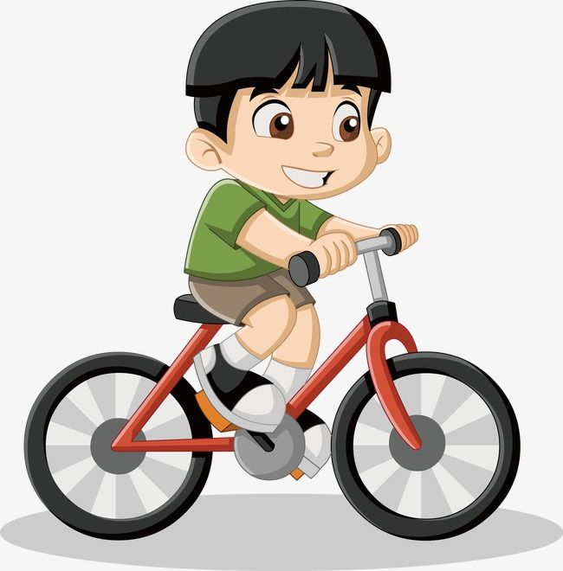
Can you ride a bike?
Insert one question here
Insert one question here
Insert one question here
Yes, I can.

Slide 43
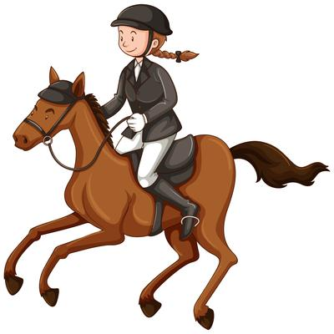
Can you ride a horse?
Insert one question here
Insert one question here
Insert one question here
Yes, I can.

Slide 44


